Slide 1
Local & Global Alignment

Slide 2
Sequences & Alignment
DNA: Nucleotide Base Sequences
Protein: Amino Acid Sequences
Why align the Sequences?

Slide 3
Sequence Similarity vs Sequence Identity
For nucleotide sequence (DNA & RNA): Both words have same meaning
"Two DNA sequences can share a high degree of sequence identity (or similarity)"---means the same.
For protein sequences: Both words have different meanings
Identity: % of exact matches between two aligned sequences
Similarity: % of aligned residues that share similar characteristics.

Slide 4
Question for you...!
If sequence A= В and В =C;
Then, would A be equal to C? (In terms of identity distance measure)
Strand A: A A G G С T T
Strand В: A A G G С
Strand C: A A G G C A T
Here identity(A,B)=100% (5 identical nucleotides / min(length(A),length(B))).
Identity(B,C)=100%, but identity(A,C)=85% ((6 identical nucleotides / 7)).
So 100% identity does not mean two sequences are the same.

Slide 5
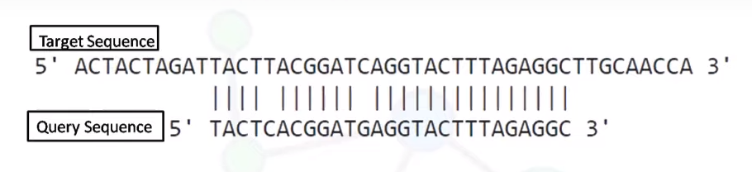
Local Alignment
Align regions having highest similarities between 2 sequences
Stretches of sequences with highest density of matches are aligned
More suitable for partially similar , different length and conserved regions containing sequences.
Align substring of target sequence with substrings of query sequence
Suitable for divergent sequences
Most general local alignment algorithm is the Smith Waterman

Slide 6
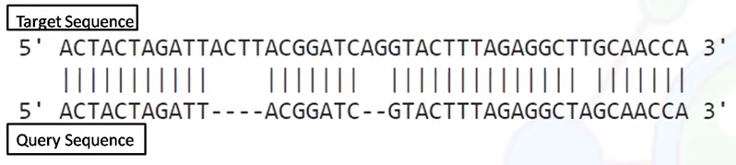
Global Alignment
Align entire sequences.
Align all letters from query and target sequences
Suitable for closely related sequences
Most general Global alignment algorithm is the Needleman - Wunsch

Slide 7
GLOBAL VS. LOCAL SEQUENCE ALIGNMENT
Global Alignment Local Alignment Tries to align entire sequence Align regions having highest similarities
Align all letters from query and target Align substring of target with substring of query
Suitable for closely related sequences Suitable for more divergent sequences
A general Global alignment method A general Local Alignment Method NEEDLEMAN - WUNSCH SMITH - WATERMAN

Slide 8
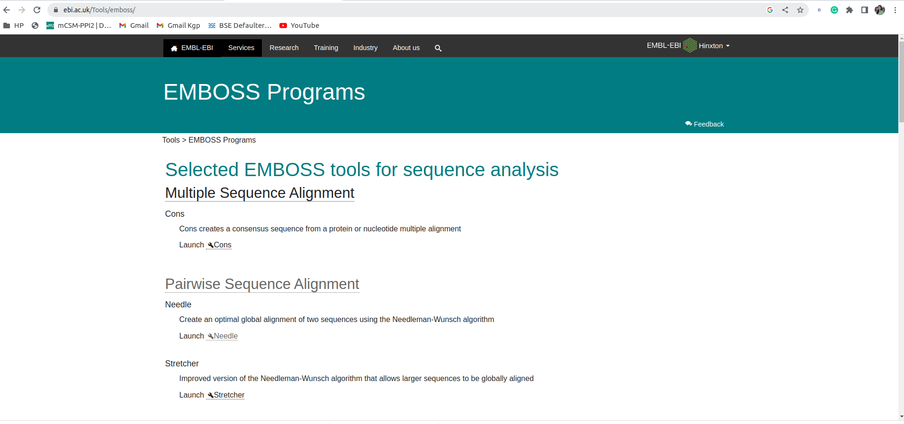

Slide 9
