Slide 1
PyMOL Tutorial
Computational Biophysics (CS61060)

Slide 2
Overview
PyMOL is an open source software created by Warren Lyford DeLano
PyMOL is used for 3D visualization of molecules
You can download the free version from https://pymol.org/

Slide 3
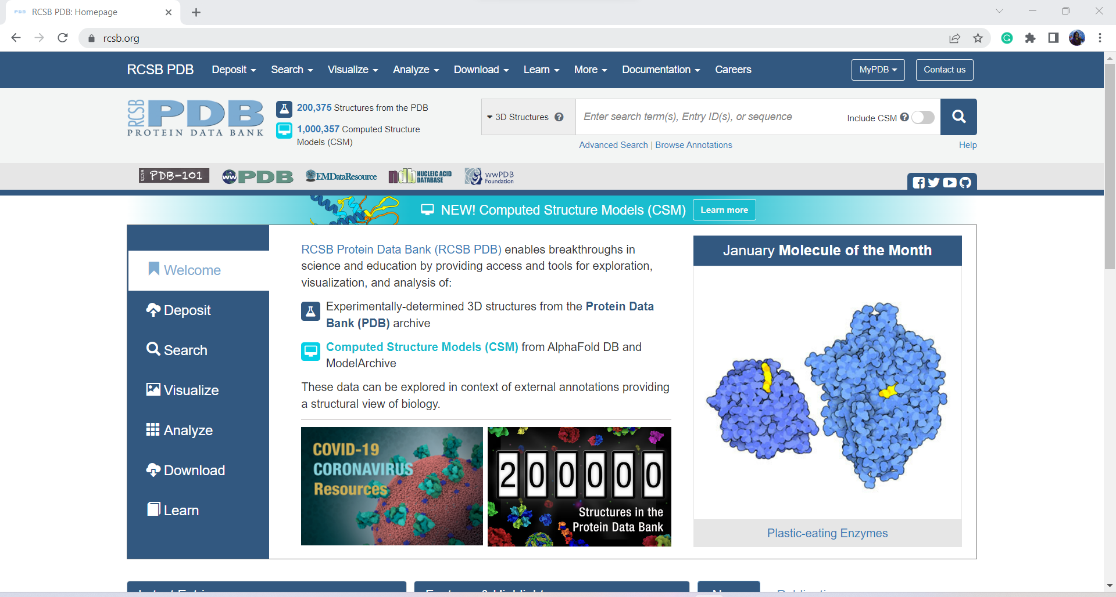
Download .pdb file from protein databank
PyMOL takes .PDB files which can be found at https://www.rcsb.org/ by
searching for the molecule of your choice.

Slide 4
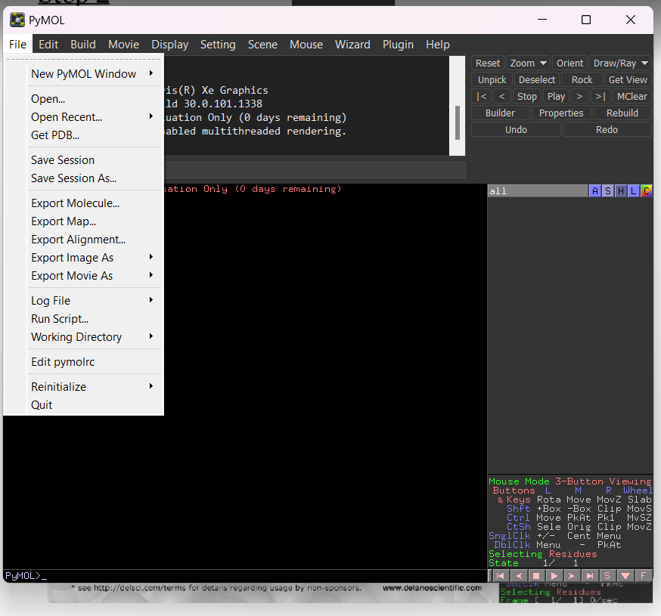
Open PyMOL application
Open your already installed PyMOL application, then navigate to the File menu and open the newly downloaded structure (pdb file)

Slide 5
Without downloading the PDB file
Pymol has access to RCSB Protein DataBank .
By using the command you can visualize protein structure.
But you need to know the PDB_id of the protein.
Command: fetch pdb_id

Slide 6
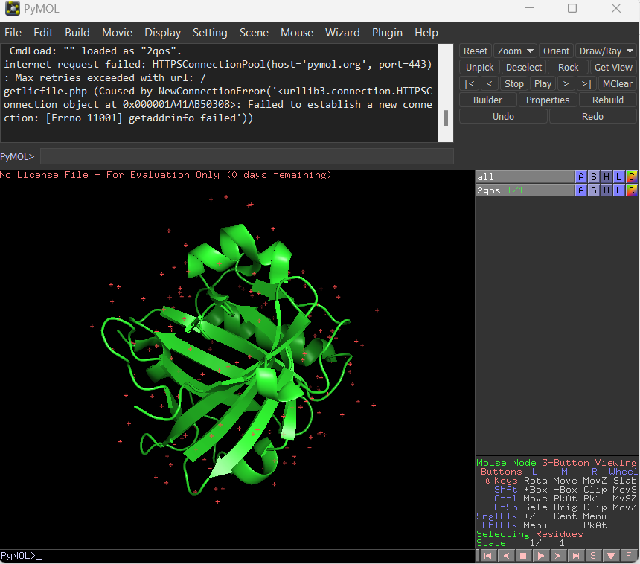
Cont..
Each of the letters in the right menu stands for-
A=Actions,
S=Show,
H=Hide,
L=Label, and
C=Color

Slide 7
Cont..
Use of Mouse:
Left button:
Rotates the protein around a center axis.
Drag the protein in a direction you want to rotate.
Center scroll wheel:
Isolate the foreground and fade away the background.
If you press scroll button and drag the protein , it makes whole protein structure to move in the screen.
Right button:
Will help in zoom in and zoom out on the protein.

Slide 8
Change the color of the molecule
There are two ways to change the color; by using the right tool bar under C=Color, or using the command line located in the window labeled PyMOL.
Command: color red, chain A
Command: color red, chain A and res 55-110

Slide 9
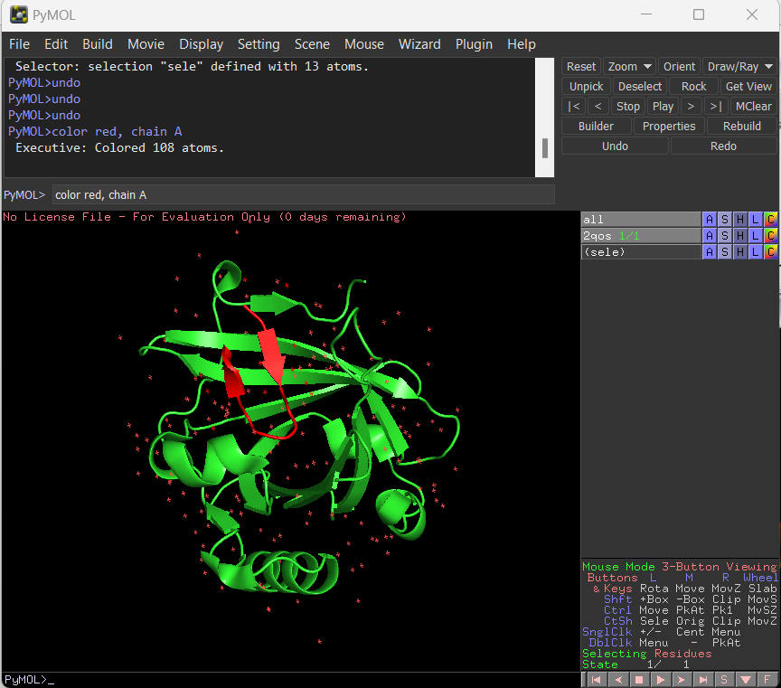
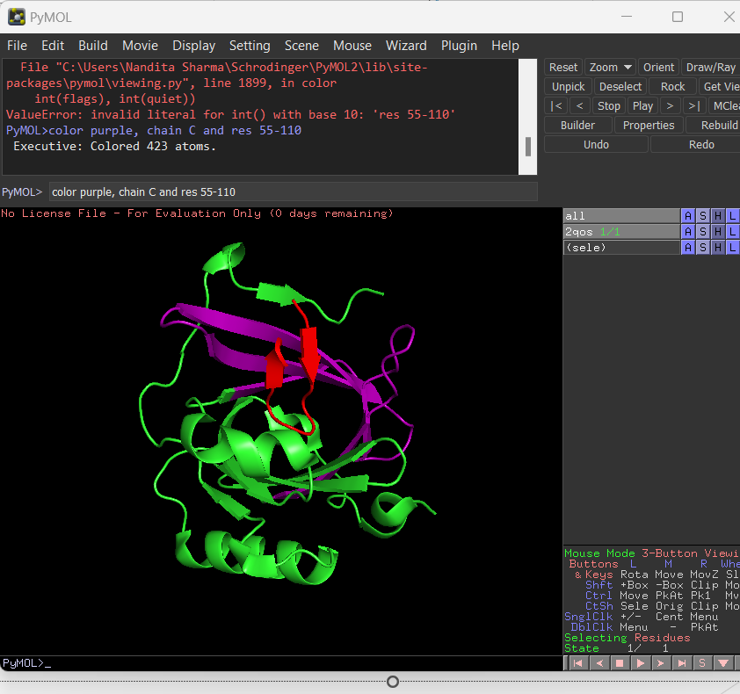
Changing the color of specific residue

Slide 10
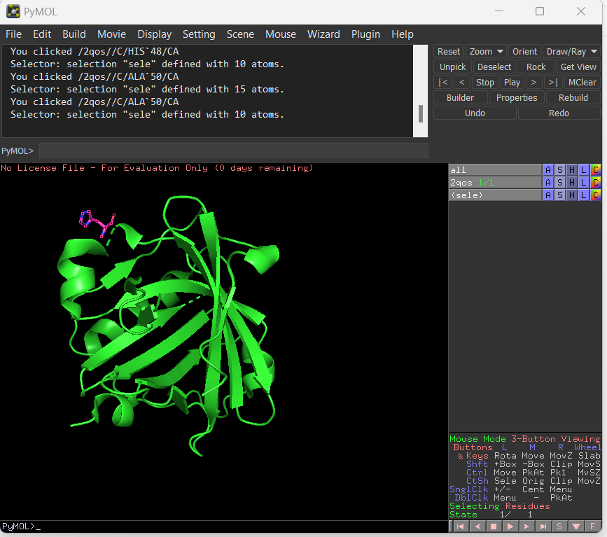
Viewing residues
The first way is to directly left click on the molecule, and the residue that is highlighted will be identified in the PyMOL Td/Tk GUI window as shown here: You can see I click on ALA 50 as shown in the text window.
At this time, you can show this side chain by navigating to the right tool bar, where you will now see a tab labeled (sele), which stands for the residue you have just selected.

Slide 11
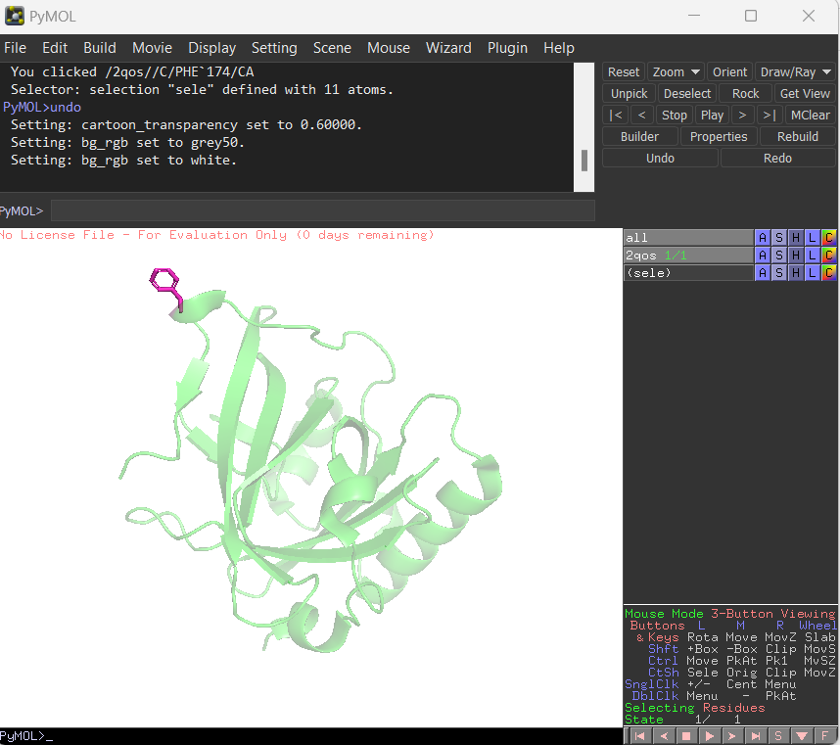
Cont..
Changing the background color:
Display-> Background ->White
Making the cartoon backbone transparent: There are times that you would like to highlight the side chains and not have the cartoon backbone take away from the figure. A nice way to do this is by making the cartoon transparent.
setting-> transparency-> cartoon

Slide 12
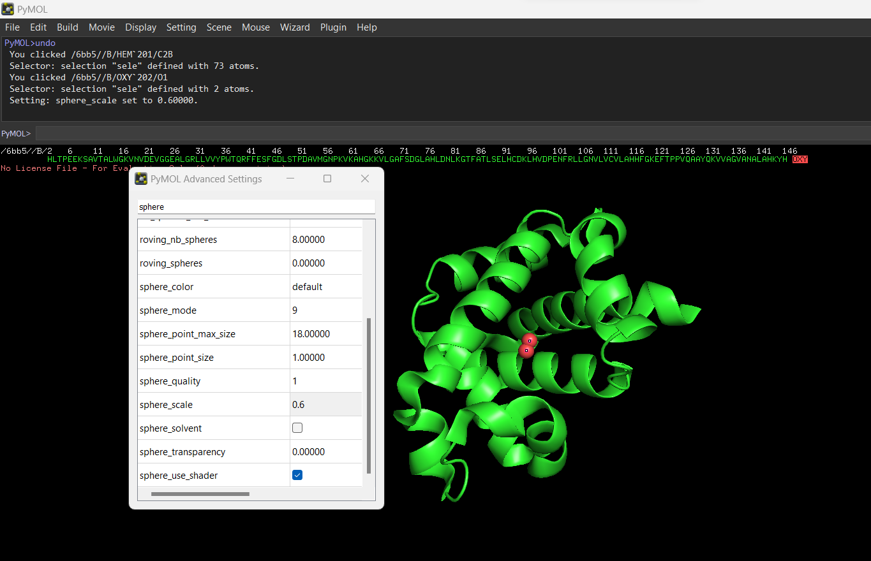
Change the size of sphere
Change the size of the sphere:
Settings->edit all-> sphere_scale
If we have spheres of uneven sizes then write in command line:
Select the atoms
Rename the selection
Show sphere, sele (selection name)
Alter sele, vdw=0.6
rebuild

Slide 13
Improve quality of the image
Go to A=’Action’ —> Click Preset —>Click Publication
It provides structure which can directly be used for publication.
Or
From upper control panel
Click Display —>Click Quality —>Maximum Quality
Or
Top Left Corner
Click Draw/Ray—>Click Ray-down —>save as png
It removes background from the image and gives high quality image.

Slide 14
Save the state of pymol file
File-> save session as ->

Slide 15
If you want only one ligand molecule
Remove water molecules
Go to A=’Action’ → bottom-right corner select chain option → click on chains to select in display window → A=‘Action’ remove atoms.
Go to A=’Action’ → bottom-right corner select residue option → click on ligand to select in display window → A=‘Action’ remove atoms.
Leave one ligand molecule and save it as pdb option.

Slide 16
Scene
When you make some changes into the protein then ‘undo’ is very difficult in pymol.
We can save the molecule with particular changes with the help of scene.
Command: Scene 001, store
Left-bottom corner you can see small box with 001 number, that is your scene for this pymol session.

Slide 17
Ligand Protein Interaction
Load the protein: for example 2UV0
Leave only one chain and ligand, rest to be deleted
Select ligand and rename it.
Go to A=’Action’ → rename
Go to H=’Hide’ → cartoon
Command: show sticks, byres all within 5 of ligand
Select the ligand by clicking on it → Go to A → find → polar contact → to any atoms

Slide 18
Fasta Sequence from pymol
Load the pdb file: for example 3CIY
Bottom -right corner→ Press S
You will see fasta sequence in screen.
Bottom -right corner → whichever option is selected ( chain/residue/atom…..)
When you click on fasta sequence, you can see your structure also get selected.
Command: print(cmd.get_fastastr(‘all’))
It will print the fasta sequence in command result display window.
We can perform many operation by selecting the atom of fasta sequence.
Like deleting the chain, residue, mutation of residue.

Slide 19
Mutation
Load pdb_file : for example 2UV0
Remove all ligand and leave one chain only.
Show sequence in screen.
Change option for selecting residue in fasta sequence.
Select any residue you want to mutate.
Change its visual into stick.
Go to wizard→mutagenesis → protein
Click on no mutation tab
Select amino acid to replace with thye original one.
Click on stick
Click apply

Slide 20
Check the stability of the mutant protein
Select mutated residue.
Go to A →modify → expand →by 5A
Go to S → stick
Change the color for better differentiation
Go to A → Go to clean
Go to H → stick
Go to H →everything
Go to S → cartoon
Save as pdb

Slide 21
Make a video/movie
Using command line
Mset 1,180
Util.mroll 1,180,1
Set ray_trace_frames, 1
Set cache_frames, 0
Using GUI options
Movie -> Program -> camera loop -> X-roll/X-rock/Y-roll/Y-rock
Save the video
File -> Export movie as -> Quicktime

