Slide 1
Assigning secondary structural elements from PDB files using DSSP
Date:22/01/24 Tutorial: 2

Slide 2
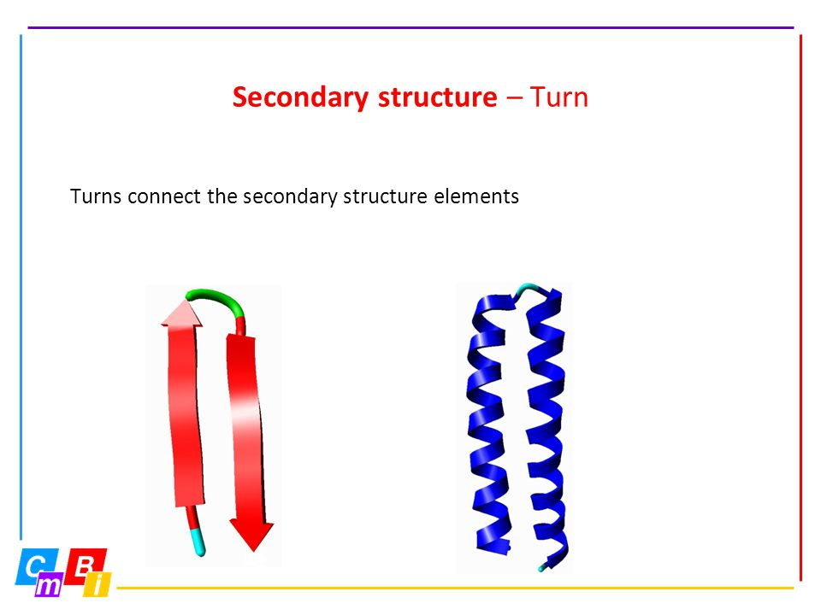

What are the secondary structure elements?
Secondary Structure elements
Helix
Beta Sheet
Beta Turn

Slide 3
Ramachandran angle and hydrogen bonding patterns and different type of helices
0 1 2 3 4
O O O O O
N — C𝛂 — C’ — N — C𝛂 — C’ — N — C𝛂 — C’ — N — C𝛂 — C’ — N — C𝛂 — C’ — C-end H H H H H
N-end
 | Helical Pitch | Hydrogen Bonding
𝝰 | 5.4 Å | (i) —-> (i+4)
3₁₀ | 5.9 Å | (i) —-> (i+3)
𝚷 | 1.5 Å | (i) —-> (i+5)

Slide 4
Dictionary of Protein Secondary Structure (DSSP) notation of secondary structural elements
G = 3-turn helix ( 3₁₀ helix).
H = 4-turn helix (𝝰 helix).
I = 5-turn helix (𝚷 helix).
T = hydrogen bonded turn (3, 4 or 5 turn)
E = extended strand in parallel and/or anti-parallel ß-sheet conformation.
В = residue in isolated ß-bridge
S = bend (the only non-hydrogen-bond based assignment).
с = coil (residues which are not in any of the above conformations).

Slide 5
Problem: Given a PDB file, assign the secondary
structural elements from the atomic coordinates.

Slide 6
Step 1: Get a PDB file from Protein Data Bank.

Slide 7
Step 2:Assign secondary structure using DSSP program.
Running DSSP in Windows
You can download the DSSP software by this https://swift.cmbi.umcn.nl/gv/dssp/
Use command prompt Command: dssp.exe -i [infile] -o [outfile]
Running DSSP in Ubuntu
Install the DSSP package: sudo apt-get install dssp
The program installs itself as mkdssp, not dssp, and Biopython looks to execute dssp, so we need to symlink the name dssp to mkdssp: sudo ln -s /usr/bin/mkdssp /usr/bin/dssp
Then you should be able to run dssp in your terminal:
dssp -i <path_to_pdb_file> -o <new_path_to_output_file>

Slide 8
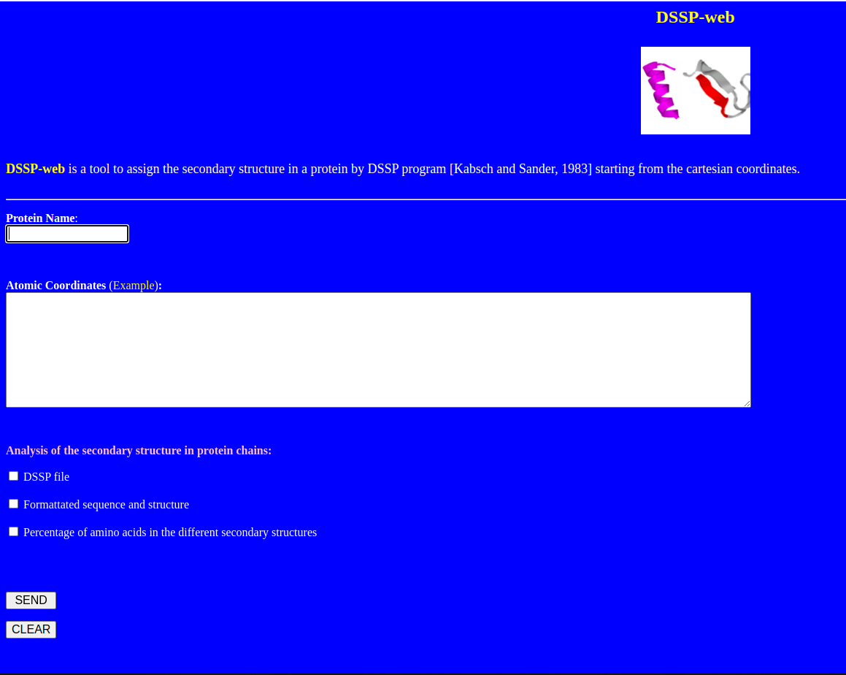
Web server of DSSP
Link :
http://bioinformatica.isa.cnr.it/SUSAN/DSSP-web/

Slide 9
STRIDE

Slide 10
STRIDE (Structural identification) is a program used to assign secondary structure annotations to a protein structure. STRIDE has slightly more complex criteria to assign codes compared to DSSP. STRIDE utilizes the atomic coordinates of a structure to assign the structure codes, which are:
Code Description
H Alpha helix
G 3-10 helix
I helix
E Extended conformation
B or b Isolated bridge
T Turn
C Coil (none of the above)
S Bend

Slide 11
Running STRIDE in Ubuntu
Download the source from the https://webclu.bio.wzw.tum.de/stride/
Create a new folder named “stride” in a place where you store software and extract the source into it
mkdir /path/to/software/stride
cp /path/to/downloaded/stride.tar.gz /path/to/software/stride
cd /path/to/software/stride
tar -zxf stride.tar.gz
cd /path/to/software/stride
make
cp stride /usr/local/bin
stride pdb > out

Slide 12
