Slide 1
Computational Biophysics
Term Project
Group no: 7
Vineet Amol Pippal (20CS30058)
Grace Sharma (20CS30022)
Sidharth Vishwakarma (20CS10081)

Slide 2
Objective
In this project, we aim to implement a research paper on miRNA-mRNA interaction prediction from the miRNA-mRNA interaction graph.
The primary objective is to develop a predictive model that can infer interactions between microRNAs (miRNAs) and messenger RNAs (mRNAs) based on the existing RNA-RNA interaction database.
The implemented solution involves several key steps, including data preprocessing, graph construction, feature extraction, model training, and evaluation.

Slide 3
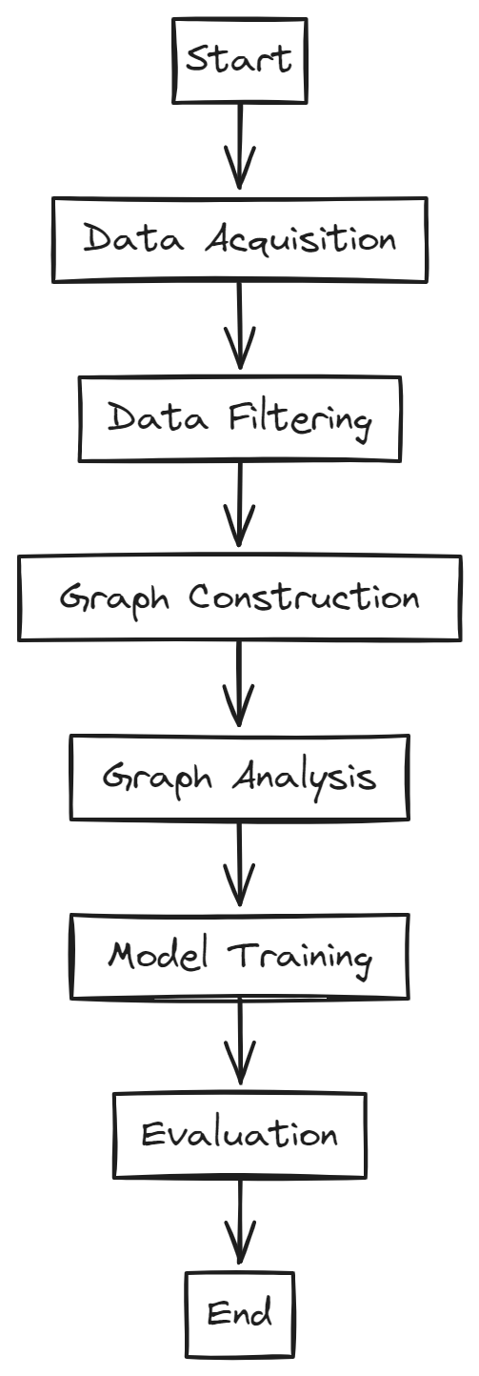
Overview
Tasks to be Performed:
1. Data Acquisition: Download the RNA-RNA interaction database from the provided link, which contains information such as RNAInter ID, interactor IDs, categories, species, and interaction scores.
2. Data Filtering: Filter the database to retain entries specific to miRNA-mRNA interactions in the Homo sapiens species, ensuring relevance to the research focus.
3. Graph Construction: Utilize the filtered dataset to construct a miRNA-mRNA interaction graph, where nodes represent miRNAs and mRNAs, and edges denote interactions between them.
4. Graph Analysis: Identify the largest connected component within the interaction graph, as it likely represents biologically meaningful interactions between miRNAs and mRNAs.
5. Model Training: Split the edges of the largest connected component into train and test sets and train an edge prediction algorithm. A basic Graph Neural Network (GNN) model with randomly initialized nodes is considered for this task.
6. Evaluation: Assess the performance of the trained model using appropriate evaluation metrics, such as Mean Squared Error (MSE), Mean Absolute Error (MAE), and R-squared score, on the test set.

Slide 4
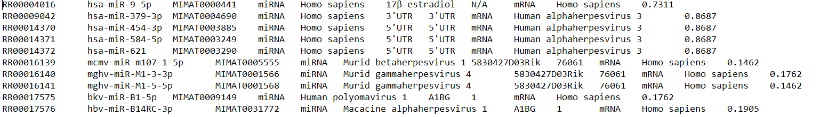
Dataset Description
The RNA-RNA interaction database provides comprehensive information about interactions between various RNA molecules, including miRNAs and mRNAs.
The dataset contains entries with attributes such as RNAInter ID, interactor IDs, categories, species, and interaction scores.
For this project, we focus on interactions between miRNAs and mRNAs in the Homo sapiens species.
First 10 lines of dataset
Link to dataset

Slide 5
Graph Construction and Analysis
1. Graph Representation:
Data Structure: Represented as a graph using the NetworkX library in Python.
Node and Edge Representation: Each node is associated with unique identifiers, and edges contain additional information such as interaction scores.
2. Identification of Largest Connected Component:
Algorithm: Largest connected component is identified using NetworkX library’s connected component analysis functionality.
Data Structure: NetworkX internally employs graph traversal algorithms, such as depth-first search (DFS), to identify connected components efficiently.

Slide 6
Model Training and Evaluation
1. Edge Prediction Algorithm:
Model Selection: Graph Neural Network (GNN) model
Model Architecture: GNN model consists of multiple layers of Graph Convolutional Networks (GCNs)
Library: Deep Graph Library (DGL)
Optimization: Adam optimizer
2. Training Process:
Data Preparation: Edges of the largest connected component are split into train and test sets
Feature Extraction: Node features, initially represented as node IDs, are extracted from the graph
Loss Function: Mean Squared Error (MSE) loss. It measures the discrepancy between predicted and actual edge weights.
3. Model Evaluation:
Metrics: Mean Squared Error (MSE), Mean Absolute Error (MAE), and R-squared score on the test set.
Analysis: The evaluation metrics provide insights into the accuracy and effectiveness of the model in predicting miRNA-mRNA interactions, thereby assessing its utility for biological research applications.

Slide 7
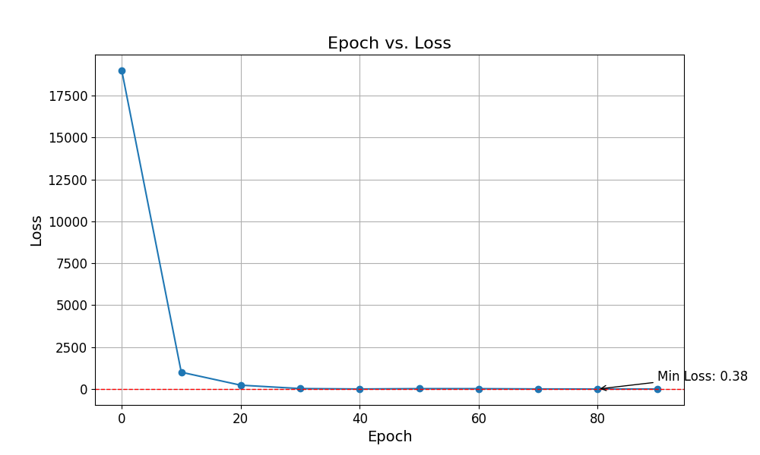
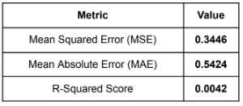
Results
Number of Nodes in largest connected component (for the given iteration of training): 17,586
Model Evaluation Metrics:-

Slide 8
Conclusions
● Moderate Model Performance: The GNN model showed moderate performance in edge prediction, indicating room for improvement in accuracy.
● Refinement Needed: Further refinement of the GNN model, including feature engineering and parameter tuning, could enhance predictive capability.
● Insights from Connected Components: Identification of significant connected components in the miRNA-mRNA interaction graph offers insights into complex regulatory relationships.
● Future Directions: Continued research is warranted to explore gene regulatory networks using complementary techniques and multi-omics data integration.
● Overall Implications: Challenges remain in understanding gene regulation, emphasizing the need for interdisciplinary collaboration and innovative methodologies.

