Slide 1

Data Structures Visualization with Programming Language
Nishanth .T (1602-21-733-102)
Siddhartha Reddy .D (1602-21-733-118)

Slide 2
Introduction
With this project, our aim is to provide a Data Structures visualization tool along with a programming language which can be used to program the different Data Structures and their methods
Using Python along with modules such as Turtle and Tkinter, we have created a Graphical Representation of different Data Structures and their operations

Slide 3
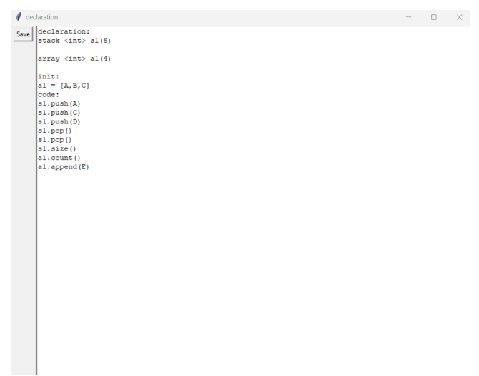
Programming Data Structures

Slide 4
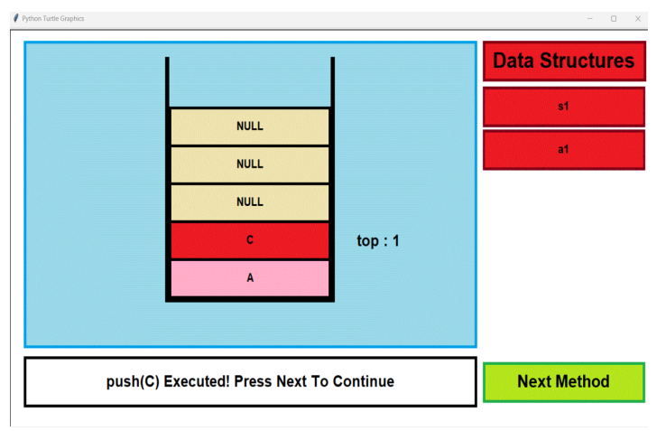
Data Structures Visualization

Slide 5
Motivation
Data Structures are one of the most important topics for any programming language and are frequently asked in interviews
Many students find it to be an intimidating topic and are often confused on how different Data Structures operate
With proper visualization of how data is manipulated, it becomes much easier to understand and implement different Structures

Slide 6
Main Features
The tool can be used offline and is encapsulated into a single Python script, along with image assets
A simple programming language has been provided so that users can get a preview of "coding" a Data Structure without worrying about the syntax or semantics of a programming language, to solely focus on the way data is manipulated in each Structure
For every operation performed, there is a text description telling the user what has been done so far

Slide 7
Additional Features
This programming language also has special features like intialisation ("init:") for which the user can intialise the elements directly rather than writing multiple methods for inserting elements multiple times.
If the capacity of object is not declared the program itself will take the maximum capacity available for the data structure.
All the exceptions including invalid method names , argument types, invalid size, Simple syntax errors and Invalid object intialisations are handled.

Slide 8
Drawbacks
This program works with simple data structures and doesn’t include data structures like CLL, DLL, Circular Queue, Dequeue, AVL Tree, B-Tree, M-Way Tree and Red-black Trees.
The capacity of objects is also limited due to the interfaced used and the size of each object is limited for its usage.
Different sorting techniques are not used, we limited the sorting with selection sort technique.
And the program works with static environment we intend to develop it for dynamic environment too.

Slide 9
Future Developments
Thus, to achieve the maximum usage of this we intend to develop a web application.
Using Dynamic environment and web architecture to make a better interface for editing the code and better visualization of the data structures.
Increase the maximum capacity of every Data Structure and improve the Exception Handling mechanism to make the tool more user-friendly

Slide 10
Thank You!

