Slide 1
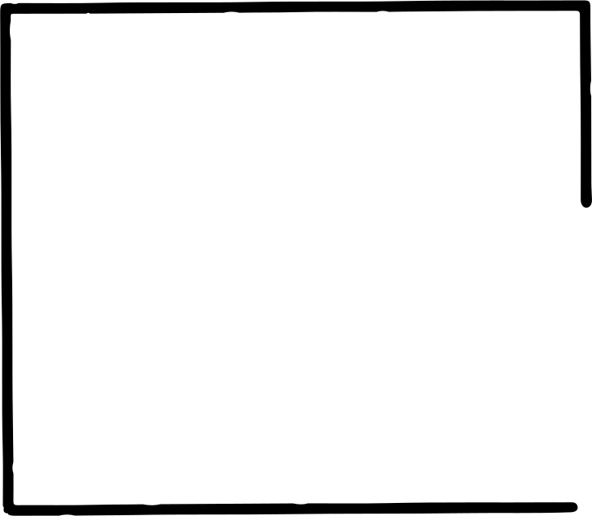
OVERFITTING AND UNDERFITTING IN ML MODELS: PREVENTION STRATEGIES
Presented by: Hallig, Siera Q.
Course Code: CSST 104
Course Title: Advance Machine Learning

Slide 2
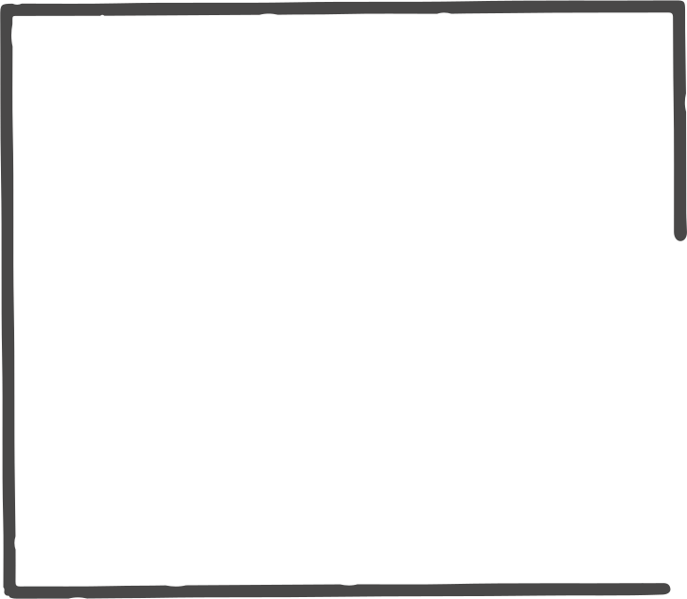
INTRODUCTION: WHAT IS OVERFITTING AND UNDERFITTING?
• Underfitting: Model is too simple and performs poorly on both training and test data.
• Overfitting: Model is too complex and performs well on training data but poorly on unseen data.
• These issues hinder model generalization.
•Goal: Understand, visualize, and prevent both issues using real-world ML models.

Slide 3
METHODOLOGY: BIAS-VARIANCE TRADEOFF & STRATEGIES
Bias-Variance Tradeoff:
Underfitting → High bias
Overfitting → High variance
Strategies Used:
Use simple vs. complex models (Linear Regression, Decision Tree, XGBoost)
Regularization (L1/L2 in XGBoost)
Learning curves to visualize training vs. validation error
Train-test split and standardization

Slide 4
IMPLEMENTATION: CODE & TOOLS
Dataset: California Housing (from sklearn.datasets)
Preprocessing: Feature scaling using StandardScaler, 80-20 train-test split
Models Used:
Linear Regression (Underfitting)
Decision Tree Regressor (Overfitting)
XGBoost Regressor (Balanced with regularization)
Evaluation: Used R² score and MSE to compare performance

Slide 5
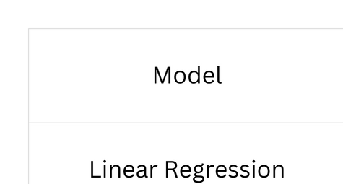
RESULTS & EVALUATION

Slide 6
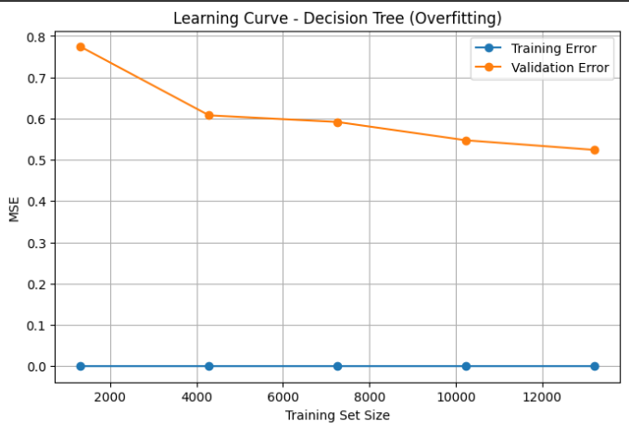
RESULTS & EVALUATION

Slide 7
CONCLUSION & KEY TAKEAWAYS
• Underfitting occurs with overly simple models.
• Overfitting occurs with overly complex models that memorize training data.
• Regularization, model selection, and visual tools like learning curves help prevent both.
• XGBoost provided the best balance between bias and variance in this study.

Slide 8
THANK YOU

