Slide 1
Neuronal Networks
Libraries
What Neuronal Networks Look like
Linear, Convolution, Pooling, Activation Functions, Loss Functions, Optimizers
Calculus
Backpropagation, Steepest Gradient Descent
Classifiers
Logistic Regression, Bayesian Classifiers, LDA, QDA, Support Vector Machines
Recurrent Networks
RNN, LSTM, Transformators

Slide 2
Libraries
Keras
FastAI
Neuronal Networks
Theano
Tensorflow
Pytorch
Classifiers and more
scikit

Slide 3
What Neuronal Networks Look Like
Linear Regression
Convolution
Pooling
Activation Functions
Loss Functions
The Main Loop of Neuronal Network Training

Slide 4
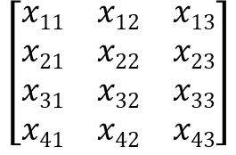
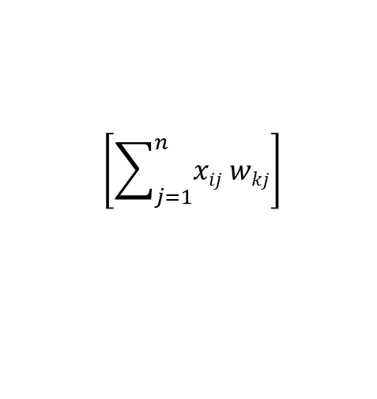
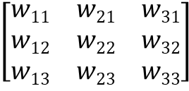
W ist die Matrix der Gewichte, X ist die Inputmatrix und X_{hidden} ist der Input für Layer 2.
layer 1
layer 2
m = 4 = Anzahl der Messungen (samples); riesengroß!
n = 3 = Anzahl der Input-Werte (features)
K = 3 = Anzahl der output-Werte (categories)
x_{i1}
W₁₁
1
1
W₁₂
W₂₁
x_{i2}
W₂₁
.
2
2
XW^{T} = Xhidden
W₃₁
W₃₂
W₂₃
W₁₃
x_{i3}
W₃₃
$$\left[\begin{matrix}w11 & w21 & w31 \\ w12 & w22 & w32 \\ w13 & w23 & w33\end{matrix}\right]$$
=
$$\left[\sum_{j=1}^{n}{xij wkj}\right]$$
3
3
$$\left[\begin{matrix}x11 & x12 & x13 \\ x21 & x22 & x23 \\ x31 & x32 & x33 \\ x41 & x42 & x43\end{matrix}\right]$$
i = 1, …, m k = 1, .. K
input
hidden
(m x n) (n x K) → (m x K)

Slide 5
Die Sigmoid-Funktion (Aktivierungsfunktion) wird auf jedes Element von Xhidden angewendet. So erhält man den Output Ohidden als Input für Layer 3.
layer 1
layer 2
layer 3
x₁
X₁hidden
O₁hidden
1
1
1
x₂
X₂hidden
O₂hidden
2
2
2
Ohidden = sigmoid(Xhidden)
x₃
X₃hidden
O₃hidden
3
3
3
input
hidden
output
Xhidden
Ohidden

Slide 6
Dasselbe in einer kompakten Notation, die direkt zur Pytorch-Implementierung führt.
Gegeben: Training Set = [X, Y]
Aufgabe: Minimiere Loss über W₁ und W₂
W₁
W₂
MSE: mean square error
Y: Zielwert
X
Linear
Sigmoid
Linear
MSE
X₀ = X
X₁ = X₀ W₁^{T}
X₂ = sigmoid(X₁)
X₃ = X₂ W₂^{T}
Loss = || X₃ - Y ||²
(m x n)
(m x K₁) ← (m x n) (n x K₁)
(m x K₁) ← (m x K₁)
(m x K₂) ← (m x K₁) (K₁ x K₂)
(1 x 1) ← (m x K₂)
Notes:
Diese Folie könnt ihr bringen, oder ich bringe sie bei mir (und würde dann Folie 11 nochmal auflegen)

Slide 7
Linear Regression
X : m x n
W : K x n
Y = XW^{T} : (m x n) (n x K) → (m x K)
Minimize loss over W!
m: number of samples n: number of features
K: number of categories
linear = torch.nn.Linear(n, K) # random value for W x = torch.tensor(…) y = torch.tensor(…)
target criterion = torch.nn.MSELoss() optimizer = torch.optim.SGD(model.parameters(), lr=eta) for i in range(n_iteration): x1 = linear(x) loss = criterion(x1, y) if abs(loss) < epsilon: break optimizer.zero_grad() loss.backward() optimizer.step()
W
X₀ = X
Linear
MSE
X₀ = X
X₁ = X₀ W^{T}
Loss = || X₁ - Y ||²
(m x n)
(m x K) ← (m x n) (n x K)
(1 x 1) ← (m x K)

Slide 8
Logistic Regression
m = 4 = Anzahl der Messungen (samples); riesengroß!
n = 3 = Anzahl der Input-Werte (features)
K = 3 = Anzahl der output-Werte (categories)
Aufgabe: Minimiere Loss über W!
W
CC: cross correlation
Y: Zielwert
X
Linear
Softmax
CC
X₀ = X
X₁ = X₀ W^{T}
X₂ = softmax(X₁)
Loss = cross correlation(X₂ - Y)
(m x n)
(m x K₁) ← (m x n) (n x K)
(m x K) ← (m x K)
(1 x 1) ← (m x K)

Slide 9

Wie lernt ein Neuronales Netz?
???
Der Fehler muss rückwärts durch das Netz popagiert werden, um die Gewichte zu bestimmen.
In den Gewichten ist das Gedächtnis des Netzes gespeichert.
Dieses Vorgehen wird als Backpropagation bezeichnet
1
W1,1 = 3
1
output error
W2,1 = 1
2
???

Slide 10
Verbindungen mit einem höheren Gewicht hatten einen größeren Einfluss auf den Output Error. Daher wird der Fehler proportional bei der Bestimmung der neuen Gewichte angewendet.
¾ error
1
W1,1 = 3
1
output error
W2,1 = 1
2
¼ error

Slide 11
Calculus
Backpropagation with Respect to X
Steepest Gradient Descent with Respect to X
Backpropagation with Respect to W
Steepest Gradient Descent with Respect to W

Slide 12
The “Hello World” of Backpropagation (Scalars)
Independent variable,
Exogenous variable,
Leaf
Dependent variable,
Endogenous variable
x
y = x * *2
How does a change of x influence y?
∂y/∂x = ∂x
∂y = 2x * ∂x
With torch.autograd
x = torch.tensor(3, require_grad=True)
y = x ** 2
y.backward()
# now: x.grad = 2 * x = 6 = ∂y/∂x (3)
a small change of x
induces a small change of y

Slide 13
The Chain Rule
Independent variable,
Exogenous variable,
Leaf
Dependent variable,
Endogenous variable
Dependent variable,
Endogenous variable
x
y = x * *2
z = y * *3
How does a change of x influence z?
∂z/∂x = ∂z/∂y * ∂y/∂z
= 3*y**2 * 2*x
= 6*x**5
∂z = 6*x**5 * ∂x
With torch.autograd
x = torch.tensor(3, require_grad=True)
y = x ** 2
z = y ** 3
z.backward()
# now: x.grad = 6*x**5 = 1428 = ∂z/∂x(3)

Slide 14
The Chain Rule Again
y = x * *2
x
t = y * z
z = x * *3
How does a change of x influence t?
∂t/∂x = ∂t/∂y*∂y/∂x + ∂t/∂z*∂y/∂x
= z * 2x + y * 3x**2
= 5x**4
∂t = 5*x**4 * ∂x
With torch.autograd
x = torch.tensor(3, require_grad=True)
y = x ** 2
z = x ** 3
t = y * z
t.backward()
# now: x.grad = 5*x**4 = 405 = ∂t/∂x(3)

Slide 15
This works for any acyclic graph
y = x * *2
x
t = y * z
z = x + y
How does a change of x influence t?
∂t/∂x = ∂t/∂y*∂y/∂x +
∂t/∂z*(∂z/∂x + ∂z/∂y*∂y/∂x)
= 3x**2 + 4x**3
x = torch.tensor(3, require_grad=True)
y = x ** 2
z = x ** 3
t = y * z
t.backward()
# now: x.grad = 5*x**4 = 405 = ∂t/∂x(3)

Slide 16
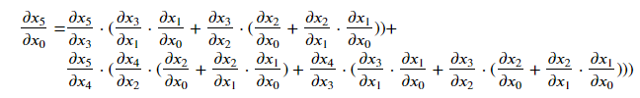
This works on any acyclic graph
x₁ = f₁(x₀)
x₃ = f₃(x₁ , x₂)
x₀
x₅ = f₅(x₃ , x₄)
x₂ = f₂(x₀ , x₁)
x₄ = f₄(x₂ , x₃)
x₅ = F(x₀ ) = f₅(f₃(f₁(x₀) , f₂(x₀ , f₁(x₀))) , f₄(f₂(x₀ , f₁(x₀)) , f₃(f₁(x₀) , f₂(x₀ , f₁(x₀)))))
How does a change of x₀ influence x₅?

Slide 17
This works on any acyclic graph for any dimensions of x
x₁ = f₁(x₀)
x₃ = f₃(x₁ , x₂)
x₀
x₅ = f₅(x₃ , x₄)
x₂ = f₂(x₀ , x₁)
x₄ = f₄(x₂ , x₃)
x₅ = F(x₀ ) = f₅(f₃(f₁(x₀) , f₂(x₀ , f₁(x₀))) , f₄(f₂(x₀ , f₁(x₀)) , f₃(f₁(x₀) , f₂(x₀ , f₁(x₀)))))
How does a change of x₀ influence x₅?

Slide 18
The Weights Come in
Independent variable,
Exogenous variable,
Leaf
W₀
W₁
X₀
X₁ = f₁(X₀, W₀)
X₂ = f₂(X₁, W₁)
loss(X₂, Y)
F(X₀, W₀, W₁) = f₂(f₁(X₀, W₀), W₁)
How does a change of W influence loss?
∂loss/∂W₁ = ∂loss/∂X₂ * ∂X₂/∂W₁
∂loss/∂W₀ = ∂loss/∂X₂ * ∂X₂/∂X₁ * ∂X₁/∂W₀

Slide 19
Steepest Gradient Descent with respect to W
The problem
min loss(F(X, W₀, W₁), y)!
w[0] = torch.tensor(…, requires_grad=True) w[1] = torch.tensor(…, requires_grad=True)
x = torch.tensor(…) y = torch.tensor(…) criterion= torch.nn.L1Loss() optimizer = torch.optim.SGD([w], lr=eta)
for i in range(n_iterations): current = F(x, w)
loss = criterion(current, y) if abs(loss) < epsilon: break optimizer.zero_grad() loss.backward() optimizer.step()
The algorithm
X given (training set)
W₀,W₁ := any values
While loss(F(X, W₀, W₁), Y) > epsilon:
W₀ = W₀ - eta * ∂F(X, W₀, W₁)/∂W₀
W₁ = W₁ - eta * ∂F(X, W₀, W₁)/∂W₁

Slide 20
Gradients on Scalar-Valued Functions
Independent variable,
Exogenous variable,
Leaf
Dependent variable,
Endogenous variable
x_{1,} x₂
y = f(x₁, x₂)
How does a change of x influence y?
grad f = [∂y/∂x₁,∂y/∂x₂]
f(x+h) = f(x) + grad f * h
With torch.autograd
x = torch.tensor([3, 4], require_grad=True)
y = f(x)
y.backward()
# now: x.grad = grad f(x)
scalars
a row vector
a column vector

Slide 21
Steepest Gradient Descent with respect to x
The problem
min loss(F(x), y)!
x = torch.tensor(… , requires_grad=True) y = torch.tensor(…) criterion = torch.nn.L1Loss() optimizer = torch.optim.SGD([x], lr=eta)
for i in range(n_iterations): current = F(x)
loss = criterion(Fx, y) if abs(loss) < epsilon: break optimizer.zero_grad() loss.backward() optimizer.step()
The algorithm
x := any value
While loss(F(x), y) > epsilon:
x = x - eta * grad F(x)
Why “steepest descent”?
F(x+h) = F(x) + grad F * h
grad F(x) * h <= (grad F(x))**2
h = - eta * grad F(x)

Slide 22
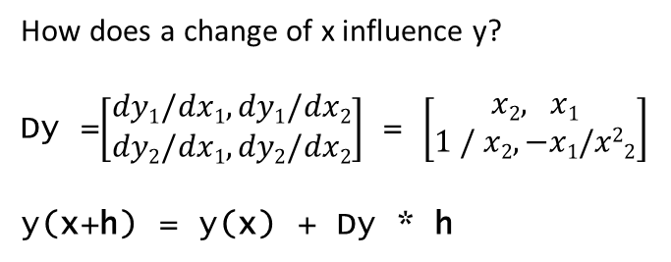
Jacobians on Vector-Valued Functions
Independent variable,
Exogenous variable,
Leaf
Dependent variable,
Endogenous variable
x₁ + x₂
y₁ = x₁ * x₂
y₂ = x₁ / x₂
How does a change of x influence y?
Dy =$\left[\begin{aligned}dy1/dx1, dy1/dx2 \\ dy2/dx1, dy2/dx2\end{aligned}\right]$ = $\left[\begin{aligned}x2, x1 \\ 1 / x2, −x1/x22\end{aligned}\right]$
y(x+h) = y(x) + Dy * h
column vectors
a column vector
The Jacobian: a matrix

Slide 23
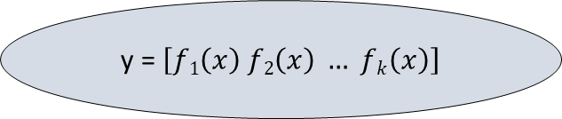
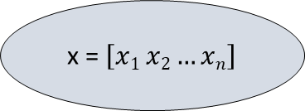
From Vectors to Matrices
How does a change of x influence y?
dy/dx = 2x
dy = 2x * dx
Independent variable,
Exogenous variable,
Leaf
Dependent variable,
Endogenous variable
x = $\left[x1 x2…xn\right]$
y = $\left[f1\left(x\right) f2\left(x\right) … fk\left(x\right)\right]$
With torch.autograd
x = torch.tensor(3, require_grad=True)
y = x ** 2
y.backward()
# now: x.grad = 2 * x = 6 = dy/dx (3)

Slide 24
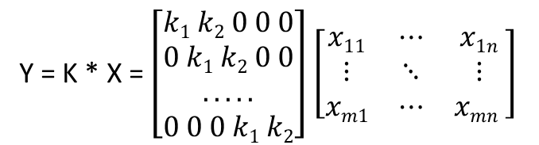
Convolution
Y = K * X = $\left[\begin{aligned}k1 k2 0 0 0 \\ 0 k1 k2 0 0 \\ . . . . . \\ 0 0 0 k1 k2\end{aligned}\right]$ $\left[\begin{matrix}x11 & ⋯ & x1n \\ ⋮ & ⋱ & ⋮ \\ xm1 & ⋯ & xmn \end{matrix}\right]$
X
C
Linear, Convolution, Pooling, Activation Functions, Loss Functions, Optimizers

Slide 25
Classifiers
Logistic Regression
Bayesian Classifiers
Gaussian, Multinomial, Binomial
QDA, LDA (Quadratic/Linear Discriminant Analysis)
Support Vector Machines

Slide 26
Recurrent Networks
Plain Recurrent Networks
The Main Loop of Recurrent Networks
LSTM
Transformers

