Slide 1
Dimensional Sinbad
-- Kiril Geshev
-- Xiaoxuan Zhang
-- Lu

Slide 2
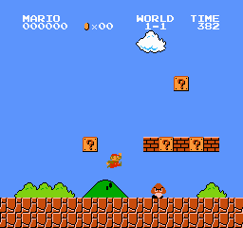
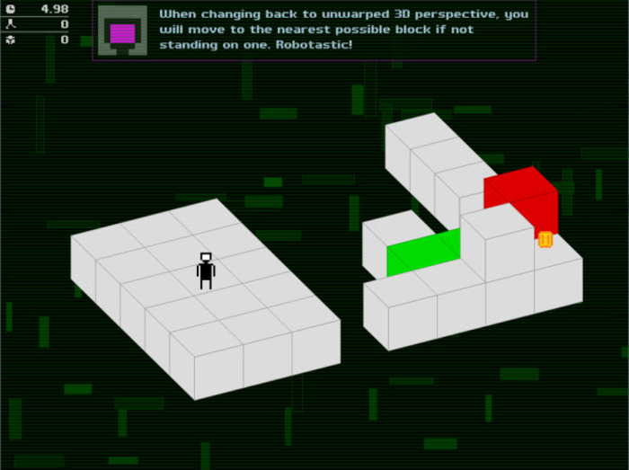
SuperMario + Ortho Robot =???

Slide 3
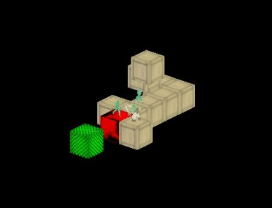
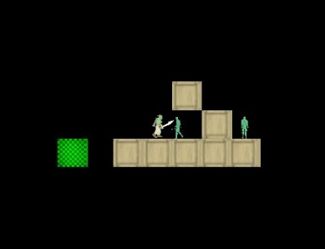
Dimensional Sinbad

Slide 4
Features
Core features
Change perspectives
Create blocks
Move player
Secondary features
Red blocks
Collect gold
Kill enemy

Slide 5
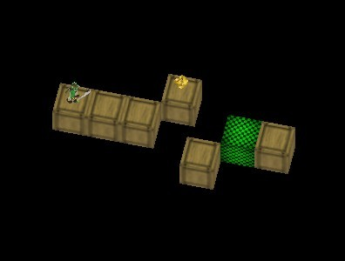
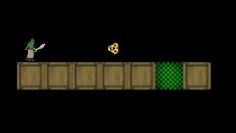
Perspective
Destination is to get the green blocks
Bridge the gap by changing perspective

Slide 6
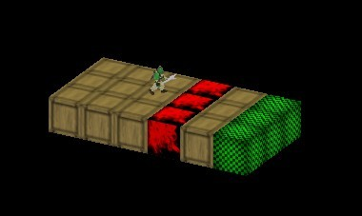
Red Blocks
Red blocks are not walkable
If you walk on it, you will die

Slide 7
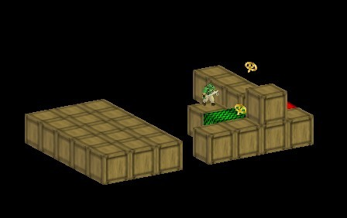
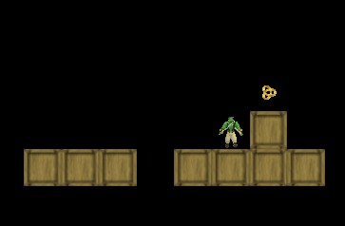
Gold
Collect gold for more score

Slide 8
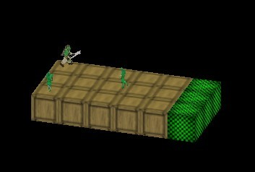
Enemy
Kill the ninjas to get more score
If you are facing them without any attack, you will lose

Slide 9
Tools
Visual Studio
SVN
XML

Slide 10
Iteration
Iteration 1
One level
4 views: north, south, east, west
Player: basic movement
Blocks: show all the blocks
Enemy: kill enemy

Slide 11
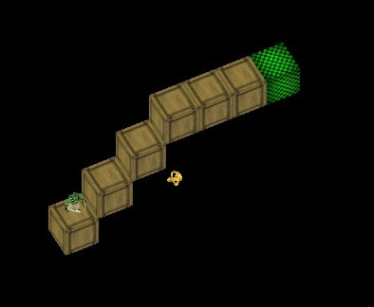
Iteration
Iteration 2
5 level
5 views: north, south, east, west, top
Blocks: red block, green block
Gold: collection

Slide 12
Demo

Slide 13
Thank you

