Slide 1
Client X — Q1 digital performance
Analysis Presentation
Author: Masai Interactive
Client: None
Date: April 24, 2026

Slide 2
Table of Contents

Slide 3
Agenda

Slide 4
Executive summary
Site sessions up 22% quarter-over-quarter; organic channel drove most of the gain.

Slide 5
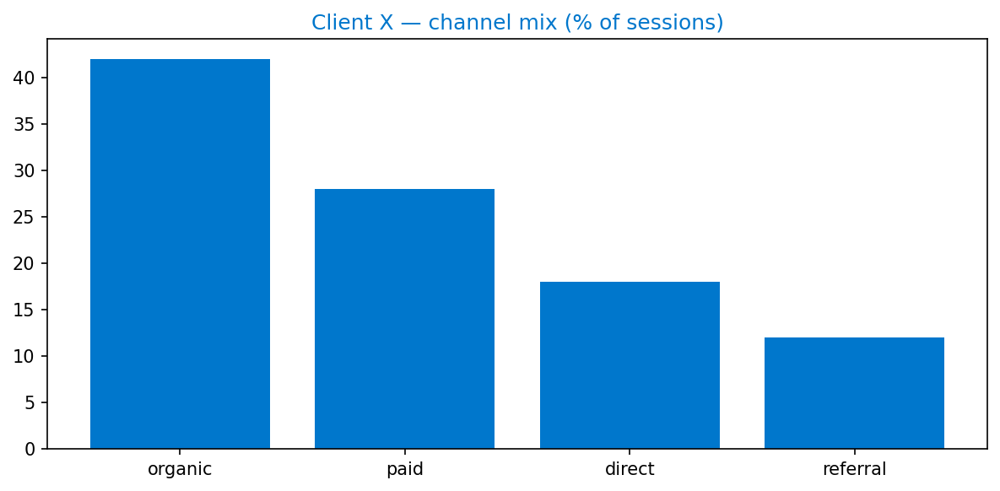
Channel mix

Slide 6
Top 3 pages
page | sessions | conv_rate_pct
page | sessions | conv_rate_pct
page | sessions | conv_rate_pct

Slide 7
Next quarter
• double-down on organic content pipeline

