Slide 1
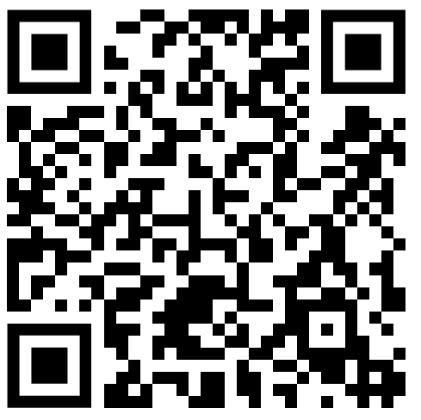
Siegfried Kaidisch
Hands-On: Deep Learning

Slide 2
Universal approximation theorem
“… feedforward networks with non-polynomial activation functions are dense in the space of continuous functions between two Euclidean spaces, with respect to the compact convergence topology.” [https://en.wikipedia.org/wiki/Universal_approximation_theorem]
In practice: When you have a set of data and some quantity can in principle be deduced from that data, a feedforward ANN (artificial neural network) can learn to do so.

Slide 3
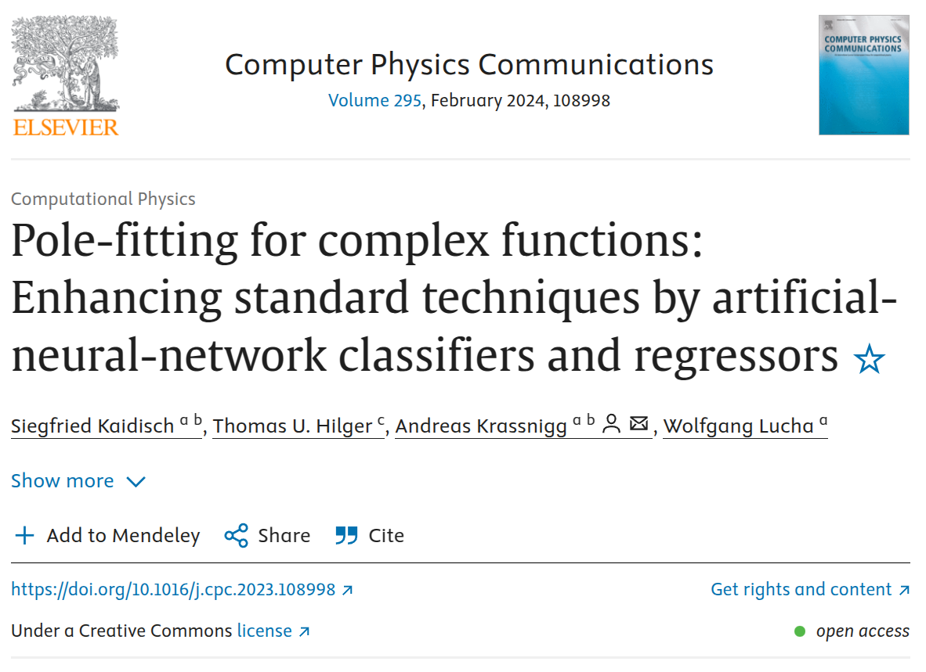
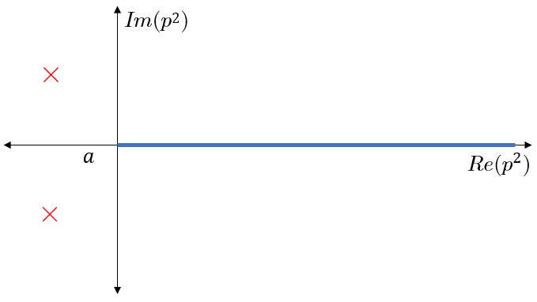
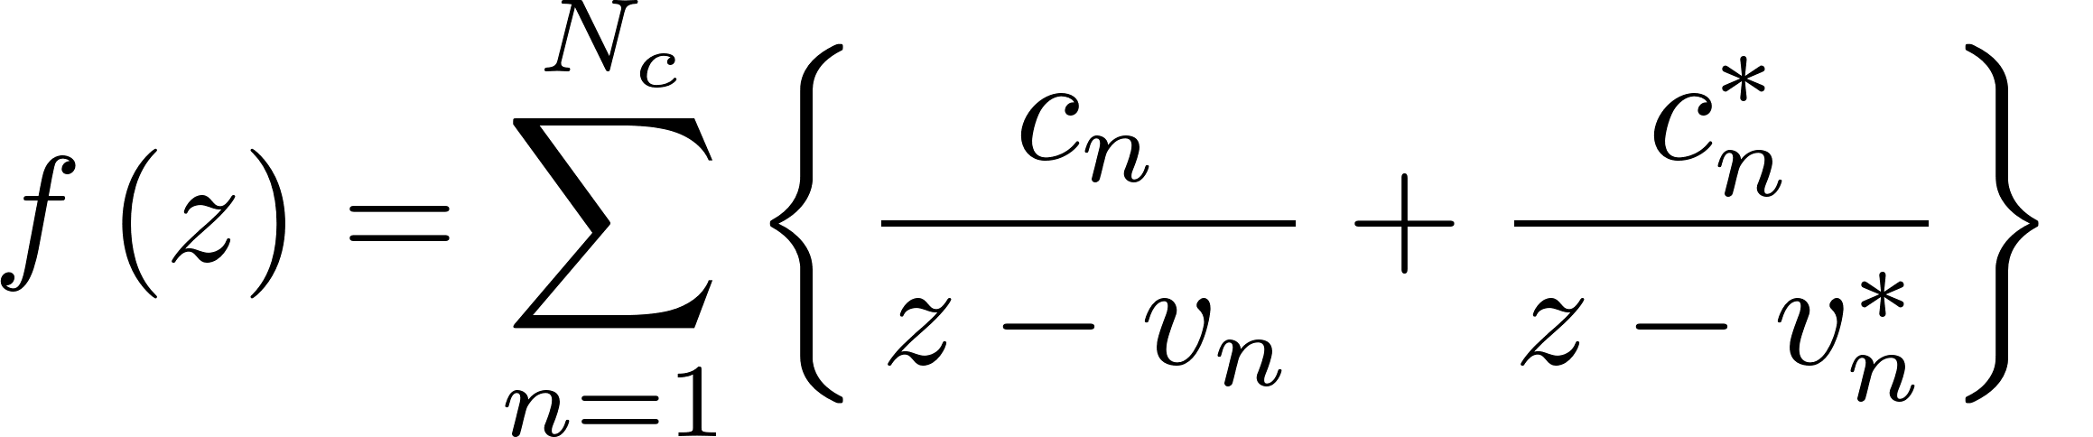
Examples
Data → ANN → Quantity
Watch history → ANN → Personal interests
Sensor readings from a factory machine → ANN → Risk of failure
Brain scan images → ANN → Presence of a tumor
Function values on R⁺ → ANN → Complex poles

Slide 4
Bad descriptors
When there is no (or a very intangible) connection between data and desired quantity, the ANN cannot learn to derive the quantity from the data
Last week’s lottery numbers → The next draw
Name of Titanic passenger → Survival probability
  Better descriptor: Which deck was the passenger on?

Slide 5
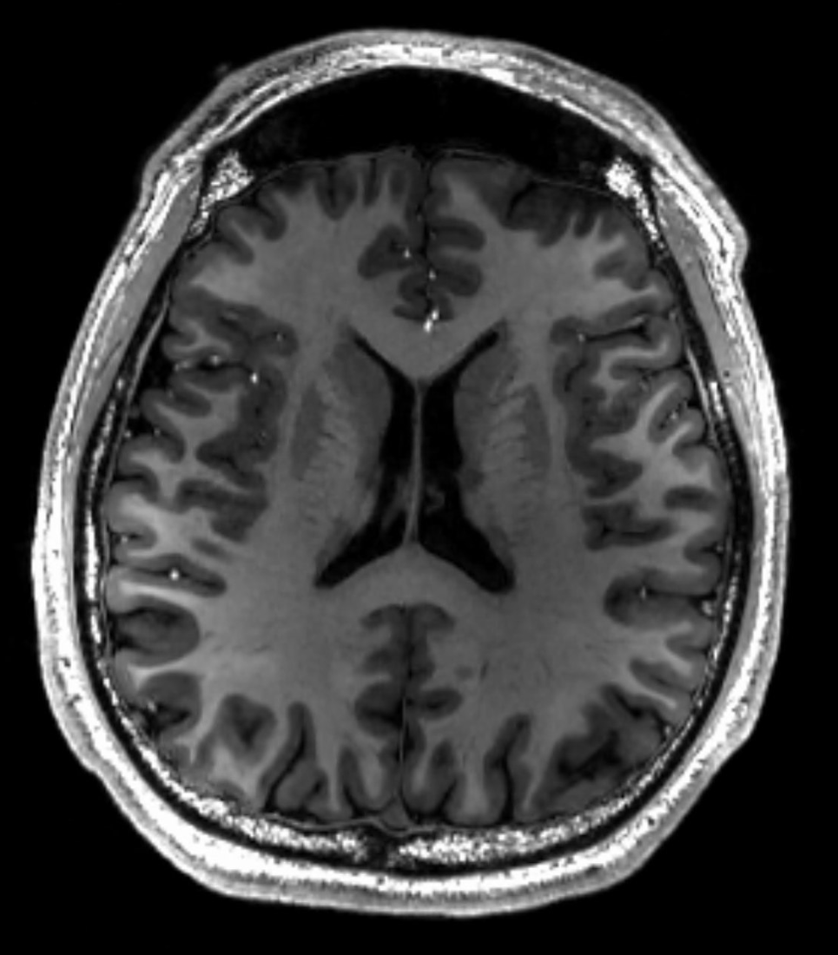
(Feedforward) Artificial neural networks
ANN
Q: What is happening inside the ANN, that derives the quantity from the data?
A: In short, a set of matrices and vectors and a non-polynomial function transform the input into the output.
Diagnose

Slide 6
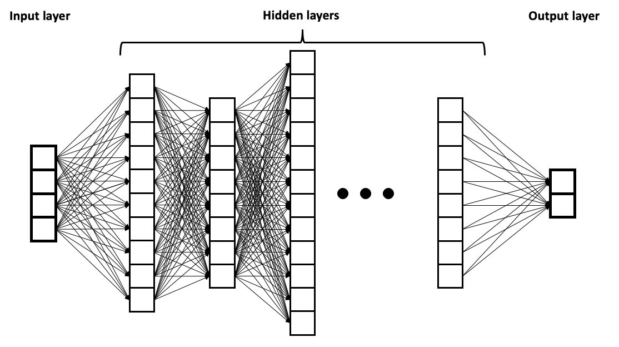
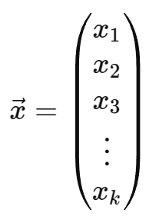



(Feedforward)
Artificial neural networks
[https://upload.wikimedia.org/wikipedia/commons/2/2f/Example_of_a_deep_neural_network.png]
[https://upload.wikimedia.org/wikipedia/commons/b/b2/MRI_of_Human_Brain.jpg]
...
= Diagnose

Slide 7
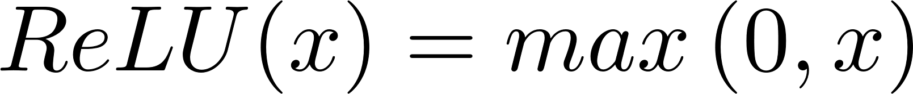
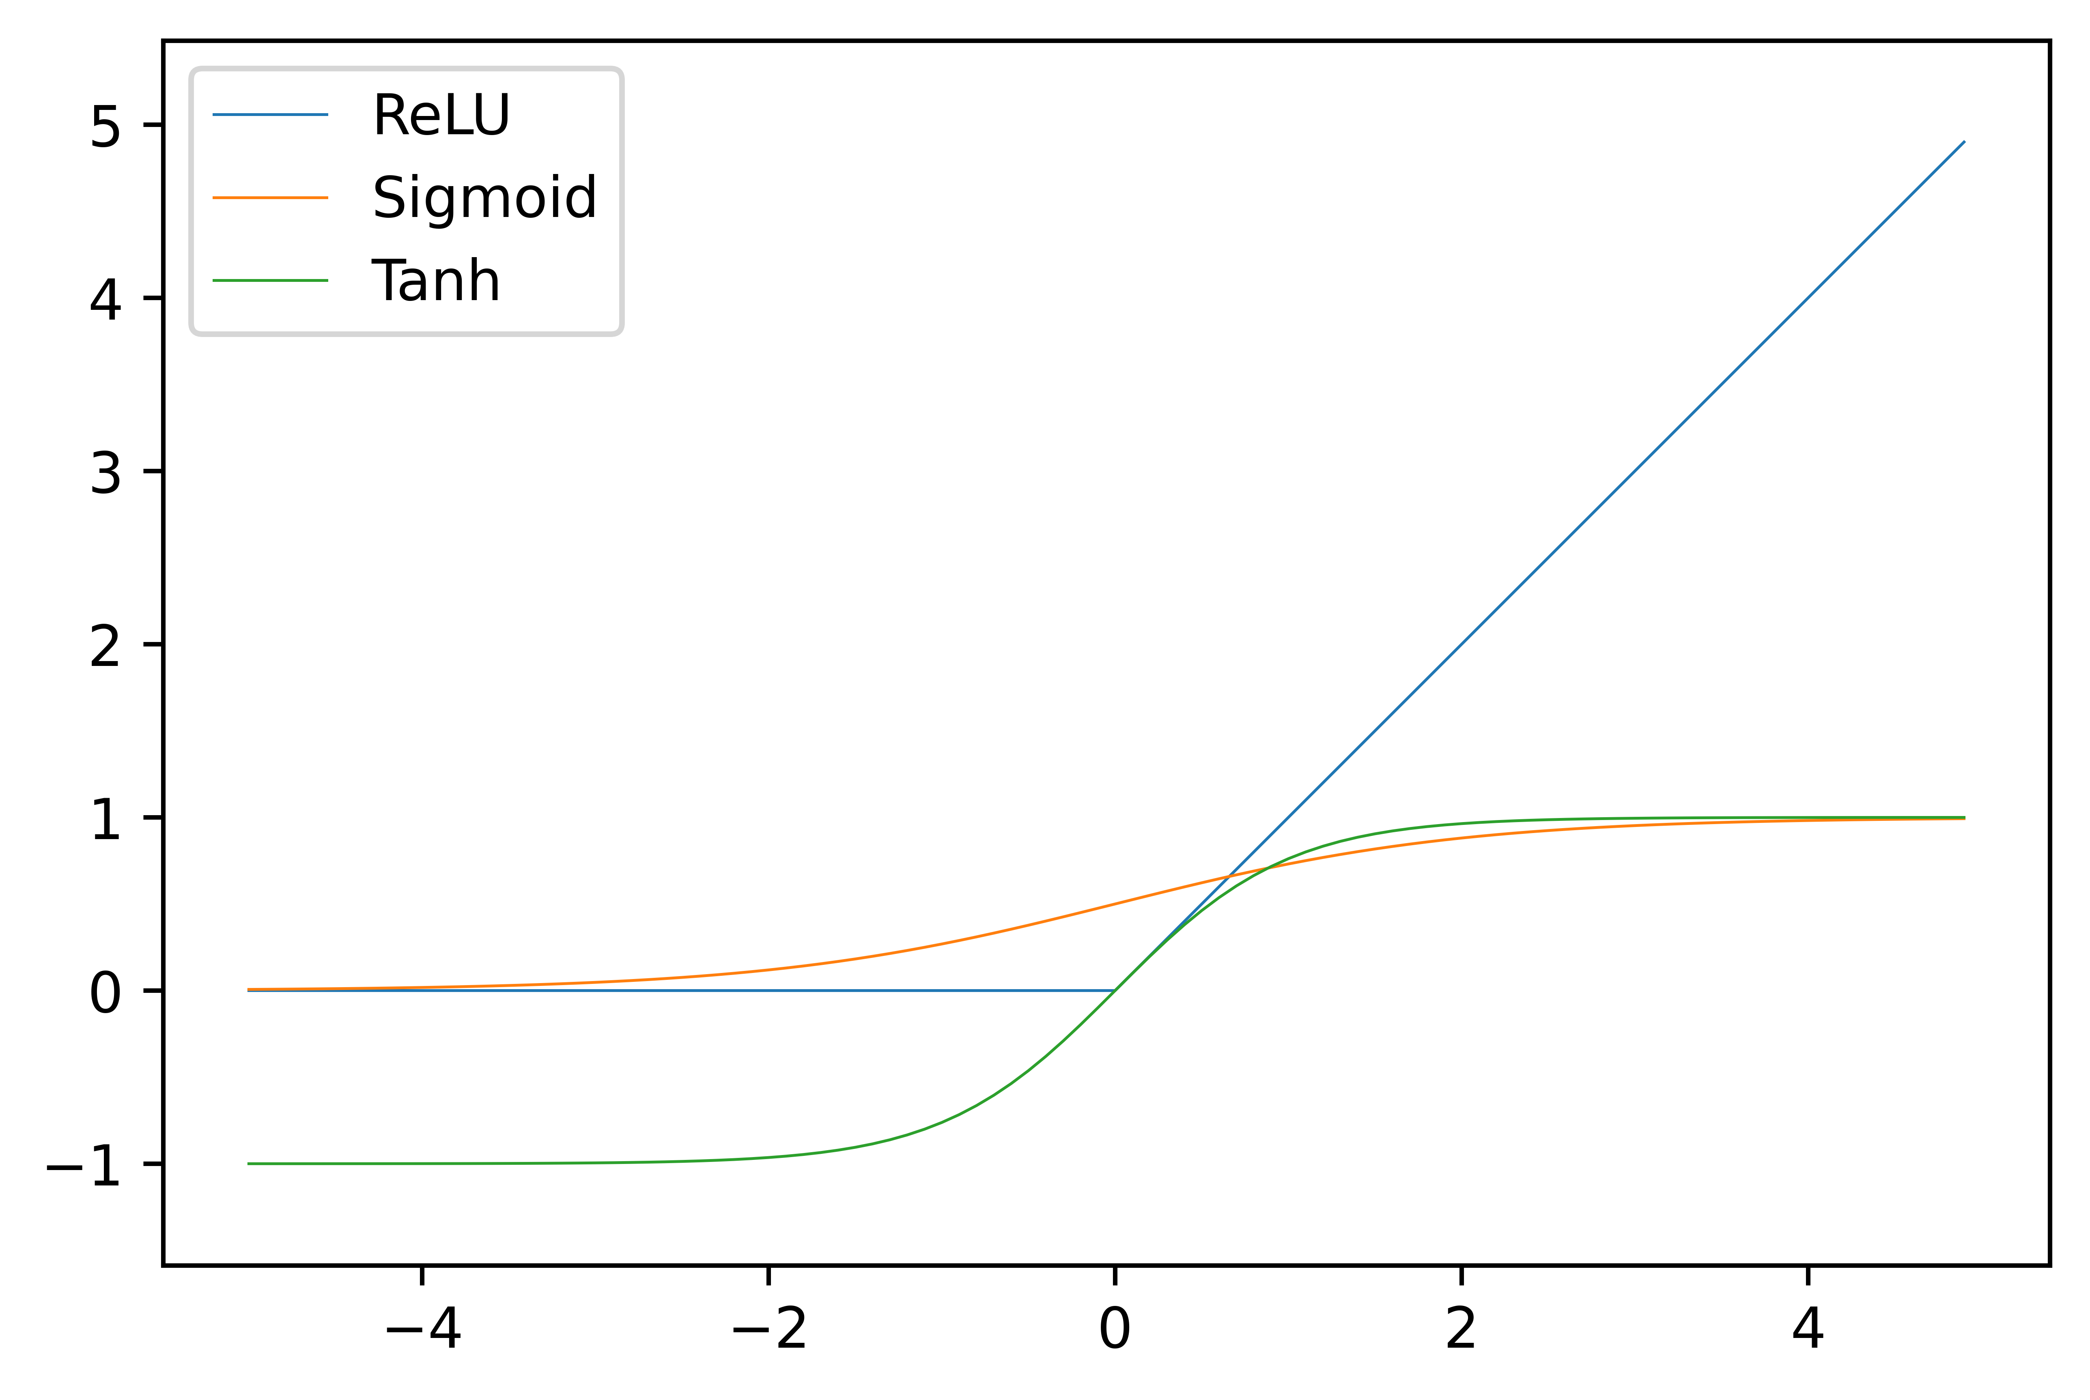
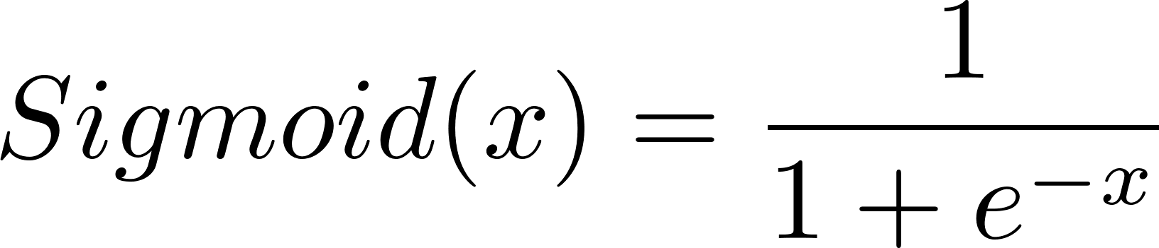
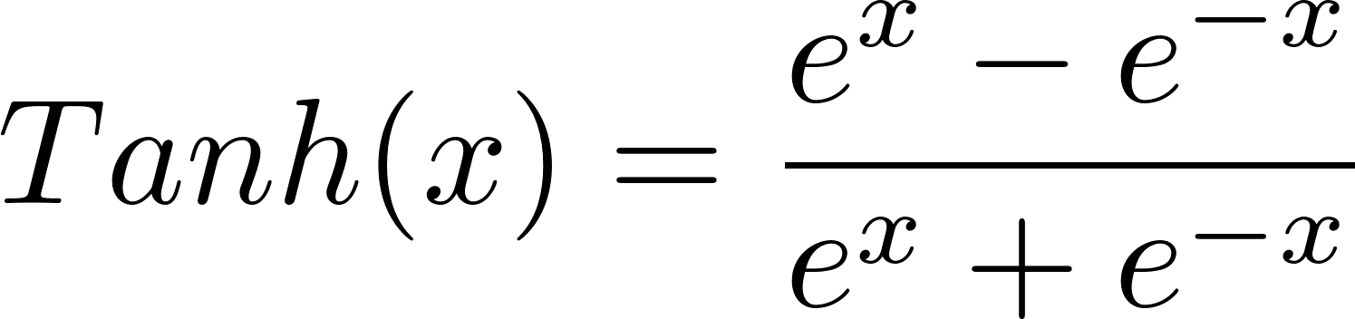
Activation functions
Non-polynomial function ᵠ

Slide 8
Training ANNs
In short: A set of matrices (weights) and vectors (biases) and a non-polynomial function
Change values in matrices and vectors → Change performance of the ANN
Training ANN = Changing weights and biases such that performance increases

Slide 9
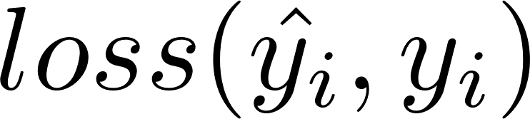
Loss function
How can we tell, what the ANN’s performance is?
We need data, where we know what the output should be!
  E.g. brainscan with a diagnosis created by a doctor
Feed the data (brainscan) to the ANN and compare its output/prediction to the correct result (diagnosis by doctor)
Loss function: a function of the correct result and the prediction of the ANN, that is a measure of how good the prediction is:
small
prediction is good

Slide 10

Loss function – example
Q: How effective will a certain treatment be for a patient?
Data: brainscan
Quantity to find: Effectiveness of treatment = Number between 0 and 100
Loss function: Mean squared error:
= 40
= 1600
= 80
= 75
= 25

Slide 11
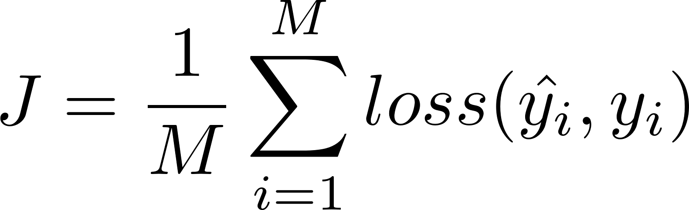
Cost function
The loss function tells us how good a single prediction of the ANN is
Cost function: = Loss function averaged over a batch of data
  Tells us the average/expected performance of the ANN
small
ANN is good
Training ANN =
Adapting weights and biases, such that
cost function gets smaller

Slide 12
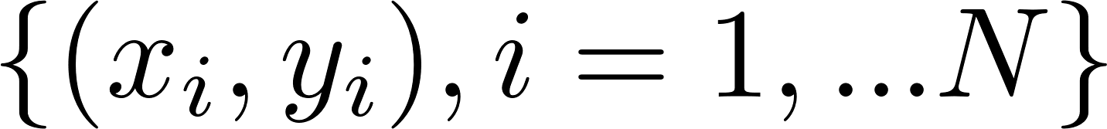
Supervised learning
Training ANN = Adapting weights and biases, such that cost function gets smaller
Q: How do we actually do this?
Supervised learning: Use manually created data
  E.g.: 10.000(=N) brainscans(=x_{i}) and the corresponding correct diagnosis(=y_{i})

Slide 13
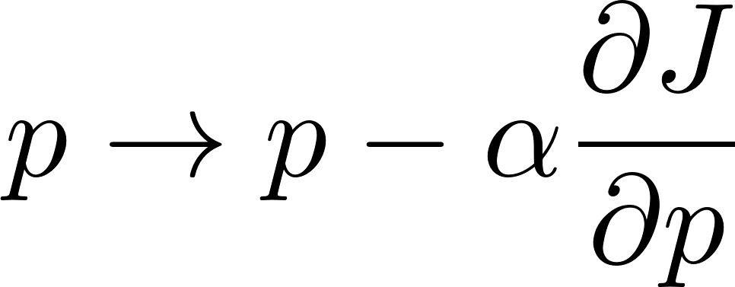
Supervised learning
Data:
Goal: minimize cost function
Procedure (backpropagation and stochastic gradient descent):
  Calculate ANN prediction for a batch of data (e.g. 100 brainscans)
  Calculate cost function
  Calculate derivative of the cost function w.r.t. ANN parameters
  (weights and biases)
  Update ANN parameters
  Repeat with next batch ...

Slide 14
What have we achieved? - Applying the ANN
Supervised Learning: use manually created data to train ANN
→ ANN learns to derive quantity from data (ANN: xi → yi)
→ Can apply ANN to new data xi, where quantity, y_{i}, is unknown (undiagnosed brain scans)
Cheap, fast and accurate

Slide 15
Training data vs. unseen data
Supervised Learning: Use manually created data to train ANN
Important: ANN will usually perform better on the data that it was trained on, than on data, that it has never seen!
  → Performance may seem better than it actually is!
Reason: Overfitting
  E.g., may have 10.000 brainscans but ANN has 100.000 parameters
  ANN may not actually learn to detect patterns, but just memorizes the training data
Solution: Split manually prepared data up

Slide 16
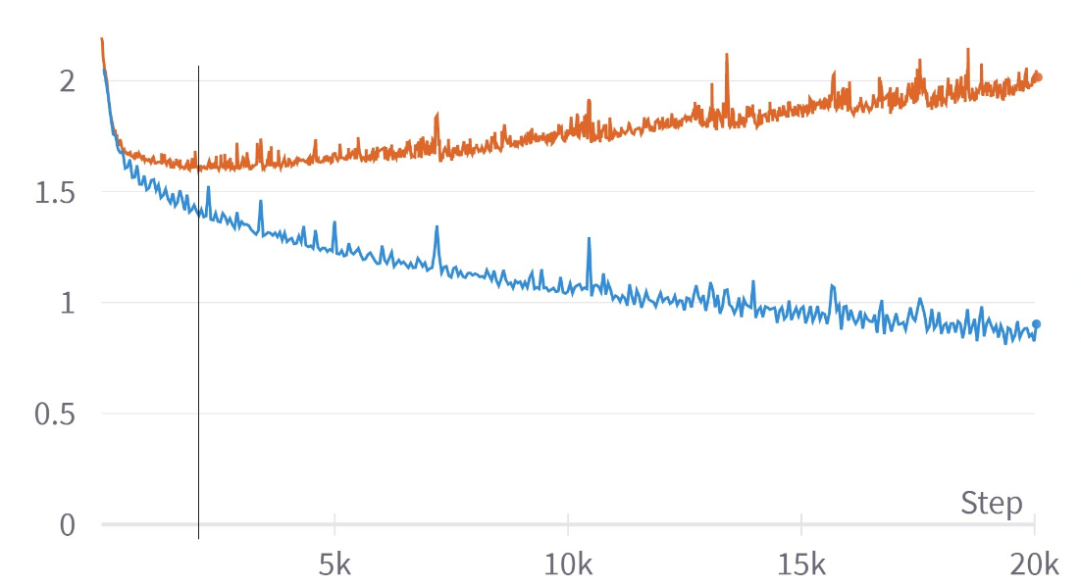
Splitting up data: training and validation
Split data into three separate sets:
  Training set: - Update parameters to enhance performance
  Validation set: - Check performance during training→ prevent overfitting
          - Never used to update ANN parameters!
Cost fct. on validation data
Cost fct. on training data

Slide 17
Splitting up data: testing
Split data into three separate sets:
  Training set: - Update parameters to enhance performance
  Validation set: - Check performance during training, prevent overfitting
  Test set: - Unbiased performance evaluation, when hyperparameters have been chosen and training is finished
Hyperparameters:
Number and size of hidden layers
Batch size
Choice of loss function
Optimization algorithm and learning rate
...

Slide 18
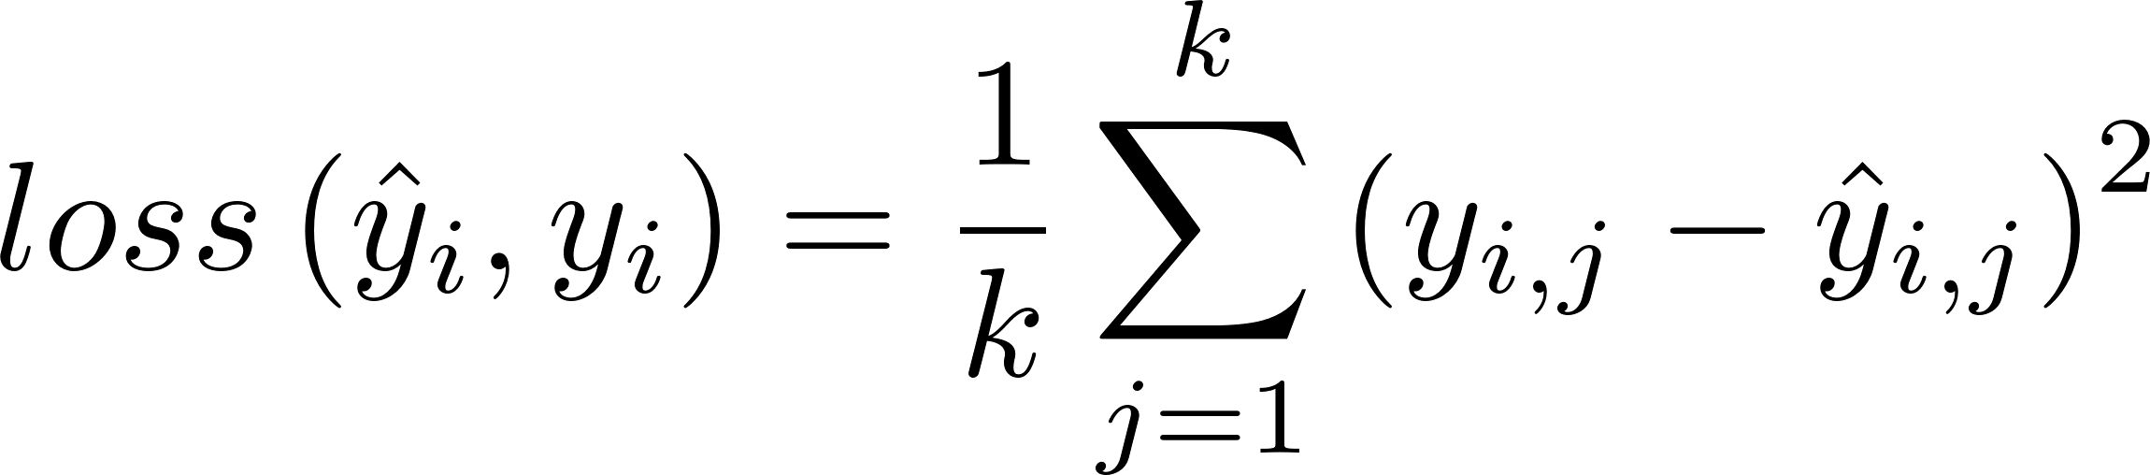
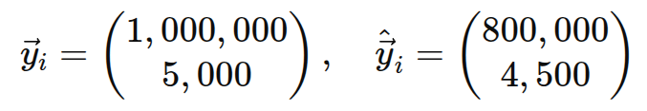
Regression
Goal: Predict a vector of real numbers
Loss function: Mean-Squared Error (MSE)
ANN output = ANN prediction
Example: Find house price and rental income from size, location score, ag
House i: x_{i} = (200, 10, 1, ...)

Slide 19
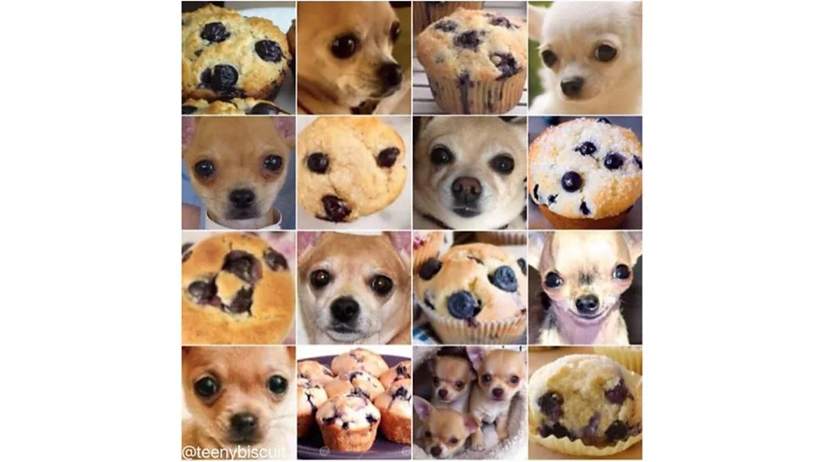
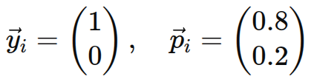
Classification
Goal: Assign input to class
Loss function: Cross-Entropy Loss
ANN prediction:
Example: Chihuahua or muffin?
  2 classes
Chihuahua
[Karen Zack (@TeenyBiscuit)]

Slide 20
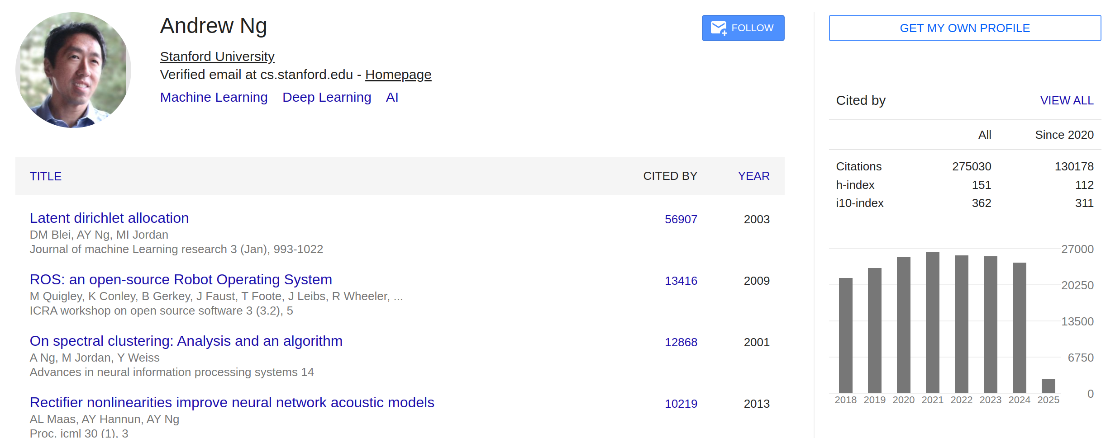
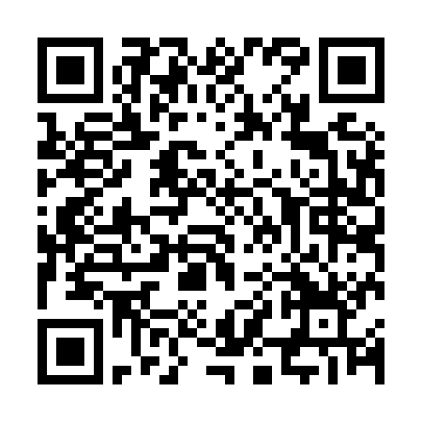
“DeepLearningAI” YouTube channel
Start with “Course 1 of the Deep Learning
Specialization”

Slide 21
Hands-on part

Slide 22
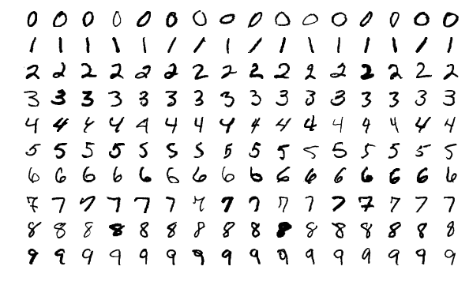
Hands-on example
MNIST
  https://www.kaggle.com/datasets/scolianni/mnistasjpg
https://upload.wikimedia.org/wikipedia/commons/2/27/MnistExamples.png

Slide 24
(Feedforward)
Artificial neural networks
[https://upload.wikimedia.org/wikipedia/commons/2/2f/Example_of_a_deep_neural_network.png]
[https://upload.wikimedia.org/wikipedia/commons/b/b2/MRI_of_Human_Brain.jpg]
...
= Diagnose

