Slide 1
Recitation 2
June 14, 2018

Slide 2
Outline
Announcements
Review Quiz 6
Pointers and memory review
Linked Lists
Classes
Sorting Algorithms
Recursion
Recitation Activity / Survey

Slide 3
Announcements
I’m out of town Saturday - Saturday
Yes, you still have recitation next week
Homework 1 due Saturday 9am
Office Hours over Google Hangouts next week- send me an email or slack if you want to chat

Slide 4
Quiz 6

Slide 5

Pointers, Addresses, and Variables

Slide 6
Classes
“When new is used to allocate memory for a C++ class object, the object's constructor is called after the memory is allocated.”
Public vs private
Public can be modified outside of the class
Private can only be (directly) modified in the class
Escapsulation
Getters and setters

Slide 7
Insertion Sort
The “natural” way to sort your cards

Slide 8
Bubble Sort

Slide 9
Quick sort
Recursive sorting algorithm
Calls itself

Slide 10
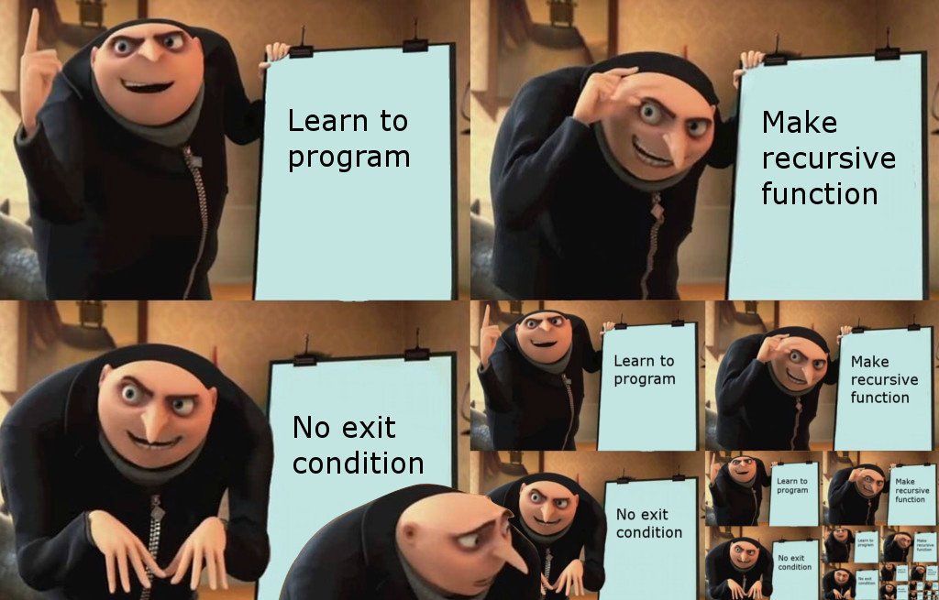
Quick Sort recursion

Slide 11
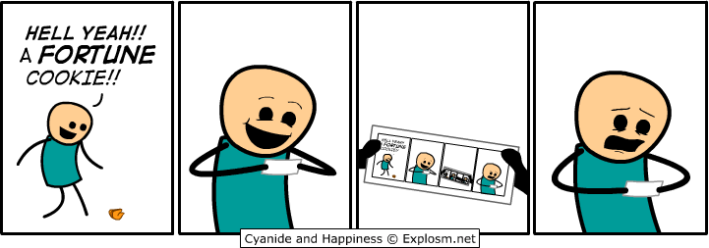
Recursion

Slide 12
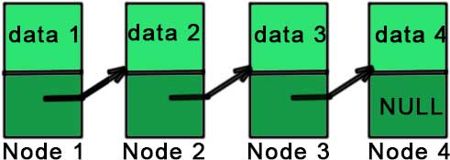
Linked Lists

Slide 13

Linked Lists

Slide 14
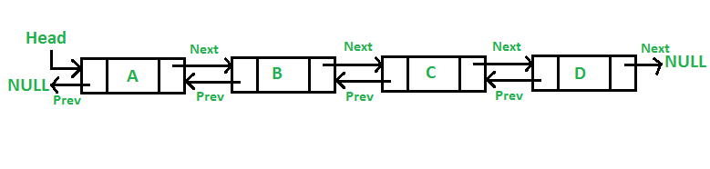
(Doubly) Linked Lists

Slide 15
Quiz Password
IHOb

