Slide 1
Recitation 3
June 21, 2018

Slide 2
Outline
Announcements
Linked Lists
Stacks/queues
Binary trees
Binary search trees
Recitation Quiz

Slide 3
Announcements
When submitting homework, please have your name in the filename and in a comment at the top of the file.
Ex: JessieFinAssignment2.cpp
Makes it easier for me to make sure I’m not crazy

Slide 4
Linked lists
Switch to driving (DON’T MAKE ADAM DRIVE)
Goal: Create and insert new node in the middle of the list

Slide 5
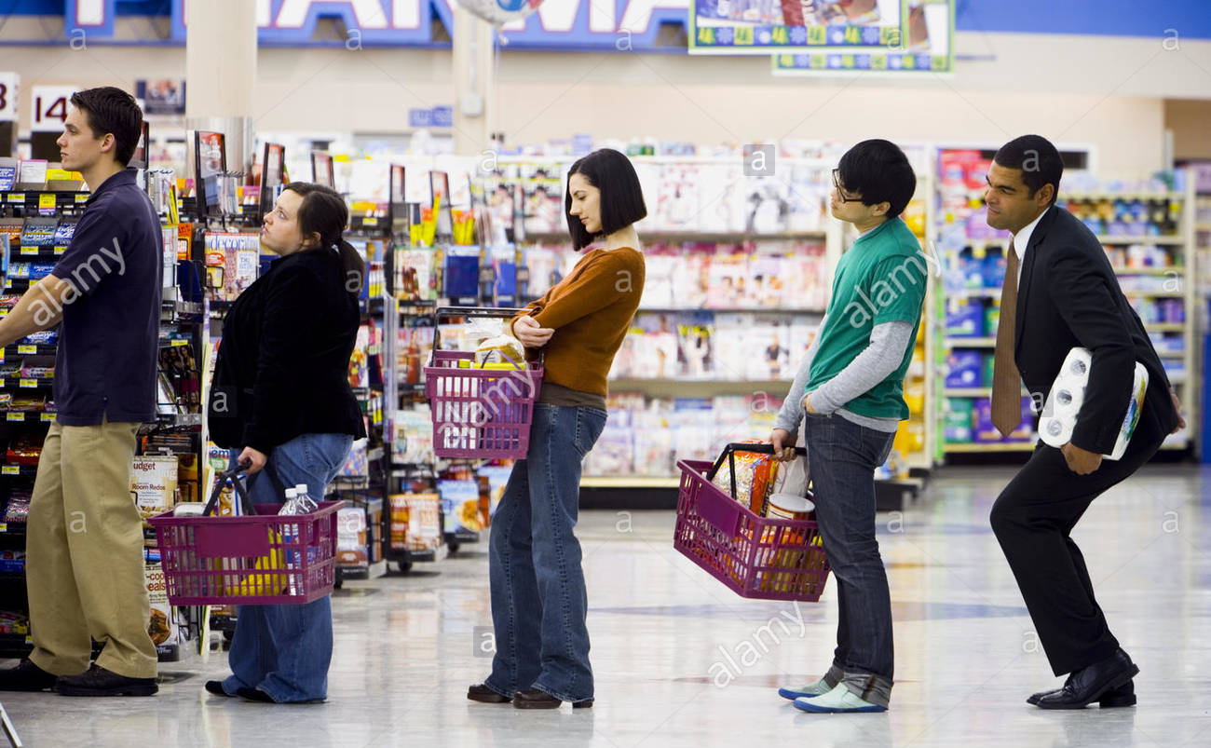
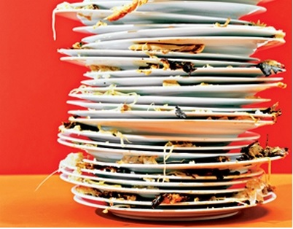
Stacks and queues
Stack
LIFO (Last in, first out)
Example: Cleaning plates in a cafeteria.
Queue
FIFO (First in, first out)
Example: Line at the grocery store

Slide 6
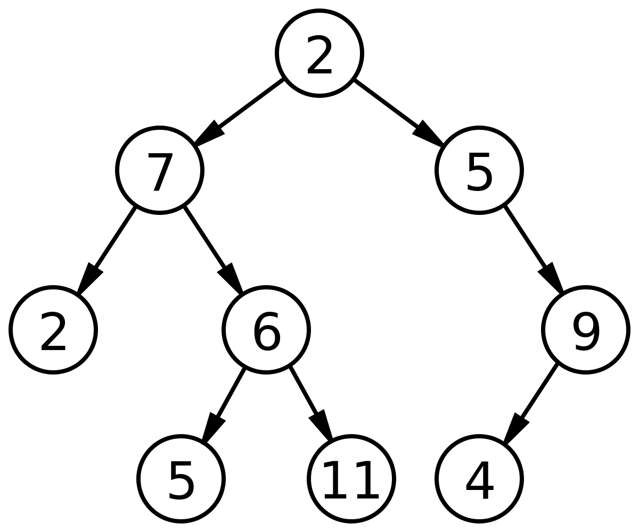
Binary (Search) Trees
Binary = (At most) 2 children
Parent has children
Balanced vs unbalanced

Slide 7
Quiz Password
CrackerBarrel

