Slide 1
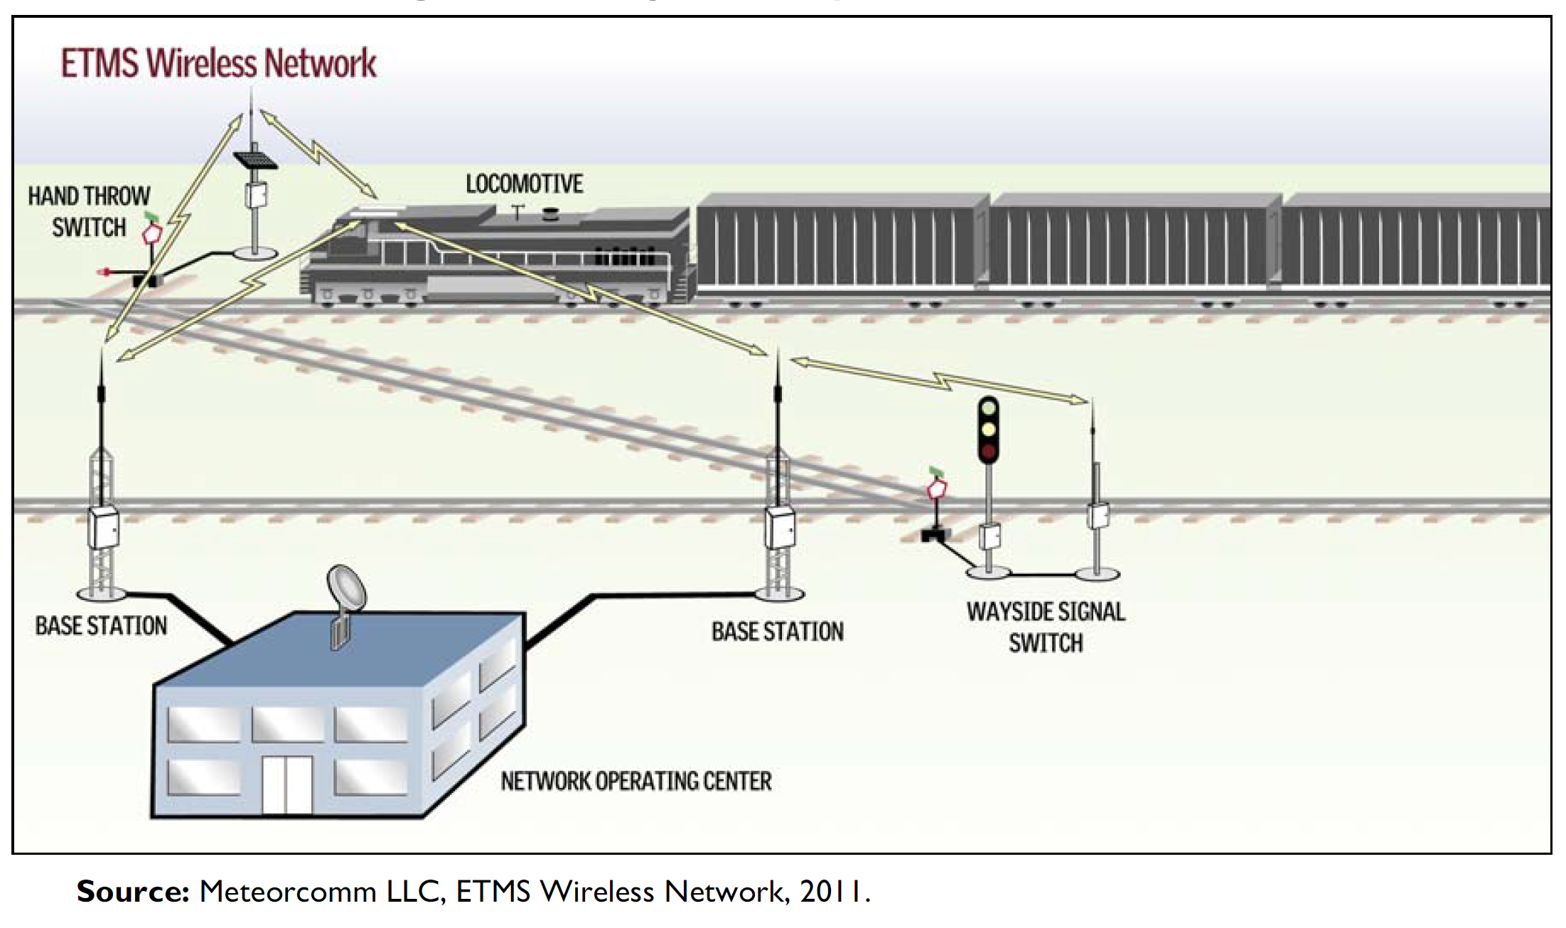
Positive Train Control (PTC)
Image Source: Peters, 2012
Notes:
PTC had been on the “Most-Wanted” list from the previous Railway regulating body, the NTSB, from 1990 until the enactment of the RSA in 2008 which mandated that PTC be installed on nearly 60,000 miles of track by end of Calendar year 2015 (Peters, 2012). PTC is defined in federal law as a “system designed to prevent train-to-train collisions, overspeed derailments, incursions into established work zone limits, and the movement of a train through a switch left in the wrong position” (Peters 2012). While the federal government has no legislation regarding technical implementation, most railways utilize embedded sensors in the track which send information via analog radio signals to the train operators to inform them of upcoming signals and circumstances, and the PTC system can then override the train engineer in the event of human error (Peters, 2012).
Between 1996 and 2015, 19 accidents were determined to be preventable using PTC technology. These accidents resulted in 84 deaths, 1,307 injuries, and millions of dollars in damages (Khashe et al, 2019). While PTC cannot prevent all failures, it provides a “critical redundancy” (Khashe et al, 2019), and there is the potential to expand PTC capabilities in the future (Peters 2012). By quantifying not only the effectiveness of the PTC implementation, but the patterns of accidents that it is and is not associated with preventing, a clearer picture can be drawn of what can be done to further improve the safety of railway systems.

Slide 2
What affect has PTC had on railroad accidents since their installation?
Can a predictive model be generated to identify accidents which could have been prevented using PTC to proactively address high-risk conditions and situations?

Slide 3
Data Overview
Data over time
42,551,002 non-empty data points in total
186 attributes
436541 records
PTC vs Non-PTC

Slide 4
Data Cleaning
Correct for inconsistent encoding
Address missing values for each attribute
Tools
Pandas functions to identify and fill null attributes
Evaluate unique encodings using pandas, re-encode with sklearn if needed, if performance is slow consider one hot encoding

Slide 5
Data Integration
Detailed accident reports?
Tools?

Slide 6
Data Reduction
Some domain “expert” choices – minor vs major
Tools?

Slide 7
Data Transformation
Generate plots for each attribute
Are any attributes noisy?
Should they be smoothed or normalized or discretized?
Concept Hierarchy Generation
Tools?

Slide 8
Evaluation
Frequent itemset generation FIG to identify frequent patterns associated with PTC vs Non-PTC accidents
Support, confidence, lift
Random forest RI for non-black-box identification of conditions which could lead to an accident preventable by PTC, and ones which require further intervention
80-20 sampling split without replacement
In tandem with bagging
Will also handle attribute selection
Accuracy, sensitivity, precision, specificity, F1, Fb
Generating an if-then rule-base model from decision trees
Rule pruning

Slide 9
References

Slide 10
Questions / TODO:
Add slide highlighting recent tragedy?
Add news articles to bibliography
Add summary graphs of accidents over time and Accidents since 2016 with and without PTC

