Slide 1
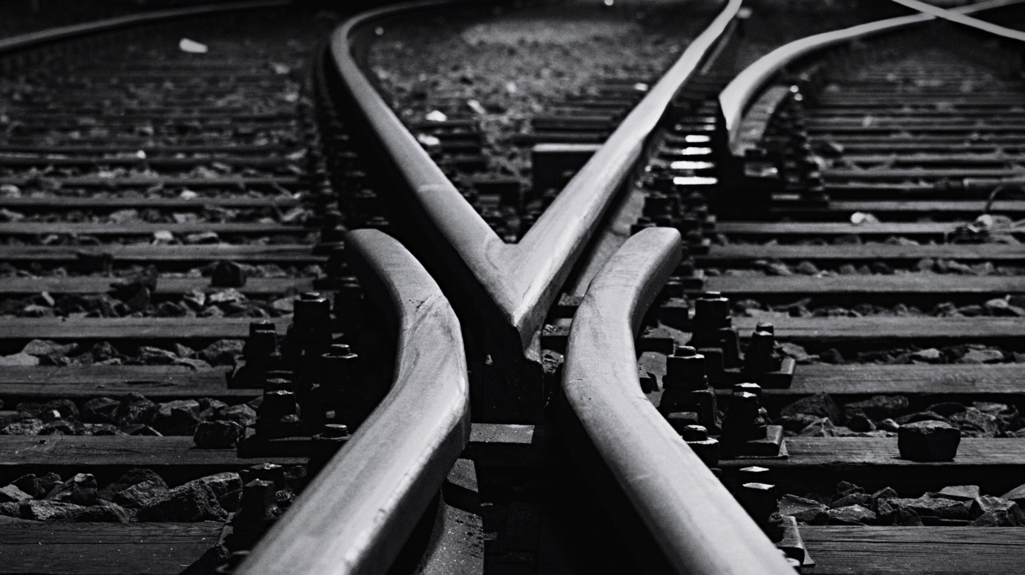
Analysis of the Effects of Regulation on Railroad Safety
Kai Liao, Katrina Siegfried, Andrew smith – Group 17

Slide 2
Project Description
Accidents at highway-railroad intersections cause tremendous losses of lives and resources. This project aims to consider the impacts of new regulations, locations of intersections, and the characteristics/topography of intersections to determine which features promote safety and which features do not.
Effects of Positive Train Control (PTC) Regulation
Accident Analysis by Location
Effects of Intersection Characteristics

Slide 3
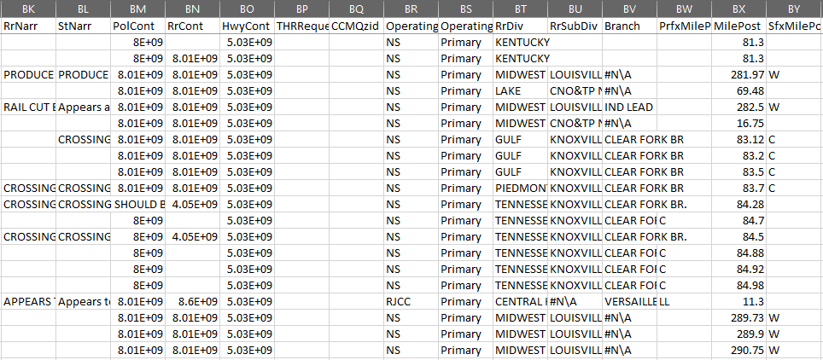
Proposed Work
Data Cleaning:
Correct spelling in narratives, make all letters capital.
Ensure all attributes don’t have duplicate items representing the same thing
Address missing values for each attribute

Slide 4
Proposed Work (cont.)
Data Preprocessing:
PTC implementation:
Data reduction using domain “expert” selections.
Data transformation by selectively smoothing, normalizing, discretizing data as needed; concept hierarchy generation to mine at different abstraction values; vertical format for FP-growth; one-hot encoding.
Crossing Location:
Fill in blanks with identical placeholders or inferred data
Verify identical formatting for all nominal values and choose relevant orders for ordinal values.
Crossing Characteristics:
Specify crossing characteristic attributes as necessary attributes to compare to.
Remove irrelevant administrative and reserved attributes.

Slide 5
Tools to Use
Tools:
Python toolboxes
pandas: data cleaning
numpy: data transformation
sklearn: fix encoding if needed (one-hot), test-train split, random forest
pyspark: fp-growth
Methods:
Decision Trees
FP-Growth
K-means Clustering
Notes:
Anyone

Slide 6
Evaluation
Method | Details | Evaluation
Decision Tree | Random Forest RI with bagging, will also help with attribute selection, use to generate if-then rule based model | 80-20 train/test split, sampling without replacement; accuracy, sensitivity, precision, specificity, F1, Fb
FP-Growth | Explore vertical format to expedite itemset generation; rule pruning | Support, lift, confidence, Χ2, Kulczynski measure, cosine; final selection of measure dependent on performance on data
K-Means Clustering | Cluster by temperature and weather, plot clustered points by latitude and longitude for visualization | Inter- and Intra- cluster similarity measured using silhouette coefficient
Notes:
Katrina

Slide 7
FP Growth Tools
Investigate frequent patterns and investigate if they do or do not shed insight on accident characteristics associated with incidents
Python
Pandas
Pyspark
Notes:
Anyone

Slide 8
FP Growth Method
Clean
Remove redundant columns
Handle null values
Transcode
One-hot encoding
FPGrowth
Test/Train Split
Find Frequent Patterns
Index strings
Notes:
Anyone

Slide 9
FP Growth Results
Support: Lift: Confidence:
[Insert sample itemsets here]
[Insert sample itemsets here]
[Insert sample itemsets here]
[Insert sample itemsets here]
[Insert sample itemsets here]
[Insert sample itemsets here]
Notes:
Anyone

Slide 10
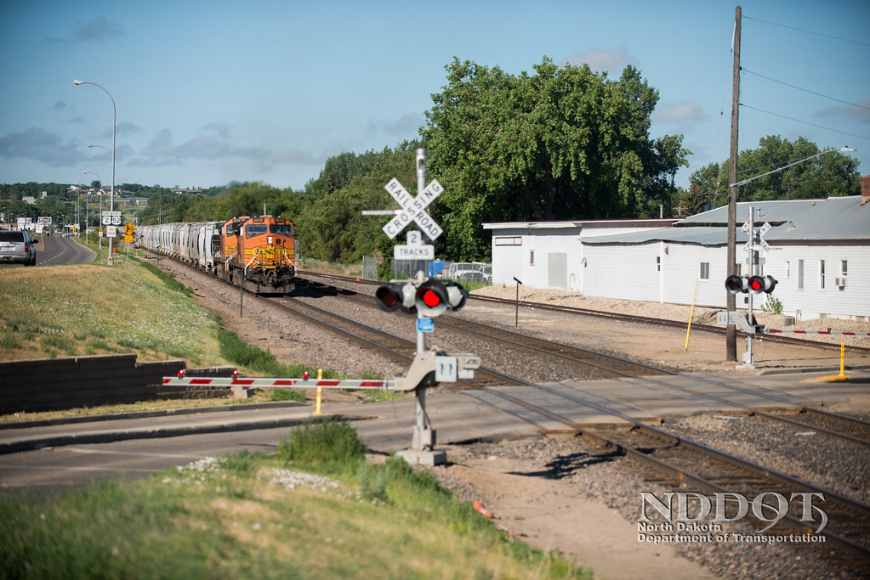
Intersection Characteristics
How do the characteristics of an intersection effect the severity of incidents between railroads and highways?
Method:
Decision Tree Classification
Notes:
Anyone

Slide 11
Decision Tree Methods
Clean
Remove null and unknown values
Consolidate duplicate values
Preprocess
Perform One-Hot encoding
Classify
Test/train split
Develop decision trees
Separate target variable
Notes:
Anyone

Slide 12
Intersection Classification Tools
The Python Pandas library was used to manipulate data frames for cleaning and preprocessing. The sklearn library is used to perform one-hot encoding, decision tree classification, and classification scoring.
python
pandas
sklearn
Notes:
Anyone

Slide 13
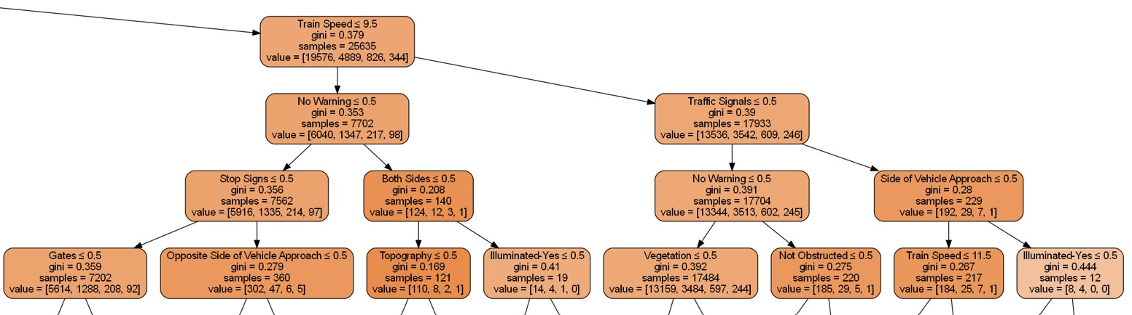
Intersection Classification Decision Tree
Notes:
Anyone

Slide 14
Intersection Classification Results
Injuries | Precision | Recall | F1-Score | Support
0 | 0.7278 | 0.9763 | 0.8339 | 34824
1 | 0.2374 | 0.0244 | 0.0443 | 10205
2 | 0.0598 | 0.0035 | 0.0066 | 1994
3+ | 0.0244 | 0.0011 | 0.0021 | 898
Accuracy: 0.7148
Notes:
Anyone

Slide 15
Intersection Classification Application
Prediction
Regulation
Innovation
How many injuries can be expected at an accident for a given intersection?
What characteristics appear to be driving increased number of injuries from accidents?
What intersection characteristics can be improved upon to decrease the number of injuries experienced?
Model Developed
Statistical analysis needed
Expert opinion needed
Notes:
Anyone

Slide 16
K-Means Locational Clustering Methods
Clean
Coerce invalid values to null
Remove null values
Calculate Coordinates
Lookup centroid coordinates by county FIPS code
Split coordinates and attach to crash data
Cluster
Cluster data using temperature and weather
Plot clustered points by latitude and longitude
Notes:
Anyone

Slide 17
K-Means Locational Clustering Tools
Three python libraries were used. The pandas library was used to manipulate data frames for cleaning and preprocessing. The sklearn library was used to perform K-means clustering. The matplotlib library was used for visualization.
pandas
sklearn
matplotlib
Notes:
Anyone

Slide 18
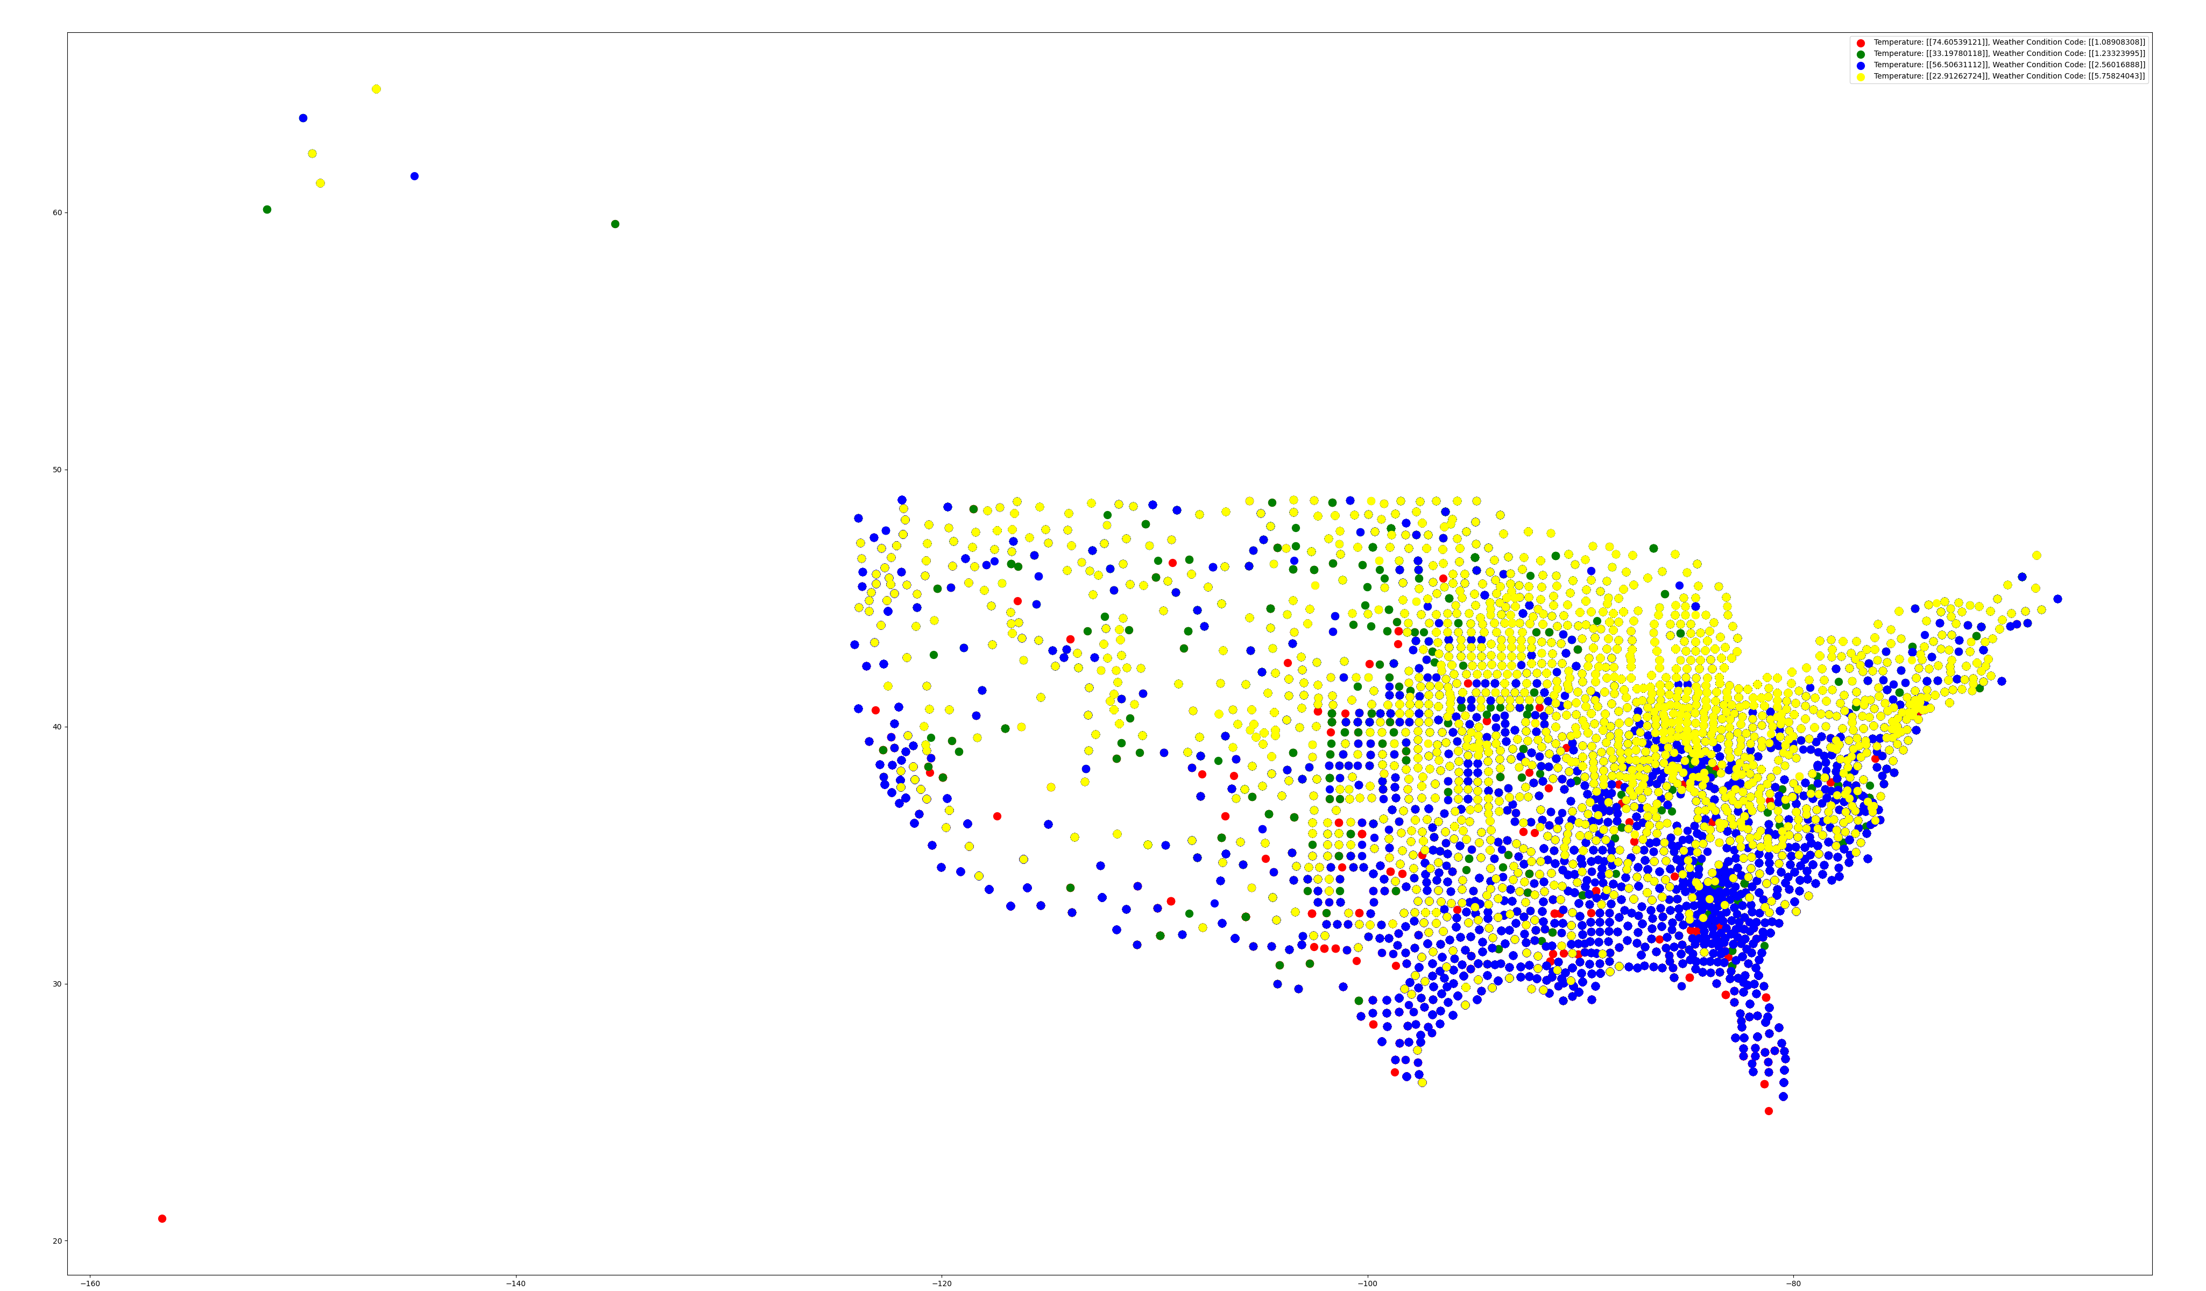
K-Means Locational Clusters
Notes:
Anyone

Slide 19
K-Means Locational Clusters Application
Freezing Snow
Northern states may need to focus on accident mitigation in blizzards
Cold Rain
Southern states may need to focus on accident mitigation in rainstorms
Clear Weather
Inclement weather, rather than clear weather, represents the largest percentage of crashes and may be a large contributing factor
Notes:
Anyone

