Slide 1
iSanta
Jack, Eric, Alex, and Andrew

Slide 2
Architecture
Using view controllers to encapsulate functionality
Need “engines” for major tasks
Image recognition
Image normalization
Exporting report to Excel
Algorithm choices are limited by processing power of an iPhone
Used iOS MVC design patterns
Notes:
Talk about each engine (why we have it, etc.)
Will talk about algorithms later
MVC = model view controller
The idea is pretty straight forward. We use views to navigate the user through the control flow. Each view will have a specific function such as inputing data or rearranging bullet points. Most of the work, however will be run in the background. For larger tasks we are implementing “engines” which will be passed the necessary data to run in the basckground.

Slide 3
Flow Diagram
Notes:
High-level flow for clients (how it’s used)
The basic gist is that This is the views the user sees and all of the posible paths that the user can follow.
We use this guide to make the storyboard flow which has become our prototype and will lead to our app.

Slide 4
Data Storage
2 Options
Serializable classes and custom I/O
A more open design
Requires more work
CoreData with SQLite
Built into iOS
Faster
Less work on our part
Restricted to how CoreData works
Not a full database
Notes:
Serializing data means a lot more overhead (code and runtime) verses CoreData

Slide 5
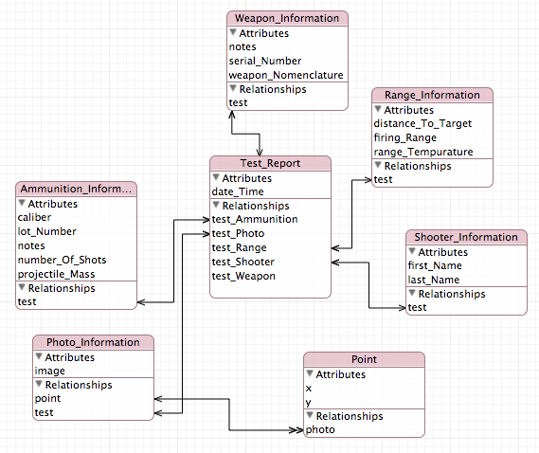
CoreData Model

Slide 6
Algorithms (change slide)

Slide 7
Algorithms (change slide)

Slide 8
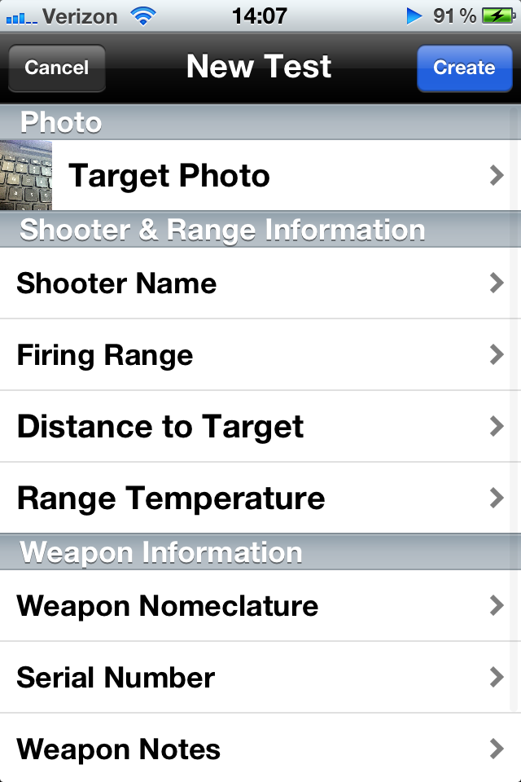

Demo

