Slide 1
iSanta
Jack, Eric, Alex, and Andrew

Slide 2
Architecture
Using view controllers to encapsulate functionality
Need “engines” for major tasks
Image recognition
Image normalization
Exporting report to Excel
Algorithm choices are limited by processing power of an iPhone
Used iOS MVC design patterns
Notes:
Talk about each engine (why we have it, etc.)
Will talk about algorithms later

Slide 3
Flow Diagram
Notes:
High-level flow for clients (how it’s used)

Slide 4
Data Storage
2 Options
Serializable classes and custom I/O
A more open design
Requires more work
CoreData with SQLite
Built into iOS
Faster
Less work on our part
Restricted to how CoreData works
Not a full database
Notes:
Serializing data means a lot more overhead (code and runtime) verses CoreData

Slide 5
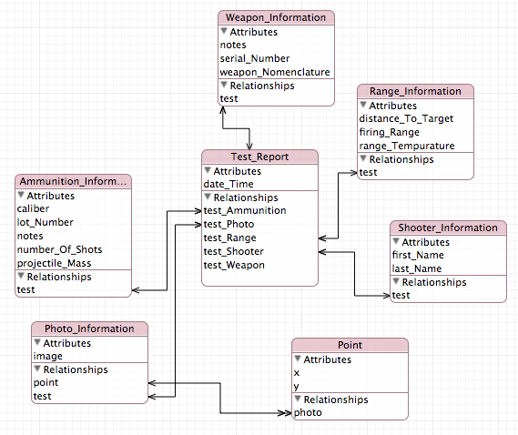
CoreData Model

Slide 6
Algorithms (change slide)

Slide 7
Algorithms (change slide)

Slide 8
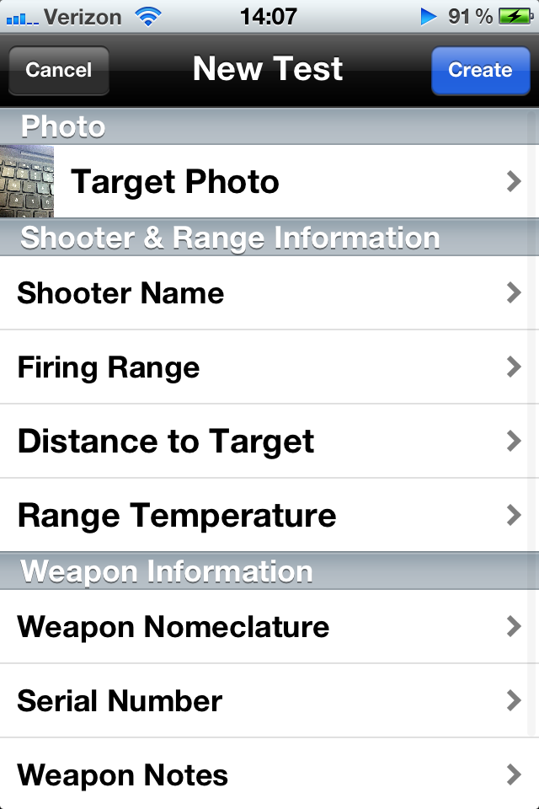

Demo

