Slide 1
iSanta
Jack, Eric, Alex, and Andrew

Slide 2
Architecture
Using view controllers to encapsulate functionality
Need “engines” for major tasks
Image recognition
Image normalization
Exporting report to Excel
Algorithm choices are limited by processing power of an iPhone
Used iOS MVC design patterns
Notes:
Talk about each engine (why we have it, etc.)
Will talk about algorithms later
MVC = model view controller
The idea is pretty straight forward. We use views to navigate the user through the control flow. Each view will have a specific function such as inputing data or rearranging bullet points. Most of the work, however will be run in the background. For larger tasks we are implementing “engines” which will be passed the necessary data to run in the basckground.

Slide 3
Flow Diagram
Notes:
High-level flow for clients (how it’s used)
The basic gist is that This is the views the user sees and all of the posible paths that the user can follow.
We use this guide to make the storyboard flow which has become our prototype and will lead to our app.

Slide 4
Data Storage
2 Options
Serializable classes and custom I/O
A more open design
Requires more work
CoreData with SQLite
Built into iOS
Faster
Less work on our part
Restricted to how CoreData works
Not a full database
Notes:
Serializing data means a lot more overhead (code and runtime) verses CoreData

Slide 5
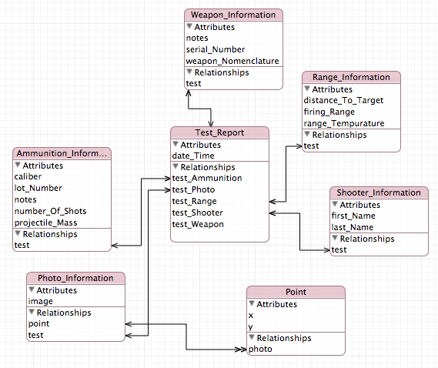
CoreData Model

Slide 6
Image Recognition
Transform angled photo to flat—simple matrix transform
Currently using Laplacian of Gaussian to find dots
Make the image grayscale, then find regions with abnormally low areas of light
Check to see if they’re dot-shaped.
Investigating Lindberg’s algorithm for more robust blob recognition, from “Discrete Scale-Space Theory and the Scale-Space Primal Sketch”

Slide 7
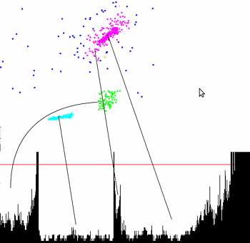
Statistics
Chi-squared for single-cluster analysis
Linearity unimportant
OPTICS to find multiple clusters
Potential for time-based linear regressions on
users’ progress over time

Slide 8
Exporting to Excel
Client wants to be able to view a report in Excel
Would prefer embedded target image, but is flexible
Currently looking at 2 possibilities
.xls binary format (Excel 2003 and below)
Still looking for a viable library
May allow for embedding of image
Office XML format
Cannot embed image
Can be created using plain text
No library needed
Notes:
Report would be attached to e-mail
if separate image, would be attached to same message
CSV also an option, but doesn’t allow for formatting
Not sure what version of Excel client would be using
.xls and Office XML have been supported for a while
Should probably avoid .xlsx (2007 and above format)

Slide 9
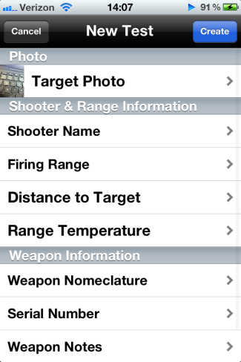

Demo

