Slide 1
Final takeaways
StarCraft II Outcome Prediction
v3_1_fixed remains at least as strong as v3_2_combatfix at final scale
RF + no_counter and XGB + full features finish essentially tied
RF is slightly stronger for classification; XGB is slightly stronger for calibrated probability estimates
The deep model is competitive but does not surpass the tabular finalists
A rigorous project narrative from dataset construction to calibrated final model selection
Replay snapshots transformed into a full tabular prediction dataset
Group-aware multi-seed evaluation on full data
Head-to-head comparison of Random Forest, XGBoost, and a deep challenger
Final recommendations separated by classification vs probability quality
Final recommendation (classification): RF + v3_1_fixed + no_counter
Final recommendation (probability quality): XGB + v3_1_fixed + full
Final project analysis · slide 1

Slide 2
Project framing
SC2 outcome prediction
Goal: predict the winner from replay snapshots and identify which conclusions remain stable under full-scale evaluation.
Research question
What had to be resolved
End-state of the project
Can tabular game-state snapshots predict the final match winner early and reliably?
Which model family is strongest once evaluation is replay-aware and multi-seed?
Potential leakage from multiple snapshots of the same replay
Changing conclusions between small staged subsets and full data
Need to judge both classification quality and probability quality
Two tabular finalists: Random Forest and XGBoost
One full-data deep challenger
Final recommendation split by use case: classification vs calibrated probabilities
Main discoveries after completing the project
The final full-data comparison does not support a strong advantage for v3_2_combatfix over v3_1_fixed.
Random Forest and XGBoost end essentially tied, but with different strengths: RF is slightly better as a classifier, XGB is slightly better as a probability model.
The best Random Forest profile excludes counter features, which turned out not to be necessary for the strongest final RF result.
Final project analysis · slide 2

Slide 3
Dataset construction pipeline
SC2 outcome prediction
The final dataset is built from replay archives through a deterministic replay-to-snapshot pipeline.
Raw replay corpus
Replay parsing + Eligibility filtering
Snapshot builder
Feature matrix
Final variants
71 replaypacks
24,057 replays
Load replay and events,
apply min/max duration
constraints, retain usable corpus
Create time-indexed rows with labels and replay IDs
Economy, combat, scouting, composition, trend features
v3_1_fixed and v3_2_combatfix
Final dataset size
Final dataset variants
Why snapshot rows matter
v3_1_fixed: final stable reference dataset
v3_2_combatfix: alternative variant with combat-related adjustments
They allow time-sensitive prediction rather than only one final label per replay.
They also force replay-aware splitting: rows from the same match cannot leak across train and test.
892,047 rows
23,241 eligible replays
Raw corpus: 71 replaypacks / 24,057 replays. After replay parsing and eligibility filtering, 23,241 replays remain for snapshot extraction.
Final project analysis · slide 3

Slide 4
Experimental protocol and data splits
SC2 outcome prediction
All final claims are based on replay-aware multi-seed evaluation.
Replay-aware protocol
Why this protocol is necessary
Split at replay level: all snapshots of a replay stay in one split
Full comparison uses three seeds: 42, 43, 44
Validation is used for model selection; test is used once for final evaluation
• Snapshot rows from the same replay are highly correlated.
• A row-level random split would overestimate performance.
• The multi-seed setup tells us whether a conclusion survives different train/validation/test assignments.
From staged exploration to final benchmark
Small staged subsets were used for debugging, model screening, and profile selection.
The final verdict was deliberately postponed until the full multi-seed comparison was complete.
Final project analysis · slide 4

Slide 5
Feature families and model inputs
SC2 outcome prediction
The project mixes state variables, derived ratios, and temporal signals extracted from the replay snapshots.
Economy
Combat
Scouting
Income, workers, resources, supply ratios
Army supply, combat score, force composition
Observed information and asymmetry cues
Composition
Temporal trends
Counter / losses
Diversity, entropy, and unit mix balance
15s deltas, 60s/120s trend or volatility signals
Handcrafted counters and recent-loss style features
Key design question
Which feature families still matter once the models are evaluated on full replay-aware multi-seed splits? A central finding is that the counter family is not required by the strongest final RF pipeline.
Final project analysis · slide 5

Slide 6
Models considered and what each one tests
SC2 outcome prediction
Each model family answers a different question about the structure of the problem.
Model family
Role in the project
Interpretation
Logistic Regression
Linear baseline
Measures how much signal is already linearly separable
Random Forest
Tree ensemble finalist
Robust classifier; easiest model to analyze by feature family
XGBoost
Boosted-tree finalist
Strong probability model with excellent log-loss behavior
Deep MLP
Final challenger
Tests whether a flexible neural model can beat strong tabular baselines
Final tabular finalists
Why keep the deep model
Metrics used at the end
Random Forest with profile no_counter
XGBoost with the full feature set
To test whether a flexible non-linear model can exploit structure missed by tabular ensembles
To ensure the final conclusion is not an artifact of comparing only tree models
Accuracy and balanced accuracy for classification performance
ROC-AUC for ranking ability
Log loss, Brier score, ECE and MCE for probability quality
Final project analysis · slide 6

Slide 7
Staged screening before the full benchmark
SC2 outcome prediction
Early experiments were used to narrow the search space before committing to full-data evaluation.
Smoke200
Smoke500
Smoke1500
Smoke3000
Smoke6000
Full
debug
and sanity
first
comparison
first
leaderboard
profile
stability
stress test
for finalists
final
verdict
What changed between staged and full results
What remained stable
Methodological lesson
At smaller scales, v3_2_combatfix appeared promising.
Some staged comparisons also suggested a clearer XGB advantage.
The final full multi-seed comparison substantially narrowed those gaps.
Replay-aware splitting mattered from the beginning.
RF remained very strong throughout the project.
The RF profile no_counter kept outperforming RF full in the larger staged runs.
Staged subsets are useful for screening, not for the final story.
The project outcome only became trustworthy after the full multi-seed runs.
Final project analysis · slide 7

Slide 8
RF profile study: why no_counter became the final RF choice
SC2 outcome prediction
The key RF question was whether handcrafted counter features actually help once the evaluation is stable.
What the profile study shows
Final RF interpretation
On both dataset variants, removing counter features improved or preserved RF performance.
The no_counter profile then survived the transition from staged subsets to the final full benchmark.
Counter features were not required by the strongest RF pipeline.
The best final RF model is therefore both stronger and simpler: RF + no_counter.
Final project analysis · slide 8

Slide 9
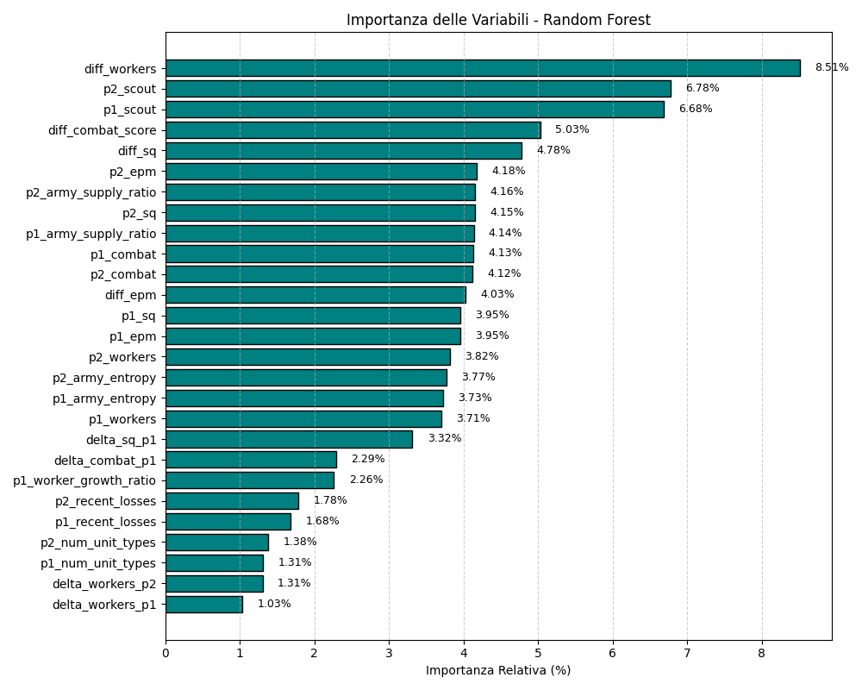
What the strongest RF model appears to learn
SC2 outcome prediction
Feature-importance patterns align the final RF model with economy, scouting, and state stability rather than with counter heuristics.
Stable top RF features across seeds
Interpretation
Economy and scouting features repeatedly appear near the top of the RF ranking.
Signals related to composition and 120-second volatility also recur.
This matches the final profile study: the strongest RF relies on broad game-state signals rather than on explicit counter features.
Takeaway
The strongest RF result is not “more handcrafted knowledge wins”; it is “the right subset of broad signals wins.”
Final project analysis · slide 9

Slide 10
Final full multi-seed benchmark
SC2 outcome prediction
Three replay-aware seeds (42, 43, 44) on the two final dataset variants.
Dataset
Model
Profile
Accuracy
Balanced Acc.
ROC-AUC
Log loss
v3_1_fixed
RF
no_counter
0.6133 ± 0.0055
0.6111 ± 0.0051
0.6605 ± 0.0055
0.6503 ± 0.0023
v3_1_fixed
XGB
full
0.6128 ± 0.0054
0.6093 ± 0.0049
0.6601 ± 0.0048
0.6484 ± 0.0025
v3_2_combatfix
RF
no_counter
0.6128 ± 0.0052
0.6107 ± 0.0048
0.6603 ± 0.0057
0.6504 ± 0.0024
v3_2_combatfix
XGB
full
0.6128 ± 0.0069
0.6093 ± 0.0062
0.6597 ± 0.0059
0.6486 ± 0.0030
What is clearly stable
What this means for the story
RF and XGB finish extremely close on both datasets.
v3_1_fixed is at least as strong as v3_2_combatfix in the final regime.
The final benchmark is more nuanced than the earlier staged experiments.
There is no dominant winner: the project ends with two co-finalist tabular models.
Final project analysis · slide 10

Slide 11
Classification-oriented comparison: RF and XGB are nearly tied
SC2 outcome prediction
The differences are real but very small, which is why the full multi-seed protocol matters.
Interpretation: RF holds a slight edge on the classification metrics, but the margin is small enough that the project should treat RF and XGB as co-finalists rather than a clear first and second place.
Final project analysis · slide 11

Slide 12
Probability quality and dataset versioning
SC2 outcome prediction
The full-scale results change the interpretation that emerged during smaller staged runs.
Dataset-version conclusion
Earlier staged experiments suggested v3_2_combatfix might be stronger.
The full multi-seed benchmark does not confirm a clear advantage for v3_2_combatfix.
At final scale, v3_1_fixed is at least as strong and in several comparisons slightly better.
Why this matters
The project does not simply report the most optimistic intermediate result.
It waits for the full benchmark and then updates the story when the final evidence says the staged narrative was too strong.
This is one of the main methodological gains of the project: conclusions are tied to the highest-quality evidence, not to the earliest promising result.
Final project analysis · slide 12

Slide 13
Deep challenger: serious, competitive, but not winning
SC2 outcome prediction
The deep model was evaluated on the same full-data protocol rather than as a toy add-on.
Deep protocol
Full v3_1_fixed only
Replay-aware seeds 42/43/44
Candidate selection on validation
Test used once after model selection
Interpretation
The deep model is not a failed branch; it reaches the same performance neighborhood as RF and XGB.
However, it remains slightly below both tabular finalists on the final full-data comparison.
Therefore, the right role for the deep result is “credible challenger,” not “final winner.”
Final project analysis · slide 13

Slide 14
Rigorous calibration protocol
SC2 outcome prediction
Post-hoc calibration was treated as a proper validation-to-test experiment, not as a descriptive afterthought.
1
2
3
4
Uncalibrated test probabilities
Fit calibrator on validation predictions only
Apply calibrator to untouched test predictions
Compare uncalibrated vs Platt vs isotonic
Why this matters
Using the test set to fit a calibrator would artificially inflate the apparent quality of the probabilities.
The protocol used here makes calibration a real held-out evaluation and allows a fair comparison between RF and XGB.
Final project analysis · slide 14

Slide 15
Calibration results: RF improves, XGB is already strong
SC2 outcome prediction
The final probability comparison is one of the clearest distinctions between the two tabular finalists.
RF after calibration
XGB after calibration
RF benefits clearly from Platt and isotonic calibration.
ECE and MCE improve substantially relative to uncalibrated RF.
XGB is already strong in its uncalibrated form.
Post-hoc calibration does not provide meaningful gains, so uncalibrated XGB remains the best probability-oriented choice.
Final project analysis · slide 15

Slide 16
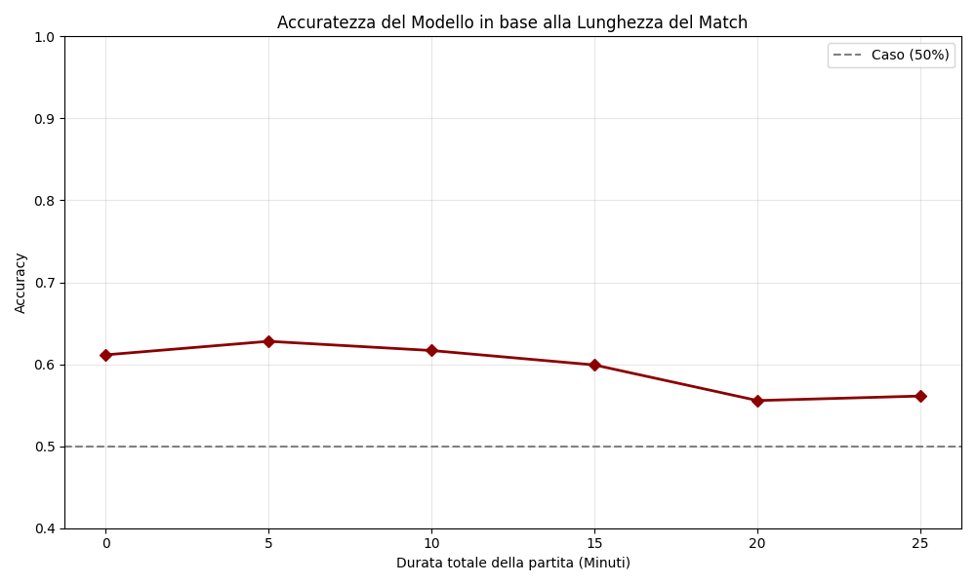
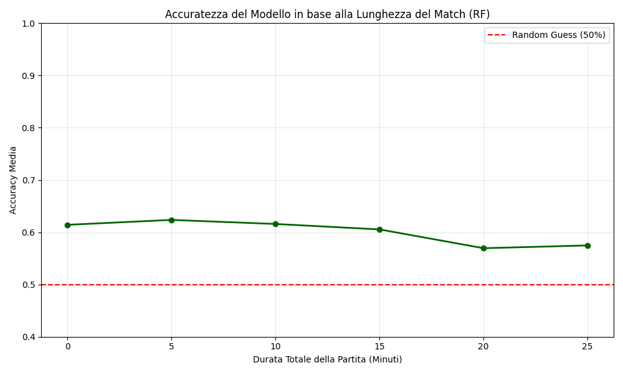
Temporal behavior across match duration
SC2 outcome prediction
The project also checked whether accuracy behaves differently across longer vs shorter games.
Overall accuracy vs match duration
RF-specific duration curve
Final project analysis · slide 16

Slide 17
Final recommendations
SC2 outcome prediction
The project ends with two defensible winners, depending on what the downstream use actually needs.
Classification-oriented recommendation
Probability-oriented recommendation
Random Forest + v3_1_fixed + no_counter
XGBoost + v3_1_fixed + full features
Slight edge on accuracy, balanced accuracy, and ROC-AUC
Simpler final RF profile because counter features are excluded
Works well if the output is used mainly as a hard winner prediction
Best final log loss and strongest uncalibrated probability quality
Already well calibrated; post-hoc calibration adds little
Best choice if the output is used as a probability rather than only as a label
The key result is not a single absolute winner but a clean and interpretable trade-off between a stronger classifier (RF) and a stronger probability model (XGB).
Final project analysis · slide 17

Slide 18
Closing summary
What the project established
What changed from the early picture
What to say in one sentence
Replay-aware full multi-seed evaluation is essential for trustworthy conclusions.
v3_1_fixed remains at least as strong as v3_2_combatfix at final scale.
RF + no_counter and XGB + full are the two real finalists.
The staged advantage of v3_2_combatfix did not survive the full benchmark.
The apparent clear XGB lead narrowed into a near tie with RF.
Counter features did not survive into the strongest final RF profile.
Use RF if you care most about classification. Use XGB if you care most about calibrated probabilities. The deep model is credible, but not the final winner.
Thank you
Final project analysis · slide 18

