Slide 1
DIY IoT (Internet of Things)
Penguicon 2018
Connie Sieh & Dave Putz

Slide 2
DIY IoT
Goals of this presentation:
Give you a good understanding of IoT devices
Help you on your way to building your own IoT device(s)
Give you some resources to help you get more info

Slide 3
DIY IoT
Agenda
Definition of some terms
Overview of an IoT system
Details on hardware components
Details on software components
Security Issues
Example programming of an IoT device
Available resources

Slide 4
DIY IoT
Why DIY?
“Smart” lights, switches, thermostats, etc. are all commercially available
In the future, even more devices will gain network capabilities
Control
Security
“for the fun of it”
Notes:
By 'doing it yourself' you can make sure that things are doing what you want, and no more. Recent example: Bose wireless headphones were reporting back what was being listened to, and that info sold.

Slide 5
DIY IoT
Definitions
  IoT (Internet of Things)
    Physical objects with network connectivity
    “smart” devices (lights, cars, alarms, etc.)
    Sensors, actuators
    Services and servers communicating with devices
    Estimates of 50 billion devices by 2020
Notes:
Many shades of this definition are possible. For now, we will consider any device that previously may have been stand-alone but now can report and/or respond over a network.

Slide 6
DIY IoT
Definitions
  MCU
    Microcontroller Unit
    Small, generally single-purpose chip
    Most often does not run an Operating System
  MPU
    Microprocessor Unit
    Usually able to multi-process
    Typically will run an Operating System
Notes:
The differences may not be important for a particular application, but you should know what they are in order to make a good choice.

Slide 7
DIY IoT
Overview of an IoT System
  End devices
    Sensors (temperature, movement, light, switches, etc.)
    Actuators (motors, relays, LEDs, etc.)
    Displays (optional)
  Programmable Microprocessor
    Able to “talk” to devices
    Has network connectivity
    Possibly controlled by phone, tablet, etc.
  Network and servers
    Data collection and analysis
    Handling notifications (messaging, emails, etc.)
Notes:
IoT is more than just a single device. It is an entire system made up of various parts. There may be many choices for each of the parts to match the desired application.
Specific examples:
End devices – temperature sensor, light bulb, garage door switch, open window detector
Microprocessor – Arduino, ESP8266, Raspberry Pi, Beaglebone
Network – Wifi, wired ethernet, bluetooth, LaRa radio
Server – local system, Raspberry Pi, cloud

Slide 8
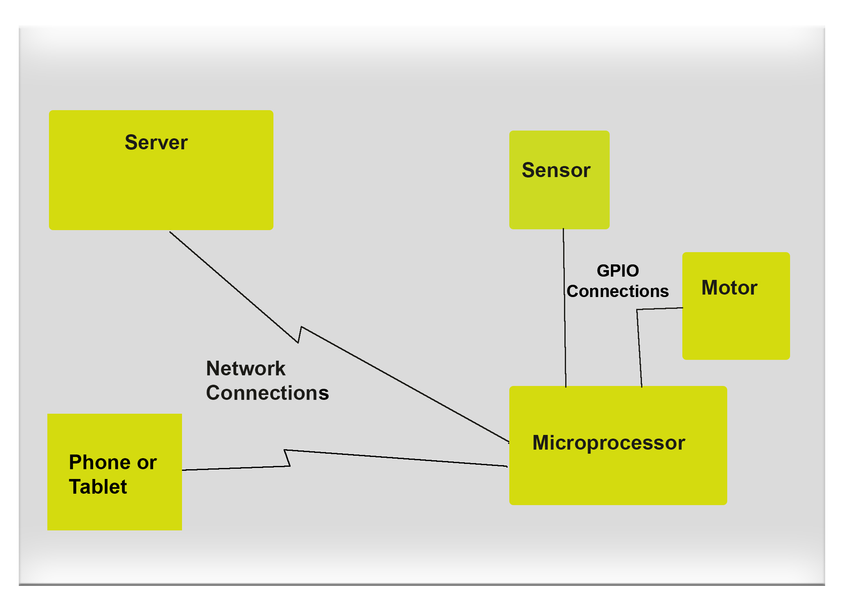
DIY IoT
Graphical Overview of a Typical IoT System
Notes:
Rough block diagram. More complicated examples (such as a complete home security system) would have many more of some pieces. For a complete “DIY” system you will need to consider and/or provide each of these parts.

Slide 9
DIY IoT
Hardware Components
  Processor
    More of an SoC “System on a Chip” than just a CPU
    Programmable
    Quite a few choices available (more on this later)
  Sensors and Actuators
    Sensors report back information about the physical environment
    Actuators (motors, switches, etc.) do something in the physical environment
Notes:
The processor is the 'heart' of the system. Most of your decision on which one(s) to use will be driven by the application, and possibly cost.

Slide 10
DIY IoT
Hardware Components
  Network
    Can be wireless or wired
    Differentiates IoT from previous sensors/actuators
    Various sorts of wireless available
      Internet lists 31 possible IoT networks
      Wifi
      Others requiring a gateway to get to the internet
        Bluetooth/BLE
        LoRa Radio
        ZigBee
Notes:
Network choices can be driven by multiple factors: 1) What does your processor support 2) what kind of reliability do you need 3) Range for wireless 4) Security 5) Speed

Slide 11
DIY IoT
Processor Types (MCU and MPU)
  Many different vendors and varieties available
    Wikipedia lists 32 MCU and 65 MPU makers
    Many vendors offer more than one model
  We will cover the features of just a few models
  Often the biggest single decision when designing an IoT system
Notes:
Trade-offs here include: cost vs. performance, cost vs. features, your familiarity with programming, power comsumption, power requirements, and vendor/communbity support.

Slide 12
DIY IoT
Some Common Processor Types
  MCUs
    Arduino
      Pluses
        Cheap (unless networking/wifi is added)
        Lots of GPIO pins
        Relatively Low Power Required (possible with just batteries)
      Minuses
        No network without adding an additional board (called a shield)
        Fairly slow CPU speed
        May have limited memory for program (sketch)

Slide 13
DIY IoT
Some Common Processor Types
  MCUs
    ESP8266 (Many form factors including NodeMCU)
      Pluses
        Built-in Wifi networking
        Cheap
      Minuses
        Limited number of GPIO pins
        Programming may have to allow for network activity (just 1 CPU))
    ESP32
      Like ESP8266 with more memory & pins, dual core

Slide 14
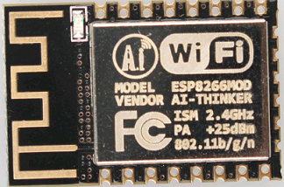
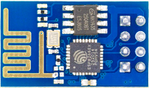
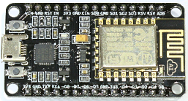
DIY IoT
Some common ESP8266 Form Factors
ESP-01
ESP-12E
NodeMCU

Slide 15
DIY IoT
Processor Types
  MPUs
    Raspberry Pi
      Pluses
        On-board compilers
        Can run other software at the same time
        Very large online community
      Minuses
        Limited numbers of GPIO and other pins
        May be more expensive than an MCU
        Configuring I2C and SPI may be more complex

Slide 16
DIY IoT
Processor Types
  MPUs
    Beagleboard
      Pluses
        More powerful processor
        More GPIO pins, I2C bus pins, PWM
        Linux
      Minuses
        More expensive
    MT7688 by Mediatek (Omega2, Omega2+,SeedStudio Linkit Smart)
      Pluses
        Cheap
        Small
        Linux
        MIPS based architecture
        May be able to avoid soldering
      Minuses
        Less common

Slide 17
DIY IoT
Sensors and Actuators
  Use GPIO (General Purpose Input Output) pins from the CPU
  Various protocols may be supported
    I2C – Can handle multiple devices on one set of 2pins
    UART – Universal Asynch Receive/Transmit
      Serial port, needs two pins (one XMIT, one RCV)
      Not all GPIO pins will support this
    SPI – Serial Peripheral Interface
      Needs 4 pins, likely defined by hardware
    PWM – Pulse Width Modulation
      Needs an analog pin
    Custom Protocols (such as DHT11)
Notes:
Choose external devices in conjunction with your CPU choice(s). Number and type of pins required is going to be a big thing to check. Library availability (to minimize how much programming you need to do) should be looked at as well.

Slide 18
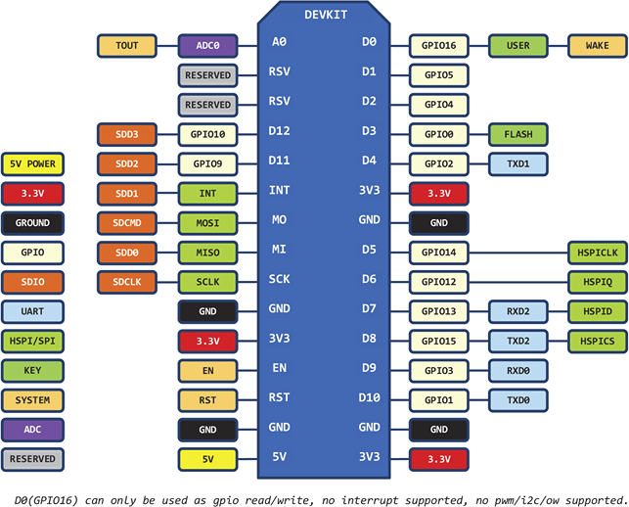
DIY IoT
GPIO Ports matter
  You will need to check the specs for your exact chip
  NodeMCU diagram
Notes:
The diagram is somewhat complex. This indicates how complicated things can get. Note that most pins have several possible connection types. Don't assume you can hook up and given external device to any given pin.

Slide 19
DIY IoT
Some Commercially Available Devices
  Sonoff (https://www.itead.cc/sonoff-wifi-wireless-switch.html)
    Smart switches
    ESP8266 based
    Uses Android/IOS app
    Hackable by soldering pins so can upload new code
  Alexa (http://alexa.amazon.com)
    Voice activated
    Able to interface with many of the smart devices on the market
  Nest thermostats (https://nest.com)
    Use a non-free protocol (wemo)
Notes:
Commercial devices are, in general, not open source. You may be giving up control for ease of use. Expect more and more of these to come on the market. You may be able to repurpose the hardware...example, Eco wifi outlets we picked up from Home Depot.

Slide 20
DIY IoT
Issues when selecting external devices
  Power requirements
    May be 3.3 or 5 volts, may not match your CPU
    May require more current than your board can provide (i.e. could need an external power supply)
  Connectivity
    May require special cables
    May need more GPIO pins than you have available
  Openness
    May have proprietary issues, making it hard to modify to do what you want
Notes:
Power matters a lot. Hooking up wrong voltages or mixing power and gound may well kill your device and/or CPU. Be especially careful when working with mains power (110 AC); mistakes there can cause fires and severe injuries.

Slide 21
DIY IoT
Software Components
  Several languages available
    Arduino IDE uses C/C++
    Micro Python available on more capable processors
    Lua script for ESP boards
    Arduino has some visual block editors available (ArduBlock, Snap4Adruino)
    Processors running their own OS have an even wider choice, both scripting and compiled languages.
Notes:
You may want to tailor your choices to your programming skills (or lack thereof).

Slide 22
DIY IoT
Software Components
  Software is needed external to your IoT device
    Somewhere to send monitor readings
      MQTT broker
      IFTTT (if this then that)
      Flow controller (such as Node-Red)
      Browser client
    Someone to send info that triggers an action to take
      MQTT broker
      Flow controller
      Browser
Notes:
Biggest choice here is whether you want to control the whole system (i.e. a local server you maintain) or trust the cloud. Both have plusses & minuses. Just understand there is no 'magic done here'; someone has to handle the data from your IoT node and/or send control messages to it.

Slide 23
DIY IoT
Definitions
  Message Broker (MQTT)
    Program that handles the queuing up of input messages (publishing) and sending out to interested clients (subscribing)
    Messages are organized by topics, with formats like directory paths (i.e. /myhouse/basement/window/1)
    Several are available, we will be using an Open Source one named mosquitto
    Fairly low overhead, can be run on small systems (such as a Raspberry Pi)
Notes:
IoT is more than just the device; it needs to communicate with something. Message brokers are one very good choice here.

Slide 24
DIY IoT
Software Components
  Protocols
    TCP/IP underlies almost everything you will do
      Have to create or obtain an IP address
      TCP/IP routing matters
    Extensible Messaging and Presence Protocol (XMPP)
    Message Queuing Telemetry Transport (MQTT)
    HTTP
    Advanced Message Queuing Protocol (AMQP)
    Constrained Application Protocol (CoAP)
Notes:
Choice of protocol may be driven by how your design things (i.e. need HTTP to talk to a browser, MQTT to talk to an MQTT broker). In general, you will not have to learn the details of the protocols, as the hardware & libraries will handle most or all of the issues. But, it's good to know what you need to look at if/when things don't work properly.

Slide 25
DIY IoT
Software Components
  Programming IDE (Integrated Development Environment)
    Most common is the Arduino IDE – even for other MCUs
  Frameworks
    May help you get running without doing much (or any) coding
    Several available
      ESPEasy - https://github.com/letscontrolit/ESPEasy
      ESPurna - https://bitbucket.org/xoseperez/espurna
      Espidf - http://docs.platformio.org/en/latest/frameworks/espidf.html
      Tasmota - https://github.com/arendst/Sonoff-Tasmota
Notes:
If you are not comfortable writing code directly you may want to look into a framework. Tradeoff is ease-of-use vs. control.

Slide 26
DIY IoT
Software Components
  Some Additional Elements
    NodeRED
      drag and drop visual flow control, runs on a server (Linux,Windows, Mac)
    IFTTT (If this then that) - https://ifttt.com/
      Create applets to tie services together
    MQTT Brokers
      Mosquitto – easy to set up, runs on a server (Linux, Windows, Mac)
      io.adafruit.com – run by Adafruit, provides a dashboard
Notes:
Flow control programs handle hooking all the bits together. You can make your applications have a consistent interface (i.e. MQTT) and then set up the flow controller to handle who/what to do with the messages.Again, choice here is between pieces you have more control over (mosquitto and Node-RED) vs. ones someone else runs (IFTTT, Adafruit)

Slide 27
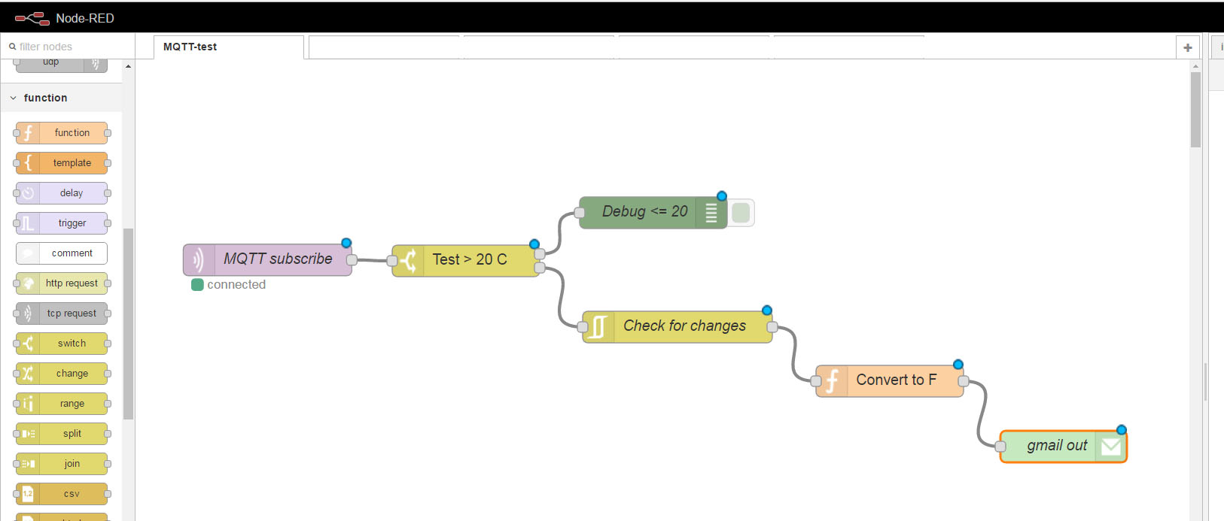
DIY IoT
Example of a Node-RED flow
Notes:
Flow control programs handle hooking all the bits together. You can make your applications have a consistent interface (i.e. MQTT) and then set up the flow controller to handle who/what to do with the messages.Again, choice here is between pieces you have more control over (mosquitto and Node-RED) vs. ones someone else runs (IFTTT, Adafruit)

Slide 28
DIY IoT
Security Issues
  Unencrypted wireless network traffic can be seen by anyone close by
    Do you really want a stranger to be able to open your garage door?
  Default router passwords are known to all the 'bad guys'
  Vendors of commercial IoT devices have been known to be lax when it comes to security
    Google for “IoT lightbulb security” - scary
  Bottom line – don't trust anyone else to make your devices secure
Notes:
Use secure wireless, even for trivial apps. Set up passwords, and guard them. Change passwords on all routers you buy. Every point on a network is a potential entry place for unauthorized access, and IoT adds possibly a lot of these.

Slide 29
DIY IoT
Security Issues
  OTA (Over the air updates)
  Using a DIY IoT system for home security
    Need to consider the monitoring issue
      Commercial vendors are 24x7; you will need to sleep
    You control who sees what
    Several good open source packages available
      ZoneMinder - https://zoneminder.com/
      openhab - https://www.openhab.org/
      Home Assistant - https://home-assistant.io/
Notes:
OTA can be handy if you are going to install a device somewhere that's hard to get to. The current library OTA versions are not considered to be highly secure, however. Improvements have been suggested, but limits on memory& CPU make it hard .

Slide 30
DIY IoT
Example Programming
  Simple ESP8266 program
/*
ESP8266 Blink by Simon Peter
*/
void setup() {
pinMode(LED_BUILTIN, OUTPUT); // Initialize the LED_BUILTIN pin as an output
}
// the loop function runs over and over again forever
void loop() {
digitalWrite(LED_BUILTIN, LOW); // Turn the LED on by making the voltage LOW
delay(1000); // Wait for a second
digitalWrite(LED_BUILTIN, HIGH); // Turn the LED off by making the voltage HIGH
delay(2000); // Wait for two seconds (to demonstrate the active low LED)
}
Notes:
Simple example shows basic outline – setup() and loop()

Slide 31
DIY IoT
Example Programming
  Simple ESP8266 program with networking
#include <ESP8266WiFi.h>
#include <WiFiClient.h>
#include <ESP8266WebServer.h>
const char* ssid = "........";
const char* password = "........";
ESP8266WebServer server(80);
const int led = 13;
Notes:
Show how incorperating networking adds some code, but not huge amounts. (apache web server has 1.8 Million lines of code). Using password triggers ESP libraries to use encrypted communications.

Slide 32
DIY IoT
Example Programming
  Simple ESP8266 program with networking
void handleRoot() {
digitalWrite(led, 1);
server.send(200, "text/plain", "hello from esp8266!");
digitalWrite(led, 0);
}
Notes:
Simple example for handling a web page request. '200' is the HTTP response code.

Slide 33
DIY IoT
Example Programming
  Simple ESP8266 program with networking
void handleNotFound(){
digitalWrite(led, 1);
String message = "File Not Found\n\n";
message += "URI: ";
message += server.uri();
message += "\n";
for (uint8_t i=0; i<server.args(); i++){
message += " " + server.argName(i) + ": " + server.arg(i) + "\n";
}
server.send(404, "text/plain", message);
digitalWrite(led, 0);
}
Notes:
Simple example for handling an error (client asked for a page we don't recognize). Note how a return message is built up. The '404' is again the HTTP response code.

Slide 34
DIY IoT
Example Programming
  Simple ESP8266 program with networking
void setup(void){
pinMode(led, OUTPUT);
digitalWrite(led, 0);
Serial.begin(115200);
WiFi.begin(ssid, password);
// Wait for connection
while (WiFi.status() != WL_CONNECTED) {
delay(500);
Serial.print(".");
}
Notes:
Setup for networking is pretty simple. Do a Wifibegin() and wait until you get connected.

Slide 35
DIY IoT
Example Programming
  Simple ESP8266 program with networking
Serial.print("Connected to ");
Serial.println(ssid);
Serial.print("IP address: ");
Serial.println(WiFi.localIP());
server.on("/", handleRoot);
server.on("/inline", [ ](){
server.send(200, "text/plain", "this works as well");
});
server.onNotFound(handleNotFound);
server.begin();
Serial.println("HTTP server started");
}
Notes:
Nore that the server.on lines are setting things up so the ESP knows what code to run when a particular web page is requested. Serial.print outputs go out the ESP USB port, so baud rate is set to match the host.

Slide 36
DIY IoT
Example Programming
  Simple ESP8266 program with networking
void loop(void){
server.handleClient();
}
Notes:
Note tha the loop() function only contains a single call, which a library routine. If you are doing a more complex server note that you may need to put in short delay() calls to allow the CPU to handle network traffic.

Slide 37
DIY IoT
To Use ESP8266 in Arduino IDE
Under File->Preferences add
http://arduino.esp8266.com/stable/package_esp8266com_index.json
To “Additional Boards managers URLS”

Slide 38
DIY IoT
Other Resources
  Arduino IDE - https://www.arduino.cc/en/main/software
  ESP8266 Arduino reference doc
    http://esp8266.github.io/Arduino/versions/2.3.0/
  Mosquitto MQTT broker - https://mosquitto.org/download/
  Node-RED flow manager - https://nodered.org
  General Esp8266 tutorials – https://hackster.io

Slide 39
DIY IoT
Other Resources
  Youtube videos
  Node-Red MQTT on Raspberry Pihttps://youtu.be/WxUTYzxIDns
  Installing mosquitto https://youtu.be/Y-H6grpWdec
  Videos showing combined data flows:
    https://www.youtube.com/watch?v=QU24kMqpFdY
    https://www.youtube.com/watch?v=YahFRqf-rFAO

Slide 40
DIY IoT
Other Resources
  Some of the books available
    ESP8266: Programming NodeMCU Using Arduino IDE - Get Started With ESP8266 by UpSkill Learning
    Building an IoT Node for less than 15 $: NodeMCU & ESP8266 by Claus Kühnel
    Learning ESP8266 — Build the Internet of Things with the Arduino IDE and Raspberry Pi
      Not yet released
    Neil Kolban ebook
      http://neilkolban.com/tech/esp8266/

Slide 41
DIY IoT
Summary
  The price of MCU hardware with WIFI / Bluetooth makes this cost effective now
    Esp8266
    Esp32
    omega2
  The price of MPU (SBC) hardware makes it possible to keep your data contained with only going outside with specific data
    Raspberry Pi
    Beaglebone
    omega2
  Advances in software frameworks allows for limited programming experience needed
    ESPeasy
    Node-Red

Slide 42
DIY IoT
Summary
  Advances in Home Automation Open Source Frameworks allow for complete home automation systems
    Home Assistant
    OpenHAB
  Existing protocols are leveraged for their simplicity
    MQTT
    HTTP
Our contact info
  siehputz@gmail.com
  https://github.com/siehputz/penguicon2018

