Slide 1

Effects of temperature on infection and the gut microbiome
Michael Sieler
Sharpton Lab
September 7, 2022
Notes:
Hello everyone. Today I will be presenting my research investigating the effects of different diets and pathogen exposure on the growth and development of gut microbiomes of zebrafish.

Slide 2


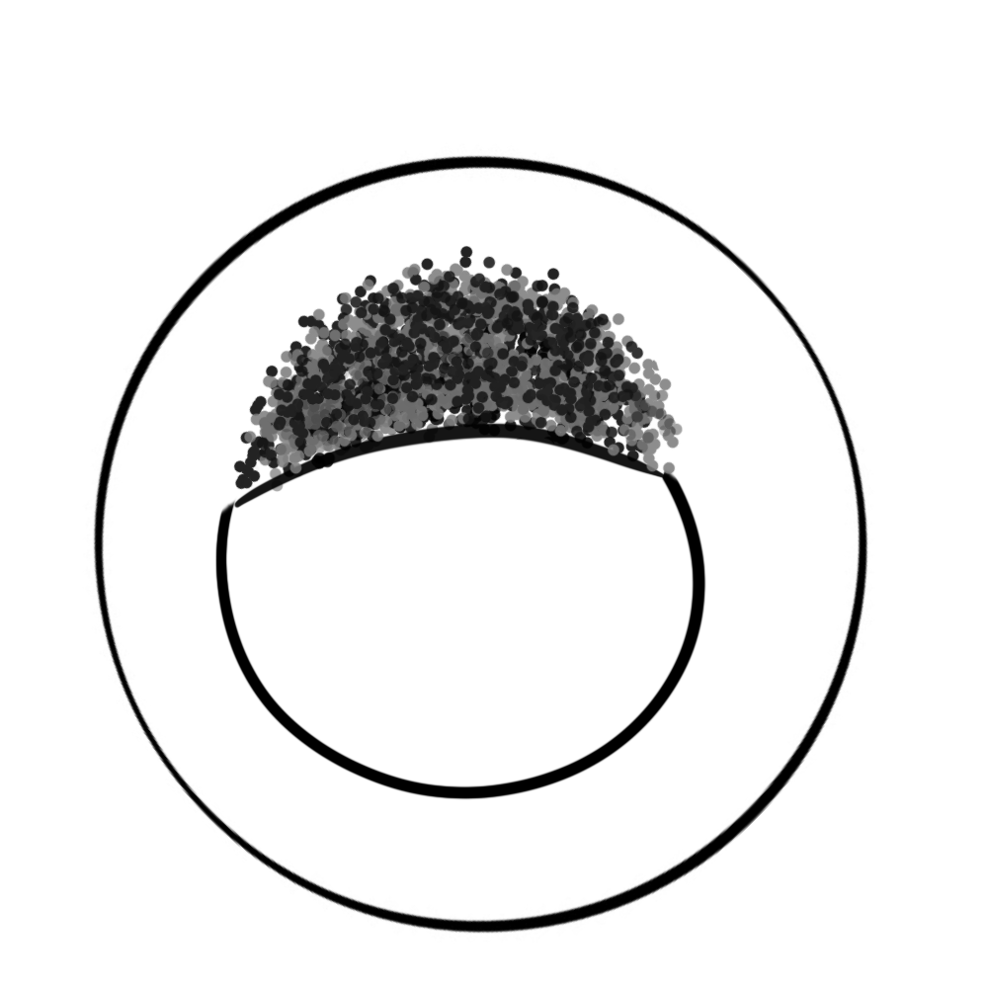
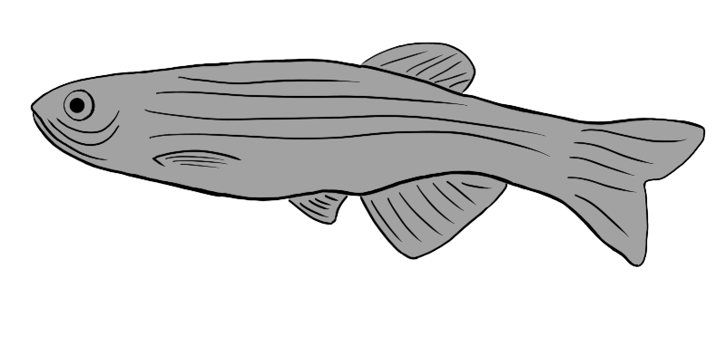


Exposed (n = ~50)
💩
Unexposed (n = ~50)
28°C
(n = 97)
💩
💩
💩
💩
💩
(n = ~300)
32°C
Fecal sampling (Days 14, 21, 28, 42)
(n = 98)
💩
35°C
(n = 95)
Fecal sample &
pathogen exposure
(Day 0)
Grown to 164 days old at 28, 32, 35°C
P. capp exposure at 0 DPE &
fecal sampling 0, 14, 28, 42 DPE
DPE = Days post exposure

Slide 3
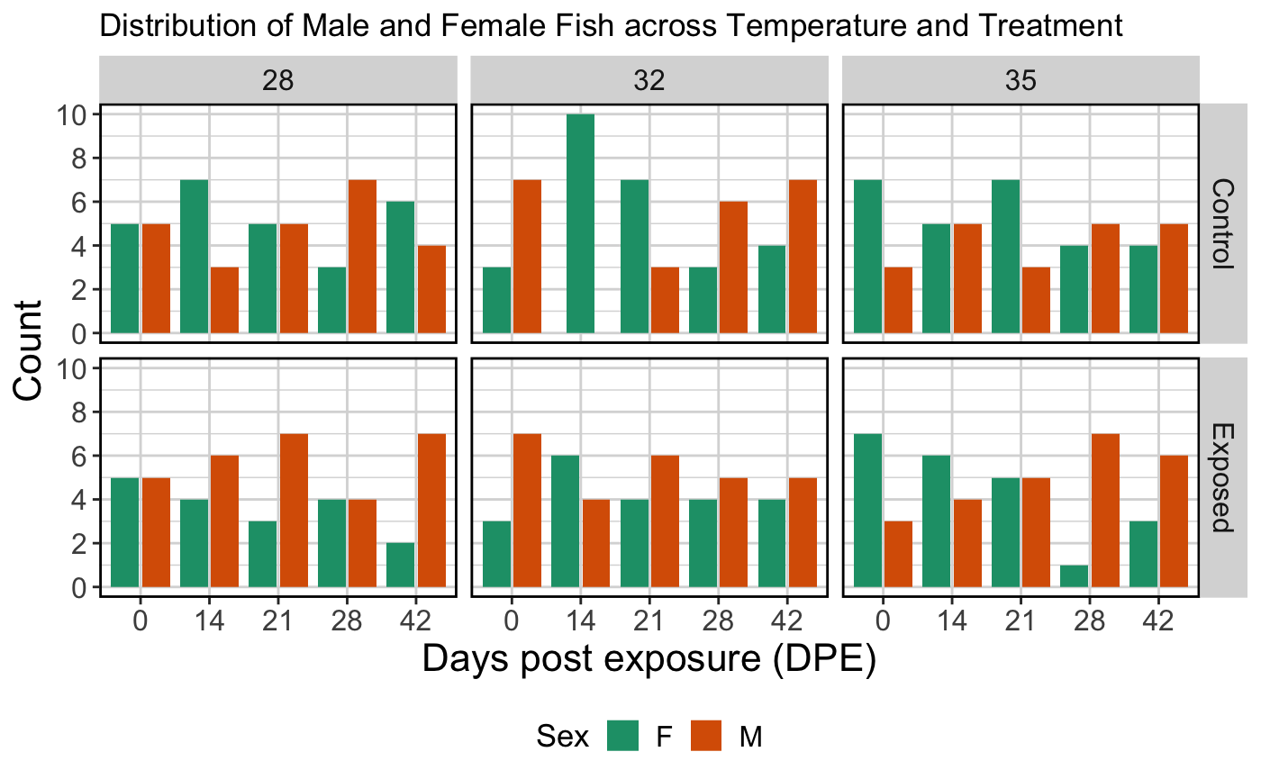
Even distribution of fish across treatments

Slide 4

💩
Gemma
(n = ~60)
💩
(n = ~180)
Watts
(n = ~60)
💩
ZIRC
💩
(n = ~60)
Pathogen
Exposure
(n=90)
💩
💩
💩
💩
Assigned diets (~1-6 mpf)
Grown to 164 days old
dpf = days post fertilization, mpf = months post fertilization
Notes:
Now, I’ll briefly walk you through the experiment and then discuss some key results
[1] For the first 30 days post fertilization (dpf), all fish were fed the same diet of paramecia
At 30 dpf, fish were assigned one of three diets.
[2] These diets included Gemma, Watts and ZIRC.
Each group of fish were fed these diets until the end of the experiment at 6 months of age
[3] At 3mpf, we collected our first round of fecal samples from fish and physiological measurements (such as weight, length and body condition score, BCS is considered an indicator of health in zebrafish)
[4] After taking fecal samples at 3mpf, half of the fish were exposed to the pathogen, Mycobacterium cholonae, while the other half acted as controls
[7] And then 6mpf we collected our final round of fecal samples and physiological data
[8] We then extracted the Microbial DNA and submitted them for sequencing
[9] From there, I ran the data through a series of pipelines to analyze the physiology and microbiomes of these fish.

Slide 5
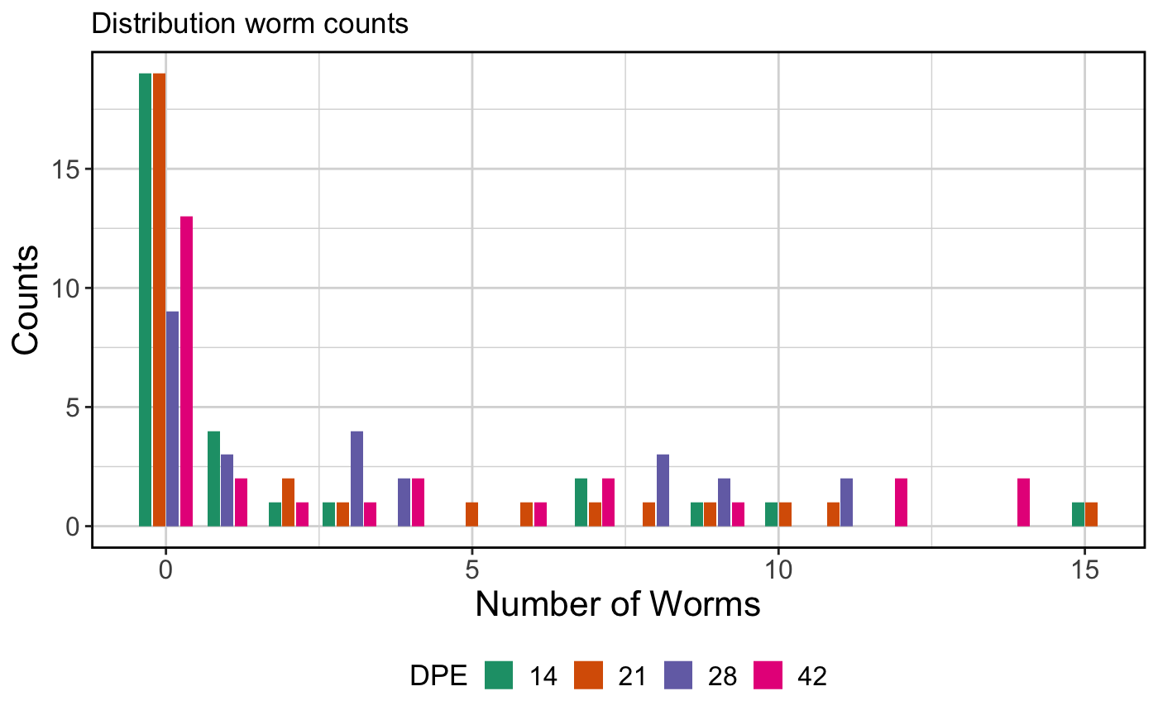
Infection counts follow a negative binomial distribution

Slide 6
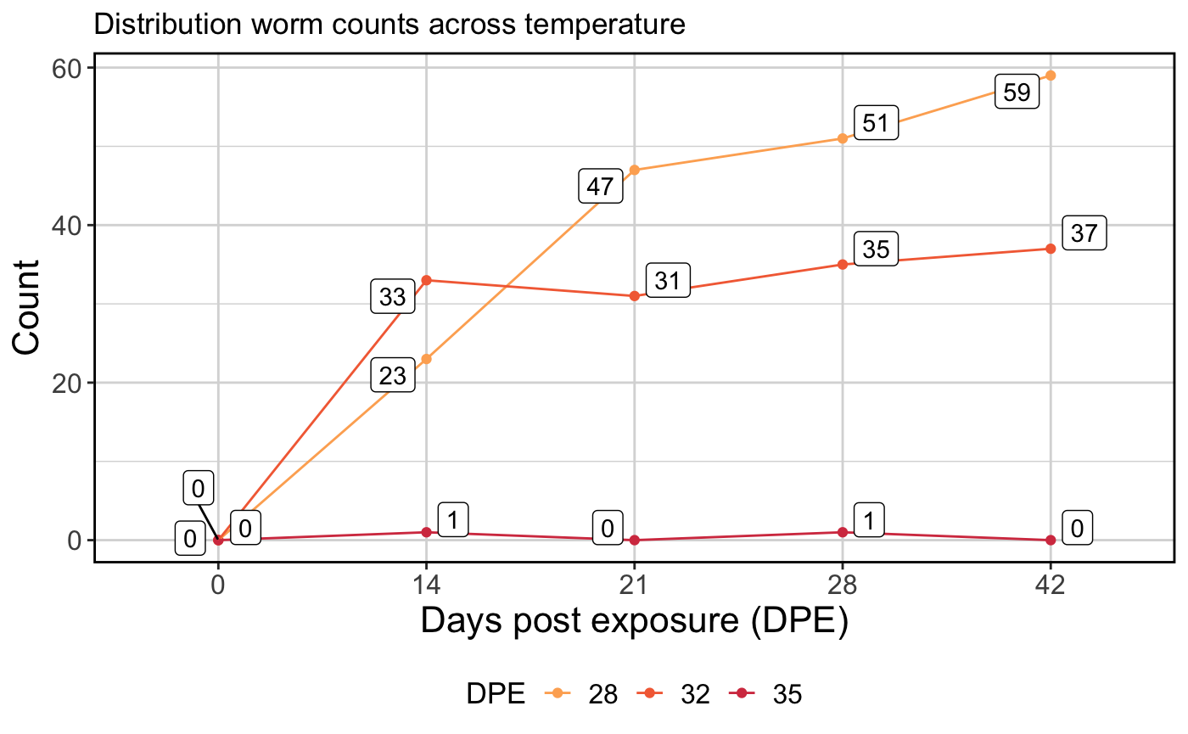
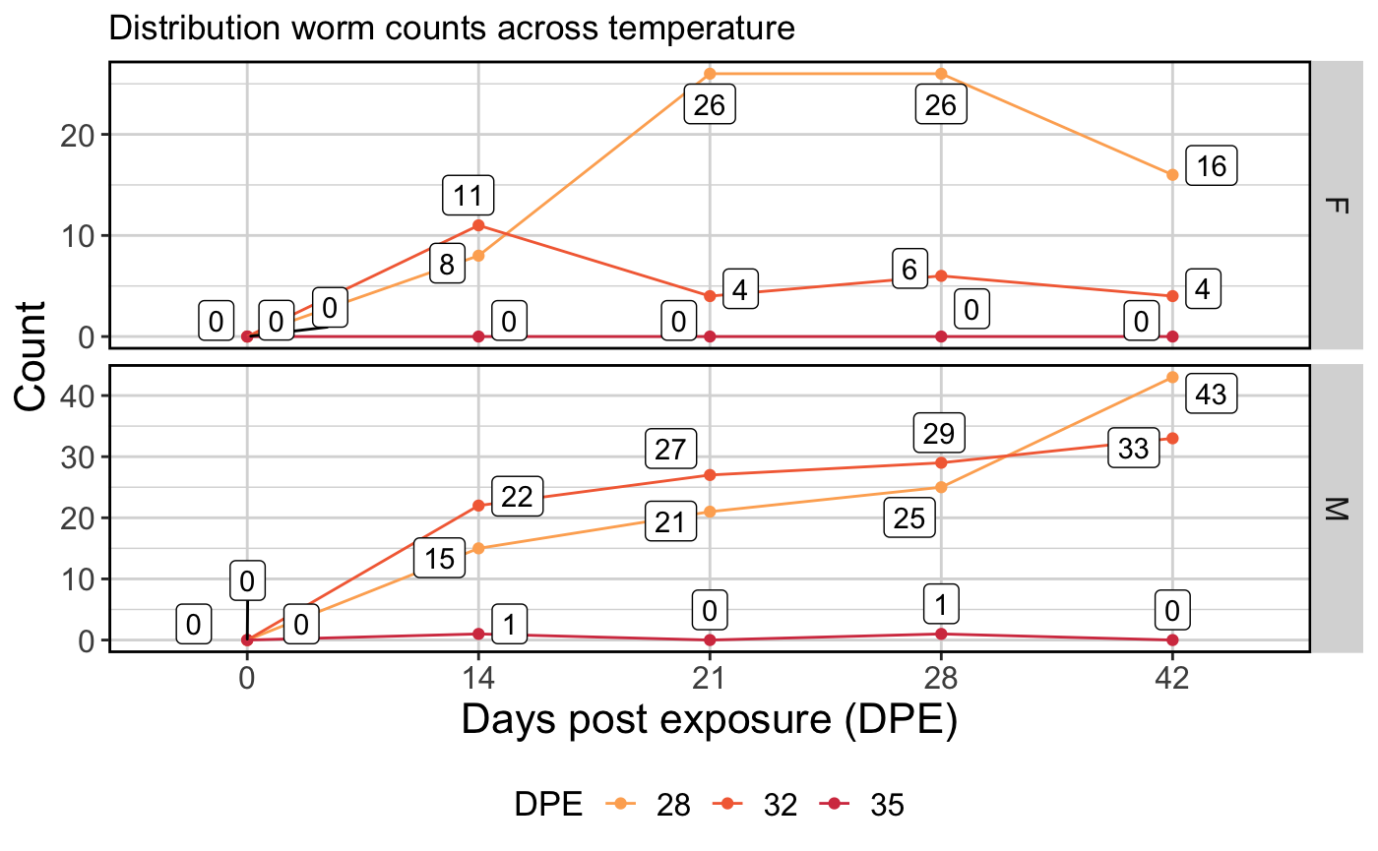
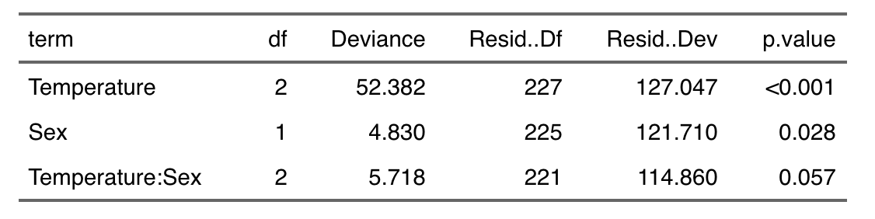
Higher temperatures result in fewer worms

Slide 7
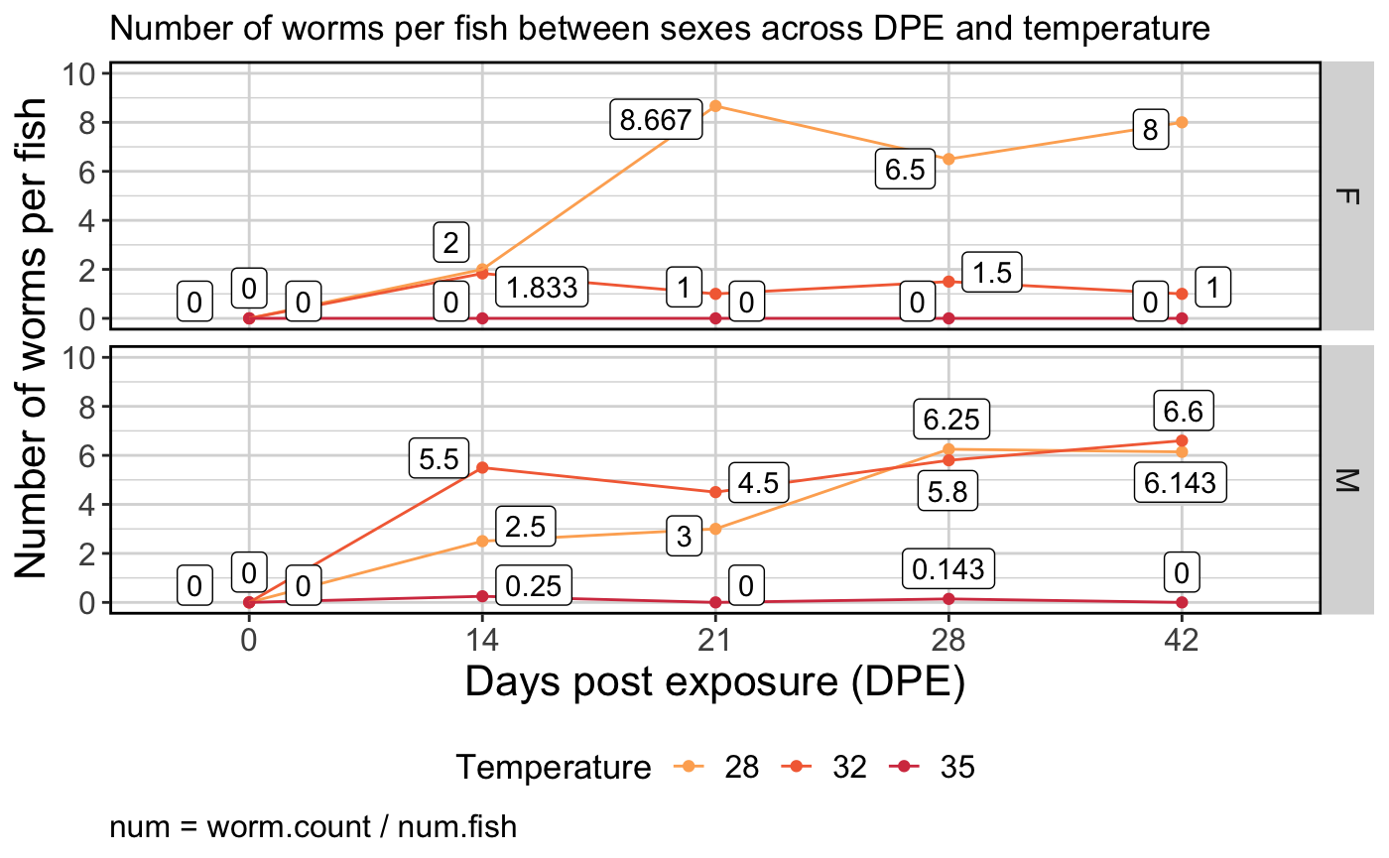
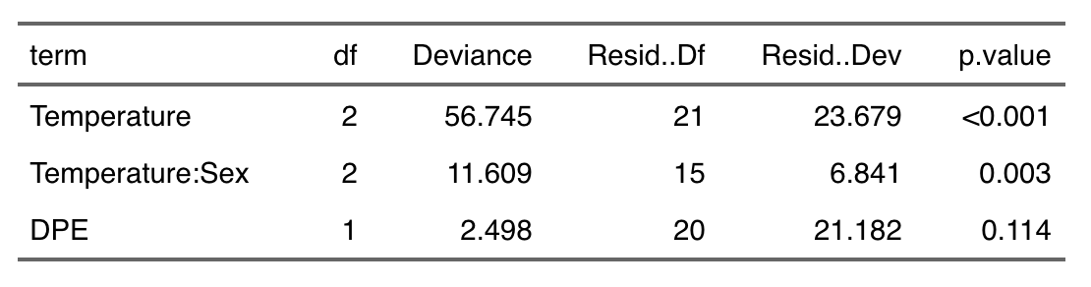
Trend holds when worm count is normalized to number of fish
Number = Total worms / Num fish

