Slide 1
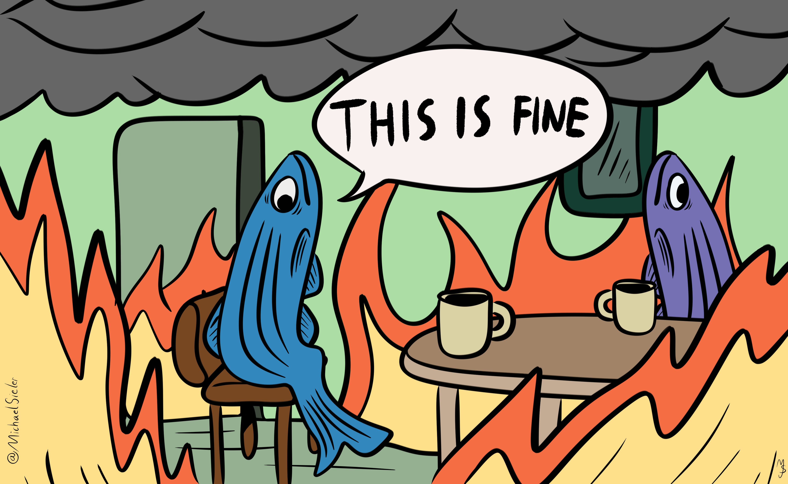

Effects of temperature on infection and the gut microbiome
Michael Sieler
Sharpton Lab
September 7, 2022
Notes:
Hello everyone. Today I will be presenting my research investigating the effects of different diets and pathogen exposure on the growth and development of gut microbiomes of zebrafish.

Slide 2
Zebrafish live in 28°C water

Slide 3

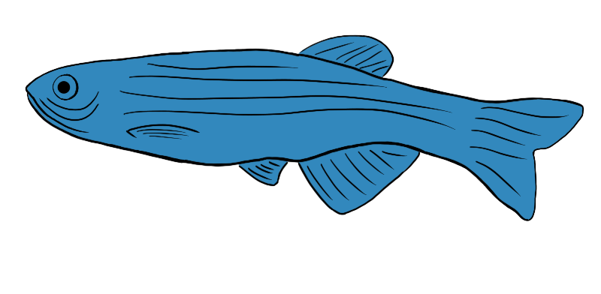
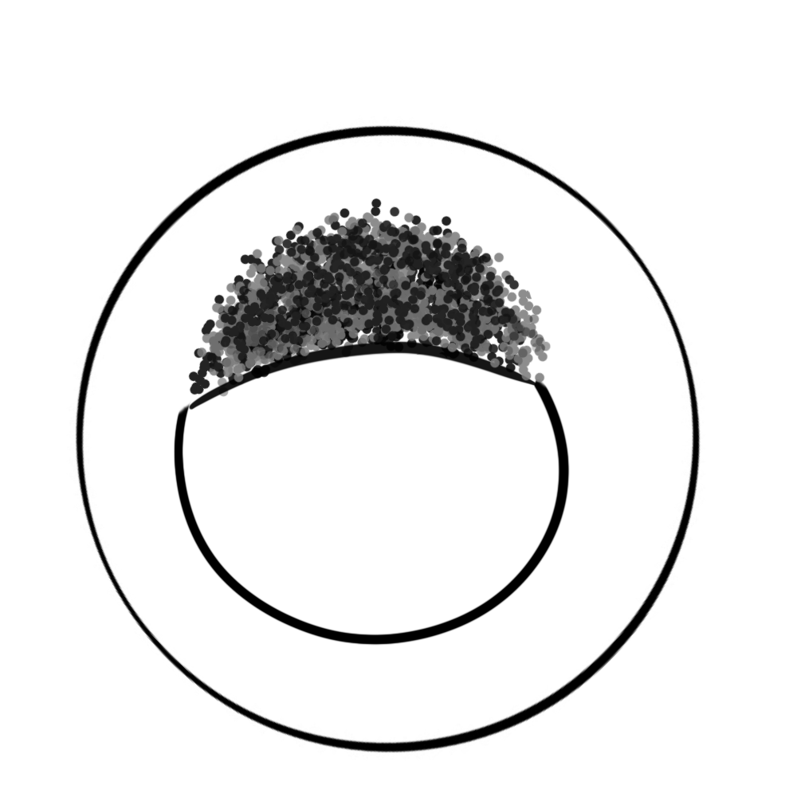
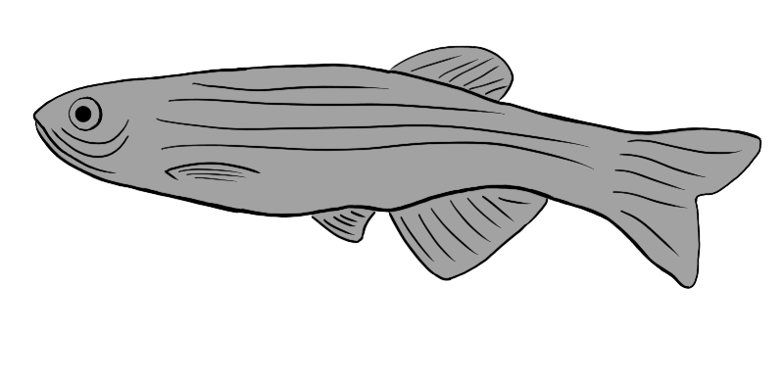
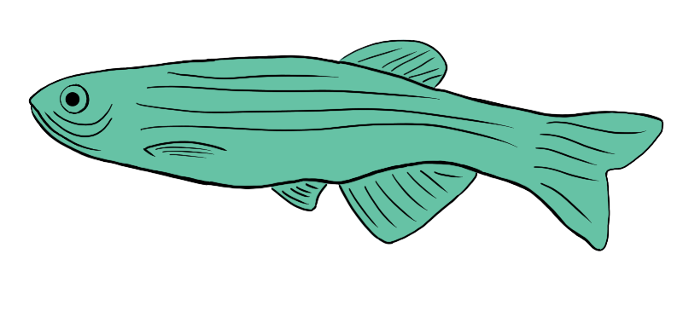
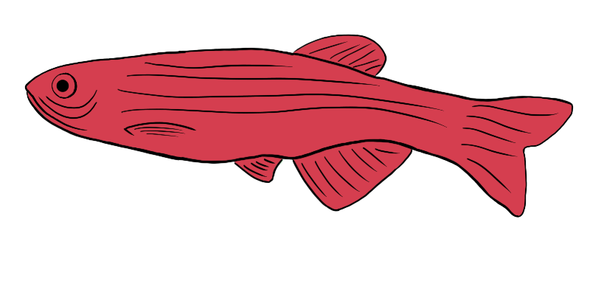
Exposed (n = ~50)
💩
Unexposed (n = ~50)
28°C
(n = 97)
💩
💩
💩
💩
💩
(n = ~300)
32°C
Fecal sampling (Days 14, 21, 28, 42)
(n = 98)
💩
35°C
(n = 95)
Fecal sample &
pathogen exposure
(Day 0)
Grown to 164 days old at 28, 32, 35°C
P. capp exposure at 0 DPE &
fecal sampling 0, 14, 28, 42 DPE
DPE = Days post exposure

Slide 4
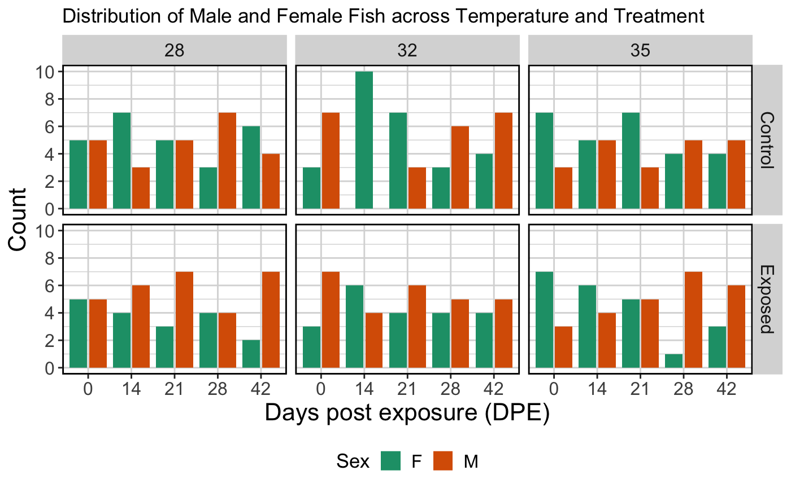
Even distribution of fish across treatments

Slide 5
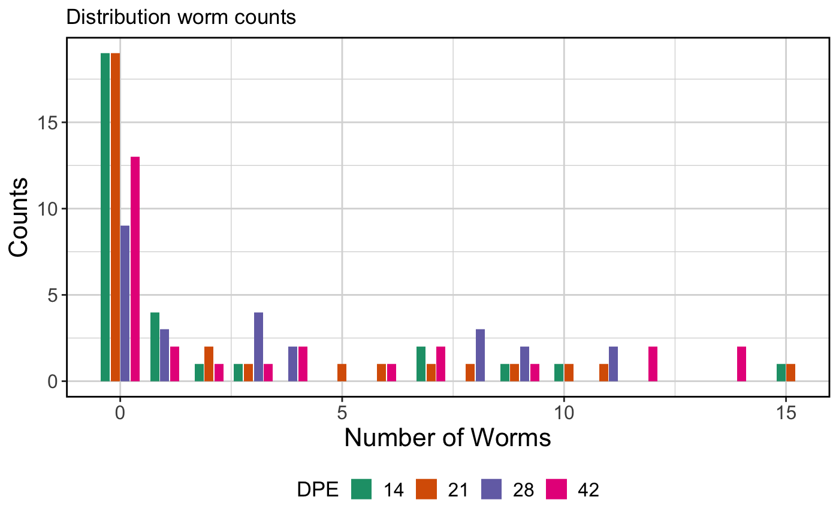
Infection counts follow a negative binomial distribution
Notes:
Negative binomial distribution

Slide 6
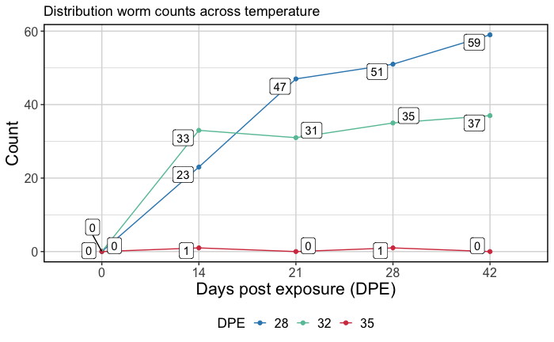
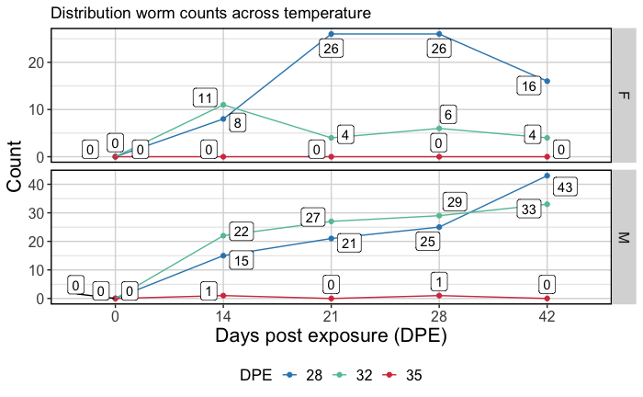
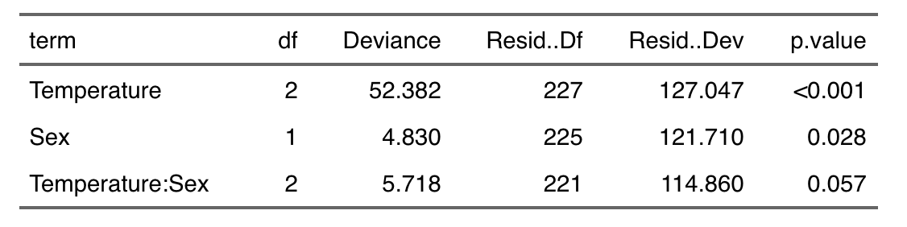
Higher temperatures result in fewer worms
Notes:
Different total amounts of worms, different rates to a “peak” infection, and sex effects

Slide 7
Microbiome

Slide 8
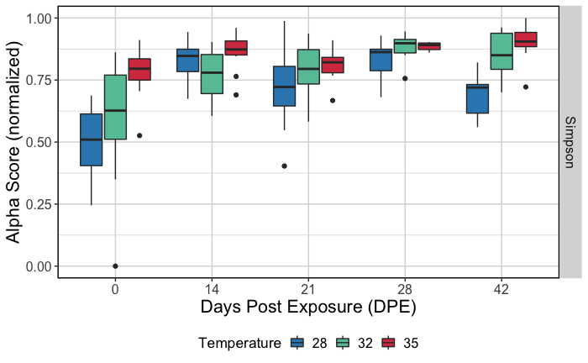
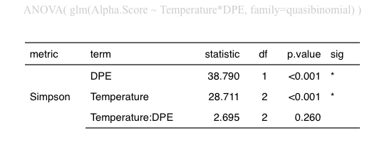
Higher temperatures associate with higher alpha diversity
Control Fish

Slide 9
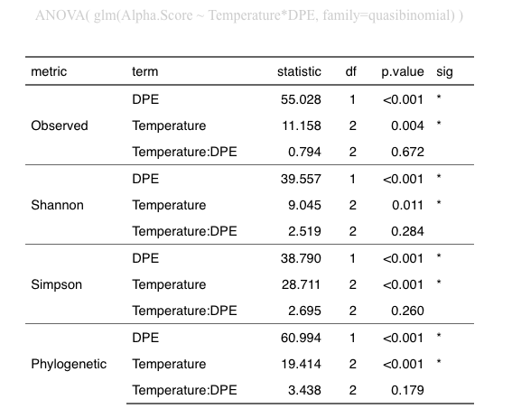
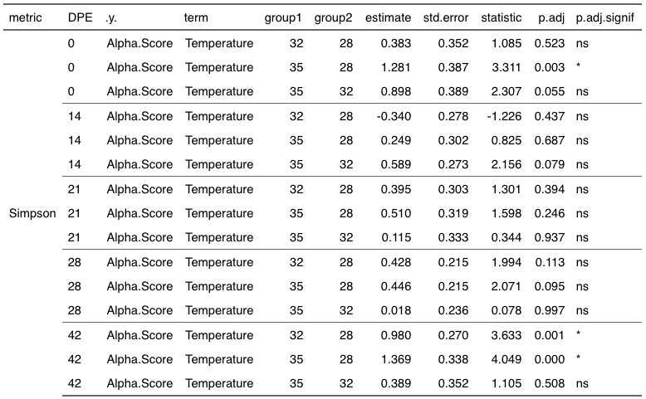

Slide 10
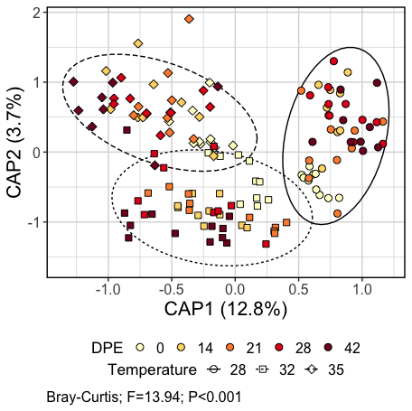
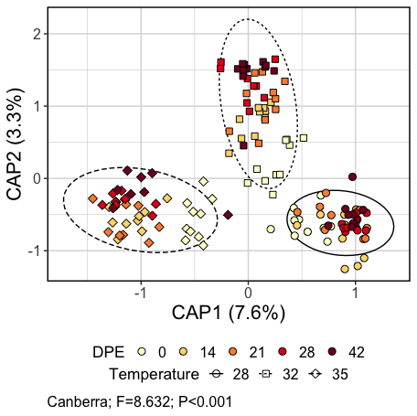
Control Fish

Slide 11
