Slide 1
Microbiome Analysis: Infection
Michael Sieler, December 19, 2022

Slide 2
Alpha diversity

Slide 3
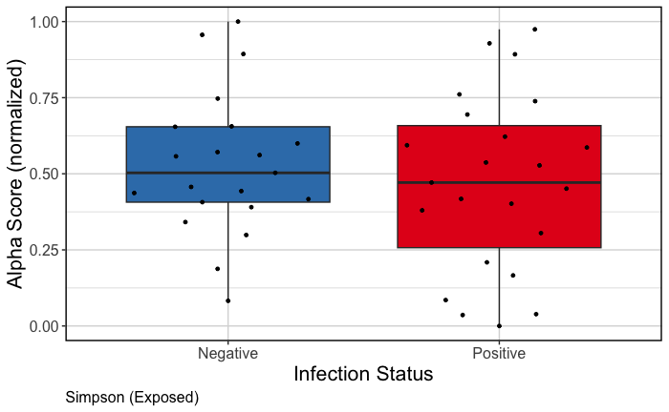
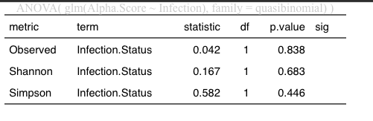
We do not see a statistical difference in alpha diversity and presence of infection (males and females)

Slide 4
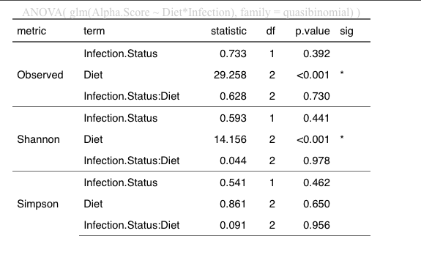
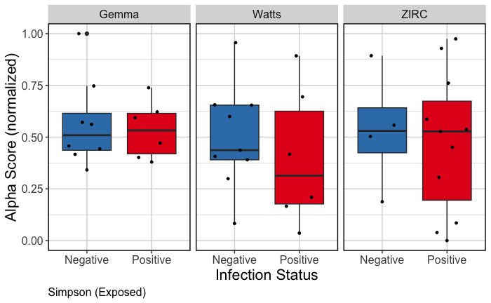
We do not see a statistical difference in alpha diversity and presence of infection depending on diet (males and females)

Slide 5
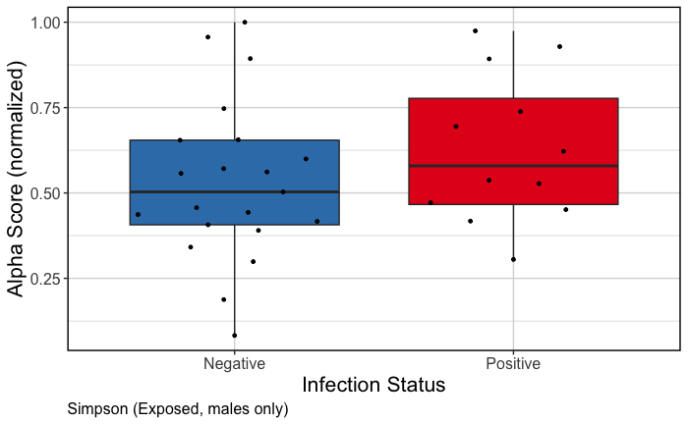
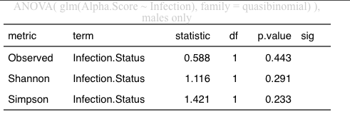
We do not see a statistical difference in alpha diversity and presence of infection (males only)

Slide 6
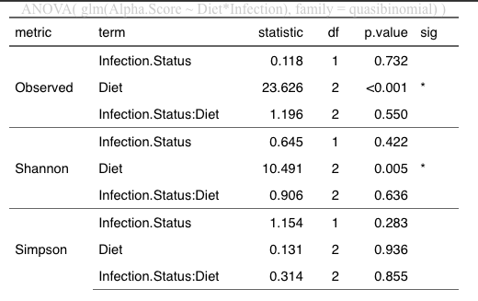
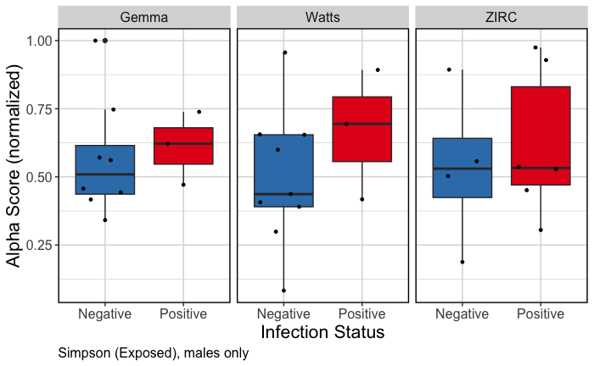
We do not see a statistical difference in alpha diversity and presence of infection depending on diet (males only)

Slide 7
Beta diversity

Slide 8
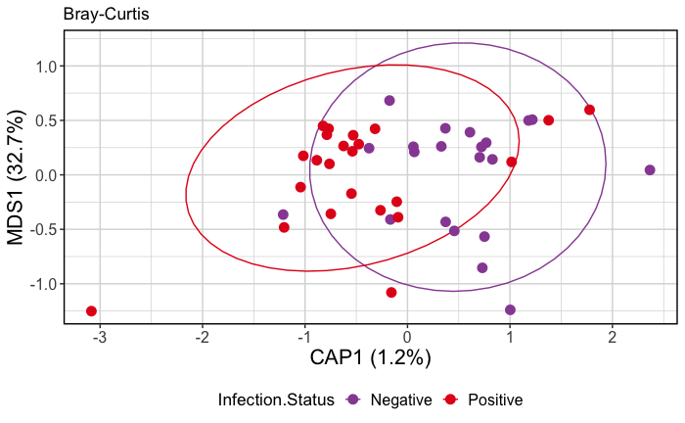
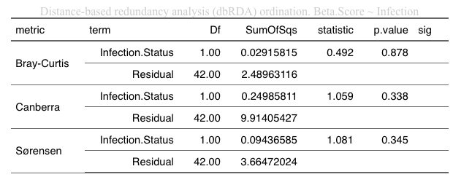
We do not see a statistical difference in beta diversity and presence of infection (males and females)

Slide 9
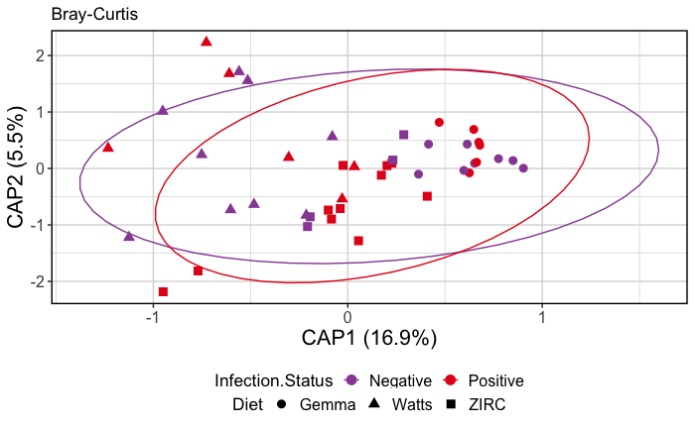
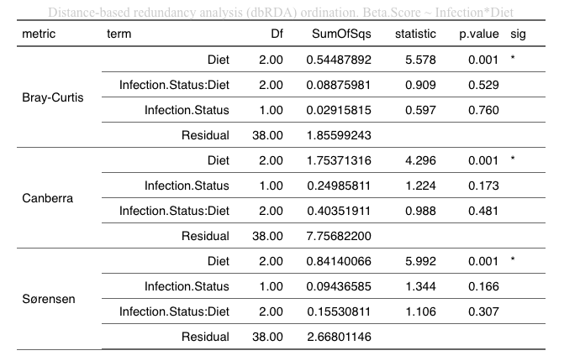
We do not see a statistical difference in beta diversity and presence of infection depending on diet (males and females)

Slide 10
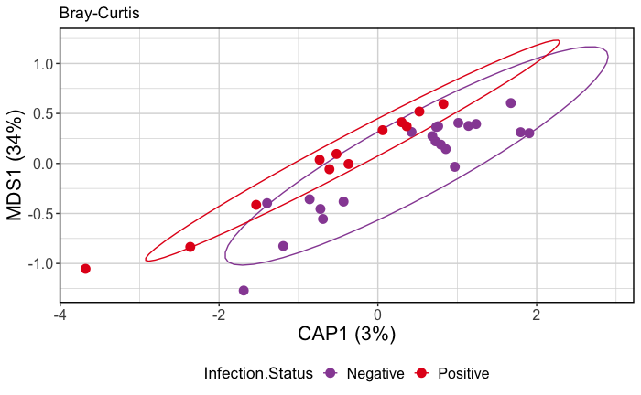
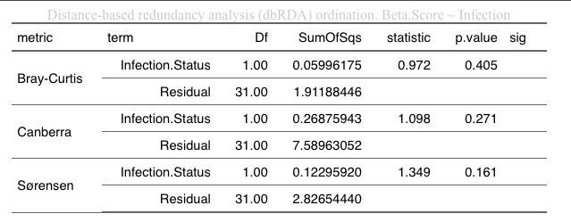
We do not see a statistical difference in alpha diversity and presence of infection (males only)

Slide 11
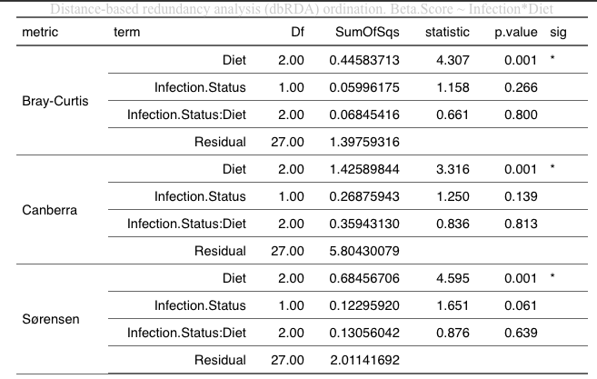
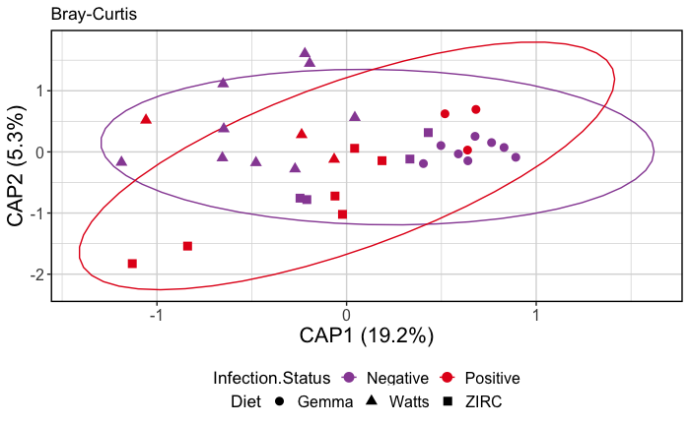
We do not see a statistical difference in alpha diversity and presence of infection depending on diet (males only)

