Slide 1
Zebrafish Interstrain Study
Michael Sieler

Slide 2
Background
Increasing use of zebrafish as a model organism in microbiome studies
Extensive homology to early human development, genetics, and biochemistry
Established, high-throughput methods
Large sample sizes
Ease of directly manipulate microbiome
Endemic to South Asia, imported to N. America
Brief history of zf line development of 5D, AB, Casper and TU
Development of lines
Genetic variation
What about microbiome variation of zf lines?
Here, we sought to characterize the microbiome diversity and composition of four common zebrafish laboratory lines: 5D, AB, Casper and TU.

Slide 3
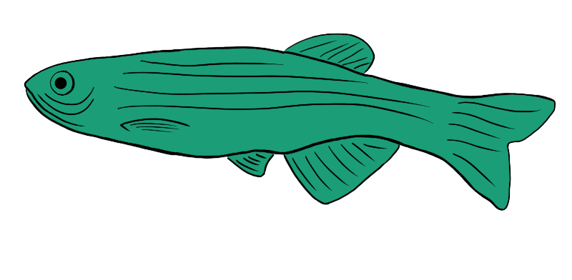
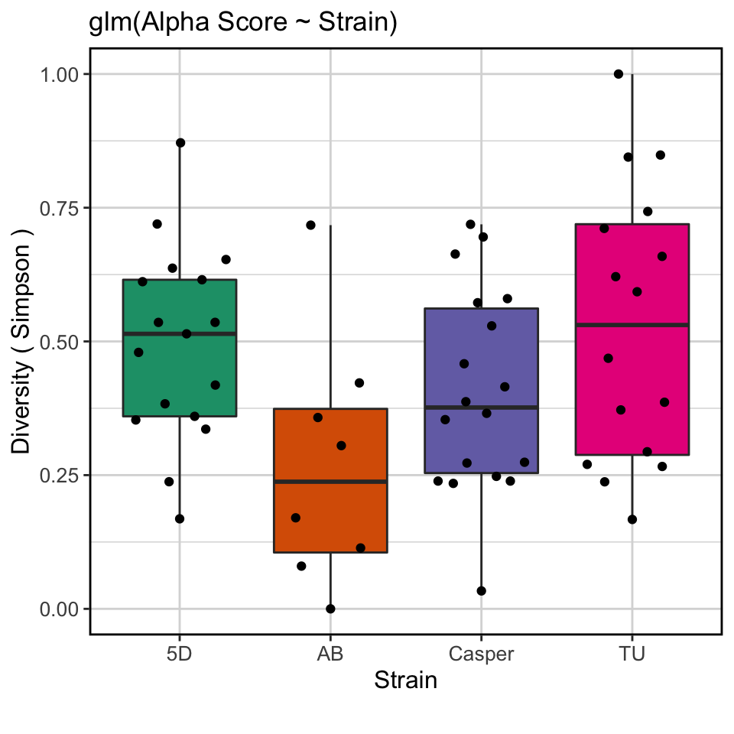

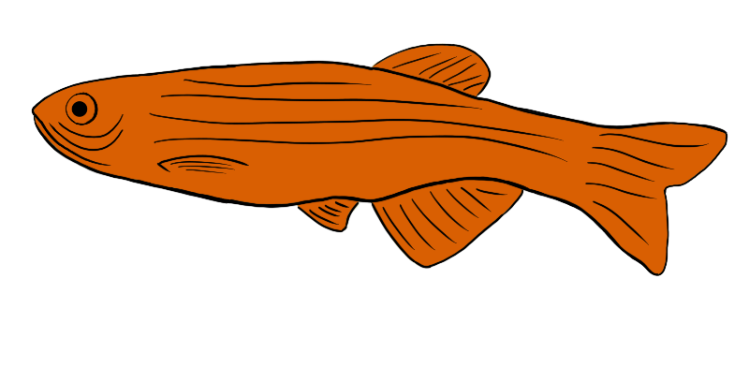
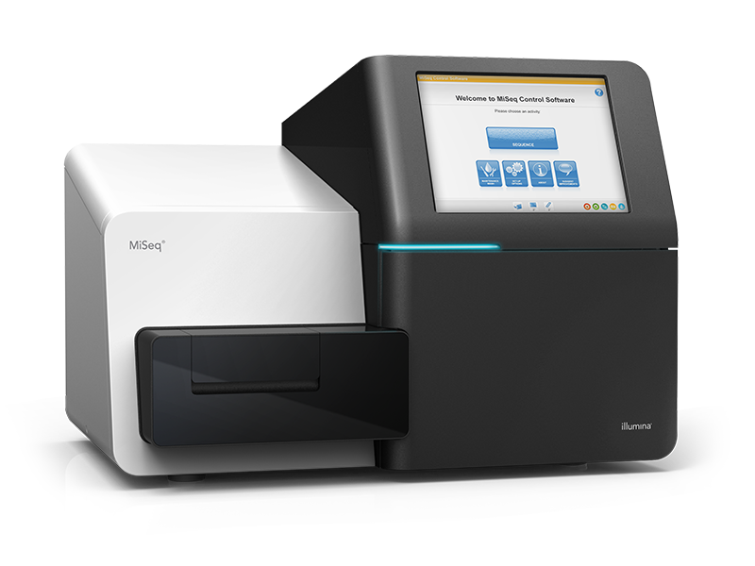
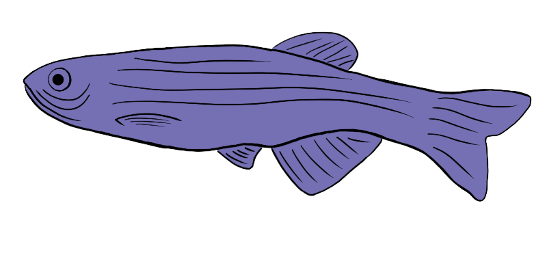
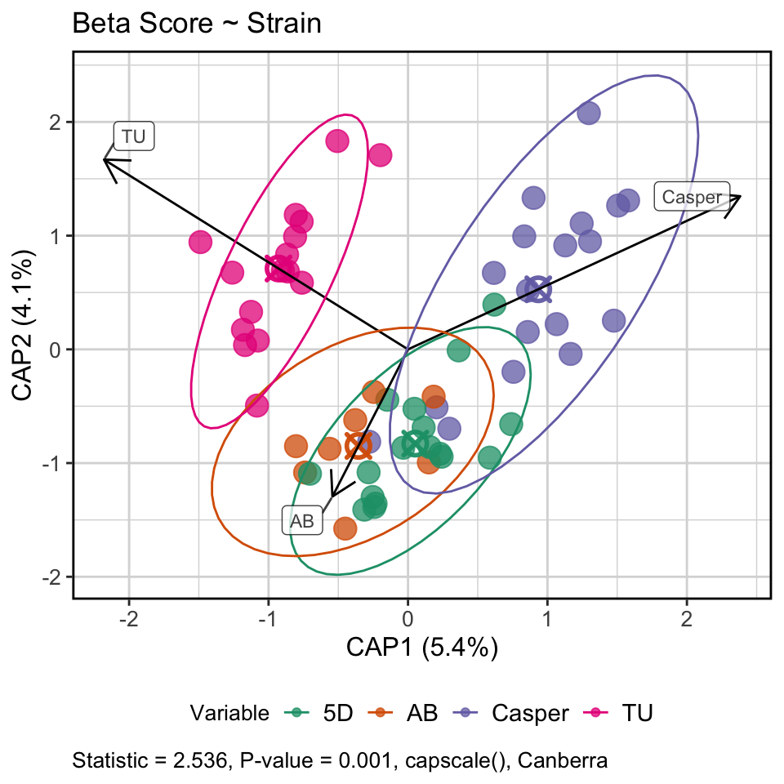
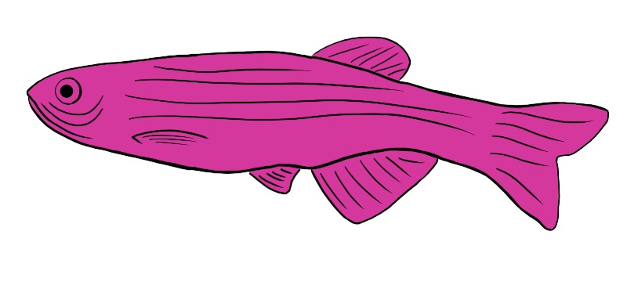
Experimental Design
5D
💩
AB
Casper
TU
Grown to adulthood (120 dpf)
Exposed to Pseudocapillaria tomentosa
(120 dpf)
Stool samples
(155 & 170 dpf)
(31 & 44 dpe)
16S sequencing
Microbiome
analyses
Notes:
We’re only focused on the control fish in this analysis because of a super saturation event which affected the exposed fish, thus confounding our results in the exposed fish. Control fish were unaffected.

Slide 4
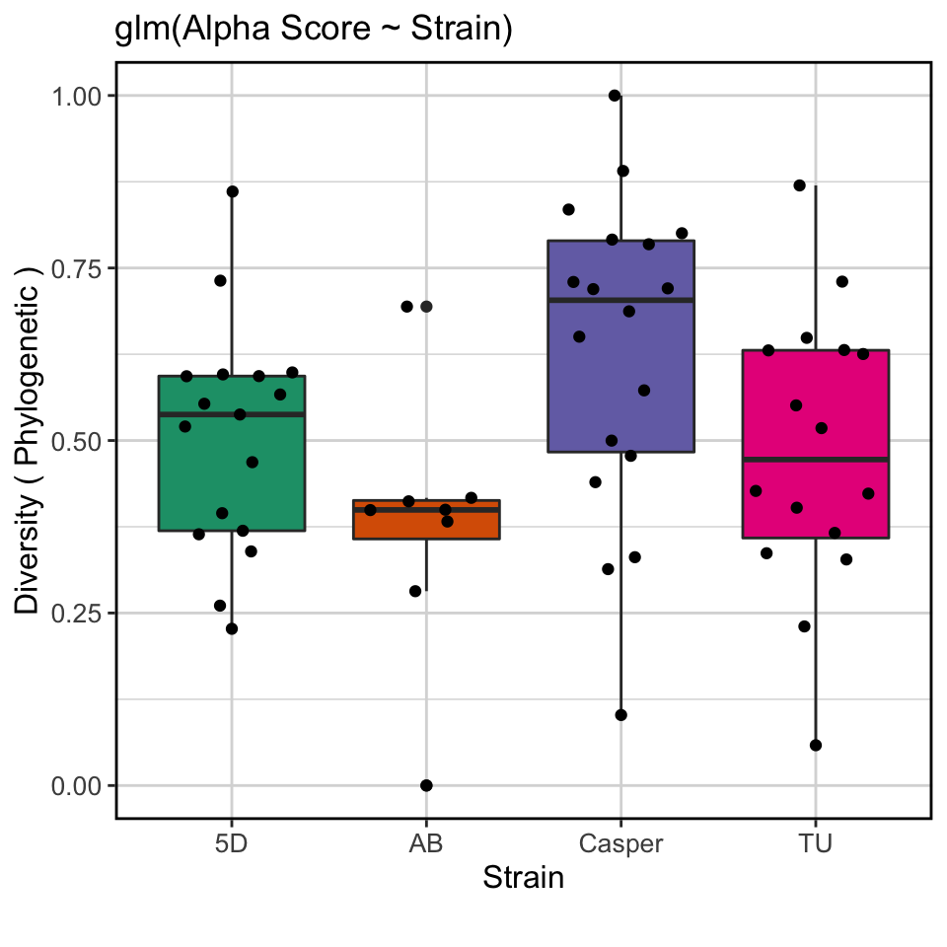
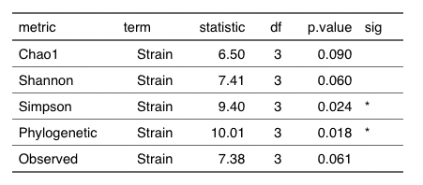
AB fish have lower alpha diversity, but generally fish have similar microbial diversity
Notes:
Which line is the most domesticated?

Slide 5
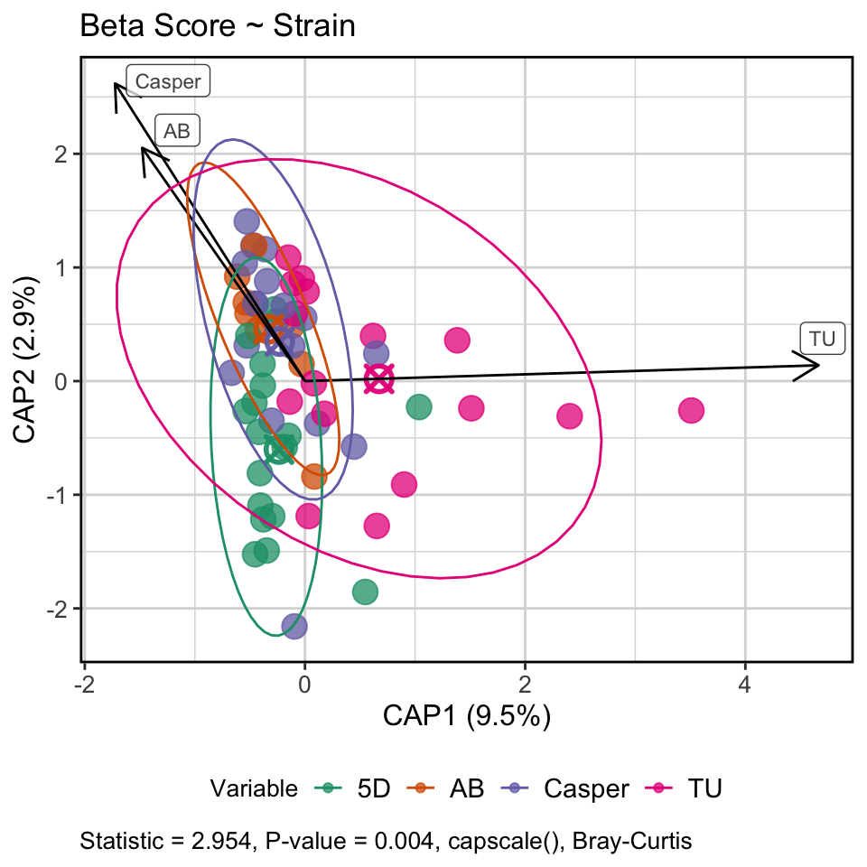
Microbial communities of abundant taxa are more similar across strains, but rarer taxa differ
Hom. Disp: Bray-Curtis, p-val = 0.058
Hom. Disp: Canberra, p-val = 0.042

Slide 6
Differentially abundant taxa by strain

Slide 7
Results summary
Strain plays a role in microbiome diversity and composition
AB fish had lower alpha diversity scores compared to others
Composition of abundant taxa don’t appear to be affected by strain, but rarer taxa are
Dispersion is lowest in rarer taxa in AB strain
Time influences composition in rarer taxa
This tracks with diet study
Female TU fish had higher alpha diversity than males, other strains weren’t different
No differences in microbiome composition between sexes

Slide 8
Conclusion
Microbiome largely conserved across strains, but differ in diversity and composition of rarer taxa
Genetic variation could select for these rarer taxa
Supports the ability to integrate microbiome data across zebrafish microbiome studies so long as you’re mindful of rarer taxa

