Slide 1
Rubikomo

Slide 2
Contents
Intro
Rubik’s Cube rules
Project structure
Data structure
Solving algorithm
Demo
Future plans
Bloopers

Slide 3
Rubikomo is an application that helps you solve a Rubik’s Cube and tries to teach you how to do so.

Slide 4
1.
Rubik’s Cube rules

Slide 5
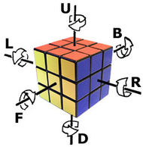
Notations for the Rubik Cube moves
For example:
U – move Up face clockwise 90°
U’ – move Up face counterclockwise 90°
U2 – move Up face clockwise 180°
Notes:
Exemplu live cu cubul (miscarile U si U’, de exemplu)

Slide 6
2.
Project structure

Slide 7
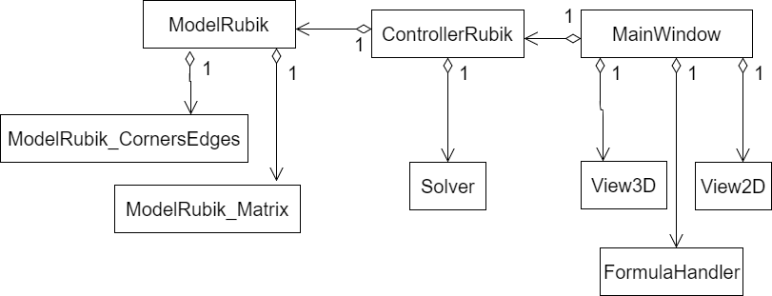
Application logic

Slide 8
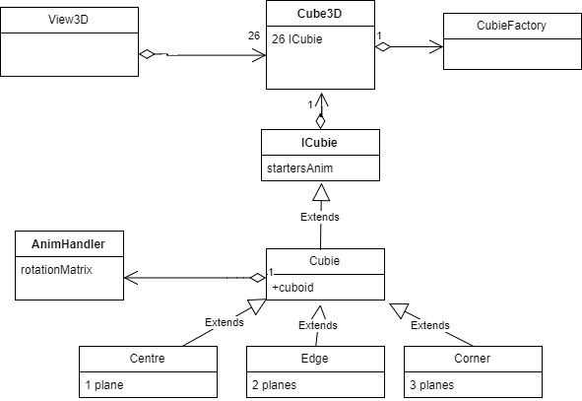
3D View design

Slide 9
3.
Data structure
Data structure is based on two models

Slide 10
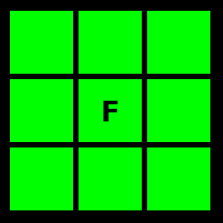
2D Model
Represented by 6 3x3 matrixes
Each matrix represents a face of the cube
Used by flat visualization

Slide 11
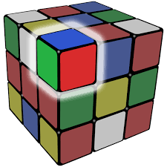
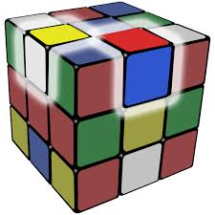
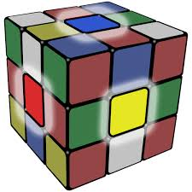
3D Model
In addition to the 2D model, the 3D model holds the orientation of each piece.
Represents all 26 pieces of the cube
3 types of pieces:
corner
edge
centre

Slide 12
4.
Solving algorithm

Slide 13
Kociemba’s Algorithm
Takes the cube to group
G1={U, D, L2, R2, F2, B2}
Finds more solutions and returns the one with the minimum number of moves.

Slide 14
Bloopers

Slide 15
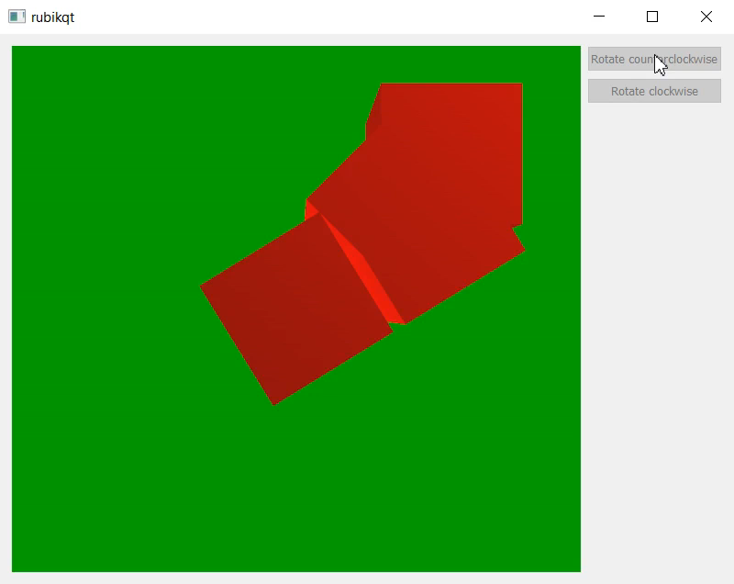
One of the many rotation tests

Slide 16
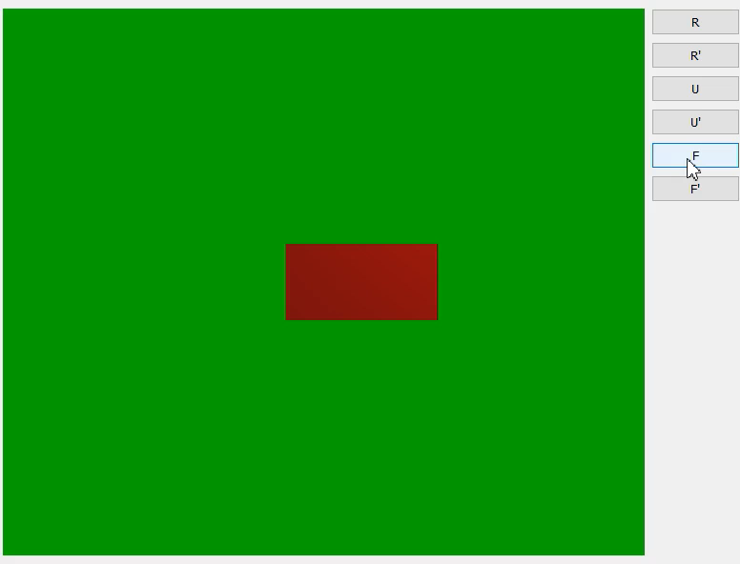
Some more tests
Heeey, come back!

Slide 17
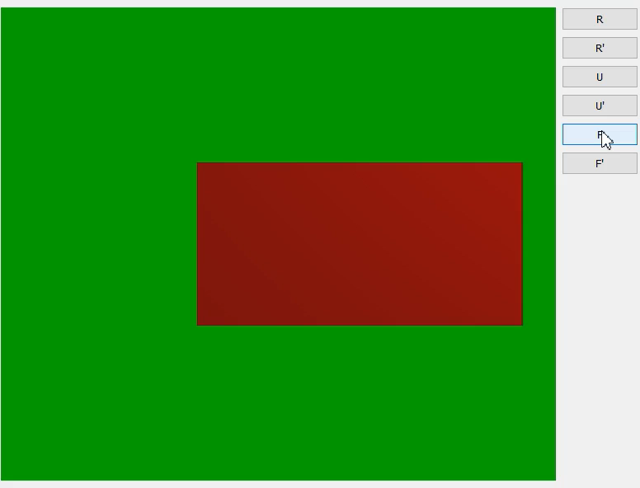
Weeeeeeeeeeeeeeee!!!! ☺

Slide 18
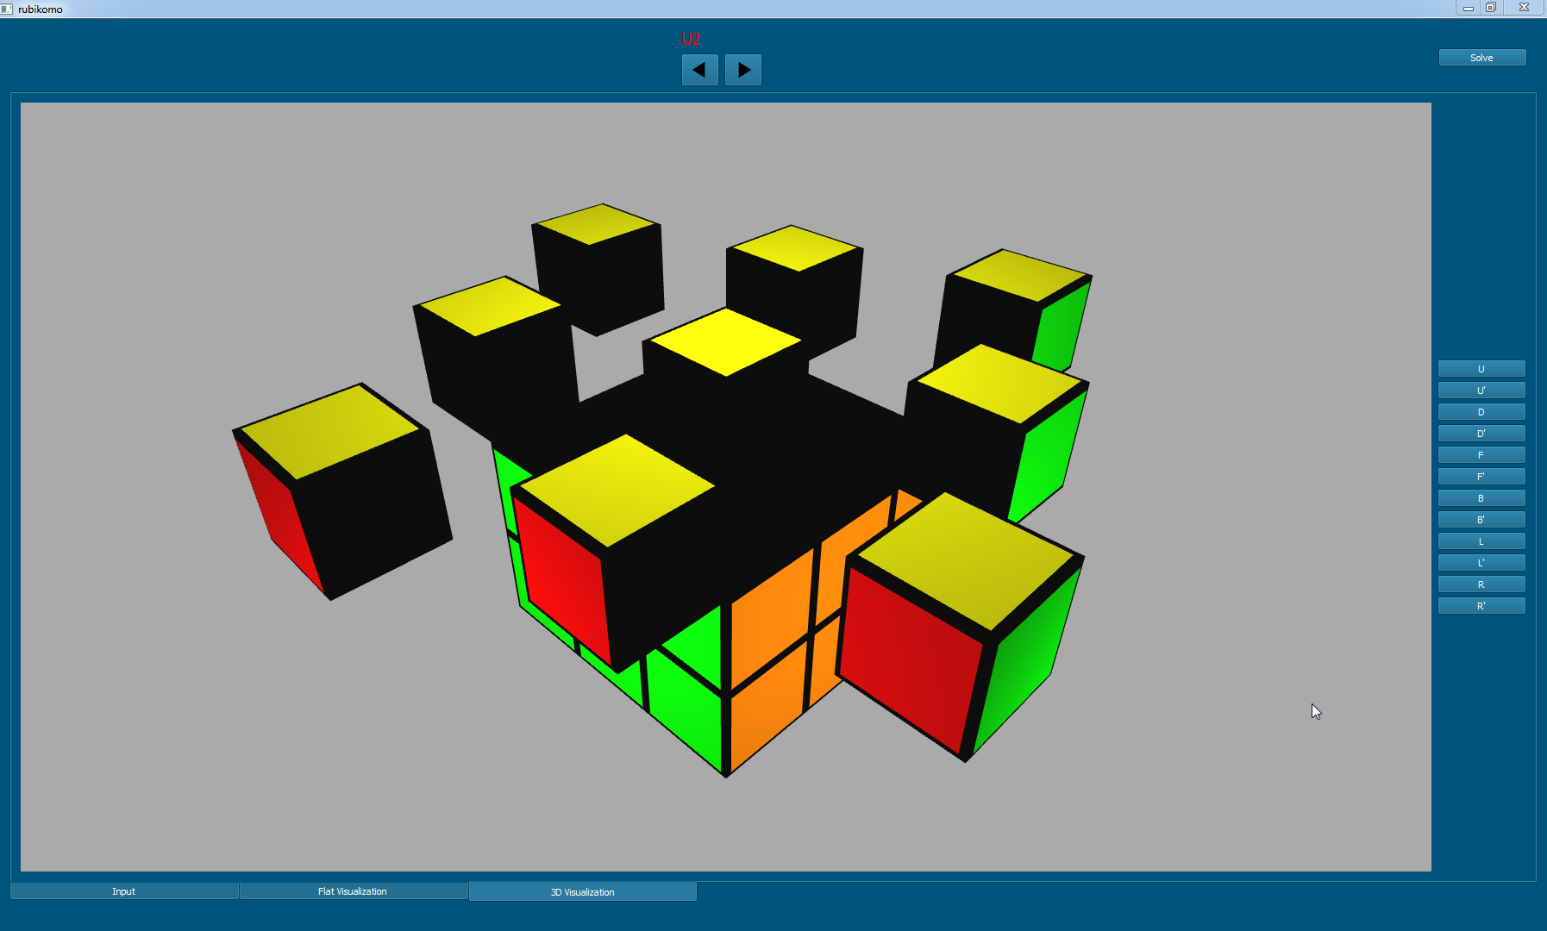
When we tought all works fine.

Slide 19
Demo

Slide 20
Future plans
Camera input
Add different solving methods
Robot solving

Slide 21
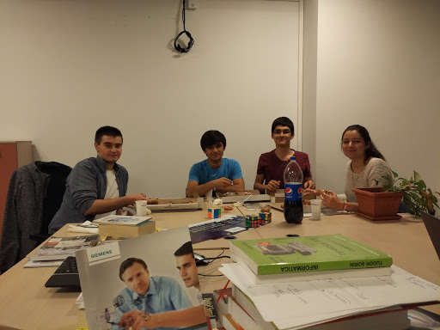
Team: Mădălin Morcov, Cosmin Polifronie, Vlad Vrabie, Andreea Pavel

Slide 22
Thanks!
Especially to:
Roxana Avădani
Adria Milescu
Dan Vasilescu

Slide 23
Questions?*
*Except how to solve a cube.

