Slide 1
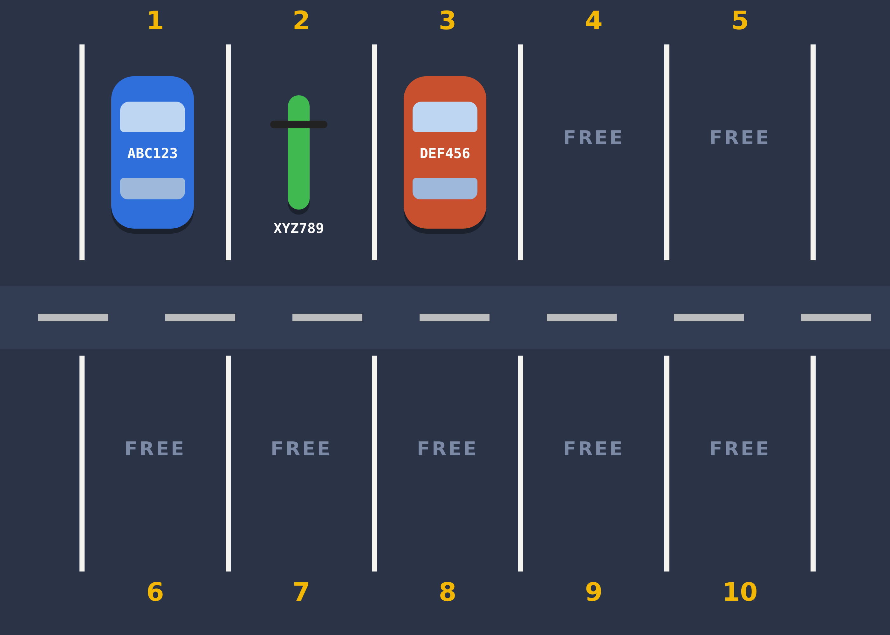
Smart Parking Management System
C++ Group Project | Console version
[Member 1] · [Member 2] · [Member 3]
American University of Phnom Penh
Notes:
Speaker: Member 1 (30 seconds). Introduce everyone by name. "Our project is a Smart Parking Management System: a C++ console program that manages a 10-space parking lot."

Slide 2



What problem are we solving?
01 · PROJECT IDEA
The problem
Our solution
On paper, an attendant must remember which spaces are free, where each vehicle is, and work out every fee by hand. Mistakes cost money and time.
A C++ console program that parks and removes vehicles, finds any plate instantly, and prints a receipt with the correct fee.
Find any vehicle
Fees by the hour
Blocks mistakes
by its plate in one step
for bikes and cars
like parking a plate twice
Who could use it: small lots at markets, campuses, apartment buildings and shops.
Notes:
Speaker: Member 1 (1 minute). Problem first: on paper it is easy to lose track of free spaces and to miscalculate fees. Then the solution: the program does the tracking and the maths automatically. The three icons are what it does best: find, charge, and prevent mistakes.

Slide 3
What we aim to achieve
02 · PROJECT GOALS
1
Track every space
2
Reject bad input
See all 10 spaces, who is parked where, and how many are free.
Full lot, unknown vehicle type, duplicate plate, or letters in the menu.
3
Charge the right fee
4
Keep the code clear
Hours × rate for each vehicle type, shown on a printed receipt.
Use only class concepts so every member can explain every line.
10
2
5
~240
parking spaces
vehicle types
menu actions
lines of C++
Notes:
Speaker: Member 1 (1 minute). Read the four goals. Each one matches something in the demo: Show (goal 1), the error messages (goal 2), the receipt (goal 3). Goal 4 is why we kept the scope small: 10 spaces, 2 vehicle types, 5 menu actions, about 240 lines.

Slide 4





Three parts working together
03 · SYSTEM DESIGN
User
main()
ParkingLot class
Types a menu number, a plate and a vehicle type.
Loops: shows the menu, reads the choice, calls the right function.
One object that holds all the data and does all the work.
private: the data
public: the functions
occupied[] plates[] types[]
entryHour[] clockHour
park() remove() showLot() search()
advance() findFree() findByPlate()
Notes:
Speaker: Member 1 (1 minute). Walk left to right. The user only talks to main(). main() never touches the arrays directly; it calls public member functions of one ParkingLot object. The data is private, so only the class's own functions can change it. That keeps the four arrays in step with each other (encapsulation).

Slide 5
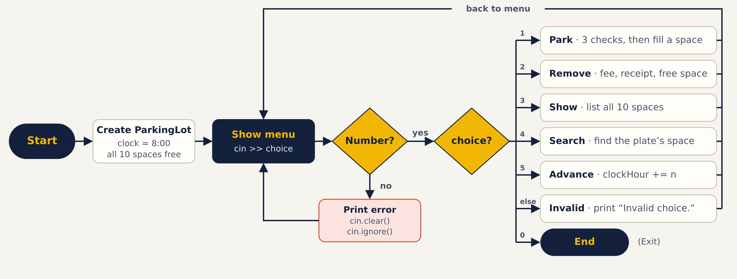
Program flowchart
03 · SYSTEM DESIGN
Notes:
Speaker: Member 1 (1 minute). Follow the arrows. The program creates one ParkingLot (clock 8:00, all spaces free), shows the menu and reads a choice. If the input is not a number we print an error, reset cin and go back. Otherwise choices 1 to 5 run an action and return to the menu: that is the while loop. Only 0 leads to End.

Slide 6
Inside the class: parallel arrays
03 · SYSTEM DESIGN
i | occupied | plates | types | entryHour
0 | true | ABC123 | car | 8
1 | true | XYZ789 | bike | 8
2 | true | DEF456 | car | 8
3 | false | "" | "" | 0
… | … | … | … | …
9 | false | "" | "" | 0
The real lot …
… and the same lot inside our four arrays.
One row = one space. The same index links the data, and space number = i + 1 because arrays start at 0.
Notes:
Speaker: Member 1 (1 minute). Point at the picture, then the table. Space 1 is index 0 in every array. Why parallel arrays and not a ParkingSpace class? The course asks for arrays and one class, and this keeps it simple. The constructor fills every row with false, empty strings and 0, and sets clockHour to 8. Hand over to Member 2.

Slide 7
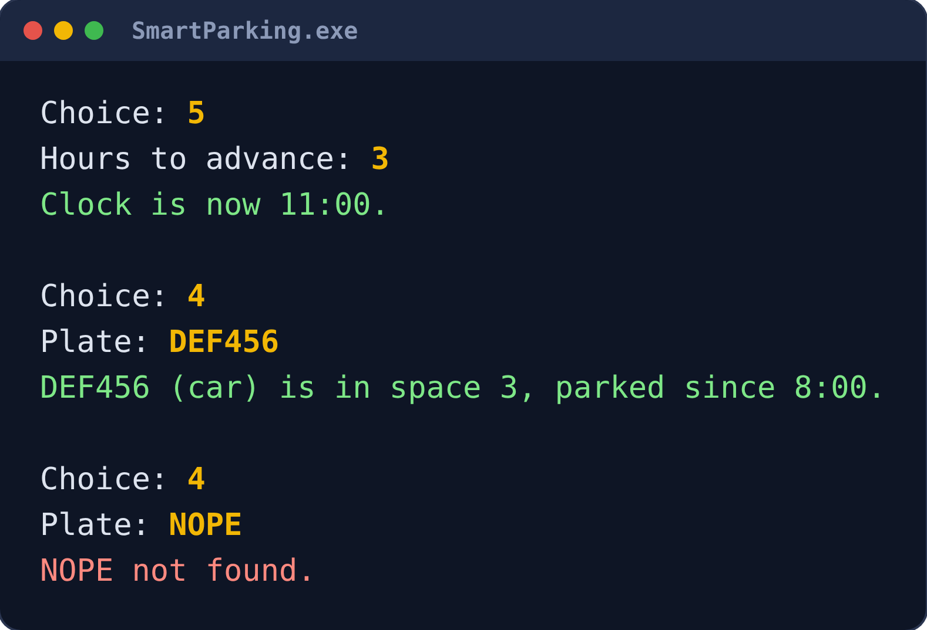
Algorithm 1: linear search
04 · ALGORITHMS
int findByPlate(string plate) {
for (int i = 0; i < MAX_SPACES; i++) {
if (occupied[i] && plates[i] == plate) {
return i;
}
}
return -1; // not found
}
findFree() uses the same loop, but stops at the first space where occupied[i] is false.
Check each space in order. −1 means "not found" because no real index is negative. Worst case: 10 checks.
Notes:
Speaker: Member 2 (1 minute). Linear search: start at index 0 and check every space until we find the plate. We check occupied[i] first so we never match an empty space. If the loop ends, the plate is not in the lot, so we return -1. The screenshot shows both results from the real program. With 10 spaces the worst case is 10 comparisons, so this is fast enough.

Slide 8
Algorithm 2: parking with three checks
04 · ALGORITHMS
CHECK 1
CHECK 2
CHECK 3
ALL PASSED
Is the lot full?
Is the type valid?
Already parked?
Fill the space
findFree() == -1
bike or car
findByPlate() != -1
set 4 arrays
if not → "Sorry, the lot is full."
if not → "Invalid type."
if not → "Already parked."
entry = clockHour
Early return: if any check fails, park() prints a message and returns straight away, so the arrays never change. The order matters: if the lot is full, nothing else is worth checking.
Notes:
Speaker: Member 2 (1 minute). park() takes a plate and a type. Each check is an if statement with an early return. Only if all three pass do we fill the space. Types must be typed in lowercase, because we compare strings exactly.

Slide 9
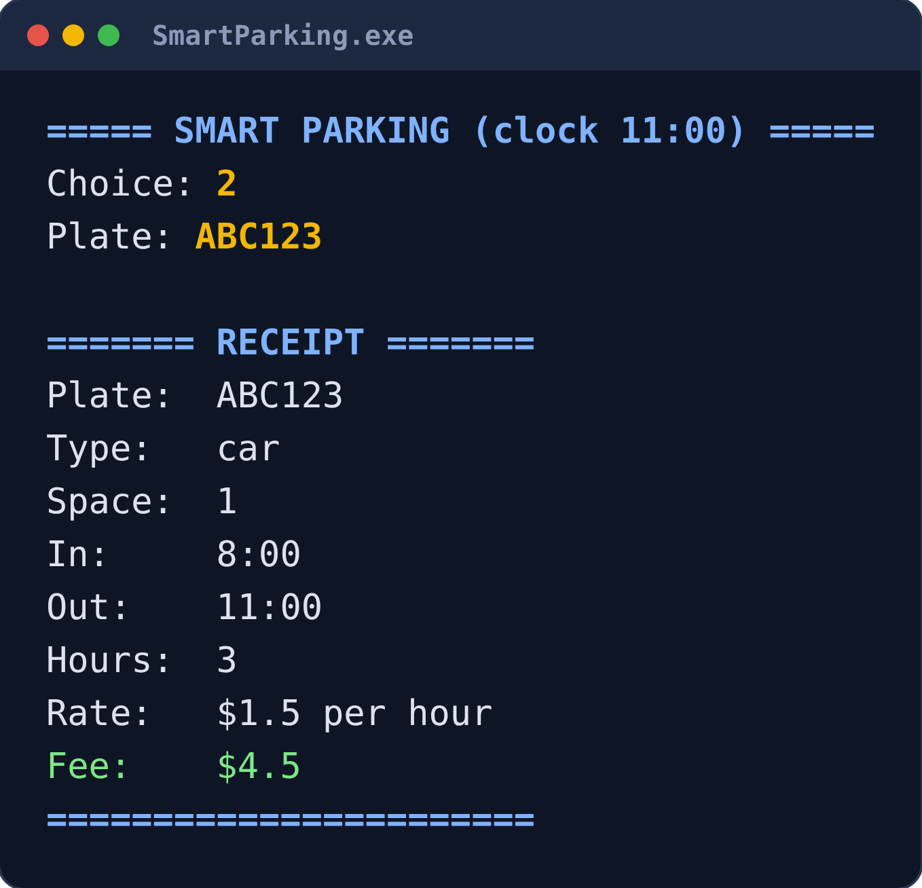
Algorithm 3: calculating the fee
04 · ALGORITHMS
fee = hours × rate
hours = clockHour - entryHour;
if (hours < 1) hours = 1; // minimum
Vehicle | Rate per hour | 3 hours
bike | $0.50 | $1.50
car | $1.50 | $4.50
getRate() picks the rate with if / else.
Real receipt: 3 h × $1.50 = $4.50
Notes:
Speaker: Member 2 (1 minute). The clock is a whole number of hours, so hours is an int. If a vehicle leaves in the same hour, hours would be 0, so we charge a minimum of 1 hour; nobody parks for free. The screenshot is the real receipt from the demo. After printing it, remove() resets the four arrays at that index. The program prints $4.5 rather than $4.50 because we do not use iomanip. Hand over to Member 3.

Slide 10
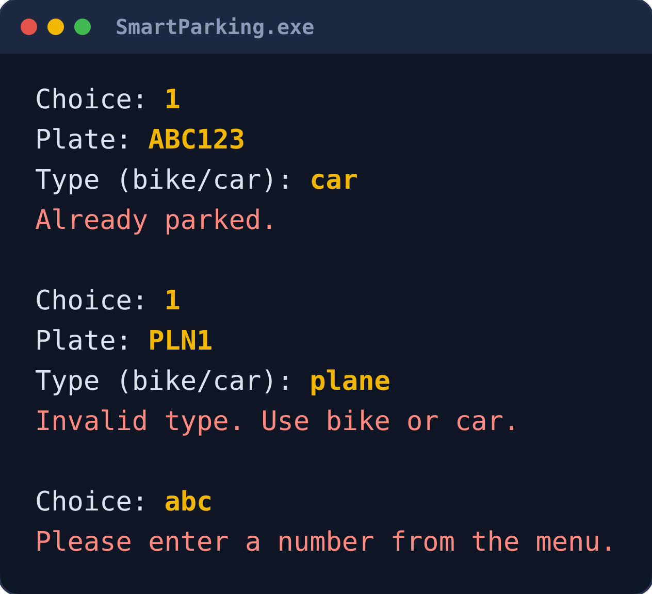
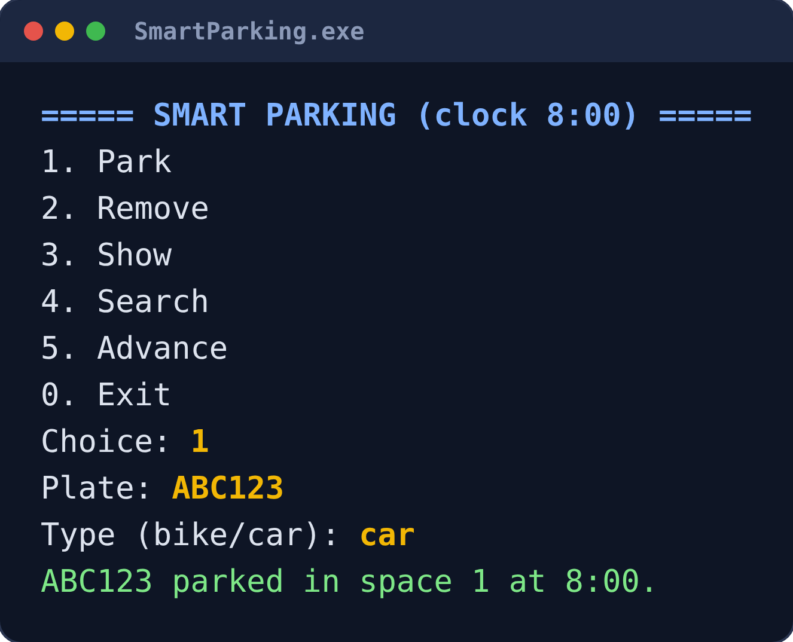
The menu loop in main()
05 · MENU AND INPUT
while (choice != 0)
keeps the program running until Exit.
if / else if
picks the action for choices 1–5.
cin.fail()
spots letters; cin.clear() and cin.ignore() reset the input.
Normal use: park ABC123
Bad input is caught, not crashed
Notes:
Speaker: Member 3 (1 minute). main() creates one ParkingLot object and repeats: print the menu, read a number, call the matching function. The loop stops at 0. Left: normal use. Right: our validation (duplicate plate, unknown type, letters at the menu). Without cin.clear() and cin.ignore(), typing letters would make the menu loop forever.

Slide 11
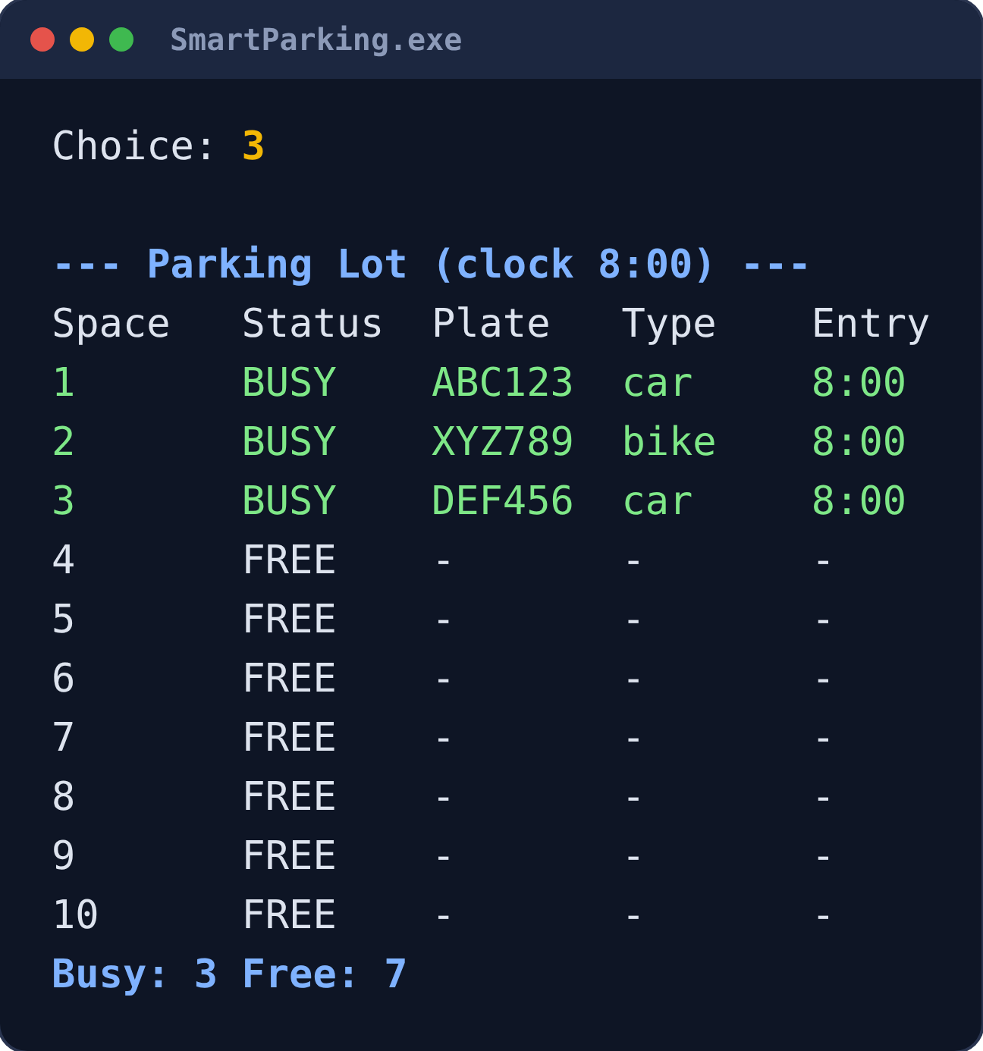
Live demo
06 · WORKING DEMO
1
Start: empty lot, clock 8:00
2
Park ABC123 car, XYZ789 bike, DEF456 car
3
Show lot → 3 busy, 7 free
4
Park ABC123 again → "Already parked."
5
Type "plane" → "Invalid type."
6
Advance the clock 3 hours → 11:00
7
Search DEF456 → space 3
8
Remove ABC123 → receipt, fee $4.5
9
Show lot → space 1 is free again
What step 3 should look like
Notes:
Speaker: Member 3 types (3 minutes); Members 1 and 2 narrate. Before class: compile once with run_console.bat. Inputs: 1, ABC123, car / 1, XYZ789, bike / 1, DEF456, car / 3 / 1, ABC123, car / 1, PLN1, plane / 5, 3 / 4, DEF456 / 2, ABC123 / 3 / 0. Closing the program empties the lot because there is no file saving; that is expected.

Slide 12
Course concepts in our code
07 · CONCEPTS USED
Concept | Where we use it
Class | ParkingLot: private data, public member functions, a constructor
Arrays | occupied, plates, types, entryHour, all size MAX_SPACES
Loops | for loops to scan the spaces; a while loop for the menu
Conditions | if / else for validation, fee rates, the 1-hour minimum and menu choices
Functions | one function per job: park, remove, search, findFree, getRate …
Constants | const int MAX_SPACES = 10 sets the size of every array and loop
Strings | plates and types stored as string and compared with ==
Libraries: only <iostream> and <string>. No pointers, vectors or other advanced features.
Notes:
Speaker: Member 3 (30 seconds). Run through the table quickly. We used only iostream and string and nothing beyond what we learned in class, so every member can explain any line.

Slide 13
What we would improve next
08 · LIMITATIONS AND NEXT STEPS
Current limitation | Possible improvement
Data is lost when the program closes | Save and load the lot with a file (fstream)
The clock counts whole hours only | Track minutes using the real time (ctime)
Types must be lowercase: "Car" is rejected | Convert input to lowercase with tolower()
Plates must be one word (cin reads one word) | Read whole lines with getline()
Only 10 spaces, all the same price | See our GUI edition: 30 spaces in 3 zones, with memberships
We left these out on purpose to keep the project small and within the concepts from class.
Notes:
Speaker: Member 2 (30 seconds). Instructors like to hear that you know your program's limits. Each one was a deliberate choice to keep the scope manageable. The last row is a bridge to our bonus GUI edition, if there is time to show it.

Slide 14
Who built what
09 · TEAM
MEMBER 1
MEMBER 2
MEMBER 3
[Name]
[Name]
[Name]
Class skeleton, parallel arrays, constructor, findFree, findByPlate, showLot
isValidType, getRate, park, remove (fee and receipt), advance
search, main menu loop, input validation, testing, slides
Presents: idea, goals, design
Presents: algorithms, limitations
Presents: menu, demo, concepts
Notes:
Speaker: Member 3 (30 seconds). Each member says their own line in one sentence. Every member should still be ready to explain any function.

Slide 15
Questions?
Thank you! Every member is ready to answer questions about the code.
Notes:
Likely questions:
1. Why parallel arrays instead of a class per space? The course asked for arrays and one class; the same index links the data.
2. Why no file saving? We kept the scope small; fstream saving is the first improvement.
3. Why a minimum of 1 hour? Otherwise leaving in the same hour would cost $0.
4. Why return -1? It can never be a real index, so it clearly means not found.
5. What if I type letters in the menu? cin fails; cin.clear() and cin.ignore() reset it.
6. Why lowercase types? We compare strings exactly.
7. What if the clock passes 24? It keeps counting (27:00); fees stay correct because we subtract entry from exit.
8. Why private data? Only the class's functions can change it, keeping the arrays consistent.
9. How to add more spaces? Change MAX_SPACES; every array and loop uses it.
10. Can a plate have a space? No, cin >> reads one word.

