Slide 1
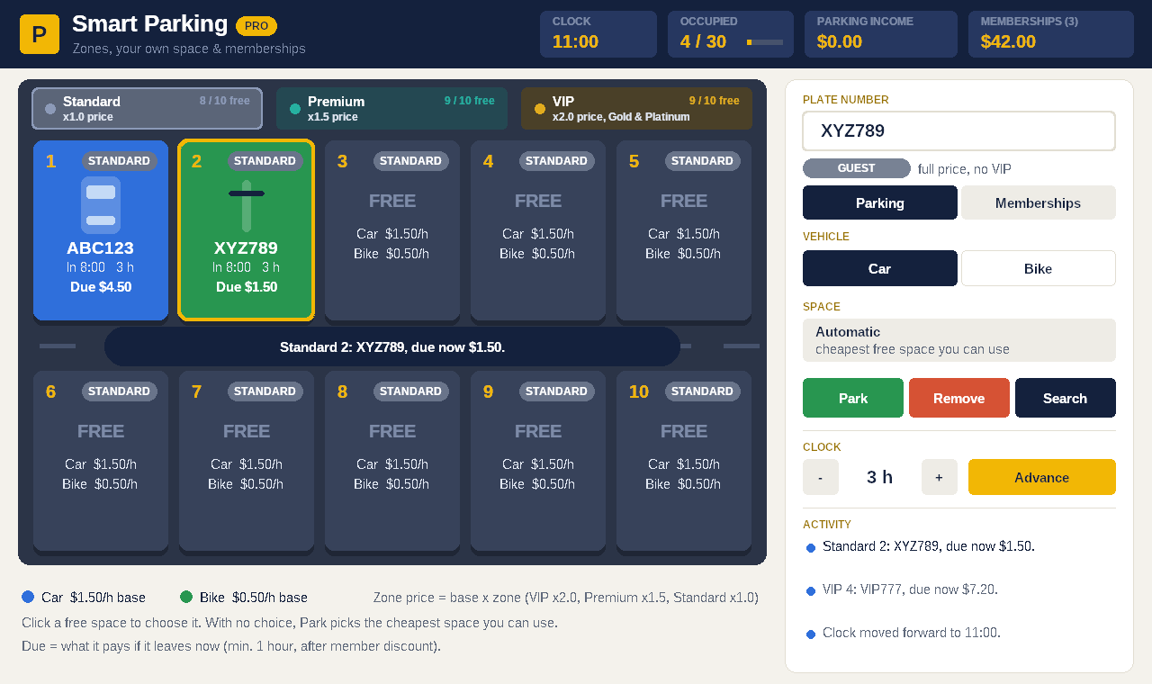
Smart Parking PRO
GUI edition: zones, your own space and memberships
[Member 1] · [Member 2] · [Member 3]
American University of Phnom Penh
Notes:
Speaker: Member 1 (30 seconds). "This is our bonus GUI edition. It uses the same ideas as the console version, but in a Windows window with zones, memberships and animations."

Slide 2
From console menu to a full window
01 · PROJECT IDEA
 | Console version | GUI edition (PRO)
Spaces | 10, all the same price | 30, in 3 zones on separate tabs
Choosing a space | Always the first free one | Click any free space, or let the system pick the cheapest
Prices | Hours × vehicle rate | Hours × vehicle rate × zone, minus member discount
Members | None | Guest, Silver, Gold, Platinum: pick, then Apply; remove any time
Interface | Text menu (1–5, 0) | Buttons, space cards, receipts and animations
Problem it solves: real parking lots charge different prices for better spots and reward regular customers. PRO shows how that works.
Notes:
Speaker: Member 1 (30 seconds). Compare the two versions row by row. The console version solves the basic problem; PRO adds what real lots do: premium spots, VIP spots and memberships.

Slide 3




What the GUI edition adds
02 · PROJECT GOALS
See everything at once
Pick your own space
All spaces, prices, fees due and income on one screen.
Click a free space, then press Park.
Fair prices by zone
Reward members
Standard ×1.0, Premium ×1.5, VIP ×2.0.
Discounts, VIP access and a free first hour for Platinum.
Notes:
Speaker: Member 1 (1 minute). Four goals; each one is a part of the screen we will show in the demo.

Slide 4
A tour of the screen
03 · SYSTEM DESIGN
1
Top bar
Clock, occupied spaces, parking and membership income
2
Zone tabs
Standard, Premium and VIP, with free spaces for each
3
Space cards
Plate, hours, fee due now and member badge
4
Lane messages
Every action appears in the driving lane
5
Control panel
Plate box, Car / Bike, Park, Remove, Search, clock
6
Memberships tab
Plans and the member list
Notes:
Speaker: Member 1 (1 minute). Point to each part of the screenshot in order 1 to 6.

Slide 5
How the parts work together
03 · SYSTEM DESIGN
WinMain()
WindowProc()
Draw + actions
Creates the window, then runs the message loop: the GUI version of main()
Windows calls it for every event: click, mouse move, timer, redraw
drawEverything() paints the screen; doPark(), doRemove(), doJoin() …
class ParkingLot
class MemberList
30 spaces in parallel arrays: occupied, plates, types, entryHour, tiers. chooseSpace(), park(), remove(), feeNow()
Up to 20 members in parallel arrays: plates, plans. join(), removeMember(), planOf()
Notes:
Speaker: Member 1 (1 minute). WinMain is our main(): it builds the window and loops over messages. WindowProc reacts to each event and calls our drawing and action functions. All data lives in two classes, ParkingLot and MemberList, both built from parallel arrays like the console version. The window never changes the arrays directly; it calls the class functions.

Slide 6
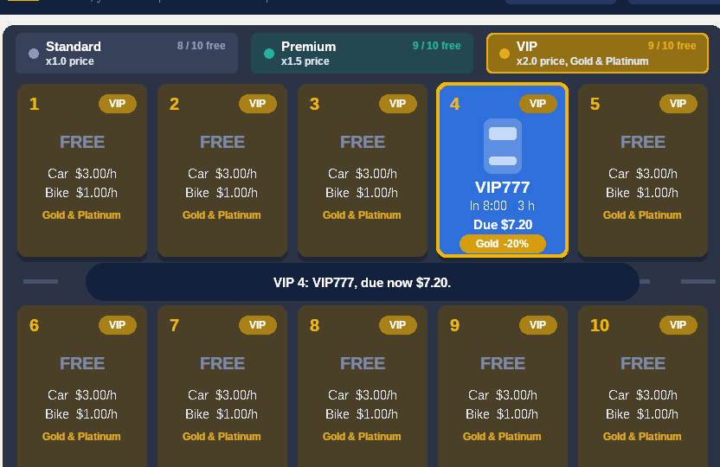
Three zones, each on its own tab
04 · ZONES
Zone | Spaces | Price | Car / h | Bike / h | Who
Standard | 1–10 | ×1.0 | $1.50 | $0.50 | Everyone
Premium | 1–10 | ×1.5 | $2.25 | $0.75 | Everyone
VIP | 1–10 | ×2.0 | $3.00 | $1.00 | Gold, Platinum
tiers[i] = i / SPACES_PER_TIER;
// 0-9 Standard, 10-19 Premium, 20-29 VIP
rate = baseRate(type) * tierMultiplier[t];
Zone names, multipliers and colours are parallel arrays too.
VIP tab: a Gold member in VIP 4
Notes:
Speaker: Member 2 (1 minute). Each zone is a tab with 10 spaces, numbered 1 to 10 inside the zone, so Premium 4 and VIP 4 are different spaces. Internally there is one array of 30 spaces; i / 10 gives the zone. The price is the base vehicle rate times the zone multiplier.

Slide 7
Algorithm 1: pick the cheapest space
04 · ALGORITHMS
int chooseSpace(int plan) {
for (int t = 0; t < TIER_COUNT; t++) {
if (t == 2 && !planVip[plan]) {
continue; // VIP: Gold & Platinum
}
for (int i = 0; i < MAX_SPACES; i++) {
if (!occupied[i] && tiers[i] == t) {
return i;
}
}
}
return -1; // nothing you may use
}
Nested loops
Outer loop: zones from cheapest to most expensive. Inner loop: spaces.
continue
Skips the VIP zone for Guest and Silver members.
Your own choice
Clicking a space skips this search, but park() still checks it is free and allowed.
Notes:
Speaker: Member 2 (1 minute). When no space is chosen, Park calls chooseSpace. The outer loop goes through the zones from cheapest to most expensive, the inner loop through the spaces, so the first match is the cheapest free space. continue skips VIP for members without VIP access.

Slide 8
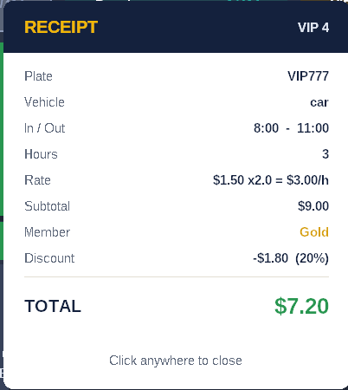
Algorithm 2: fee with zones and memberships
04 · ALGORITHMS
fee = hours × rate × zone × (1 − discount)
Example: VIP777 | Value
Car, VIP zone | $1.50 × 2.0 = $3.00 / h
Parked 8:00 → 11:00 | 3 hours → $9.00
Gold member | − 20% = − $1.80
Total | $7.20
Platinum: the first hour is free (hours − 1) before the 30% discount.
The real receipt from the program
Notes:
Speaker: Member 2 (1 minute). Walk through the example: 3 hours in a VIP space as a Gold member is 3 × $3.00 = $9.00, minus 20% = $7.20, the same number as the receipt. Each card also shows 'Due' live: what the vehicle would pay if it left now.

Slide 9
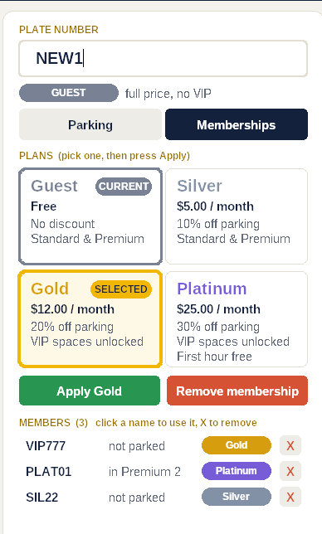
Plans: pick one, then press Apply
05 · MEMBERSHIPS
Plan | Price | Discount | VIP | Extra
Guest | Free | 0% | No
Silver | $5 / month | 10% | No
Gold | $12 / month | 20% | Yes
Platinum | $25 / month | 30% | Yes | 1st hour free
1
Type a plate
2
Click a plan: it is only SELECTED
3
Press Apply to confirm
X
Remove membership, or X in the list
Gold is selected but not yet applied
Notes:
Speaker: Member 3 (1 minute). Plans are stored in parallel arrays: name, price, discount, VIP access, free hour. Clicking a plan only selects it; Apply confirms it and adds the monthly fee to membership income. Members can be removed with the red button or the X next to each name.

Slide 10
Algorithm 3: removing from an array
05 · MEMBERSHIPS
Remove SIL22:
string removeMember(string plate) {
int k = find(plate);
if (k == -1) return plate + " is not a member.";
for (int j = k; j < count - 1; j++) {
plates[j] = plates[j + 1];
plans[j] = plans[j + 1];
}
count--;
...
}
before
VIP777
SIL22
TEMP9
PLAT01
after
VIP777
TEMP9
PLAT01
empty
Everyone after SIL22 moves one place left, then count goes from 4 to 3. The same idea works for any array.
Notes:
Speaker: Member 3 (1 minute). Arrays have a fixed size, so to delete a member we shift everyone after it one step left and reduce count. Point at the before and after rows.

Slide 11
Events, drawing and animation
06 · HOW THE WINDOW WORKS
Message loop
Double buffering
GetMessage() waits for an event, DispatchMessage() sends it to WindowProc.
Each frame is drawn on a hidden picture first, then copied at once: no flicker.
Timer animation
Smooth motion
About 60 times a second the timer redraws while something moves: cars drive in and out, money counts up.
progress() gives 0 → 1, easeOut() slows the end, blend() mixes two colours.
Notes:
Speaker: Member 3 (1 minute). Windows programs are event driven: instead of reading a menu number, we wait for messages like clicks and timer ticks. Drawing happens in WM_PAINT using double buffering. The animations are simple maths: progress goes from 0 to 1 over half a second.

Slide 12
Live demo
07 · WORKING DEMO
1
Memberships: VIP777 → pick Gold → Apply
2
Parking: ABC123, Car, press Park → Standard 1 (cheapest)
3
VIP tab: click VIP 4 with guest DEF456 → blocked
4
VIP777 → click VIP 4 → Park
5
Premium tab: pick 2 for a bike
6
Advance the clock 3 hours: Due amounts go up
7
Remove VIP777 → receipt $7.20
8
Remove a membership with X
Notes:
Speaker: Member 3 drives (3 minutes). Open SmartParkingPro.exe before class to check it starts. Follow the steps in order; each step shows one feature. Step 3 shows the VIP rule message in red in the driving lane.

Slide 13
The same course concepts, scaled up
08 · CONCEPTS USED
Concept | Where we use it in PRO
Classes | ParkingLot and MemberList, each with private data and public functions
Arrays | Spaces, zones, plans, members and even the buttons are parallel arrays
Loops | Nested loops in chooseSpace(); shifting loop in removeMember()
Conditions | VIP rule, Platinum free hour, which button was clicked
Functions | One job each: park, remove, join, removeMember, drawCard, easeOut …
Windows API | Comes with Windows: CreateWindow, messages, GDI drawing, a timer
Build: g++ SmartParkingPro.cpp -o SmartParkingPro.exe -mwindows -lgdi32
Notes:
Speaker: Member 3 (30 seconds). The GUI did not need new course concepts for the logic: it is the same classes, arrays, loops and functions, just more of them. The only new part is the Windows API, which is built into Windows.

Slide 14
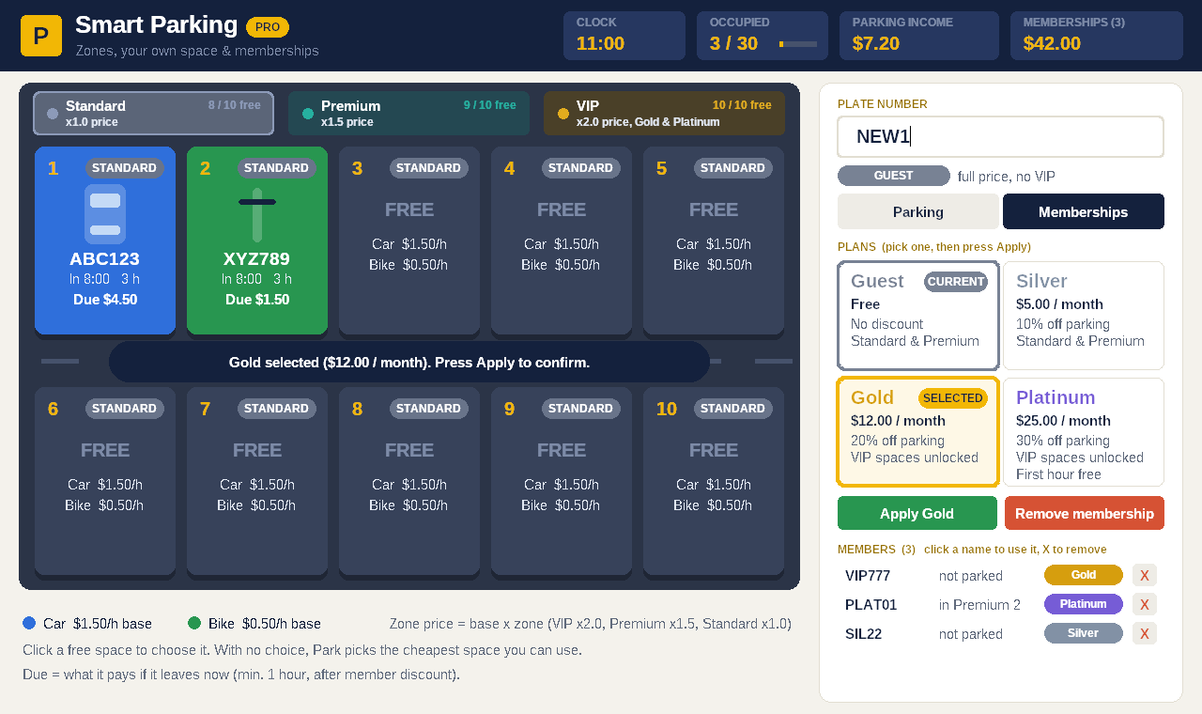
Questions?
Thank you for watching our GUI edition.
Notes:
Likely questions:
1. Why one array of 30 instead of three arrays? One array keeps every function the same as the console version; i / 10 gives the zone.
2. How does it pick a space automatically? chooseSpace() loops through zones from cheapest to most expensive.
3. Why can't Silver park in VIP? planVip[] is false for Guest and Silver; park() checks it.
4. How is a member removed? Shift everyone after it one place left, then count--.
5. How do the animations work? A timer redraws ~60 times a second while progress() goes from 0 to 1.
6. Why not std::to_string? Our MinGW 6.3 does not support it, so intToText() builds the digits with % 10 and / 10.
7. Is data saved? No, like the console version; file saving would be the next step.

