Slide 1


Glossier: Designing Visibility and Belonging

Slide 2
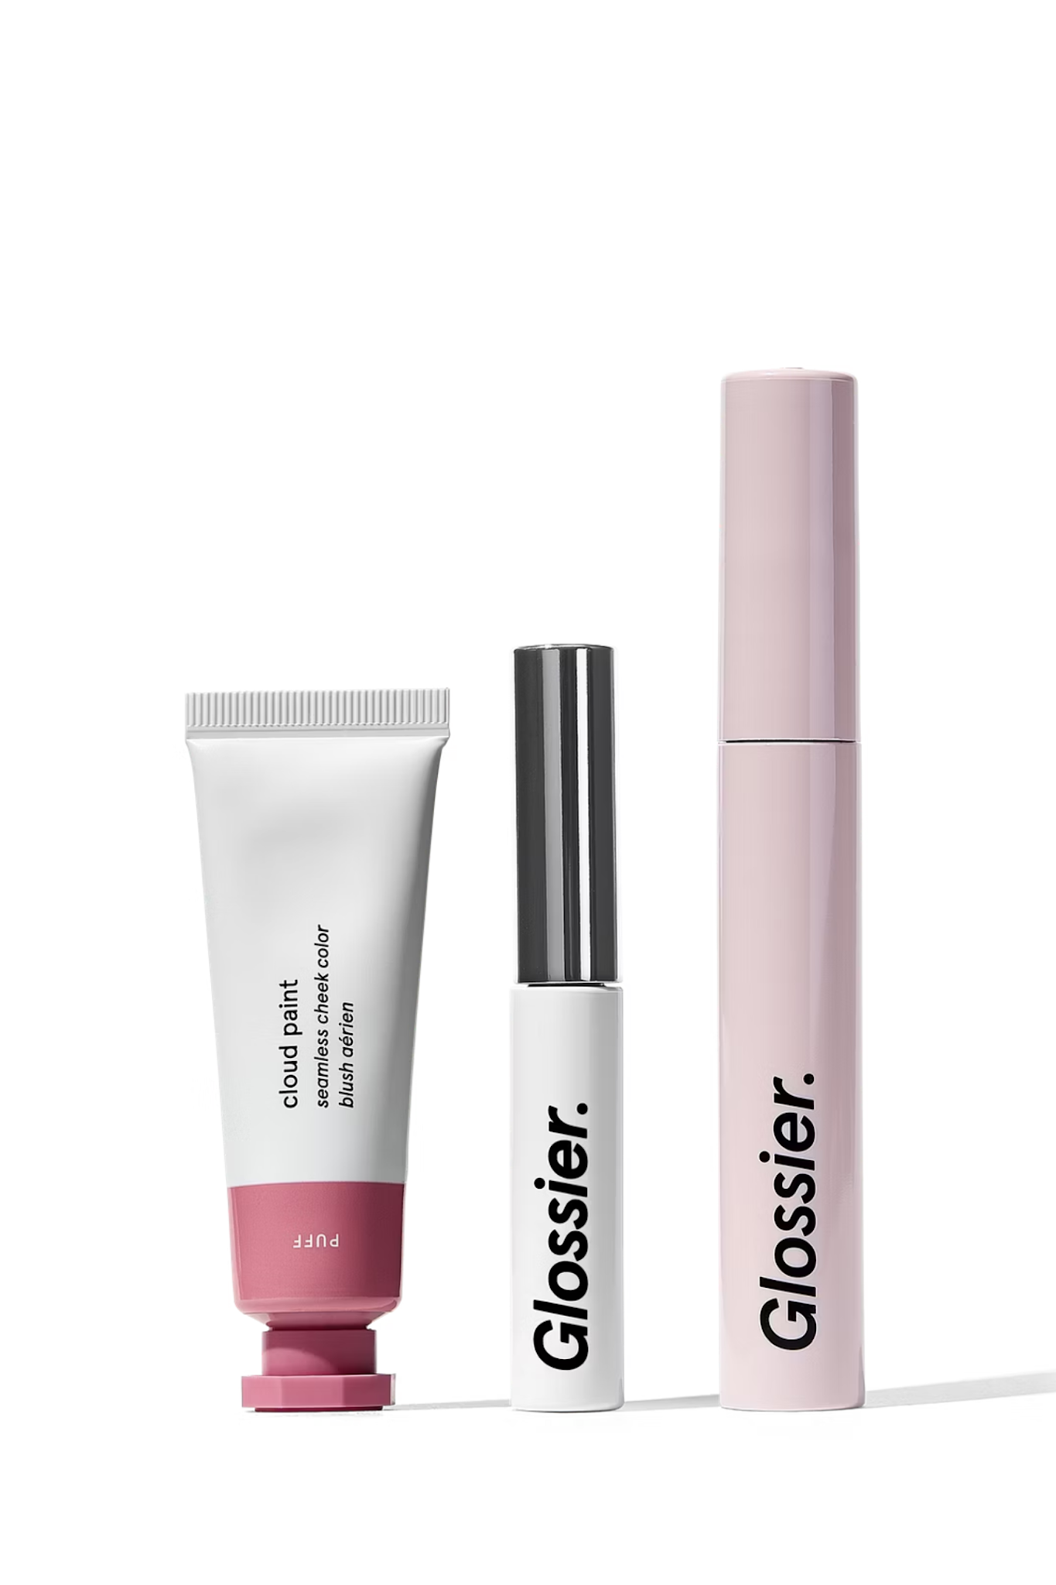
What Glossier Is
Glossier is a beauty brand that built its identity less through traditional advertising and more through design choices that felt intentional, recognizable, and social.
It sells skincare and makeup, but the brand experience extends far beyond the products themselves. Glossier was designed to feel minimal, modern, and easy to recognize in everyday life.

Slide 3


Creative Decision #1: Choosing to Look Different From Every Other Beauty Brand
One of Glossier's most important creative decisions was to intentionally not look like other beauty brands.
At the time, most makeup packaging was dark, glossy, and very "luxury." Glossier went in the opposite direction. Their products were minimal, soft, and almost utilitarian. Some of the lip glosses even resembled small paint tubes rather than traditional cosmetics.
The opportunity here was standing out in a crowded market where everything looked the same. The constraint was making minimal design still feel premium and intentional.
This decision was necessary because it visually communicated Glossier's core message: beauty should feel approachable, creative, and part of everyday life.

Slide 4
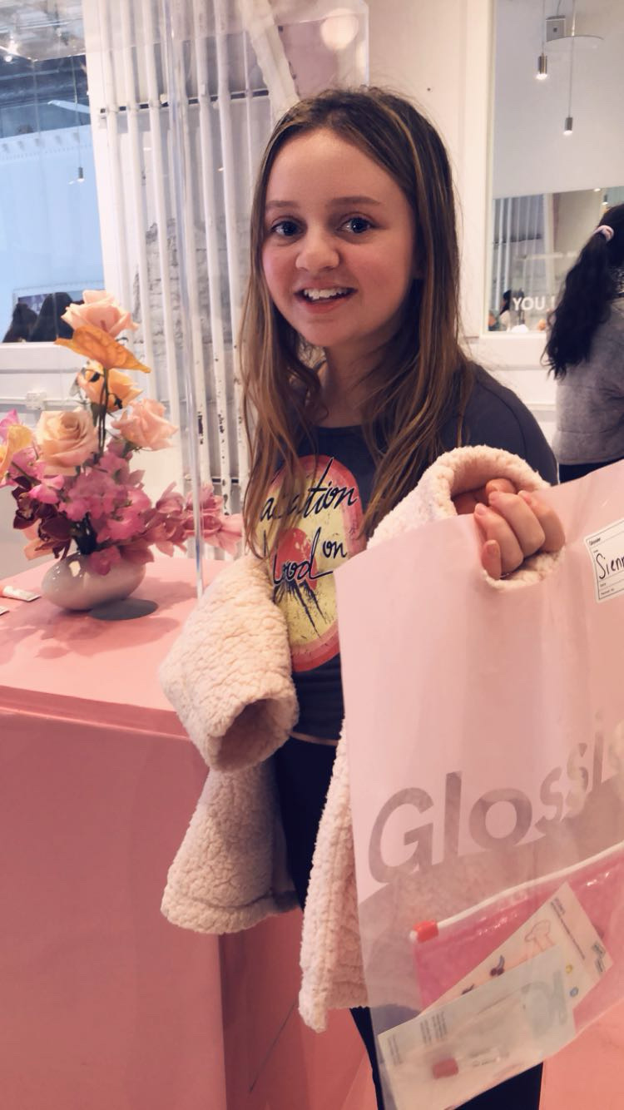
Creative Decision #2: Separating the Store From the Signal
A really interesting design decision Glossier made was not making the pop-up storefront itself loud or colorful.
Most Glossier pop-ups were actually minimalistic — white exteriors with a simple black text logo. Instead of using the building as the attention-grabber, Glossier used the bags as the visual signal.
The opportunity was creating visibility without disrupting the brand's clean aesthetic. The constraint was that pop-ups were temporary and couldn't rely on heavy signage or permanent structures.
This decision meant that you didn't notice Glossier because of a bright storefront — you noticed it because people were walking around the city carrying millenial pink bags.

Slide 5


Creative Decision #3: Ownership as belonging
The pink bags became a moving advertisement and a social signal.
At any school, any gym, any youtubers video– there was this bag carrying just about anything. People put pencils in it, makeup as it was intended, or even used it as a purse
The opportunity was turning customers into brand visibility. The constraint was that the packaging still had to be functional, reusable, and affordable.
This decision made the brand visible after the purchase, not just at the point of sale.

Slide 6
Reflection: Did It Work?
Yes, it worked.
Glossier managed to stay minimal while still being highly visible. Instead of relying on loud storefronts or heavy branding, the brand let its customers carry the identity for them.
If anything, Glossier shows how design can create recognition and belonging without needing excess.
What could have been done differently is expanding inclusivity earlier and adapting more quickly to changes in beauty culture, but the core design strategy was extremely strong.

Slide 7
Final Takeaway
Glossier proves that:
Visibility doesn't have to come from architecture
Packaging can function as wayfinding
Ownership can become identity
By separating the store from the signal, Glossier used design to turn everyday people into moving landmarks — and that's what made the brand feel everywhere.

