Slide 1
CSE110A: Compilers
The dog ran across the park
ARTICLE
NOUN
VERB
PREPOSITION
ARTICLE
NOUN
Topics:
Lexical Analysis:
Short comings of naïve scanner
Regular expressions:
Recursive definition
Syntactic sugar
groups
04A-lexers-re(55)

Slide 2
Review

Slide 3
Naïve implementation
A scanner that implements
ID = [characters]
NUM = [numbers]
ASSIGN = ”=“
PLUS = “+”
MULT = “*”
IGNORE = [“ “]

Slide 4
Naïve implementation
class StringStream:
def __init__(self, input_string):
self.string = input_string
def is_empty(self):
return len(self.string) == 0
def peek_char(self):
if not self.is_empty():
return self.string[0]
return None
def eat_char(self):
self.string = self.string[1:]
Building block:

Slide 5
Naïve implementation
Building block:
class StringStream:
def __init__(self, input_string):
self.string = input_string
def is_empty(self):
return len(self.string) == 0 # returns bool
def peek_char(self):
if not self.is_empty():
return self.string[0] # returns first char
return None # the string is empty
def eat_char(self):
self.string = self.string[1:] # rest of string
This class allows strings to be read as if we were doing I/O from a file.
So you are implementing with an abstraction that works both from a string or from a file.

Slide 6
Naïve implementation
First step in implementing the scanner
class NaiveScanner:
def __init__(self, input_string):
self.ss = StringStream(input_string) # get a line of code to work on
def token(self):
while self.ss.peek_char() in IGNORE:
self.ss.eat_char() # ignore blanks
if self.ss.is_empty():
return None
ID = [characters]
NUM = [numbers]
ASSIGN = ”=“
PLUS = “+”
MULT = “*”
IGNORE = [“ “]

Slide 7
Naïve implementation
First step in implementing the scanner
class NaiveScanner:
def token(self):
...
if self.ss.peek_char() == "+":
value = self.ss.peek_char()
self.ss.eat_char()
return ("ADD", value)
if self.ss.peek_char() == "*":
value = self.ss.peek_char()
self.ss.eat_char()
return ("MULT", value)
ID = [characters]
NUM = [numbers]
ASSIGN = ”=“
PLUS = “+”
MULT = “*”
IGNORE = [“ “]

Slide 8
Naïve implementation
First step in implementing the scanner
class NaiveScanner:
def token(self):
...
if self.ss.peek_char() in NUMS:
value = ""
while self.ss.peek_char() in NUMS:
value += self.ss.peek_char()
self.ss.eat_char()
return ("NUM", value)
ID = [characters]
NUM = [numbers]
ASSIGN = ”=“
PLUS = “+”
MULT = “*”
IGNORE = [“ “]

Slide 9
Topics:
Naïve Parser:
Code demo and discussion
Regular expressions

Slide 10
Code Demo (demo1 part1)

Slide 11
Shortcomings of Naïve scanner
Any thoughts?

Slide 12
Shortcomings of Naïve scanner
IDs with numbers in them?
x1, y1, etc.
how would you solve?
Numbers with a decimal point in them?
4.5, 9999.99998
how would you solve this?
Two character operators:
++, +=
how would you solve this?

Slide 13
Shortcomings of Naïve scanner
IDs with numbers in them?
x1, y1, etc.
how would you solve?
Numbers with a decimal point in them?
4.5, 9999.99998
how would you solve this?
Two character operators:
++, +=
how would you solve this?
Things get really hacky really quickly!
Creates a bad design that is
not easily extended
or maintained

Slide 14
How do we solve this?
A new token definition language:
Regular Expressions (RE)
Tokens will be defined using regular expressions
Scanners can then utilize regular expression matchers
Benefits:
Extensible design
easy to add new tokens, modify existing definitions
Modular
Scanner can utilize common regex libraries
Cons:
Token definitions are restricted to regular languages
Potentially slower
Regular expression matchers are complicated

Slide 15
How do we solve this?
A new token definition language:
Regular expressions
Tokens will be defined using regular expressions
Scanners can then utilize regular expression matchers
Benefits:
Extensible design
easy to add new tokens, modify existing definitions
Modular
Scanner can utilize common regex libraries
Cons:
Token definitions are restricted to regular languages
Potentially slower
Regular expression matchers are complicated

Slide 16
Regular expressions
Some theory:
Given a language L, a string s is either part of that language or not
Integers are a language: “5”, “6”, “-7” is in the language. “abc” is not.
Languages are grouped into families depending on how “hard” it is to determine if a string is part of that language.

Slide 17
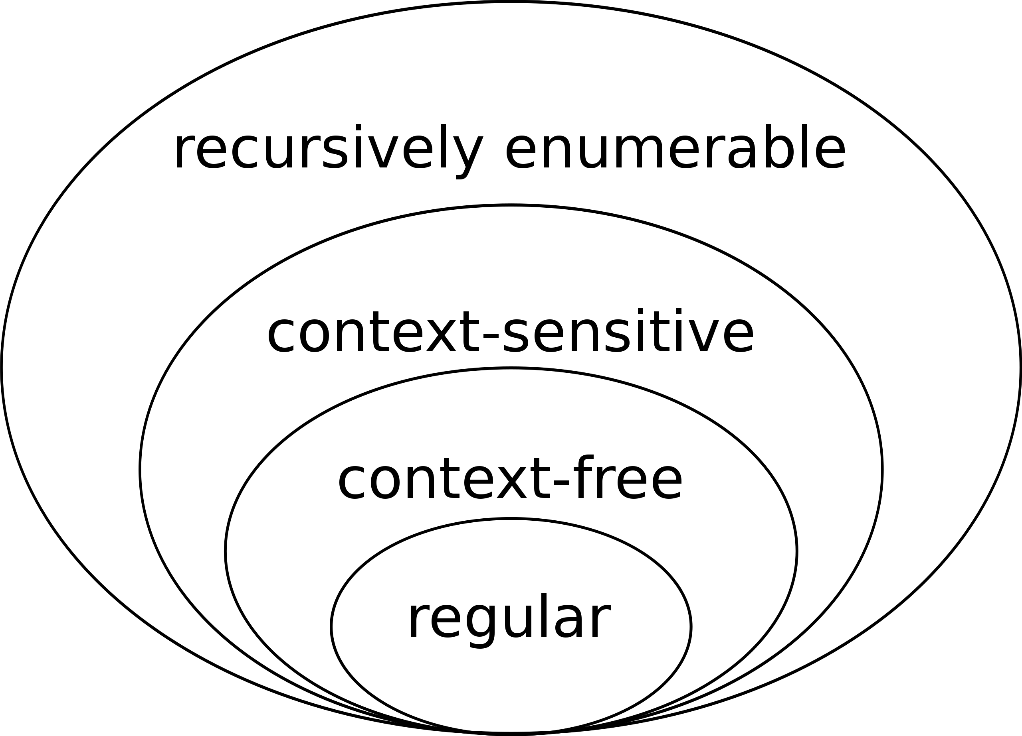
Regular expressions
The simplest languages are regular. We will use regular languages as our token language. We will use the next level: context-free, as the
language for our parser. Higher levels are interesting, but not as useful
in compilers. Why?
image source: wikipedia

Slide 18
Regular expressions
The simplest languages are regular. We will use regular languages as our token language. We will use the next level: context-free, as the
language for our parser. (e.g. ((( … ))) Higher levels are interesting, but not as useful
in compilers. Why? Because deciding if a string is in a recursively enumerable language is undecidable.
image source: wikipedia

Slide 19
Regular expressions
What is a regular language?
image source: wikipedia

Slide 20
Regular expressions
What is a regular language?
For this class: A regular language is a language that can be expressed as a regular expression.
image source: wikipedia

Slide 21
Regular expressions
What is a regular language?
For this class: A regular language is a language that can be expressed as a regular expression.
What is a regular expression?
image source: wikipedia

Slide 22
Regular expressions
We will define regular expressions (RE) recursively
We will show examples at each step.
And show to match them in Python
A string matches an RE if it belongs to the regular language defined by the RE
Python has a great RE matching library

Slide 23
Regular expressions in Python
# import the library
import re
# pattern is a string representing the RE
# the function reports whether string matches RE
re.fullmatch(pattern, string)

Slide 24
Regular expressions
We will define regular expressions (RE) recursively
Like any recursive function, we can start with the base case:
a regular expression can be a single character or the empty string

Slide 25
Regular expressions
We will define regular expressions (RE) recursively
Like any recursive function, we can start with the base case:
a regular expression can be a single character or the empty string
Example:
ASSIGN = “=“
PLUS = ”+”
Python:
import re
re.fullmatch(“=“, “=“)
re.fullmatch(“+”, “+”) # what happens here?

Slide 26
Regular expressions
When we define regular expressions, some characters are special.
They are operators in the regular expression language
If we want to use them as a character, then we need to ”escape them” with a \
“+” happens to be one of those characters
https://riptutorial.com/regex/example/15848/what-characters-need-to-be-escaped-
Python:
import re
re.fullmatch(“=“, “=“)
re.fullmatch(“\+”, “+”) # what happens here?

Slide 27
Regular expressions
We will define regular expressions (RE) recursively
Like any recursive function, we can start with the base case:
a regular expression can be a single character or the empty string
Python:
import re
re.fullmatch(““, ““)
Not super useful for us, but useful for the theory

Slide 28
Regular expressions
First recursive case: concatenation
Two REs can be concatenated by simply writing them in sequence:
RE1 = ”a”, RE2 = “b”
concatenated it is: RE12 = “ab”
This allows us to build words
Example:
FOR = “for“
WHILE = ”while”
Python:
import re
re.fullmatch(“for“, “for“)
re.fullmatch(“a+b”, “a+b”) # what happens here?

Slide 29
Can we define these tokens yet?
ARTICLE = {The, A, My, Your}
NOUN = {Dog, Car, Computer}
VERB = {Ran, Crashed, Accelerated}
ADJECTIVE = {Purple, Spotted, Old}
Tokens
Tokens Definitions

Slide 30
Can we define these tokens yet? No, we need one more operator
ARTICLE = {The, A, My, Your}
NOUN = {Dog, Car, Computer}
VERB = {Ran, Crashed, Accelerated}
ADJECTIVE = {Purple, Spotted, Old}
Tokens
Tokens Definitions

Slide 31
Regular expressions
Second recursive operator: choice (sometimes called ”union”, or “or”)
Two REs can be choiced together using the “|” operator
RE1 = “a”, RE2 = “b”
The choice is: RE1|2 = “a|b”
Matches either
Example:
OP = “*|+“
CMP = “==|<=|>=”
Python:
import re
re.fullmatch(“*|+“, “+“)
re.fullmatch(“==|<=|>=”, “==”)

Slide 32
Can we define these tokens yet?
ARTICLE = {The, A, My, Your}
NOUN = {Dog, Car, Computer}
VERB = {Ran, Crashed, Accelerated}
ADJECTIVE = {Purple, Spotted, Old}
Tokens
Tokens Definitions

Slide 33
Can we define these tokens yet? Yes!
ARTICLE = “The|A|Mine|Your”
NOUN = “Dog|Car|Computer”
VERB = “Ran|Crashed|Accelerated”
ADJECTIVE = “Purple|Spotted|Old”
Tokens
Tokens Definitions

Slide 34
Can we define these tokens yet?
ID = [characters]
NUM = [numbers]
ASSIGN = ”=“
PLUS = “+”
MULT = “*”
IGNORE = [“ “]

Slide 35
Can we define these tokens yet? No!
ID = [characters]
NUM = [numbers]
ASSIGN = ”=“
PLUS = “+”
MULT = “*”
IGNORE = [“ “]

Slide 36
Regular expressions
Last recursive operator: Repeat
Unary operator: *
RE1 = “a”
Repeat RE1 zero or more times: ”a*”
Example:
RE1 = “a*“
RE2 = “a*|b*”
RE3 = ”a|b*
Python:
import re
re.fullmatch(“a*|b*“, “aaa“)
re.fullmatch(“a*|b*”, “”)

Slide 37
Regular expressions
Last recursive operator: Repeat
Unary operator: *
RE1 = “a”
Repeat RE1 zero or more times: ”a*”
Example:
RE1 = “a*“
RE2 = “a*|b*”
RE3 = ”a|b*
Python:
import re
re.fullmatch(“a*|b*“, “aaa“)
re.fullmatch(“a*|b*”, “”)
Precedence?

Slide 38
Regular expressions
These are the theoretical foundational operators.
Most languages give syntactic sugar to make common cases easier
Most languages also break the theory
Perl regexes are extremely complicated
https://www.perlmonks.org/?node_id=809842
Python regexes (with recursion) can capture some context free languages
https://www.npopov.com/2012/06/15/The-true-power-of-regular-expressions.html#matching-context-free-languages

Slide 39
Regular expressions
strict repeat operator: +
one or more repeats (the * operator is 0 or more repeats)
derivation: “r+” = “rr*”

Slide 40
Regular expressions
Ranges:
digits [0-9]
alpha [a-z], [A-Z]
Derivation: [0-9] = ”1|2|3|4|5|6|7|8|9|0”
Lets try C style IDs: [a-zA-Z_][a-zA-Z_0-9]*
Hexadecimal numbers:

Slide 41
Regular expressions
Ranges:
digits [0-9]
alpha [a-z], [A-Z]
Derivation: [0-9] = ”1|2|3|4|5|6|7|8|9”
Lets try C style IDs: “[a-zA-Z][0-9a-zA-Z]*”
Hexadecimal numbers: “0x[0-9a-fA-F]+”

Slide 42
Regular expressions
optional operator ?
optional characters
“r?” = “|r”
Example: “ab?”

Slide 43
Regular expressions
optional operator ?
optional characters
“r?” = “|r”
Example: “ab?”
Let’s do simple floating-point numbers:

Slide 44
Regular expressions
optional operator ?
optional characters
“r?” = “|r”
Example: “ab?”
Let’s do simple floating-point numbers: “[0-9]+(\.[0-9]+)?”

Slide 45
Regular expressions
any character ‘.’
example using email (this is probably too general!)

Slide 46
Regular expressions
any character ‘.’
example using email (this is probably too general!)
”.*@.*\.com”

Slide 47
Using REs
What if we want to extract the domain or user name from the email?
We can use groups!
use ()s to delimitate groups
”(.*)@(.*\.com)”
Index the resulting object with [1] and [2] to get to the user name and domain respectively

Slide 48
Using REs
you can give groups id names rather than using indices
“(?P<name>.+)@(?P<domain>.+\.com)”

Slide 49
Example Using RE groups
you can give groups id names rather than using indices
“(?P<name>.+)@(?P<domain>.+\.com)”
import re
pattern = r"(?P<name>.+)@(?P<domain>.+\.com)"
email = "johndoe@example.com"
match = re.match(pattern, email) # apply pattern
if match:
name = match.group("name") # extract user name
domain = match.group("domain") # extract domain
print(f"Name: {name}, Domain: {domain}")
else:
print("No match found.")

Slide 50
But what is the r prefix in r’…’ for
pattern = r"(?P<name>.+)@(?P<domain>.+\.com)“
It stands for raw, and it indicates that \. Should not escape the .
But should correspond the two characters “\” and “.”
e.g. r’\n’ implies the two characters “\” and “\n” whereas
‘\n’ implies a line feed.

Slide 51
REs are good for?
Scanning large amounts of documents quickly, looking for:
Websites
Email
Profiling numbers
Variable usages
What else?

Slide 52
RE examples
What can REs not do?
Nested structures, such as parenthesis matching:
Try doing arithmetic expressions
You will not be able to match ()s
Classical example: REs cannot capture same number of repeats:
A{N}B{N}
REs cannot parse HTML!!!
One of the most upvoted answers on stackoverflow!
https://stackoverflow.com/questions/1732348/regex-match-open-tags-except-xhtml-self-contained-tags/1732454#1732454

Slide 53
For your homework
You’ll need to write tokens for a simple programming language, including:
ID = [characters]
NUM = [numbers]
ASSIGN = ”=“
PLUS = “+”
MULT = “*”
IGNORE = [“ “]

Slide 54
How to implement an RE matcher?
Overview: first you have to parse the RE...
Chicken and egg problem
The language of REs is not a regular language. It is context sensitive (because it has ()s)
But once you can parse the RE, there are several options

Slide 55
How to implement an RE matcher?
parsing with Brzozowski derivatives
We discuss this in CSE211 (Graduate Compiler Course)
Elegant solution, but difficult to make fast
https://harrisongoldste.in/languages/2017/09/30/derivatives-of-regular-expressions.html
Convert to an automata
Learn more about this CSE103
A cool website about FSMs (Finite State Machines)
https://ivanzuzak.info/noam/webapps/fsm_simulator/
But we are not implementing an RE matcher, just using it.

Slide 56
How to use REs in a scanner implementation?
Will be the next topic of discussion.

