Slide 1
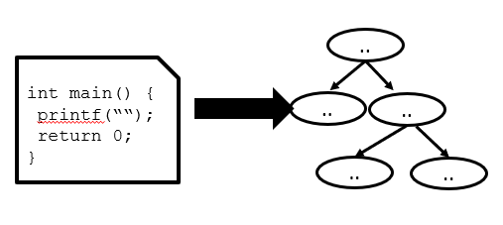
CSE110A: Compilers
Topic:
Bottom Up Parsing
Lecturer: Mrcelo Siero
Accreditation:
Most slides taken directly from Stanfords: CS143 Lecture 8
slide design by: Prof. Alex Aiken with some modifications by
Marcelo Siero
Source: https://web.stanford.edu/class/cs143/lectures/lecture08.pdf

Slide 2
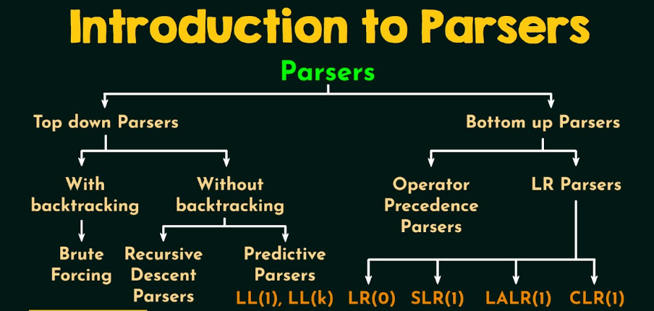
Source: https://www.youtube.com/watch?v=OIKL6wFjFOo

Slide 3
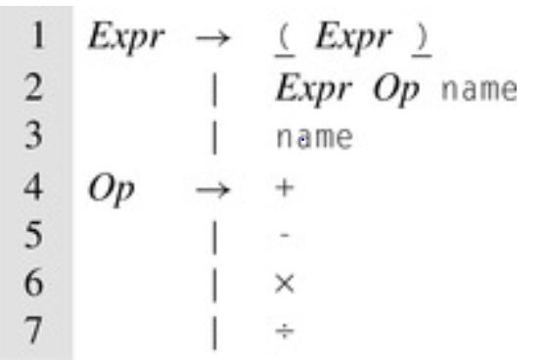

Some Definitions
Context Free Grammar: Formally, a context-free grammar G is a quadruple ( T, NT, S, P) where: T is a set of terminals, NT is a set of non-terminals, S is a Start symbol, and P a set of Productions all for language L(G).
Ambiguity: A grammar G is ambiguous if some sentence in L( G) has more than one rightmost (or leftmost) derivation.
Sentential Form: a string of symbols that occurs as one step in a valid derivation
Derivation: a sequence of rewriting steps that begins with the grammar's start symbol and ends with a sentence in the language
BNF grammar for Expressions
Sentence: a string of symbols that can be derived from the rules of a grammar, i.e. a sentential form without non-terminals.
Classical ambiguous grammar from Algol 60

Slide 4
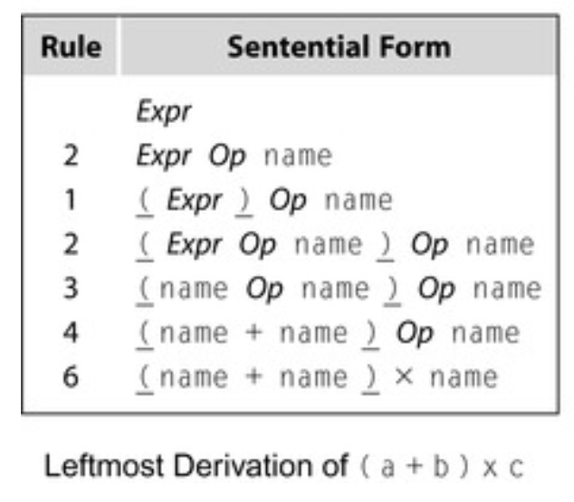
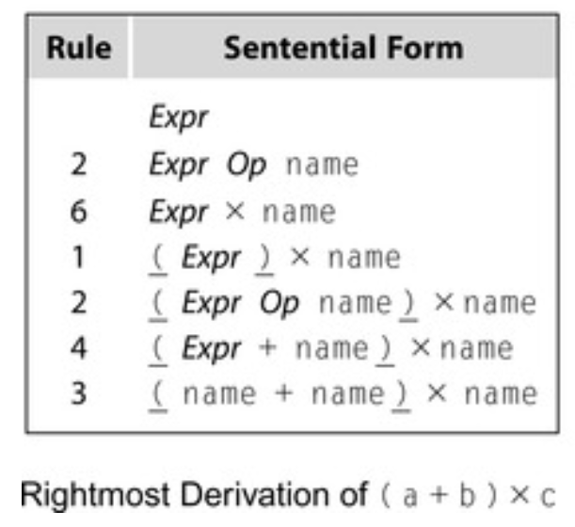
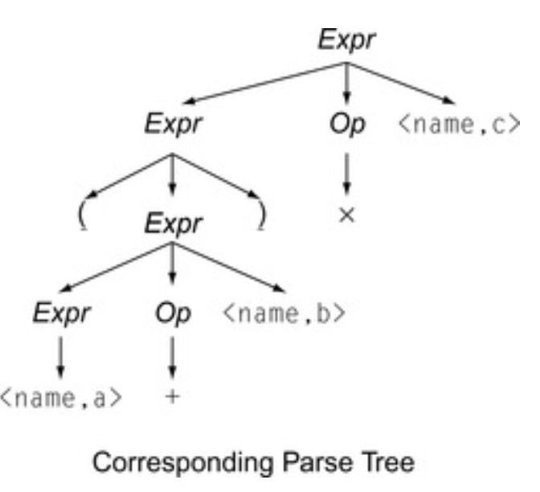



























Leftmost and Rightmost Derivations
Note that leftmost derivations tend to be right associative
Rightmost derivations left associative.

Slide 5
Bottom-Up Parsing
Bottom-up parsing is more general than top-down parsing
And just as efficient
Builds on ideas in top-down parsing
Bottom-up is a very popular method
Concepts: State Table Algorithms for Advanced
Course in compilers.

Slide 6
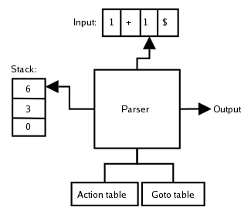
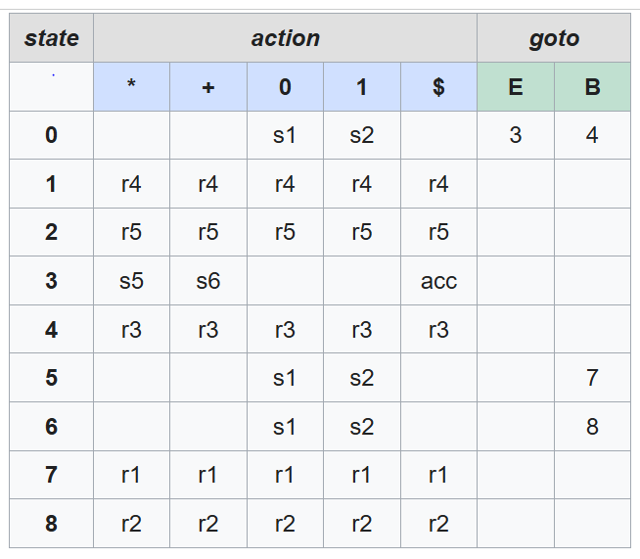
Bottom-Up Parsing
example of LR parsing
LR parsing maintains a stack of states.
There is a 1-to-1 correspondence:
each grammar symbol shifted/reduced to exactly one state pushed on the stack
(1) E → E * B
(2) E → E + B
(3) E → B
(4) B → 0
(5) B → 1
T: *, +, 0, 1
NT: E, B
Start: E
Actions:
Shift: sn , push state n, eat input token
Reduce: rm, reduce with rule m
Accept: acc, indicates input string accepted.

Slide 7
Bottom-Up Parsing (Pseudo Code from EAC Ch3.4)
push $;
push start_state: s₀;
word = NextWord();
while (true)do:
state = top_of_stack
if (Action[state.word] = “reduce A::=b”):
pop 2 * |b| symbols;
state = top_of_stack
push A;
push Goto[state, A];
elif (Action[state.word] = “shift s_{i}”):
push word;
push s_{i};
word = NextWord();
elif (Action[state.word] = “accept”):
break
else:
Fail();
report_success
S : Expr
1. Expr : Expr + Term
2. | Expr - Term
3. | Term
4. Term : Term * Factor
5. | term / Factor
6. | Factor
7. Factor : ( Expr )
| num
9. | name

Slide 8
Bottom-Up Parsing (Pseudo Code from EAC Ch3.4)
re-written for clarity
# Initialize stack with start state and end marker
stack = [(s0, None)] # None means no symbol yet
lookahead = NextWord() # first input symbol
while True:
# Get the current parser state from top of stack
state = stack[-1][0] # top tuple: (state, symbol)
# Look up action in the parsing table using (state,lookahead)
action = Action[state, lookahead]
if action is "reduce A -> β":
# Pop 2 * |β| elements (state, symbol pairs) for RHS
for i in range(len(β)):
stack.pop()
# Top of stack is now the state before β
prev_state = stack[-1][0]
# Push LHS nonterminal A
stack.append((Goto[prev_state, A], A))
elif action is "shift s_i":
# Push the terminal and new state
stack.append((s_i, lookahead))
# Advance input
lookahead = NextWord()
elif action is "accept":
break
else:
Fail() # syntax error
S : Expr
1. Expr : Expr + Term
2. | Expr - Term
3. | Term
4. Term : Term * Factor
5. | term / Factor
6. | Factor
7. Factor : ( Expr )
| num
9. | name

Slide 9
An Introductory Example
Bottom-up parsers don’t need left-factored grammars
Revert to the “natural” grammar for our example:
E → T + E
| T
T → int * T
| int
| (E)
Consider the string: int * int + int

Slide 10
The Idea
E → T + E | T
T → int * T | int | (E)
Bottom-up parsing reduces a string to the start symbol by inverting productions:
int * int + int int * T + int T + int
T + T T + E E
T → int
T → int * T T → int
E → T
E → T + E

Slide 11
Observation
E → T + E | T
T → int * T | int | (E)
Read the productions in reverse (bottom to top)
This is a reverse rightmost derivation!
int * int + int int * T + int T + int
T + T T + E E
T → int
T → int * T T → int
E → T
E → T + E

Slide 12
Important Fact #1
Important Fact #1 about bottom-up parsing:
A bottom-up parser traces a rightmost derivation in reverse, i.e. from a Sentence to Start symbol.

Slide 13
E → T + E | T
T → int * T | int | (E)
A Bottom-up Parse
E
int * int + int
int * T + int
T
E
T + int
T + T
T
T
T + E
E
int
*
int
+
int

Slide 14
A Bottom-up Parse in Detail (1)
E → T + E | T
T → int * T | int | (E)
int * int + int
int
*
int
+
int

Slide 15
A Bottom-up Parse in Detail (2)
E → T + E | T
T → int * T | int | (E)
int * int + int
int * T + int
T
int
*
int
+
int

Slide 16
A Bottom-up Parse in Detail (3)
E → T + E | T
T → int * T | int | (E)
int * int + int
int * T + int
T
T + int
T
int
*
int
+
int

Slide 17
A Bottom-up Parse in Detail (4)
E → T + E | T
T → int * T | int | (E)
int * int + int
int * T + int
T
T + int
T + T
T
T
int
*
int
+
int

Slide 18
A Bottom-up Parse in Detail (5)
E → T + E | T
T → int * T | int | (E)
int * int + int
int * T + int
T
E
T + int
T + T
T
T
T + E
int
*
int
+
int

Slide 19
A Bottom-up Parse in Detail (6)
E → T + E | T
T → int * T | int | (E)
E
int * int + int
int * T + int
T
E
T + int
T + T
T
T
T + E
E
int
*
int
+
int

Slide 20
Where Do Reductions Happen?
Important Fact #1 has an interesting consequence:
Let αβω be a step of a bottom-up parse
Assume the next reduction is by X→ β
Then ω is a string of terminals
Why? Because αXω → αβω is a step in a right-most derivation

Slide 21
Notation
Idea: Split string into two substrings
Right substring is as yet unexamined by parsing (a string of terminals)
Left substring of sentential form has both terminals and non-terminals
The dividing point is marked by a |
The | is not part of the string
Initially, all input is unexamined |x₁x₂ . . . x_{n}

Slide 22
Shift-Reduce Parsing
Bottom-up parsing uses only two kinds of actions:
Shift (Push onto a Stack)
Reduce (Apply a production rule)

Slide 23
Shift
Shift: Move | one place to the right
– Shifts a terminal to the left string
ABC|xyz ⇒ ABCx|yz

Slide 24
Reduce
Apply an inverse production at the right end of the left string
– If A → xy is a production, then
Cbxy|ijk ⇒ CbA|ijk

Slide 25
The Example with Reductions Only
E → T + E | T
T → int * T | int | (E)
int * int | + int
int * T | + int
reduce T → int
reduce T → int * T
T + int |
reduce T → int
T + T |
reduce E → T
T + E |
reduce E → T + E
E |

Slide 26
The Example with Shift-Reduce Parsing
E → T + E | T
T → int * T | int | (E)
| int * int + int shift
int | * int + int shift
int * | int + int shift
int * int | + int reduce T → int
int * T | + int reduce T → int * T
T | + int shift
T + | int shift
T + int |
reduce T → int
T + T |
reduce E → T
T + E |
reduce E → T + E
E |

Slide 27
A Shift-Reduce Parse in Detail (1)
E → T + E | T
T → int * T | int | (E)
| int * int + int
int
↑
*
int
+
int

Slide 28
A Shift-Reduce Parse in Detail (2)
E → T + E | T
T → int * T | int | (E)
| int * int + int
int | * int + int
int * int
↑
+
int

Slide 29
A Shift-Reduce Parse in Detail (3)
E → T + E | T
T → int * T | int | (E)
| int * int + int
int | * int + int int * | int + int
int
*
int
↑
+
int

Slide 30
A Shift-Reduce Parse in Detail (4)
E → T + E | T
T → int * T | int | (E)
| int * int + int
int | * int + int int * | int + int int * int | + int
int
*
int +
↑
int

Slide 31
A Shift-Reduce Parse in Detail (5)
E → T + E | T
T → int * T | int | (E)
| int * int + int
int | * int + int int * | int + int int * int | + int int * T | + int
T
int
*
int +
↑
int

Slide 32
A Shift-Reduce Parse in Detail (6)
E → T + E | T
T → int * T | int | (E)
| int * int + int
int | * int + int int * | int + int
int * int | + int
T
int * T | + int
T | + int
T
int
*
int +
↑
int

Slide 33
A Shift-Reduce Parse in Detail (7)
E → T + E | T
T → int * T | int | (E)
| int * int + int
int | * int + int int * | int + int
int * int | + int
T
int * T | + int
T | + int
T + | int
T
int
*
int
+
int
↑

Slide 34
A Shift-Reduce Parse in Detail (8)
E → T + E | T
T → int * T | int | (E)
| int * int + int
int | * int + int int * | int + int
int * int | + int
T
int * T | + int
T | + int
T + | int
T
T + int |
int
*
int
+
int
↑

Slide 35
A Shift-Reduce Parse in Detail (9)
E → T + E | T
T → int * T | int | (E)
| int * int + int
int | * int + int int * | int + int
int * int | + int
T
int * T | + int
T | + int
T + | int
T
T
T + int |
T + T |
int
*
int
+
int
↑

Slide 36
A Shift-Reduce Parse in Detail (10)
E → T + E | T
T → int * T | int | (E)
| int * int + int
int | * int + int int * | int + int
int * int | + int
T
E
int * T | + int
T | + int
T + | int
T
T
T + int |
T + T |
int
*
int
+
int
T + E |
↑

Slide 37
A Shift-Reduce Parse in Detail (11)
E → T + E | T
T → int * T | int | (E)
| int * int + int
int | * int + int
E
int * | int + int
int * int | + int
T
E
int * T | + int
T | + int
T + | int
T
T
T + int |
T + T |
int
*
int
+
int
T + E |
↑
E |

Slide 38
The Stack
Left string can be implemented by a stack
– Top of the stack is the |
Shift pushes a terminal on the stack
Reduce pops 0 or more symbols off of the stack (production RHS) and pushes a non-terminal on the stack (production LHS)

Slide 39
Conflicts
In a given state, more than one action (shift or reduce) may lead to a valid parse
If it is legal to shift or reduce, there is a shift-reduce conflict
If it is legal to reduce by two different productions, there is a reduce-reduce conflict
When using a parser generator you may well see conflicts, that will have to be disambiguated.

Slide 40
Key Issue
How do we decide when to shift or reduce?
Example grammar:
E → T + E | T
T → int * T | int | (E)
Consider step int | * int + int
We could reduce by T → int giving T | * int + int
A fatal mistake!
No way to reduce to the start symbol E

Slide 41
Definition: Handles
Intuition: Want to reduce only if the result can still be reduced to the start symbol S
Assume a rightmost derivation
S →* αXω → αβω
Then X → β in the position after α is a handle of αβω
Can and must reduce at handles.

Slide 42
Handles (Cont.)
Handles formalize the intuition
– A handle is a string that can be reduced and also allows further reductions back to the start symbol (using a particular production at a specific spot)
We only want to reduce at handles
Note: We have said what a handle is, not how to find handles

Slide 43
Important Fact #2
Important Fact #2 about bottom-up parsing:
In shift-reduce parsing, handles appear
only at the top of the stack, never
inside the stack

Slide 44
Why?
Informal induction on # of reduce moves:
True initially, stack is empty
Immediately after reducing a handle
right-most non-terminal on top of the stack
next handle must be to right of right-most non-terminal, because this is a right-most derivation
Sequence of shift moves reaches next handle

Slide 45
Summary of Handles
In shift-reduce parsing, handles always appear at the top of the stack
Parsing decisions are made by scanning from left to right, but we only reduce rightmost valid production (handle). Parser only needs to examine the stack up to the handle at the top; it does not need to look further to the left.
Bottom-up parsing algorithms are based on recognizing handles

Slide 46
Recognizing Handles
There are grammars with no known efficient algorithms to recognize handles
Some CFGs, use proofs to guarantee either finding the handle, or determining its ambiguous conflict. These are known as: SLR(1), LALR(1), Canonical LR(1),
For the heuristics we use here, these are the SLR grammars
Other heuristics work for other grammars

Slide 47
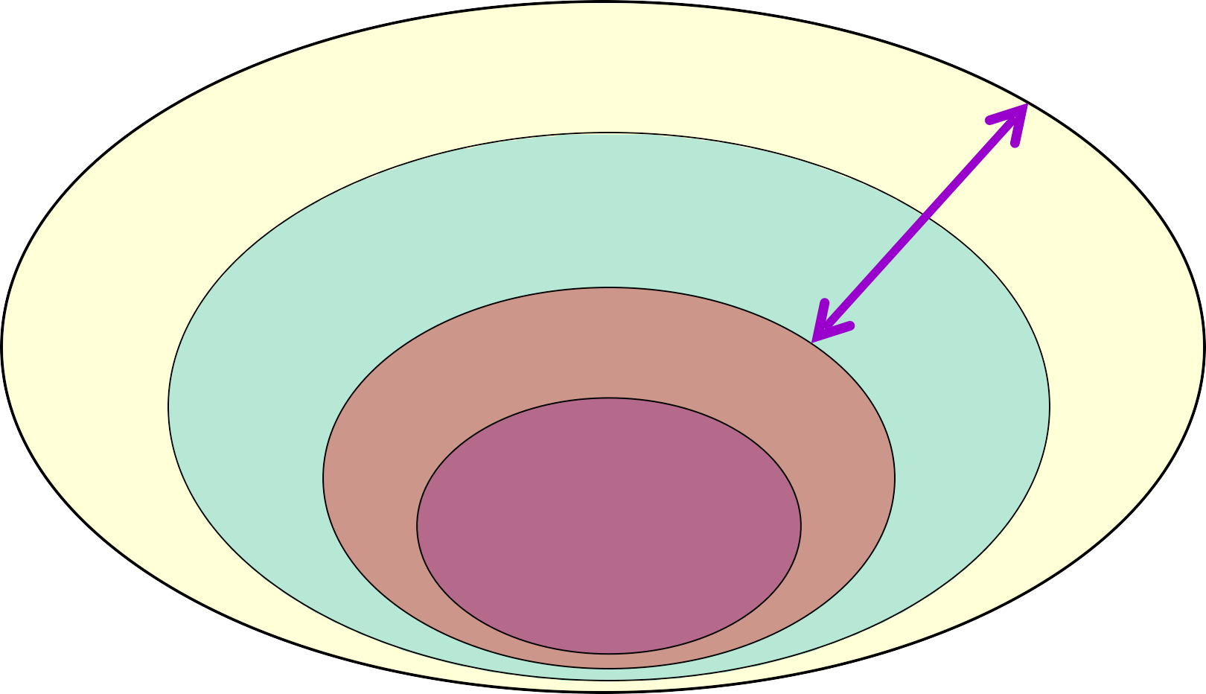
Grammars
All CFGs
Unambiguous CFGs
will generate conflicts
SLR CFGs
LR(0) CFGs

Slide 48
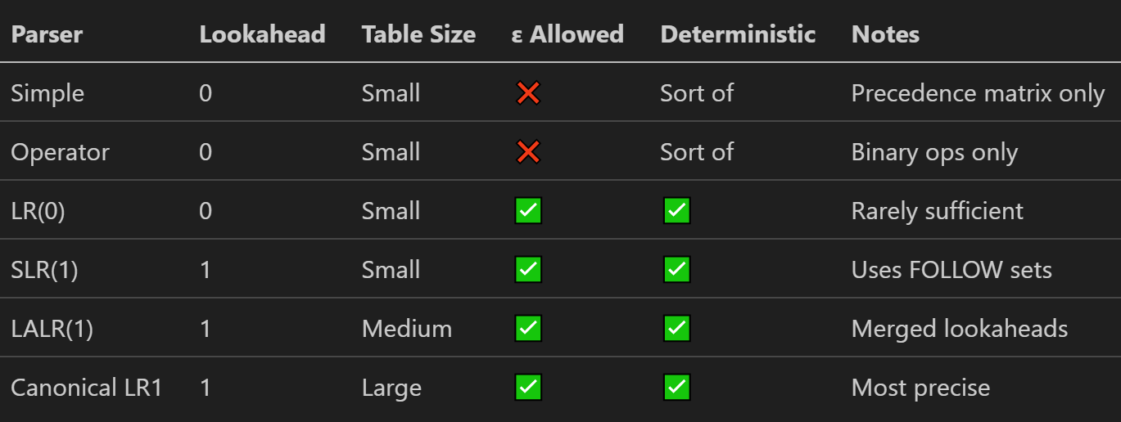
Categories of Bottom Up Grammars
Canonical LR(1) is “most precise” because it uses full lookahead to make reductions, handling all grammars that an LR(1) parser can handle without conflicts, unlike SLR(1) or LALR(1).

