Slide 1
CSE110A: Compilers
..
Topics:
Syntactic Analysis continued
Derivations
Parse trees
Precedence and associativity
int main() { printf(““);
return 0; }
..
..
..
..

Slide 2
Ambiguous grammars
What happens when different derivations have different parse trees?
1: Statement ::= ”if” Expr “then” Statement “else” Statement
2: | ”if” Expr “then” Statement
3: | Assignment
4: | ....
can we derive this string?
if Expr₁ then if Expr₂ then Assignment₁ else Assignment₂
Next few figures taken from the EAC book (Chapter 3.1)

Slide 3
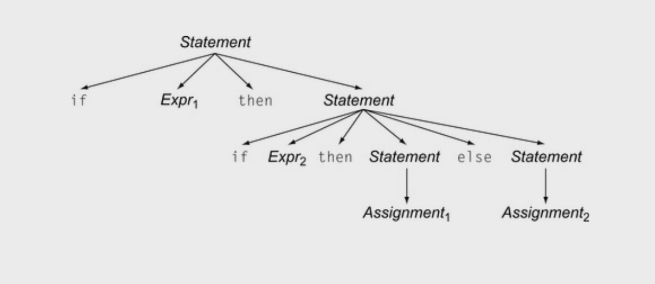
Ambiguous grammars
1: Statement ::= ”if” Expr “then” Statement “else” Statement
2: | ”if” Expr “then” Statement
3: | Assignment
4: | ....
if Expr₁ then if Expr₂ then Assignment₁ else Assignment₂

Slide 4
Ambiguous grammars
1: Statement ::= ”if” Expr “then” Statement “else” Statement
2: | ”if” Expr “then” Statement
3: | Assignment
4: | ....
if Expr₁ then if Expr₂ then Assignment₁ else Assignment₂
Valid derivation

Slide 5
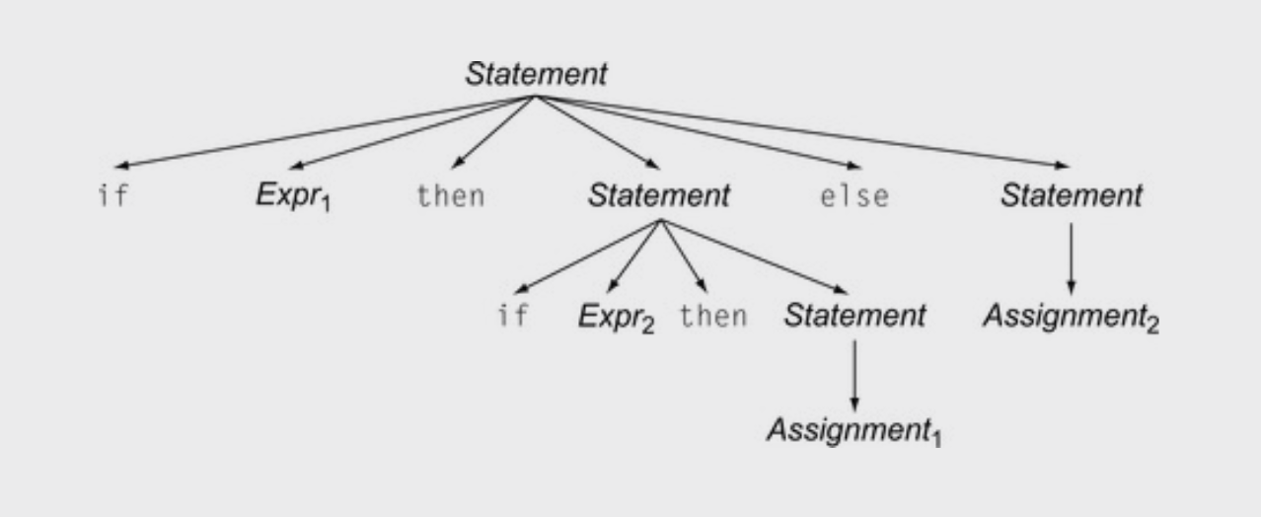
Ambiguous grammars
1: Statement ::= ”if” Expr “then” Statement “else” Statement
2: | ”if” Expr “then” Statement
3: | Assignment
4: | ....
if Expr₁ then if Expr₂ then Assignment₁ else Assignment₂
Valid derivation

Slide 6
Ambiguous grammars
1: Statement ::= ”if” Expr “then” Statement “else” Statement
2: | ”if” Expr “then” Statement
3: | Assignment
4: | ....
if Expr₁ then if Expr₂ then Assignment₁ else Assignment₂
Valid derivation
And another valid derivation

Slide 7
Ambiguous grammars
Is this an issue? Don’t we only care if a grammar can derive a string?
Valid derivation
And another valid derivation

Slide 8
Meaning into structure
We want to start encoding meaning into the parse structure. We will want as much structure as possible as we continue through the compiler
The structure is that we want evaluation of program to correspond to a post order traversal of the parse tree (also called the natural traversal)

Slide 9
Post order traversal
visiting for for different types
of traversals:
pre order?
in order?
post order?

Slide 10
Post order traversal
3
visiting for for different types
of traversals:
post order
1
2

Slide 11
Ambiguous grammars
Encoding meaning into structure can result in very different programs
Valid derivation
Also a valid derivation

Slide 12
Programming language structure
int x = 1; //true
int y = 0; //false
int check0 = 0;
if (x)
if (y)
pass();
else
check0 = 1;
pop quiz: what is the value of check0 at the end?

Slide 13
Programming language structure
x = 1
y = 0
check0 = 0
if (x):
if (y):
pass
else:
check0 = 1
print(check0)
How does Python handle this?

Slide 14
Programming language structure
x = 1
y = 0
check0 = 0
if (x):
if (y):
pass
else:
check0 = 1
print(check0)
x = 1
y = 0
check0 = 0
if (x):
if (y):
pass
else:
check0 = 1
print(check0)
Invalid syntax, you need to indent, which makes it clear
How does Python handle this?

Slide 15
Ambiguous expressions
First let’s define tokens:
NUM = ”[0-9]+”
PLUS = ‘\+’
TIMES = ‘\*’
LP = ‘\(’
RP = ‘\)’
Expr :== NUM
| Expr PLUS Expr
| Expr TIMES Expr
| LP Expr RP
Let’s define a simple expression language

Slide 16
Parse trees examples
input: 5
expr ::= NUM
| expr PLUS expr
| expr TIMES expr
| LPAREN expr RPAREN
expr

Slide 17
Parse trees examples
input: 5
expr ::= NUM
| expr PLUS expr
| expr TIMES expr
| LPAREN expr RPAREN
expr
<NUM, 5>

Slide 18
Parse trees examples
input: 5*6
expr ::= NUM
| expr PLUS expr
| expr TIMES expr
| LPAREN expr RPAREN

Slide 19
Parse trees examples
input: 5*6
expr ::= NUM
| expr PLUS expr
| expr TIMES expr
| LPAREN expr RPAREN
expr

Slide 20
Parse trees examples
input: 5*6
expr ::= NUM
| expr PLUS expr
| expr TIMES expr
| LPAREN expr RPAREN
expr
expr
<TIMES>
expr

Slide 21
Parse trees examples
input: 5*6
expr ::= NUM
| expr PLUS expr
| expr TIMES expr
| LPAREN expr RPAREN
expr
expr
<TIMES>
expr
<NUM, 5>
<NUM, 6>

Slide 22
Parse trees examples
input: 5**6
What happens in an error?
expr ::= NUM
| expr PLUS expr
| expr TIMES expr
| LPAREN expr RPAREN
expr

Slide 23
Parse trees examples
input: 5**6
What happens in an error?
expr ::= NUM
| expr PLUS expr
| expr TIMES expr
| LPAREN expr RPAREN
expr
expr
<TIMES>
expr

Slide 24
Parse trees examples
input: 5**6
What happens in an error?
expr ::= NUM
| expr PLUS expr
| expr TIMES expr
| LPAREN expr RPAREN
expr
expr
<TIMES>
expr
<NUM, 5>
<TIMES>
<NUM, 6>
Not possible!

Slide 25
Parse trees examples
input: (1+5)*6
expr ::= NUM
| expr PLUS expr
| expr TIMES expr
| LPAREN expr RPAREN

Slide 26
Parse trees examples
input: (1+5)*6
expr ::= NUM
| expr PLUS expr
| expr TIMES expr
| LPAREN expr RPAREN
expr

Slide 27
Parse trees examples
input: (1+5)*6
expr ::= NUM
| expr PLUS expr
| expr TIMES expr
| LPAREN expr RPAREN
expr
expr
<TIMES>
expr

Slide 28
Parse trees examples
input: (1+5)*6
expr ::= NUM
| expr PLUS expr
| expr TIMES expr
| LPAREN expr RPAREN
expr
expr
<TIMES>
expr
<NUM, 6>

Slide 29
Parse trees examples
input: (1+5)*6
expr ::= NUM
| expr PLUS expr
| expr TIMES expr
| LPAREN expr RPAREN
expr
expr
<TIMES>
expr
<LPAREN>
expr
<RPAREN>
<NUM, 6>

Slide 30
Parse trees examples
input: (1+5)*6
expr ::= NUM
| expr PLUS expr
| expr TIMES expr
| LPAREN expr RPAREN
expr
expr
<TIMES>
expr
<LPAREN>
expr
<RPAREN>
<NUM, 6>
expr
<PLUS>
expr

Slide 31
Parse trees examples
input: (1+5)*6
expr ::= NUM
| expr PLUS expr
| expr TIMES expr
| LPAREN expr RPAREN
expr
expr
<TIMES>
expr
<LPAREN>
expr
<RPAREN>
<NUM, 6>
expr
<PLUS>
expr
<NUM, 1>
<NUM, 5>

Slide 32
Parse trees examples
Does this parse tree capture the structure we want?
input: (1+5)*6
expr
expr ::= NUM
| expr PLUS expr
| expr TIMES expr
| LPAREN expr RPAREN
expr
<TIMES>
expr
<LPAREN>
expr
<RPAREN>
<NUM, 6>
expr
<PLUS>
expr
<NUM, 1>
<NUM, 5>

Slide 33
Parse trees
How about: 1 + 5 * 6
expr ::= NUM
| expr PLUS expr
| expr TIMES expr
| LPAREN expr RPAREN

Slide 34
Parse trees
How about: 1 + 5 * 6
expr
expr ::= NUM
| expr PLUS expr
| expr TIMES expr
| LPAREN expr RPAREN
expr
<TIMES>
expr
expr
<PLUS>
expr
<NUM, 6>
<NUM, 1>
<NUM, 5>

Slide 35
Ambiguous Grammars
expr ::= NUM
| expr PLUS expr
| expr TIMES expr
| LPAREN expr RPAREN
input: 1 + 5 * 6
expr
expr
<TIMES>
expr
expr
<PLUS>
expr
<NUM, 6>
<NUM, 1>
<NUM, 5>

Slide 36
Ambiguous Grammars
expr ::= NUM
| expr PLUS expr
| expr TIMES expr
| LPAREN expr RPAREN
input: 1 + 5 * 6
expr
expr
expr
expr
expr
<PLUS>
expr
<TIMES>
expr
expr
<NUM, 1>
expr
<TIMES>
expr
<PLUS>
<NUM, 6>
<NUM, 1>
<NUM, 5>
<NUM, 5>
<NUM, 6>

Slide 37
Avoiding Ambiguity
How to avoid ambiguity related to precedence?
Define precedence into the grammar:
Ambiguity comes from conflicts. Explicitly define how to deal with conflicts by indicating that:
* has higher precedence than +
Some parser generators support this,
e.g. YACC(C), Bison (C), Antlr (Java), PLY(Python)

Slide 38
Avoiding Ambiguity
How to avoid ambiguity related to precedence?
Second way: add new production rules
One non-terminal for each level of precedence
lowest precedence at the top
highest precedence at the bottom
Lets try with expressions and the following:
+ * ()

Slide 39
Avoiding Ambiguity
Second way: new production rules
One non-terminal for each level of precedence
lowest precedence at the top
highest precedence at the bottom
Operator | Name | Productions
+ | expr | : expr PLUS expr | term
* | term | : term TIMES term | factor
() | factor | : LPAREN expr RPAREN | NUM
Precedence
increases going down

Slide 40
Now lets create a parse tree
input: 1+5*6
Operator | Name | Productions
+ | expr | : expr PLUS expr | term
* | term | : term TIMES term | factor
() | factor | : LPAREN expr RPAREN | NUM

Slide 41
Now lets create a parse tree
input: 1+5*6
expr
Operator | Name | Productions
+ | expr | : expr PLUS expr | term
* | term | : term TIMES term | factor
() | factor | : LPAREN expr RPAREN | NUM

Slide 42
Now lets create a parse tree
input: 1+5*6
expr
Operator | Name | Productions
+ | expr | : expr PLUS expr | term
* | term | : term TIMES term | factor
() | factor | : LPAREN expr RPAREN | NUM
expr
<PLUS>
expr

Slide 43
Now lets create a parse tree
input: 1+5*6
expr
Operator | Name | Productions
+ | expr | : expr PLUS expr | term
* | term | : term TIMES term | factor
() | factor | : LPAREN expr RPAREN | NUM
expr
<PLUS>
expr
term
factor
<NUM, 1>

Slide 44
Now lets create a parse tree
input: 1+5*6
expr
Operator | Name | Productions
+ | expr | : expr PLUS expr | term
* | term | : term TIMES term | factor
() | factor | : LPAREN expr RPAREN | NUM
expr
<PLUS>
expr
term
term
factor
<NUM, 1>

Slide 45
Now lets create a parse tree
input: 1+5*6
expr
Operator | Name | Productions
+ | expr | : expr PLUS expr | term
* | term | : term TIMES term | factor
() | factor | : LPAREN expr RPAREN | NUM
expr
<PLUS>
expr
term
term
term
<TIMES>
term
factor
<NUM, 1>

Slide 46
Now lets create a parse tree
input: 1+5*6
expr
Operator | Name | Productions
+ | expr | : expr PLUS expr | term
* | term | : term TIMES term | factor
() | factor | : LPAREN expr RPAREN | NUM
expr
<PLUS>
expr
term
term
term
<TIMES>
term
factor
factor
factor
<NUM, 1>
<NUM, 5>
<NUM, 6>

Slide 47
Parsing Regular Expressions (and considering precedence)
Tokens (Terminals)
PIPE = “|”
DOT = “.”
STAR = “*”
LPAR = “\(“
RPAR = “\)”
CHAR = “[^a-zA-Z]”
Let’s try it for an RE language, {| . * ()}
Assume . is a concatenation operator
Terminals are in upper-case
Operator | Name (LHS) | Productions (RHS)
PIPE | choice | choice PIPE choice concat
DOT | concat | Concat DOT concat starred
STAR | starred | Starred STAR unit
 | unit | LPAR choice RPAR CHAR
Possible names for
NT (Non-Terminals):
choice
concat
starred
unit

Slide 48
Parsing Regular Expressions (and considering precedence)
Let’s try it for an RE language, {| . * ()}
Assume . is a concatenation operator
Terminals are in upper-case
Operator | Name (LHS) | Productions (RHS)
| | choice | choice PIPE choice concat
. | concat | concat DOT concat star
* | starred | starred STAR unit
() | unit | LPAR choice RPAR CHAR

Slide 49
Parsing Regular Expressions (and considering precedence)
Let’s try it for an RE language, {| . * ()}
Assume . is a concatenation operator
Terminals are in upper-case
Operator | Name | Productions
| | choice | : choice PIPE choice | concat
. | concat | : concat DOT concat | starred
* | starred | : starred STAR | unit
() | unit | : LPAREN choice RPAREN | CHAR

Slide 50
Parsing Regular Expressions (and considering precedence)
Let’s try it for an RE language, {| . * ()}
Assume . is a concatenation operator
Terminals are in upper-case
input: a.b | c*
Operator | Name | Productions
| | choice | : choice PIPE choice | concat
. | concat | : concat DOT concat | starred
* | starred | : starred STAR | unit
() | unit | : LPAREN choice RPAREN | CHAR

Slide 51
Parsing Regular Expressions (and considering precedence)
Let’s try it for an RE language, {| . * ()}
Assume . is a concatenation operator
Terminals are in upper-case
input: a.b | c*
choice
Operator | Name | Productions
| | choice | : choice PIPE choice | concat
. | concat | : concat DOT concat | starred
* | starred | : starred STAR | unit
() | unit | : LPAREN choice RPAREN | CHAR
choice
<|>
choice
concat
concat
concat
<.>
concat
starred
starred
starred
unit
<*>
unit
unit
<CHAR, c>
<CHAR, a>
<CHAR ,b>

Slide 52
How many levels of precedence does C have?
https://en.cppreference.com/w/c/language/operator_precedence

Slide 53
Have we removed all ambiguity?

Slide 54
Let’s make some more parse trees
input: 2+3+4
Operator | Name | Productions
+ | expr | : expr PLUS expr | term
* | term | : term TIMES term | factor
() | factor | : LP expr RP | NUM

Slide 55
Let’s make some more parse trees
input: 2+3+4
expr
Operator | Name | Productions
+ | expr | : expr PLUS expr | term
* | term | : term TIMES term | factor
() | factor | : LP expr RP | NUM
expr
<PLUS>
expr
term
expr
<PLUS>
expr
term
term
factor
factor
factor
<NUM, 2>
<NUM, 3>
<NUM, 4>

Slide 56
This is ambiguous, is it an issue?
input: 2+3+4
expr
expr
expr
<PLUS>
expr
expr
<PLUS>
expr
expr
<PLUS>
expr
term
term
expr
<PLUS>
expr
term
term
factor
term
term
factor
factor
factor
<NUM, 4>
factor
factor
<NUM, 2>
<NUM, 2>
<NUM, 3>
<NUM, 3>
<NUM, 4>

Slide 57
What about for a different operator?
input: 2-3-4

Slide 58
What about for a different operator?
input: 2-3-4
expr
expr
expr
<MINUS>
expr
expr
<MINUS>
expr
expr
<MINUS>
expr
term
term
expr
<MINUS>
expr
term
term
factor
term
term
factor
factor
factor
<NUM, 4>
factor
factor
<NUM, 2>
<NUM, 2>
<NUM, 3>
<NUM, 3>
<NUM, 4>
Which one is right?

Slide 59
Associativity
Describes the order in which we apply the same operator
Sometimes it doesn’t matter:
When?

Slide 60
Associativity
Describes the order in which we apply the same operator
Sometimes it doesn’t matter:
Integer addition
Integer multiplication
Good test:
((a OP b) OP c) == (a OP (b OP c))
What about floating-point arithmetic?
These operators
are said to be associative

Slide 61
Associativity
If an operator is not associative then we define
left to right (left-associative)
2-3-4 is evaluated as ((2-3) - 4)
What other operators are left-associative
right-to-left (right-associative)
Any operators you can think of?

Slide 62
Associativity
If an operator is not associative then we define
left to right (left-associative)
2-3-4 is evaluated as ((2-3) - 4)
What other operators are left-associative
right-to-left (right-associative)
Assignment,
power operator

Slide 63
How to encode associativity?
Like precedence, some tools (e.g. YACC) allow associativity specification through keywords:
“+”: left, “^”: right
Like precedence, we can also encode it into the production rules

Slide 64
Ambiguous associativity for a single operator
input: 2-3-4
expr
expr
<MINUS>
expr
Operator | Name | Productions
- | expr | : expr MINUS expr | NUM
<NUM, 2>
expr
<MINUS>
expr
<NUM, 3>
<NUM, 4>

Slide 65
Associativity for a single operator
input: 2-3-4
expr
expr
<MINUS>
expr
Operator | Name | Productions
- | expr | : expr MINUS NUM | NUM
<NUM, 2>
expr
<MINUS>
expr
<NUM, 3>
<NUM, 4>
Note that with recursion on the left derivations can only happen from left to right.
No longer allowed

Slide 66
Associativity for a single operator
input: 2-3-4
expr
expr
<MINUS>
<NUM,?>
Operator | Name | Productions
- | expr | : expr MINUS NUM | NUM
Lets start over

Slide 67
Associativity for a single operator
input: 2-3-4
expr
expr
<MINUS>
<NUM,4>
Operator | Name | Productions
- | expr | : expr MINUS NUM | NUM

Slide 68
Associativity for a single operator
input: 2-3-4
expr
expr
<MINUS>
<NUM,4>
Operator | Name | Productions
- | expr | : expr MINUS NUM | NUM
expr
<MINUS>
<NUM,3>

Slide 69
Associativity for a single operator
input: 2-3-4
expr
expr
<MINUS>
<NUM,4>
Operator | Name | Productions
- | expr | : expr MINUS NUM | NUM
expr
<MINUS>
<NUM, 3>
<NUM, 2>
Left associative:
No longer ambiguous

Slide 70
Should you have associativity when its not required?
input: 2+3+4
Benefits?
Drawbacks?
expr
expr
<PLUS>
<NUM,4>
Operator | Name | Productions
+ | expr | : expr PLUS NUM | NUM
expr
<PLUS>
<NUM, 3>
<NUM, 2>

Slide 71
Should you have associativity when its not required?
input: 2+3+4
Benefits?
Drawbacks?
expr
expr
<PLUS>
<NUM,4>
Operator | Name | Productions
+ | expr | : expr PLUS NUM | NUM
expr
<PLUS>
<NUM, 3>
<NUM, 2>
Good design principle to avoid ambiguous grammars,
even when strictly not required too.
Helps with debugging, etc. etc.
Many tools will warn if it detects ambiguity

Slide 72
Let’s make a richer expression grammar
Operator | Name | Productions
Let’s do operators [+,*,-,/,^] and()
Tokens:
NUM = “[0-9]+”
PLUS = ‘\+’
TIMES = ’\*’
LP = ‘\(’
RP = \)’ MINUS = ‘-’
DIV = ‘/’
CARROT =’ \^’
Assume Non-Term names:
expr
term
pow
factor
Note the recursion from pow makes raising to a power right to left associative,
As opposed to PLUS, MINUS, TIMES DIV
Which are left-to-right associative.
First consider precedence, then associativity

Slide 73
Let’s make a richer expression grammar
Operator | Name | Productions
+,- | expr | : expr PLUS term | expr MINUS term | term
*,/ | term | : term TIMES pow | term DIV pow | pow
^ | pow | : factor CARROT pow | factor
() | factor | : LPAR expr RPAR | NUM
Let’s do operators [+,*,-,/,^] and()
Tokens:
NUM = “[0-9]+”
PLUS = ‘\+’
TIMES = ’\*’
LP = ‘\(’
RP = \)’ MINUS = ‘-’
DIV = ‘/’
CARROT =’ \^’
Assume Non-Term names:
expr
term
pow
factor
Note the recursion from pow makes raising to a power right to left associative,
As opposed to PLUS, MINUS, TIMES DIV
Which are left-to-right associative.

Slide 74
What associativities does C have?
https://en.cppreference.com/w/c/language/operator_precedence

Slide 75
Next topic: algorithms for syntactic analysis
Top down parsing
oracle parsing
removing left recursion
constructing lookahead sets

