Slide 1
CSE110A: Compilers
..
AST
..
..
..
..
MIDTERM REVIEW
PostOrder Traversal Example
CFG
...
...
...
...
3 address code
store i32 0, ptr %2
%3 = load i32, ptr %1
%4 = add nsw i32 %3, 1,
store i32 %4, ptr %1
%5 = load i32, ptr %2

Slide 2
Post-Order Traversal == Postfix
When compilers parse arithmetic or logical expressions, they often build a parse tree or abstract syntax tree (AST) representing the expression's structure.
Post order traversal of trees naturally matches how expressions can be evaluated using a stack-based approach — like in a stack machine or when generating Reverse Polish Notation (RPN).

Slide 3
An Aside: Tree Traversal Orders
Let’s review different type of
tree traversal algorithms:
pre-order?
in-order?
post-order?

Slide 4
Possible Tree Traversal Orders
Traversal Order | Order Visited | Example Output
pre-order | Top-Root->Left-Child->Right-Child | A B D E G H C F
in-order | Left/Bottom->Its-Root->Right/Bottom Caveat: for binary trees only, not used in compilers | D B G E H A C F
post-order | Left/Bottom->Right/Bottom->Its-Root | D G H E B F C A
A
B
C
Traversals never visit the same node twice.
D
E
F
Pre-order Traversal (Root-Left-Right. Top to Bottom)
Prioritizes visits from top to bottom, and left to right
Useful for serializing and copying trees.
G
H
In-order Traversal (Left-Root-Right, Bottom to Top)
Prioritizes visits from bottom left to right visiting parent nodes on the way. Sometimes used for sorting.
Post-order (or natural) Traversal (Left-Right-Root)
Prioritizes traversing subtrees by visiting lowest nodes first, and parent nodes later. Useful for evaluating expression trees (e.g. parsing)

Slide 5
Post-Order Traversal
Post order traversal
For 2 children nodes

Slide 6
Post order traversal
3
Post order traversal
For 2 children nodes
1
2

Slide 7
Post order traversal
Post order traversal
For 3 children nodes

Slide 8
Post order traversal
4
Post order traversal
For 3 children nodes
1
2
3

Slide 9
Post order Traversal == Postfix Notation
Post-order traversal of a tree ensures that all required semantic information for a node is available before the node is processed.
The information is stored in the node’s children.
For expressions this is similar to postfix notation (RPN, reverse polish notation).
Example: For an N-ary operator, evaluate all N arguments first, then invoke the operator.
4
1
2
3

Slide 10
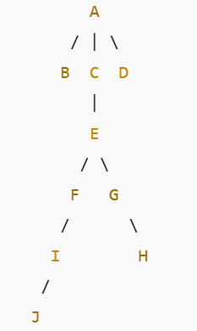
Post-Order Traversal : Another Example
Traversal:
B →
J → I → F →
H → G →
E → C →
D →
A
Visit children
bottom-up
left to right,
then parent)

