Slide 1
CSE110A: Compilers
..
Topics:
Scope
int main() { printf(““);
return 0; }
..
..
..
..

Slide 2
Homework questions?

Slide 3
Scope
What is scope?
Can it be determined at compile time? Can it be determined at runtime?
C vs. Python (demo)
Anyone have any interesting scoping rules they know of?

Slide 4
One consideration: Scope
Lexical scope example
int x = 0;
int y = 0;
{
int y = 0;
x+=1;
y+=1;
}
x+=1;
y+=1;
What are the final values in x and y?

Slide 5
How to track scope?
Symbol table object
Two methods:
lookup(id) : lookup an id in the symbol table. Returns None if the id is not in the symbol table.
insert(id,info) : insert a new id (or overwrite an existing id) into the symbol table along with a set of information about the id.
What information might we store about an id?

Slide 6
a very simple programming language
ID = [a-z]+
INCREMENT = “\+\+”
TYPE = “int”
LBRAC = “{“
RBRAC = “}”
SEMI = “;”
statements are either a declaration or an increment
int x;
x++;
int y;
y++;

Slide 7
a very simple programming language
ID = [a-z]+
INCREMENT = “\+\+”
TYPE = “int”
LBRAC = “{“
RBRAC = “}”
SEMI = “;”
statements are either a declaration or an increment
int x;
{
int y;
x++;
y++;
}
y++;

Slide 8
a very simple programming language
ID = [a-z]+
INCREMENT = “\+\+”
TYPE = “int”
LBRAC = “{“
RBRAC = “}”
SEMI = “;”
statements are either a declaration or an increment
int x;
{
int y;
x++;
y++;
}
y++;
error!

Slide 9
How to track scope?
Say we matched the statement: int x;
SymbolTable ST;
declare_statement ::= TYPE ID SEMI
{}
lookup(id) : lookup an id in the symbol table. Returns None if the id is not in the symbol table.
insert(id,info) : insert a new id (or overwrite an existing id) into the symbol table along with a set of information about the id.

Slide 10
How to track scope?
Say we matched the statement: int x;
SymbolTable ST;
declare_statement ::= TYPE ID SEMI
{
self.eat(TYPE)
variable_name = self.to_match[1] # lexeme value
self.eat(ID)
ST.insert(variable_name,None)
self.eat(SEMI)
}

Slide 11
How to track scope?
Say we matched string: x++;
SymbolTable ST;
inc_statement ::= ID INCREMENT SEMI
{}
lookup(id) : lookup an id in the symbol table. Returns None if the id is not in the symbol table.
insert(id,info) : insert a new id (or overwrite an existing id) into the symbol table along with a set of information about the id.

Slide 12
How to track scope?
Say we matched string: x++;
SymbolTable ST;
inc_statement ::= ID INCREMENT SEMI
{
variable_name = self.to_match[1] # lexeme value
if ST.lookup(variable_name) is None:
raise SymbolTableException(variable_name)
self.eat(ID)
self.eat(INCREMENT)
self.eat(SEMI)
}

Slide 13
How to track scope?
SymbolTable ST;
statement : LBRAC statement_list RBRAC
int x;
{
int y;
x++;
y++;
}
y++;

Slide 14
How to track scope?
SymbolTable ST;
statement : LBRAC statement_list RBRAC
int x;
{
int y;
x++;
y++;
}
y++;
start a new scope S
remove the scope S

Slide 15
How to track scope?
Symbol table
four methods:
lookup(id) : lookup an id in the symbol table. Returns None if the id is not in the symbol table.
insert(id,info) : insert a new id into the symbol table along with a set of information about the id.
push_scope() : push a new scope to the symbol table
pop_scope() : pop a scope from the symbol table

Slide 16
How to track scope?
SymbolTable ST;
statement : LBRAC statement_list RBRAC
You will be adding the functions to push and pop scopes in your homework

Slide 17
How to implement a symbol table?
Thoughts? What data structures are good at mapping strings?
Symbol table
four methods:
lookup(id) : lookup an id in the symbol table. Returns None if the id is not in the symbol table.
insert(id,info) : insert a new id into the symbol table along with a set of information about the id.
push_scope() : push a new scope to the symbol table
pop_scope() : pop a scope from the symbol table

Slide 18
How to implement a symbol table?
Many ways to implement:
A good way is a stack of hash tables:
HT 0
base scope
Stack of hash tables

Slide 19
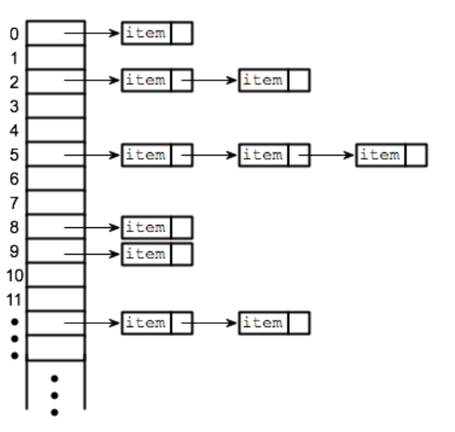
What is a Hash Table?
A HASH Table starts with a hashing function that maps a string (key) to an index.
The Index goes into a table of buckets. The more indexes (bucket lists) the less likelihood of a collision.
Bucket lists entries store each key, value pair.
Dicts in Python are implemented using hash tables.
HT 0
Key
value
Src: https://www.hackerearth.com/practice/data-structures/hash-tables/basics-of-hash-tables/tutorial/

Slide 20
How to implement a symbol table?
Many ways to implement:
A good way is a stack of hash tables:
HT 0
push_scope()
Stack of hash tables

Slide 21
How to implement a symbol table?
Many ways to implement:
A good way is a stack of hash tables:
adds a new Hash Table to the top of the stack
HT 1
HT 0
push_scope()
Stack of hash tables

Slide 22
How to implement a symbol table?
Many ways to implement:
A good way is a stack of hash tables:
HT 1
insert(id,data)
HT 0
Stack of hash tables

Slide 23
How to implement a symbol table?
Many ways to implement:
A good way is a stack of hash tables:
insert (id -> data)
At the top hash table
HT 1
insert(id,data)
HT 0
Stack of hash tables

Slide 24
How to implement a symbol table?
Many ways to implement:
A good way is a stack of hash tables:
HT 1
HT 0
lookup(id)
Stack of hash tables

Slide 25
How to implement a symbol table?
Many ways to implement:
A good way is a stack of hash tables:
HT 1
check here first
HT 0
lookup(id)
Stack of hash tables

Slide 26
How to implement a symbol table?
Many ways to implement:
A good way is a stack of hash tables:
HT 1
HT 0
then check here
lookup(id)
Stack of hash tables

Slide 27
How to implement a symbol table?
Many ways to implement:
A good way is a stack of hash tables:
HT 1
HT 0
pop_scope()
Stack of hash tables

Slide 28
How to implement a symbol table?
Many ways to implement:
A good way is a stack of hash tables:
What happens to the symbols in the HT 1?
HT 0
Stack of hash tables

Slide 29
How to implement a symbol table?
Example
int x = 0;
int y = 0;
{
int y = 0;
x++;
y++;
}
x++;
y++;
HT 0
Stack of hash tables

Slide 30
How to implement a symbol table?
Example
int x = 0;
int y = 0;
{
int y = 0;
x++;
y++;
}
x++;
y++;
HT 0
(x,0)
(y,0)
Stack of hash tables

Slide 31
How to implement a symbol table?
Example
int x = 0;
int y = 0;
{
int y = 0;
x++;
y++;
}
x++;
y++;
Push a local name space
HT 1
(y,0) -> (y,1)
HT 0
(x,0)->(x,1)
(y,0)
Stack of hash tables

Slide 32
How to implement a symbol table?
Example
int x = 0;
int y = 0;
{
int y = 0;
x++;
y++;
}
x++;
y++;
Pop a local name space, leaving global name space
HT 0
(x,1)
(y,0)
Stack of hash tables

Slide 33
WHAT ELSE?
GLOBAL VARIABLES (Top Of Stack ST)
NAMED SPACES
DYNAMIC SCOPES
STATIC LOCAL (C, or Algol “Own”)

Slide 34
What about Dynamic Scope?
Example from Perl
Some languages support dynamic scope, e.g. Perl and Lisp.
use strict;
use warnings;
our $x = "global"; # Global variable
sub a {
print "In a: x = $x\n";
b();
}
sub b {
print "In b: x = $x\n";
}
sub foo {
local $x = "local in main"; # Temporarily override
# $x for dynamic scope
print "In foo: x = $x\n";
a();
}
main();
print "After foo: x = $x\n";
In the example x is a global variable (our $x)
and a dynamic variable in foo (local x)
when foo calls a() it masks out the global variable x and passes down the local variable to be used in function a and b. x in those functions is derived from the call chain on the stack. This is not lexical scope, it is dynamic scope
Try it, play with it.
Stack of hash tables
gets dynamically chained
based on the call stack
Learn more click HERE

Slide 35
Next Topic:
We will discuss parser generators

