Slide 1
Quiz-07-AMB-TOP-DOWN-REC-DESC Topics: Ambiguity HW2 Top-Down Parsing Recursive Descent Parsing

Slide 2
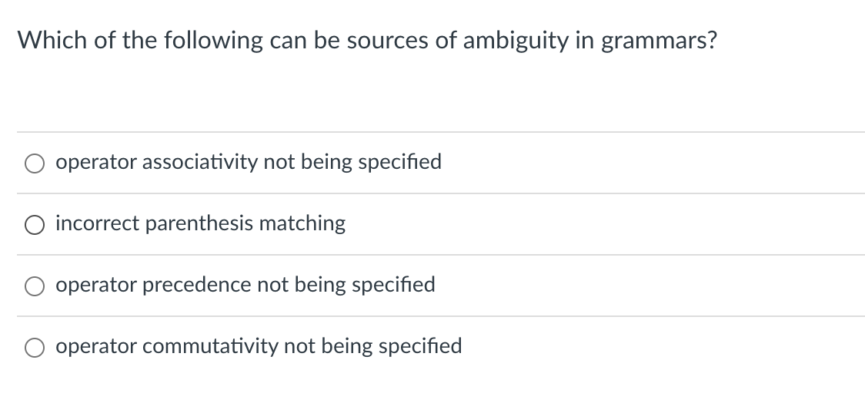
Quiz

Slide 3
Quiz
ANSWER:
Both operator associativity and operator precedence need to be addressed to avoid ambiguity in grammars.

Slide 4
Homework 2

Slide 5
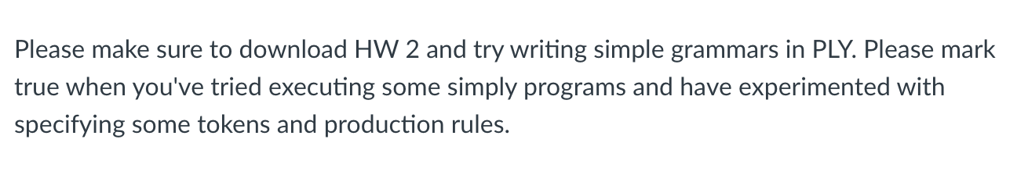
Quiz

Slide 6
Quiz
Has everyone seen the new program on FIRST, FOLLOW, FIRST+?
A shout out to our student Laurel Willey for the great work on helping
Make this happen.

Slide 7
Top-Down Parsing

Slide 8
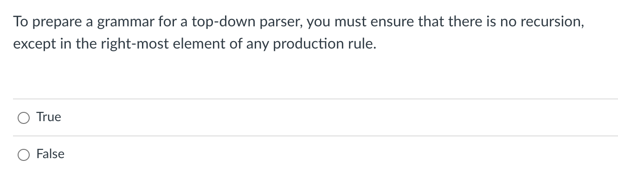
Quiz

Slide 9
Quiz
False. You do have to get rid of left recursion to avoid infinite recursion. But that said you can have more than one recursion in the RHS side. e.g.
a ::= B a C a D
Above shows two points of recursion on the RHS of the production, however it does not have left-recursion. We next elaborate on we can
Get rid of left-recursion.

Slide 10
root = start symbol; focus = root;
push(None);
to_match = s.token();
while (true):
if (focus is a nonterminal)
pick next rule (A ::= B1,B2,B3...BN);
push(BN... B3, B2);
focus = B1
else if (focus == to_match)
to_match = s.token()
focus = pop()
else if (to_match == None and focus == None)
Accept
1: Expr ::= Expr Op Unit
2: | Unit 3: Unit ::= ‘(‘ Expr ‘)’
4: | ID
5: Op ::= ‘+’
6: | ‘*’
What can go wrong
Can we derive the string (a+b)*c
Expanded Rule | Sentential Form
start | Expr
2 | Expr Op Unit
2 | Expr Op Unit Op Unit
2 | Expr Op Unit Op Unit Op Unit
2 | Expr Op Unit ....
Variable | Value
focus
to_match
s.istring
stack
Infinite recursion!

Slide 11
Eliminating direct left recursion
Fee ::= Fee “a”
| “b”
What does this grammar describe?

Slide 12
Eliminating direct left recursion
The grammar can be rewritten as
Fee ::= Fee “a”
| “b”
Fee ::= “b” Fee2
Fee2 ::= “a” Fee2
| “”

Slide 13
Eliminating direct left recursion
In general, A and B can be any sequence of non-terminals and terminals
Fee ::= Fee A
| B
Fee ::= B Fee2
Fee2 ::= A Fee2
| “”

Slide 14
Eliminating direct left recursion
1: Expr ::= Expr Op Unit
2: | Unit 3: Unit ::= ‘(‘ Expr ‘)’
4: | ID
5: Op ::= ‘+’
6: | ‘*’
Lets do this one as an example:
Fee ::= B Fee2
Fee2 ::= A Fee2
| “”
Fee ::= Fee A
| B

Slide 15
Eliminating direct left recursion
A = ??
B = ??
1: Expr ::= Expr Op Unit
2: | Unit 3: Unit ::= ‘(‘ Expr ‘)’
4: | ID
5: Op ::= ‘+’
6: | ‘*’
1: Expr ::= ??
2: Expr2 ::= ??
3: | ?? 4: Unit ::= ‘(‘ Expr ‘)’
5: | ID
6: Op ::= ‘+’
7: | ‘*’
Lets do this one as an example:
Fee ::= B Fee2
Fee2 ::= A Fee2
| “”
Fee ::= Fee A
| B

Slide 16
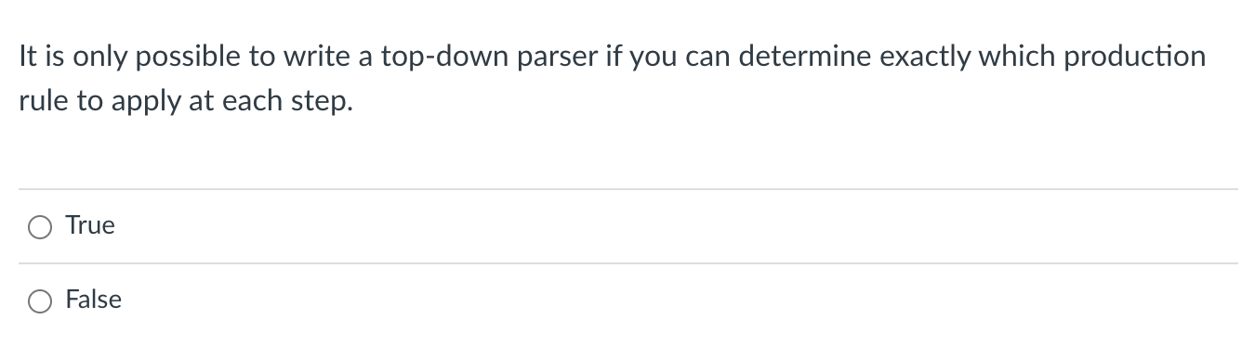
Quiz

Slide 17
Quiz
This is FALSE. You can write a parser that does not know which production option to apply if you are willing to do backtracking. That said this is not ideal since backtracking can lead to much slower parsing.

Slide 18
root = start symbol; focus = root;
push(None);
to_match = s.token();
while (true):
if (focus is a nonterminal)
cache_state();
pick next rule (A ::= B1,B2,B3...BN);
if B1 == “”: focus=pop(); continue;
push(BN... B3, B2);
focus = B1
else if (to_match == None and focus == None)
Accept
else if (focus == to_match)
to_match = s.token()
focus = pop()
else if (we have a cached state)
backtrack();
else
parser_error()
1: Expr ::= ID Expr2
2: Expr2 ::= ‘+’ Expr2
| ””
Keep track of what choices we’ve done
Can we match: “a”?
Expanded Rule | Sentential Form
start | Expr
1 | ID Expr2

Slide 19
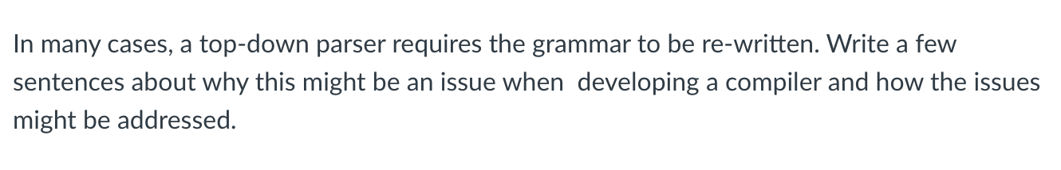
Quiz

Slide 20
Eliminating direct left recursion
A = OP Unit
B = Unit
1: Expr ::= Expr Op Unit
2: | Unit 3: Unit ::= ‘(‘ Expr ‘)’
4: | ID
5: Op ::= ‘+’
6: | ‘*’
1: Expr ::= Unit Expr2
2: Expr2 ::= Op Unit Expr2
3: | “” 4: Unit ::= ‘(‘ Expr ‘)’
5: | ID
6: Op ::= ‘+’
7: | ‘*’
Lets do this one as an example:
Fee ::= B Fee2
Fee2 ::= A Fee2
| “”
Fee ::= Fee A
| B

Slide 21
Recursive Descent and LL Parsing

Slide 22
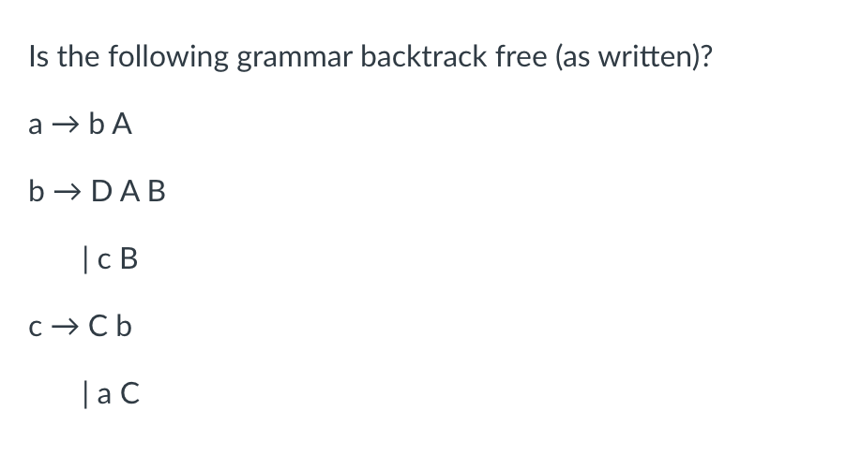
Quiz

Slide 23
Quiz
First sets
There are no empty productions so the First Set+ shown for each option is the same as the First Set but some production options do NOT have a disjoint First Set+ (i.e. unique terminals) so this grammar is NOT backtrack-free.
{D,C}
{D}
{C,D}
{C}
{D,C}

Slide 24
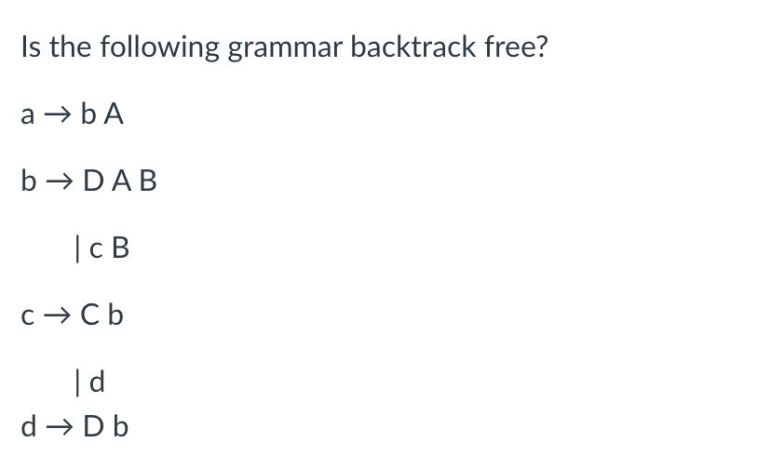
Quiz

Slide 25
Quiz
First sets
{}
{}
{}
{}
{}
{}

Slide 26
Quiz
First sets
{C,D}
There are no empty productions so the First Set+ shown for each option is the same as the First Set but some production options do NOT have a disjoint First Set+ (i.e. unique terminals) so this grammar is NOT backtrack-free.
{D}
{C,D}
{C}
{D}
{D}

Slide 27
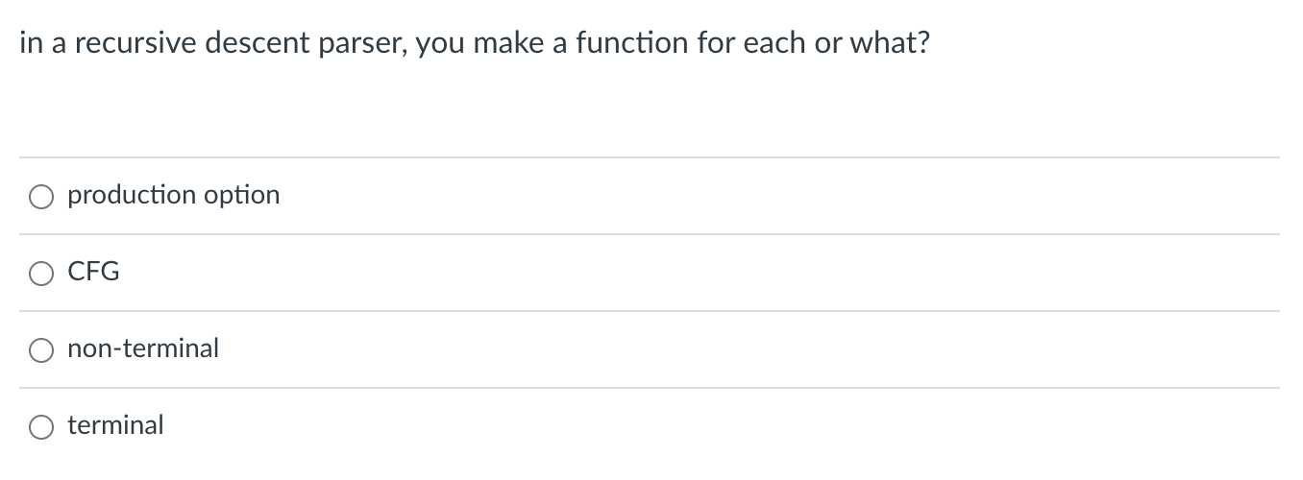
Quiz
We create a function for each non-terminal. We elaborate how this is done in the next few slides.

Slide 28
Let’s look at the grammar
1: Expr ::= Unit Expr2
2: Expr2 ::= Op Unit Expr2
3: | “” 4: Unit ::= ‘(‘ Expr ‘)’
5: | ID
6: Op ::= ‘+’
7: | ‘*’

Slide 29
Let’s look at the grammar
1: Expr ::= Unit Expr2
2: Expr2 ::= Op Unit Expr2
3: | “” 4: Unit ::= ‘(‘ Expr ‘)’
5: | ID
6: Op ::= ‘+’
7: | ‘*’
How do we parse an Expr?

Slide 30
Let’s look at the grammar
1: Expr ::= Unit Expr2
2: Expr2 ::= Op Unit Expr2
3: | “” 4: Unit ::= ‘(‘ Expr ‘)’
5: | ID
6: Op ::= ‘+’
7: | ‘*’
How do we parse an Expr?
We parse a Unit followed by an Expr2

Slide 31
Let’s look at the grammar
1: Expr ::= Unit Expr2
2: Expr2 ::= Op Unit Expr2
3: | “” 4: Unit ::= ‘(‘ Expr ‘)’
5: | ID
6: Op ::= ‘+’
7: | ‘*’
How do we parse an Expr?
We parse a Unit followed by an Expr2
We can just write exactly that!
def parse_Expr(self):
self.parse_Unit();
self.parse_Expr2();
return

Slide 32
Let’s look at the grammar
1: Expr ::= Unit Expr2
2: Expr2 ::= Op Unit Expr2
3: | “” 4: Unit ::= ‘(‘ Expr ‘)’
5: | ID
6: Op ::= ‘+’
7: | ‘*’
How do we parse an Expr2?

Slide 33
Let’s look at the grammar
1: Expr ::= Unit Expr2
2: Expr2 ::= Op Unit Expr2
3: | “” 4: Unit ::= ‘(‘ Expr ‘)’
5: | ID
6: Op ::= ‘+’
7: | ‘*’
How do we parse an Expr2?
First+ sets: 1: {‘(‘, ID}
2: {‘+’, ‘*’}
3: {None, ’)’} 4: {‘(‘}
5: {ID}
6: {‘+’}
7: {‘*’}

Slide 34
Let’s look at the grammar
1: Expr ::= Unit Expr2
2: Expr2 ::= Op Unit Expr2
3: | “” 4: Unit ::= ‘(‘ Expr ‘)’
5: | ID
6: Op ::= ‘+’
7: | ‘*’
How do we parse an Expr2?
def parse_Expr2(self):
token_id = get_token_id(self.to_match)
# Expr2 ::= Op Unit Expr2
if token_id in ["PLUS", "MULT"]:
self.parse_Op()
self.parse_Unit()
self.parse_Expr2()
return
# Expr2 ::= ""
if token_id in [None, ”RPAR"]:
return
raise ParserException(-1, # line number (for you to do)
self.to_match, # observed token
["PLUS", "MULT", ”RPAR"]) # expected token
First+ sets: 1: {‘(‘, ID}
2: {‘+’, ‘*’}
3: {None, ’)’} 4: {‘(‘}
5: {ID}
6: {‘+’}
7: {‘*’}

Slide 35
Let’s look at the grammar
1: Expr ::= Unit Expr2
2: Expr2 ::= Op Unit Expr2
3: | “” 4: Unit ::= ‘(‘ Expr ‘)’
5: | ID
6: Op ::= ‘+’
7: | ‘*’
How do we parse a Unit?
First+ sets: 1: {‘(‘, ID}
2: {‘+’, ‘*’}
3: {None, ’)’} 4: {‘(‘}
5: {ID}
6: {‘+’}
7: {‘*’}

Slide 36
Let’s look at the grammar
1: Expr ::= Unit Expr2
2: Expr2 ::= Op Unit Expr2
3: | “” 4: Unit ::= ‘(‘ Expr ‘)’
5: | ID
6: Op ::= ‘+’
7: | ‘*’
How do we parse a Unit?
def parse_Unit(self):
token_id = get_token_id(self.to_match)
# Unit ::= ‘(‘ Expr ‘)’
if token_id == "LPAR":
self.eat("LPAR")
self.parse_Expr()
self.eat("RPAR")
return
# Unit :: = ID
if token_id == "ID":
self.eat("ID")
return
raise ParserException(-1, # line number (for you to do)
self.to_match, # observed token
["LPAR", "ID"]) # expected token
First+ sets: 1: {‘(‘, ID}
2: {‘+’, ‘*’}
3: {None, ’)’} 4: {‘(‘}
5: {ID}
6: {‘+’}
7: {‘*’}

Slide 37
Let’s look at the grammar
1: Expr ::= Unit Expr2
2: Expr2 ::= Op Unit Expr2
3: | “” 4: Unit ::= ‘(‘ Expr ‘)’
5: | ID
6: Op ::= ‘+’
7: | ‘*’
How do we parse a Unit?
def parse_Unit(self):
token_id = get_token_id(self.to_match)
# Unit ::= ‘(‘ Expr ‘)’
if token_id == "LPAR":
self.eat("LPAR")
self.parse_Expr()
self.eat("RPAR")
return
# Unit :: = ID
if token_id == "ID":
self.eat("ID")
return
raise ParserException(-1, # line number (for you to do)
self.to_match, # observed token
["LPAR", "ID"]) # expected token
ensure that to_match has token ID of “LPAREN”
and get the next token
First+ sets: 1: {‘(‘, ID}
2: {‘+’, ‘*’}
3: {None, ’)’} 4: {‘(‘}
5: {ID}
6: {‘+’}
7: {‘*’}

Slide 38
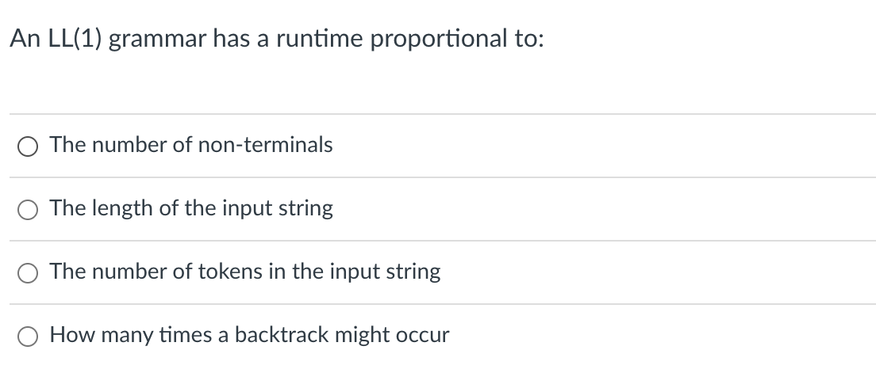
Quiz

Slide 39
Quiz
The number of tokens will proportionally affect the parsing time. If backtracks can occur it would definitely have an effect that would slow down parsing, not necessarily proportional.

