Slide 1
Floating Point Numbers
(and use in Modern AI)
Instructor: Marcelo Siero
CSE12

Slide 2
Integers and Fixed Point vs Floating-Point
Integers are linear from 0 up towards the largest number
Fractions are linear but between 1 and 0
Floating point numbers includes an exponent which is not linear but represents an exponential, thus giving numbers much greater “dynamic range”

Slide 3
Floating Point Numbers
Consider: A x 10^{B}, where A is one decimal digit, B, a signed number, allows this one number to express extremely large numbers, or extremely small numbers based on the value of the exponent B.
A B A x 10^{B}
0 any 0
1 .. 9 0 1 .. 9
1 .. 9 1 10 .. 90
1 .. 9 2 100 .. 900
1 .. 9 -1 0.1 .. 0.9
1 .. 9 -2 0.01 .. 0.09
Using exponential powers you can express a very large dynamic range, i.e. huge numbers and very small numbers.

Slide 4
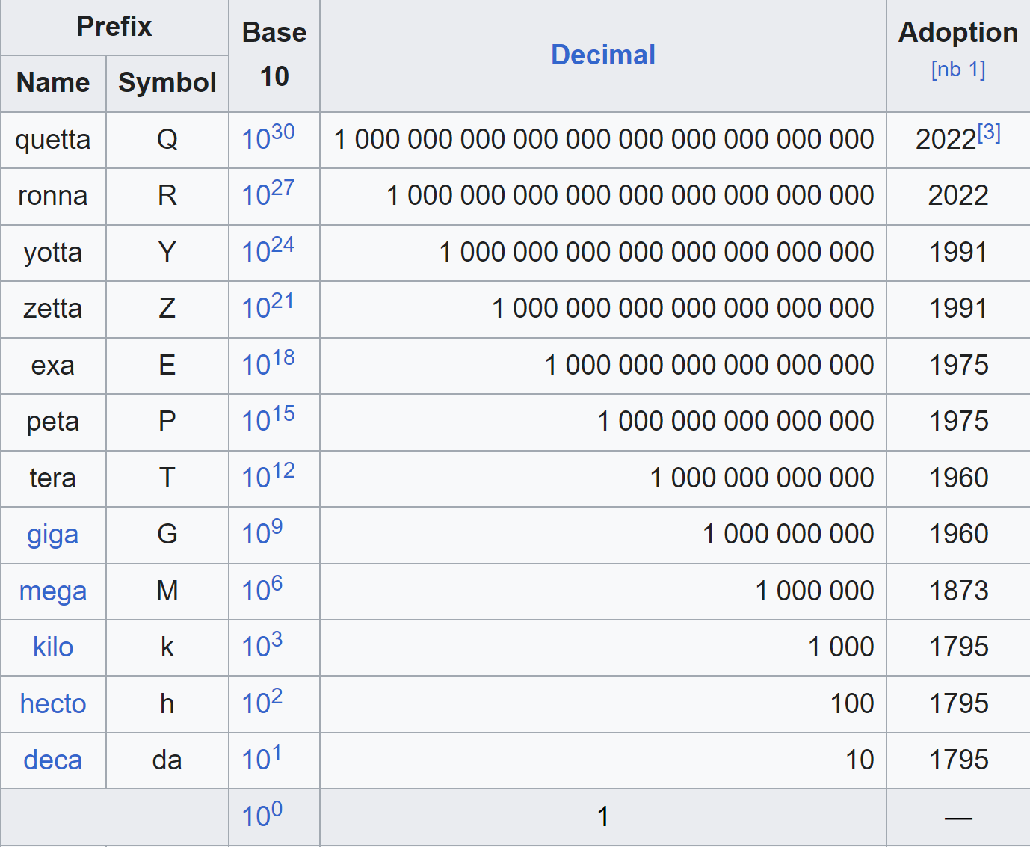
International System of Units (SI)
For integer type
numbers,
i.e. >= 1.0
A metric prefix is a unit prefix that precedes a basic unit of measure to indicate a multiple or sub-multiple of the unit. These metric prefixes used today are decadic.
SI prefixes are metric prefixes that were standardised for use in the International System of Units (SI) by the International Bureau of Weights and Measures (BIPM) in resolutions dating from 1960 to 2022
Source: Wikipedia “Metric_prefix”

Slide 5
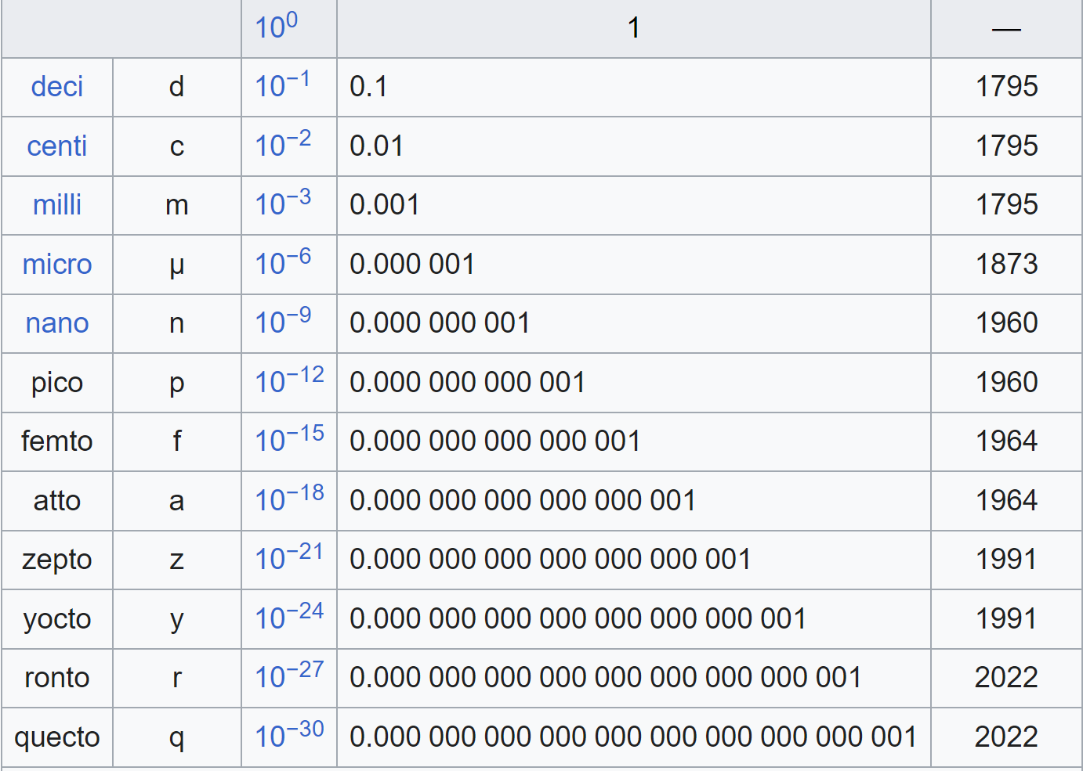
International System of Units (SI)
For fractional type numbers
i.e. < 1.0
Source: Wikipedia “Metric_prefix”

Slide 6
Real numbers as Decimal Floating Point
Our decimal system handles non-integer real numbers by adding an extra symbol, the decimal point (.) for fixed point notation:
e.g. 3,456.78 = 3*10³ + 4*10² + 5*10¹ + 6*10⁰ + 7*10⁻¹ + 8.10⁻²
The floating point, or scientific, notation further allows us to represent very large and very small numbers (integer or real), with as much or as little precision as needed, e.g.:
Unit of electric charge e = 1.602 176 462 * 10⁻¹⁹ Coul.
Volume of universe = 1 * 10⁸⁵ cm³
the two components of these numbers are called the mantissa (provides precision) and the
exponent (provides dynamic range)
How to do scientific notation in binary?
Standard: IEEE 754 Floating-Point

Slide 7
Real numbers in Binary Floating Point
We mimic the decimal floating point notation to create a “hybrid” binary floating point number:
We first use a “binary point” to separate whole numbers from fractional numbers to make a fixed point notation:
e.g. 00011001.110 = 1*2⁴ + 1*2³ + 1*2⁰ + 1*2⁻¹ + 1*2⁻² => 25.75
(2⁻¹ = 0.5 and 2⁻² = 0.25, etc.)
We then “float” the binary point:
00011001.110 => 1.1001110 x 2⁴
mantissa = 1.1001110, exponent = 4
Now we have to express this without the extra symbols ( x, 2, . )
by convention, we divide the available bits into three fields:
sign, mantissa, exponent
Note: The 1st 1 coresponds to the most significant bit of the binary number.

Slide 8
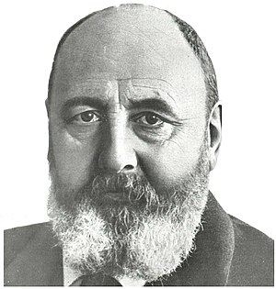
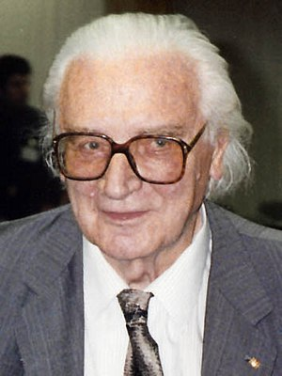
INNOVATORS OF FLOATING POINT
In 1914, Leonardo Torres y Quevedo proposed a form of floating point in the course of discussing his design for a special-purpose electromechanical calculator
In 1938, Konrad Zuse of Berlin completed the Z1, the first binary, programmable mechanical computer;[9] it uses a 24-bit binary floating-point number representation with a 7-bit signed exponent, a 17-bit significand (including one implicit bit), and a sign bit
Source: Wikipedia

Slide 9
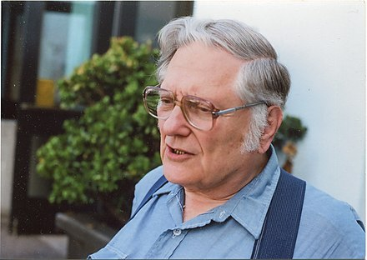
STANDARDIZATION OF FLOATING POINT
Floating-point compatibility across multiple computing systems was in desperate need of standardization by the early 1980s, leading to the creation of the IEEE 754 standard once the 32-bit (or 64-bit) word had become commonplace. This standard was significantly based on a proposal from Intel, which was designing the i8087 numerical co-processor; Motorola, which was designing the 68000 around the same time, gave significant input as well.
In 1989, a Canadian mathematician and computer scientist William Kahan was honored with the Turing Award for being the primary architect behind this proposal; he was aided by his student Jerome Coonen and a visiting professor, Harold Stone.[13]
Kahan is now emeritus professor of mathematics and of electrical engineering and computer sciences (EECS) at the University of California, Berkeley.
Source: Wikipedia

Slide 10
IEEE-754 fp Numbers Single Precision
32 bits:
1
8 bits
23 bits (+1)
s
biased exp.
fraction
N = (-1)^{s} x 1.fraction x 2^{(biased exp. – 127)}
Sign: 1 bit (like in sign-magnitude)
Mantissa: 23 bits (like in signed-magnitude)
We “normalize” the mantissa (by adjusting the exponent) and DROP the leading 1 thus recording only the fractional binary part
Exponent: 8 bits
To handle both positive and negative exponents , we add 127 to the actual exponent creating a “biased exponent”:
2⁻¹²⁷ => biased exponent = 0000 0000 (= 0)
2⁰ => biased exponent = 0111 1111 (= 127)
2⁺¹²⁷ => biased exponent = 1111 1110 (= 254)
Range in decimal: ~1.18e-38 to ~3.40e38 with 6–9 significant digits of precision

Slide 11
IEEE-754 fp numbers
Example:
25.75 => 00011001.110 => 1.1001110 x 2⁴
Sign bit = 0 (indicates positive)
Normalized mantissa (fraction) =
(1.)100 1110 0000 0000 0000 0000
The first 1 is assumed, i.e. not explicitly given.
Biased exponent = 4 + 127 = 131 => 1000 0011
So 25.75 => 0100 0001 1100 1110 0000 0000 0000 0000
=> 0x41CE0000 as a 32-bit number in hex

Slide 12
How to convert 64.2 into IEEE SP
1) Get integer and fractional binary form for 64.2
Binary left of radix/decimal point (integer): 1000000
Binary of right of radix/decimal (fractional):
Successively multiply value by 2 and compare to 1
0.2 x 2 = 0.4 less than 1 so… 0
0.4 x 2 = 0.8 less than 1 so… 0
0.8 x 2 = 1.6 g.t. 1 so… 1
0.6 x 2 = 1.2 g.t. 1 so… 1
0.2 x 2 = 0.4 0
0.4 x 2 = 0.8 0
0.8 x 2 = 1.6 1
0.6 x 2 = 1.2 1
… (repeats)

Slide 13
(continued)
So the integer for 64: 1000000
Binary for .2: .0011 0011 0011 0011 ...
64.2 is: 1000000.0011 0011 0011 0011 …
2) Normalized in binary form
Produces: 1.00000000110011... X 2⁶
Notes:
What numbers cannot be represented because of 0’s?
13

Slide 14
(continued)
3. Turn positive exponent into biased with 127
E = 6 + 127 = 133 = 10000101
4. Put it together:
23-bit F is: (1.)0000000011 0011 0011 0011 0
S E F is: (Sign, Exponent, Fraction)
S = 0
E = 10000101
F = 00000000110011001100110
In hex:
0x42806666
0100 0010 1000 0000 0110 0110 0110 0110

Slide 15
Convert IEEE SP to Decimal Real
What is the decimal value for this SP FP number 0xC228 0000?
Convert to binary
1100 0010 0010 1000 0000 0000 0000 0000
Break into S, E, F:
E is 10000100 = 132 decimal: 132 – 127 = 5
F is (1.)0101000…
Move decimal over 5: 101010.000…
Accounting for S E F results in -42!
Notes:
42 (base 10)
15

Slide 16
Convert IEEE SP to Real: Example
0x3F800000

Slide 17
Convert IEEE SP to Real
0x3F800000
0011 1111 1000 0000 0000 0000 0000 0000

Slide 18
Convert IEEE SP to Real
0x3F800000
0011 1111 1000 0000 0000 0000 0000 0000
S = 0
E = 0111 1111 = 127 - 127
F = 1.0
0x3F8 = 1 in single precision floating point

Slide 19
Take Home Practice
What is 47.625₁₀ in SP FP format?
What is 0x44ed8000 as real number?

Slide 20
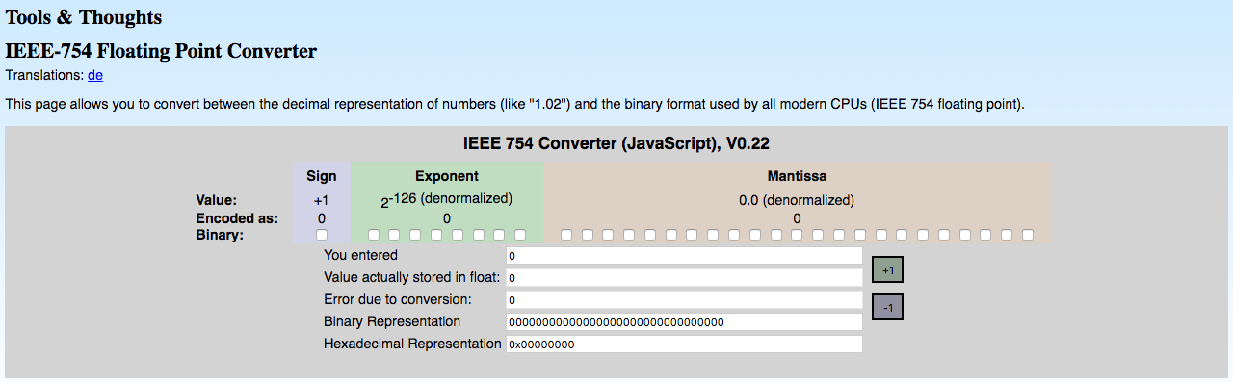
Check your Practice
http://www.h-schmidt.net/FloatConverter/IEEE754.html

Slide 21
IEEE-754 Double Precision
Double precision (64 bit) floating point
64 bits:
1
11 bits
52 bits (+1)
s
biased exp.
fraction
N = (-1)^{s} x 1.fraction x 2^{(biased exp. – 1023)}
Range: ~2.23e-308 … ~1.80e308 with full 15–17 decimal digits precision

Slide 22
IEEE-754 Half Precision, FP16: For AI Applications
Half-precision (16-bit) floating point
Trend in AI towards FP16, because lower precision calculations seem not to be critical. It often speeds up calculations, without harming the results.
Smaller range and precision than FP32
16 bits:
1
5 bits
10 bits (+1)
s
biased exp.
fraction
N = (-1)^{s} x 1.fraction x 2^{(biased exp. – 15)}
Range: (6.10e−5 to 6.1e+4) with 3.3 significant decimal digits precision
Supported by modern NVIDIA GPUs and others.
Source: https://moocaholic.medium.com/fp64-fp32-fp16-bfloat16-tf32-and-other-members-of-the-zoo-a1ca7897d407
Source: https://blogs.nvidia.com/blog/tensorfloat-32-precision-format/

Slide 23
BFP16: Brain Floating Point, AI Applications
Half-precision (16-bit) floating point
Trend in AI towards FP16, because lower precision calculations seem not to be critical. It often speeds up calculations, without harming the results.
Same dynamic range but less precision than FP32
Better for training avoiding underflow and overflow.
Faster and smaller than FP32
Google TPU, Intel AMX, NVIDIA Hopper,
16 bits:
1
8 bits
7 bits (+1)
s
biased exp.
fraction
N = (-1)^{s} x 1.fraction x 2^{(biased exp. – 127)}
Range: (+/- 3.4e−38 to 3.4e+38) with ~2.4 significant decimal digits precision
Source: https://moocaholic.medium.com/fp64-fp32-fp16-bfloat16-tf32-and-other-members-of-the-zoo-a1ca7897d407
Source: https://blogs.nvidia.com/blog/tensorfloat-32-precision-format/
Source: https://nhigham.com/2020/06/02/what-is-bfloat16-arithmetic/

Slide 24
Processors with BFloat16 Support
Vendor | Product / Family | Type | BF16 Support | Architecture / Notes
Intel | Xeon Scalable (4th Gen) | CPU | Yes | AMX, Sapphire Rapids
Intel | Xeon Scalable (3rd Gen) | CPU | Yes | AVX-512 + BF16
Intel | Habana Gaudi / Gaudi2 | AI Accelerator | Yes | Native BF16
AMD | EPYC 9004 (Zen 4) | CPU | Yes | AVX-512 + BF16
AMD | Ryzen 7000 (Zen 4) | CPU | Yes | AVX-512 BF16
AMD | Instinct MI300 Series | GPU | Yes | BF16, FP8, CDNA 3
Google | TPU v2, v3, v4 | AI Accelerator | Yes | Native BF16 only
NVIDIA | A100 (Ampere) | GPU | Yes | Tensor Cores: FP16, BF16, FP32
NVIDIA | H100 (Hopper) | GPU | Yes | BF16, FP8, Tensor memory format
ARM | Neoverse V2 / V3 | CPU | Partial | SVE2 + BF16 optional

Slide 25
BFP16: Brain Floating Point Notes
AVX-512 BF16 is key enabling instruction set for x86 CPUs (Intel & AMD).
AMX (Intel) provides matrix-tile-based H/W blocks accelerate BF16 DNN ops
TPUs use BF16 as their primary numeric format — no FP32 inside.
NVIDIA uses BF16 in newer generations (Ampere and Hopper)
BF16 is not IEEE 754, but most compilers/hardware treat it as a standard due to its practical benefits
BF16 Supports: Zero, NaN, +/- Infinity, and sub-normal?? (see up-coming slides)
Great Reference: https://github.com/riscv/riscv-isa-manual/blob/main/src/bfloat16.adoc

Slide 26
Floating-Point Format Comparison
Format | Bits | Exponent Bits | Mantissa Bits | Exponent Bias | Precision (≈ digits) | Dynamic Range | IEEE 754? | Notes
FP64 | 64 | 11 | 52 | 1023 | ~15.7 | ±1.8e-308 to 1.8e+308 | Yes | Double precision
FP32 | 32 | 8 | 23 | 127 | ~7.2 | ±1.4e-45 to 3.4e+38 | Yes | Standard float
FP16 | 16 | 5 | 10 | 15 | ~3.3 | ±6.1e-5 to 6.5e+4 | Yes | Half precision
BFloat16 | 16 | 8 | 7 | 127 | ~2.4 | ±3.4e-38 to 3.4e+38 | No | Same range as FP32
TF32 | 19 | 8 | 10 | 127 | ~3.3 | ±1.4e-45 to 3.4e+38 | No | NVIDIA-only format
FP8 (E4M3) | 8 | 4 | 3 | 7 | ~1.0 | ±6e-3 to 2.4e+1 | No | Used for ML inference
FP8 (E5M2) | 8 | 5 | 2 | 15 | ~0.75 | ±6e-5 to 6.5e+4 | No | Wider range, less precision

Slide 27
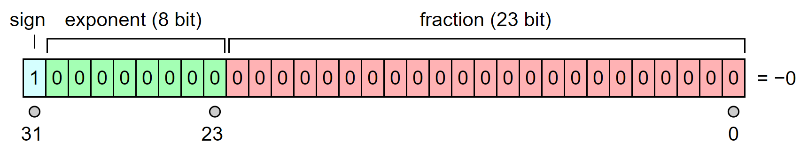
Expressing Zero in IEEE 754
In IEEE 754 binary floating-point formats, zero values are represented by the convention of having the biased exponent and significand both being zero.
Unlike Integers, Floating Point has both positive and negative zeros.
Note when exponent = 0 the fraction is de-normalized
(i.e. no hidden 1 is now implied)
Source: By Octahedron80 - Modified from Image:IEEE 754 Single Floating Point Format.svg, original by Codekaizen, CC BY 3.0, https://commons.wikimedia.org/w/index.php?curid=3697716

Slide 28
Representing NaN, +/- Infinity
Like for 0, these values are represented based on a convention:
Infinity (+ and -):
exponent = 255 (1111 1111)
and fraction = 0
NaN (Not a Number):
exponent = 255 and fraction ≠ 0
e.g. 0.0 divided by 0.0
is arithmetically undefined or a NaN.

Slide 29
Subnormal Numbers
A normal number is defined as a floating point number with a 1 at the start of the significand. Thus, the smallest normal number in double precision is 1.000...x2-1022.
The smallest representable normal number is called the underflow level, or UFL.
Can go even smaller by removing restriction that first number significand myst be a 1.
These numbers are known as subnormal, and are stored with all zeros in the exponent.
Technically, zero is also a subnormal number.
Subnormal numbers do not have as many significant digits as normal numbers.
The use of subnormal numbers allows for more gradual underflow to zero.
32-bit (SP) subnormal number:
1
8 bits
23 bits
s
00000000
010 0000 0000 0000 0000
N = (-1)^{s} x 0.fraction x 2^{(–126)}
Source: https://courses.physics.illinois.edu/cs357/sp2020/notes/ref-4-fp.html

Slide 30
Example FP8: For AI Applications
There are 2 8-bit floating points formats, used for AI.
FP8, lower precision calculations always critical. It can speeds up calculations and takes less space.
Better dynamic range than int8
e.g.
8 bits:
1
4 or 5 bits
3 or 2 bits (+1)
s
biased exp.
fraction
N = (-1)^{s} x 1.fraction x 2^{(biased exp. – (7 or 15)}
Supported by very modern NVIDIA GPUs
Source: https://moocaholic.medium.com/fp64-fp32-fp16-bfloat16-tf32-and-other-members-of-the-zoo-a1ca7897d407

Slide 31
Details of FP8 Binary Formats:
 | E4M3 | E5M2
Exponent Bias | 7 | 15
Infinities | N/A | S11111.00
NaN | S1111.111 | S11111.[01,10,11]
Zeros | S0000.000 | S00000.00
Max Normal | S0000.111 = 1.75*2⁻⁶=448 | S11110.11 = 1.75*2⁻¹⁵=57,344
Min Normal | S0001.000 = 2⁻⁶ | S00001.00 = 2⁻¹⁴
Max subnorm | S0000.111 = 0.875*2⁻⁶ | S00000.11 = 0.75*2⁻¹⁴
Min subnorm | S0000.001 = 2⁻⁹ | S00000.01 = 2⁻¹⁶
Source: https://ar5iv.labs.arxiv.org/html/2209.05433
FP8 Formats for Deep Learning

Slide 32
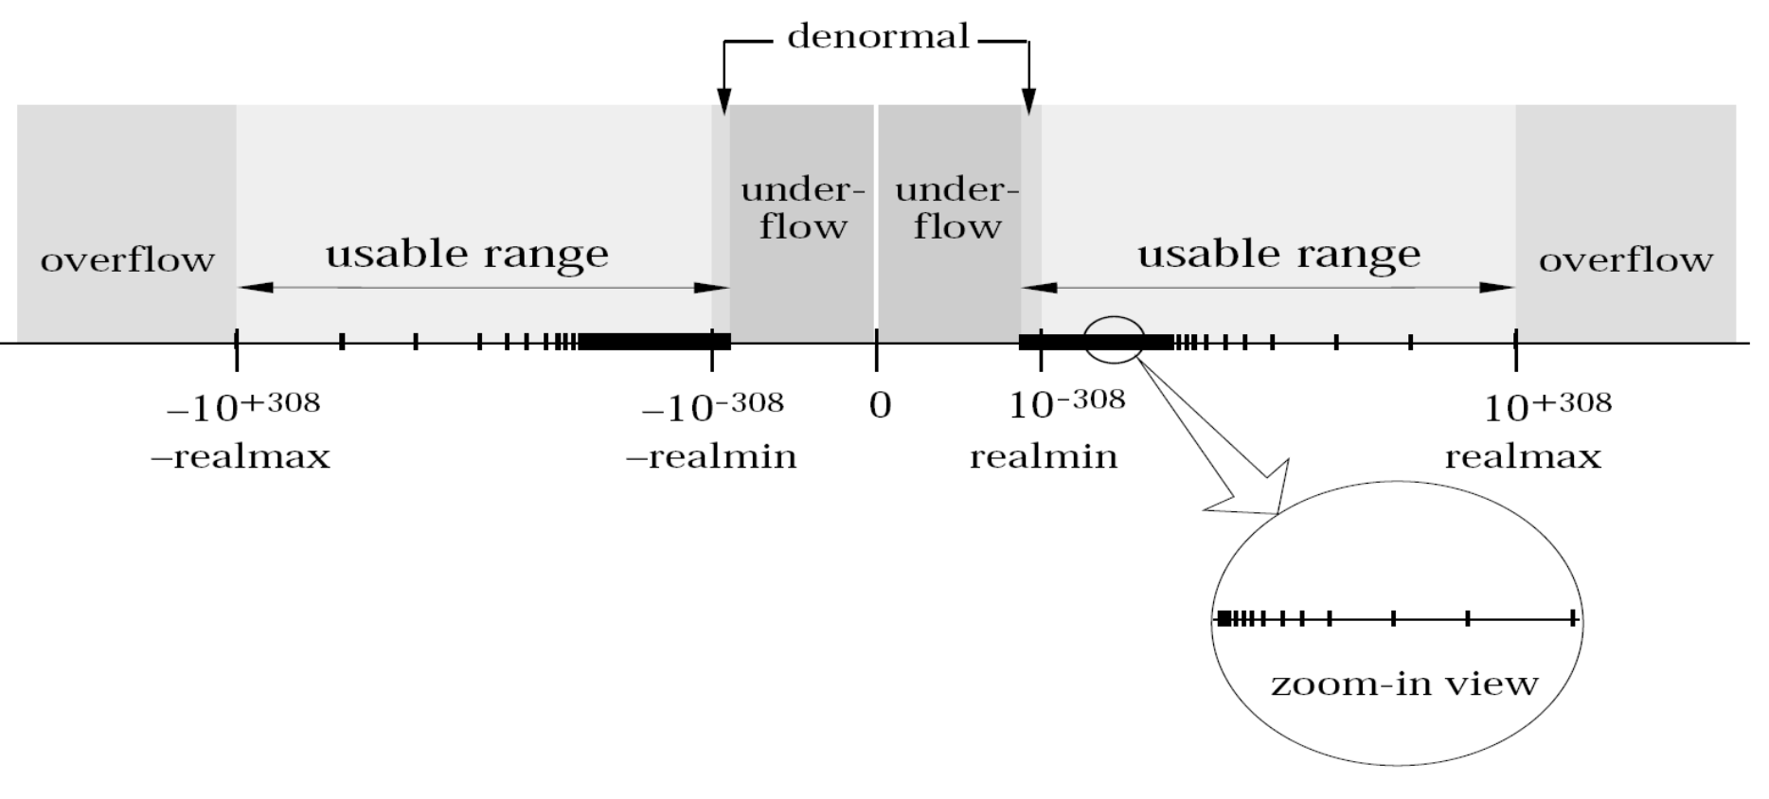
IEEE-754 Floating Point Number Line (SP=32-bits)
Source: https://courses.physics.illinois.edu/cs357/sp2020/notes/ref-4-fp.html

