Slide 1
CSE110A: Compilers
Topics:
Start of Module 4 – Optimizations
Introduction

Slide 2
Module 4: Optimizations

Slide 3
Discussion
What are compiler optimizations?
Why do we want compiler optimizations?

Slide 4
Discussion
What are compiler optimizations?
automated program transforms designed to make code more optimal
optimal can mean different things
code optimized for one system might be different for code optimized for a different system
we can optimize for speed, for energy efficiency, or for code size. What else?
Why do we want the compiler to help us optimize?
So we can write more maintainable/portable code
So we don’t have to worry about learning nuanced details about every possible system

Slide 5
Discussion
What are some compiler optimizations you know about?

Slide 6
Discussion
What are some compiler optimizations you know about?
for (int i = x = x + 1; } | 0; | i | < | 10; | i++) | {
loop unrolling
for (int i = | 0; | i | < | 10; | i++) | {
x = x + 1;
i++; x = x + 1; }

Slide 7
Discussion
What are some compiler optimizations you know about?
int foo() {
int i,j,k; i = 10;
j = i; k = j;
return k;
}
for (int i = 0; i < 10; i++) { x = x + 1;
}
loop unrolling
for (int i = 0; i < 10; i++) { x = x + 1;
i++;
x = x + 1;
}
constant propagation
int foo() {
int i,j,k; return 10;
}

Slide 8
Discussion
What are some compiler optimizations you know about?
for (int i = 0; i < 10; i++) { x = x + 1;
}
loop unrolling
for (int i = 0; i < 10; i++) { x = x + 1;
i++;
x = x + 1;
}
What does this save us?

Slide 9
Discussion
What are some compiler optimizations you know about?
for (int i = 0; i < 10; i++) { x = x + 1;
}
optimizations at one stage can enable optimizations at another stage:
loop unrolling
for (int i = 0; i < 10; i++) { x = x + 1;
i++;
x = x + 1;
}
for (int i = 0; i < 10; i+=2) {
}
x = x + 2;
provides a bigger window for local analysis
What does this save us?

Slide 10
Discussion
What are some compiler optimizations you know about?
let’s do a few more
Function inlining
int add(int x, int y) { return x + y;
}
int foo(int x, int y, int z) { return add(x,y);
}
int foo(int x, int y, int z) { return x + y;
}
What does this save us?
code size? speed? the ability to debug? local regions to optimize more?

Slide 11
Discussion
What are some compiler optimizations you know about?
There are many more! This is an active area of research and development
For a rough metric:
git effort shows activities on different files and directories
clang C++/C parser: 3.5K commits clang AST: 8.7K commits
LLVM transforms/optimizations: 30K commits
The LLVM project has been under active development since 2000, and Clang since about 2007–2008.
The transformation part of the code base has the most activity by far

Slide 12
Discussion
How do you enable compiler optimizations?

Slide 13
Discussion
How do you enable compiler optimizations?
most C/++ compilers
optimizing for speed
-O0, -O1, -O2, -O3 optimizing for size
-Os, -Oz
relax some constraints (especially around floating point):
-Ofast
We can use Godbolt to test various optimizations.
https://stackoverflow.com/questions/15548023/clang-optimization-levels

Slide 14

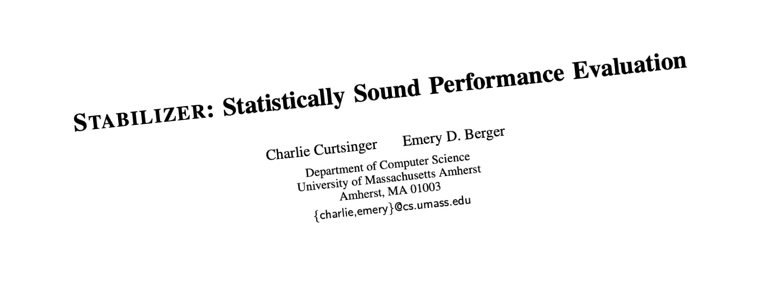
Discussion
2013 research paper
“the performance impact of -O3 over -O2 optimizations is indistinguishable from random noise.”

Slide 15
Discussion
What are some of the biggest improvements you’ve seen from compiler optimizations?

Slide 16
Discussion
What are some of the biggest improvements you’ve seen from compiler optimizations?
compiler optimizations are great at well-structured, regular loops and arrays

Slide 17
Discussion
What kind of transforms on your code is the compiler allowed to do?

Slide 18
Discussion
What kind of transforms on your code is the compiler allowed to do?
Matrix-add
Many-add example
Why did we get such a dramatic increase?

Slide 19
Discussion
int p(int arr[], int start, int end)
{
int pivot = arr[start];
int count = 0;
for (int i = start + 1; i <= end; i++) {
if (arr[i] <= pivot) count++;
}
int pivotIndex = start + count; swap(arr[pivotIndex], arr[start]);
Extreme example
int i = start, j = end;
while (i < pivotIndex && j > pivotIndex) {
while (arr[i] <= pivot) { i++;
}
while (arr[j] > pivot) { j--;
}
void foo(int * arr, int n)
{
int i, j;
for (i = 0; i < n - 1; i++)
for (j = 0; j < n - i - 1; j++) if (arr[j] > arr[j + 1]) {
tmp = arr[j];
arr[j] = arr[j + 1]); arr[j + 1] = tmp;
}
}
if (i < pivotIndex && j > pivotIndex) { swap(arr[i++], arr[j--]);
}
}
}
return pivotIndex;
void foo(int *arr, int n)
{
if (start >= end) return;
int p = p(arr, m, n);
foo(arr, start, p - 1);
}
foo(arr, p + 1, end);
is this transform legal?
code from https://www.geeksforgeeks.org/

Slide 20
Yes this transform would be legal!
int p(int arr[], int start, int end)
{
Discussion
Extreme example
int pivot = arr[start];
int count = 0;
for (int i = start + 1; i <= end; i++) {
if (arr[i] <= pivot) count++;
}
Could any compiler figure it out? currently unlikely..
int pivotIndex = start + count; swap(arr[pivotIndex], arr[start]);
This is a technique called “super optimizing” and it is getting more and more interest
int i = start, j = end;
while (i < pivotIndex && j > pivotIndex) {
while (arr[i] <= pivot) { i++;
}
bubble sort
while (arr[j] > pivot) { j--;
}
void foo(int * arr, int n)
{
int i, j;
for (i = 0; i < n - 1; i++)
for (j = 0; j < n - i - 1; j++) if (arr[j] > arr[j + 1]) {
tmp = arr[j];
arr[j] = arr[j + 1]); arr[j + 1] = tmp;
}
}
if (i < pivotIndex && j > pivotIndex) { swap(arr[i++], arr[j--]);
}
}
}
return pivotIndex;
void foo(int *arr, int n)
{
if (start >= end) return;
int p = p(arr, m, n);
foo(arr, start, p - 1);
}
foo(arr, p + 1, end);
quick sort
is this transform legal?
code from https://www.geeksforgeeks.org/

