Slide 1
CSE110A: Compilers
..
Topics:
Starting Module 2: Parsing
Introduction
Production Rules
Derivations and Parse Trees
A Simple Expression Grammar
int main() { printf(““);
return 0; }
..
..
..
..

Slide 2
Announcements
Homework 1
due Tue 1/27 at 11:59PM
Quiz 5: Scanner EM-SOS-NG-Actions
due Tue 1/27 at 5PM
Module 2: Parsing Starting today.
Lots of Tutoring is Available,
See Calendar for Details

Slide 3
Module 2: CFG and Parsing
Parsing:
Often times scanning is also included in parsing
Specifically this module is about “Syntactic Analysis”

Slide 4
Compiler Architecture
compiler
creates structure
produces executable code
Optimizations
Optimizations
Optimizations
machine code
input program
Front end
Optimizations
Back end
string
parsing
code gen
optimizations
build on each other
Still working in the front end
Notes:
Create Structure and Find Errors (the earlier the better) – don’t propagate errors.

Slide 5
IR program
input program
Lexical Analysis
Syntactic Analyzer
Semantic Analyzer
Intermediate code gen
IR optimizations
loop!
optimized IR program
string
token stream
syntax tree
syntax tree
target code gen
ISA program
target code optimizations
loop!
optimized ISA program
machine code
More detailed view

Slide 6
IR program
input program
Lexical Analysis
Syntactic Analyzer
Semantic Analyzer
Intermediate code gen
IR optimizations
loop!
optimized IR program
string
token stream
syntax tree
syntax tree
target code gen
position = initial + rate * 60;
ISA program
target code optimizations
loop!
optimized ISA program
machine code
More detailed view

Slide 7
IR program
input program
Lexical Analysis
Syntactic Analyzer
Semantic Analyzer
Intermediate code gen
IR optimizations
loop!
optimized IR program
string
token stream
syntax tree
syntax tree
target code gen
position = initial + rate * 60;
Token stream
<id,1> <assign,=> <id,2> <bin_op,+> <id,3> <bin_op,*> <num,60> <semi,;>
target code optimizations
loop!
optimized ISA program
machine code

Slide 8
position = initial + rate * 60;
IR program
input program
Lexical Analysis
Syntactic Analyzer
Semantic Analyzer
Intermediate code gen
IR optimizations
loop!
optimized IR program
string
token stream
syntax tree
syntax tree
target code gen
Token stream
<id,1> <assign,=> <id,2> <bin_op,+> <id,3> <bin_op,*> <num,60> <semi,;>
parse tree
=
target code optimizations
+
loop!
<id,1>
<id,2>
*
<id,3>
60
machine code
Notes:
Create trees – get to nodes are aperators, leaves are other nodes or tokens

Slide 9
Syntactic Analysis
Lexical Analysis turns a string into a stream of tokens
Syntactic Analysis determines if the tokens fit into the syntactic structure of the language
In our natural language example, it describes the structure of sentences

Slide 10
Syntactic Analysis
Natural language example
The dog ran across the park
ARTICLE
NOUN
VERB
PREPOSITION
ARTICLE
NOUN
What are valid sentences?
ARTICLE NOUN VERB PREPOSITION ARTICLE NOUN
ARTICLE ADJECTIVE NOUN VERB
Now we check if stream of lexemes fits
a sentence

Slide 11
How do we express a valid sentence?
List of tokens:
ARTICLE NOUN VERB PREPOSITION ARTICLE NOUN
Pros? Cons?

Slide 12
How do we express a valid sentence?
List of tokens (is this sufficient?):
ARTICLE NOUN VERB PREPOSITION ARTICLE NOUN
Pros? Cons?
Simple, but probably too simple

Slide 13
How do we express a valid sentence?
Several lists of tokens
ARTICLE NOUN VERB PREPOSITION ARTICLE NOUN
ARTICLE NOUN VERB
ARTICLE ADJECTIVE NOUN VERB
ARTICLE ADJECTIVE ADJECTIVE NOUN VERB
Pros? Cons?

Slide 14
How do we express a valid sentence?
Several lists of tokens
ARTICLE NOUN VERB PREPOSITION ARTICLE NOUN
ARTICLE NOUN VERB
ARTICLE ADJECTIVE NOUN VERB
ARTICLE ADJECTIVE ADJECTIVE NOUN VERB
Pros? Cons?
Potentially infinite choices

Slide 15
How do we express a valid sentence?
Regular expressions over tokens (is this enough):
ARTICLE ADJECTIVE* NOUN VERB
Pros? Cons?

Slide 16
How do we express a valid sentence?
Regular expressions over tokens:
ARTICLE ADJECTIVE* NOUN VERB
Pros? Cons?
Regular expressions worked really well for tokens
Provides decent expressivity
But what might go wrong?

Slide 17
Mathematical expressions
tokens:
NUM = “[0-9]+”
PLUS = “\+”
MULT = “\*”
Can we describe expressions?
Notes:
What is an expression … an expression evaluates to something (RHS of assignment)

Slide 18
Mathematical expressions
NUM ((PLUS | MULT) NUM)*
5
5 + 6
5 + 6 * 3

Slide 19
Mathematical expressions
NUM ((PLUS | MULT) NUM)*
5
5 + 6
5 + 6 * 3
But what does this one mean?
What if we want different precedence?
Notes:
Has some structure – but deeper meaning is not there.

Slide 20
Mathematical expressions
NUM ((PLUS | MULT) NUM)*
5
5 + 6
5 + 6 * 3
But what does this one mean?
What if we want different precedence?
(5 + 6) * 3
Can we do this one?
Notes:
We want to introduce meaning. RE’s finds matches. but does not do much about adding meaning.

Slide 21
Mathematical expressions
tokens:
NUM = “[0-9]+”
PLUS = “\+”
MULT = “\*”
OPAR = “\(“
CPAR = “\)”

Slide 22
Mathematical expressions
OPAR? NUM ((PLUS | MULT) OPAR? NUM CPAR?)*
Add parenthesis tokens
5
5 + 6
5 + 6 * 3
(5 + 6) * 3
Can we do this one?
Notes:
We want to introduce meaning. RE’s finds matches. but does not do much about adding meaning.

Slide 23
Mathematical expressions
OPAR? NUM ((PLUS | MULT) OPAR? NUM CPAR?)*
Seems like it works! But what is the issue?

Slide 24
Mathematical expressions
OPAR? NUM ((PLUS | MULT) OPAR? NUM CPAR?)*
Seems like it works! But what is the issue?
(5 + 6 * 3
What about this one?
Notes:
Catch the issue of matching parenthesis as early as possible..

Slide 25
Mathematical expressions
OPAR? NUM ((PLUS | MULT) OPAR? NUM CPAR?)*
Seems like it works! But what is the issue?
(5 + 6 * 3
What about this one?
()s are a key part of syntax. They are important for the structure we want to create and
we need to reliably detect strings that are not syntactically valid!

Slide 26
Context Free Grammars: A new class of languages
Regular expressions CANNOT match
(),
{},
HTML start/end tags
etc.
We will use context free grammars
Notes:
A provable theorem in CSE103

Slide 27
Recall: Language theory
Some theory:
Given a language L, a string s is either part of that language or not
Integers are a language: “5”, “6”, “-7” is in the language. “abc” is not.
Languages are grouped into families depending on how “hard” it is to determine if a string is part of that language.

Slide 28
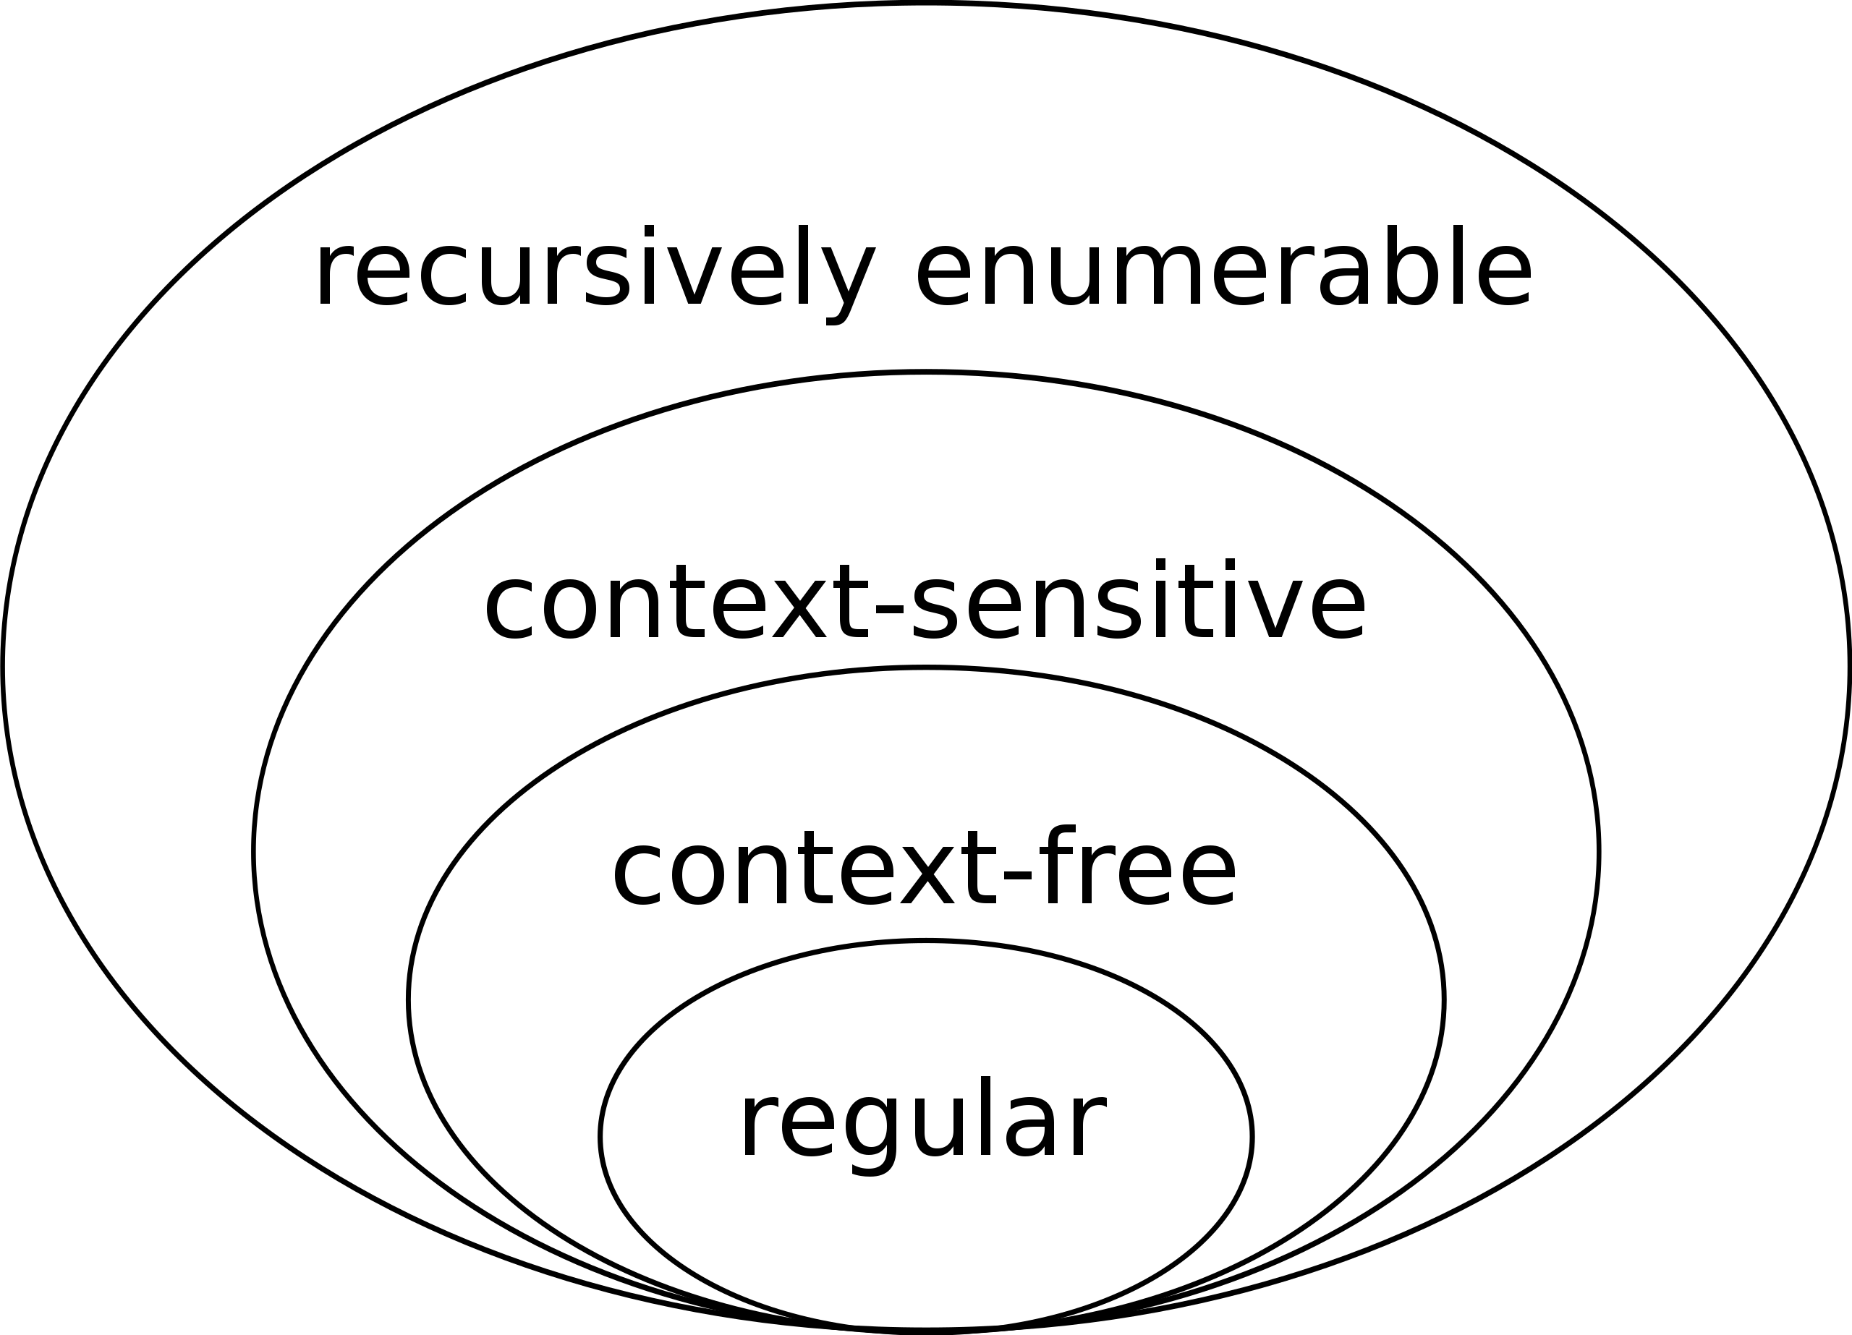
Recall: Language theory: Chomsky Hierarchy
The simplest languages are regular. We used
regular expressions for tokens.
They are fast, even in the general case
good level of abstraction for tokens
We will now use context-free languages (CFG) for
Syntactic Analysis
Fast algorithms exist in many cases (not all)
Determining membership can be even inefficient
or even undecidable at higher levels (context-sensitive and recursively enumerable)
image source: wikipedia

Slide 29
Context-Free Languages (CFG)
We will define similar to regular languages
In this class a context-free language is a language that can be recognized by a context-free grammar

Slide 30
Context-Free Languages
We will define similar to regular languages
In this class a context-free language is a language that can be recognized by a context-free grammar
....
What is a context-free grammar?

Slide 31
Context-free grammar
We will use Backus–Naur form (BNF) form
non-terminals are language ids. You can have as many as you need.
each non-terminal maps to one or more production rules.
one non-terminal is designated as the start or goal symbol
non-terminal-1 ::= production-rule-1
| production-rule-2
| ...
non-terminal-2 ::= production-rule-1
| production-rule-2
| ...
....

Slide 32
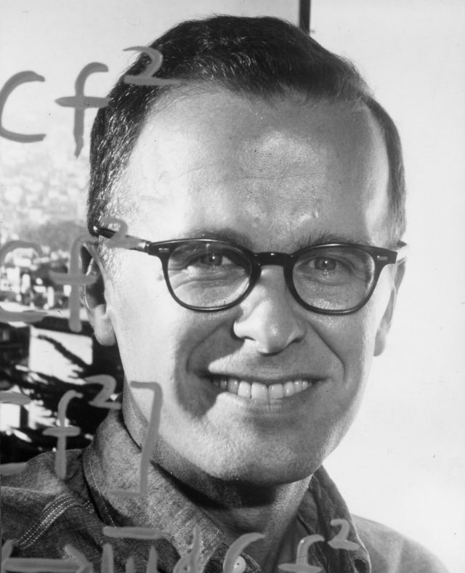
John Backus (BNF)
Examples:
add_expr ::= NUM ‘+’ NUM
mult_expr ::= NUM ‘*’ NUM
John Warner Backus (December 3, 1924 – March 17, 2007) was an American computer scientist. He led the team that invented and implemented FORTRAN, the first widely used high-level programming language, and was the inventor of the Backus–Naur form (BNF), a widely used notation to define syntaxes of formal languages. He later did research into the function-level programming paradigm, presenting his findings in his influential 1977 Turing Award lecture "Can Programming Be Liberated from the von Neumann Style?"^{[1]}
joint_expr ::= add_expr ‘*’ add_expr simple_expr ::= NUM ‘+’ NUM
| NUM ‘*’ NUM
“Much of my work has come from being lazy. I didn’t like writing programs, so I started work on a system to make them easier to write”
John Backus, Inventor of Fortran
 | Speedcoding FORTRAN ALGOL Backus–Naur form Function-level programming
Source: Wikipedia
https://www.ibm.com/history/john-backus

Slide 33
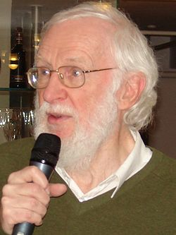
Peter Naur (BNF)
Examples:
add_expr ::= NUM ‘+’ NUM
mult_expr ::= NUM ‘*’ NUM
Peter Naur (25 October 1928 – 3 January 2016)^{[1]} was a Danish computer science pioneer and 2005 Turing Award winner. He is best remembered as a contributor, with John Backus, to the Backus–Naur form (BNF) notation used in describing the syntax for most programming languages. He also contributed to creating the language ALGOL 60.
joint_expr ::= add_expr ‘*’ add_expr simple_expr ::= NUM ‘+’ NUM
| NUM ‘*’ NUM
In his book Computing: A Human Activity (1992), which is a collection of his contributions to computer science, he rejected the formalist school of programming that views programming as a branch of mathematics. He did not like being associated with the Backus–Naur form (attributed to him by Donald Knuth) and said that he would prefer it to be called the Backus normal form.
“
Source: Wikipedia
 | ALGOL Backus–Naur form

Slide 34
Context-free grammar
We will use Backus–Naur form (BNF) form
Production rules contain a sequence of either non-terminals or terminals
In our class, terminals will either be tokens or a string constants as a short-cut for a token e.g. `+’
Examples:
add_expr ::= NUM ‘+’ NUM
mult_expr ::= NUM ‘*’ NUM
joint_expr ::= add_expr ‘*’ add_expr
simple_expr ::= NUM ‘+’ NUM
| NUM ‘*’ NUM
Notes:
But the power of CFGs come from the use of recursion.

Slide 35
Deriving strings
A CFG G is said to derive a string s if s is in the language of G
We can show a string s belongs to G by providing a derivation
SheepNoise ::= ‘baa’ SheepNoise
| ‘baa’
Start with a sentinel string: a string containing terminals and non-terminals:
“SheepNoise”
Then pick one of the non-terminals and expand it
We will find a derivation using the table method,
Always starting with the “start” NT: here it is SheepNoise
Notes:
A non-terminal is defined in terms of itself.

Slide 36
Deriving strings
Give each production rule a numeric id
1: SheepNoise ::= ‘baa’ SheepNoise
2: | ‘baa’
String: “baa”
String: “baa baa”
RULE | Sentential Form
start | SheepNoise
RULE | Sentential Form
start | SheepNoise

Slide 37
Deriving strings
Give each production rule a numeric id
1: SheepNoise ::= ‘baa’ SheepNoise
2: | ‘baa’
String: “baa”
String: “baa baa”
RULE | Sentential Form
start | SheepNoise
2 | “baa”
RULE | Sentential Form
start | SheepNoise
1 | “baa” SheepNoise
2 | “baa baa”

Slide 38
Mathematical expressions
tokens:
NUM = “[0-9]+”
OPAR = “\(“
CPAR = “\)”
1:
2:
3:
4:
5:

Slide 39
Mathematical expressions
tokens:
NUM = “[0-9]+”
OPAR = “\(“
CPAR = “\)”
1: Expr ::= ‘(’ Expr ‘)’
2: | Expr Op NUM
3: | NUM
4: Op ::= ‘+’
5: Op | ‘*’

Slide 40
A more complicated example
1: Expr ::= ‘(’ Expr ‘)’
2: | Expr Op ID
3: | ID
4: Op ::= ‘+’
5: Op | ‘*’
Can we derive the string (a+b)*c
RULE | Sentential Form
start | Expr

Slide 41
A more complicated example
1: Expr ::= ‘(’ Expr ‘)’
2: | Expr Op ID
3: | ID
4: Op ::= ‘+’
5: Op | ‘*’
Can we derive the string (a+b)*c
RULE | Sentential Form
start | Expr
2 | Expr Op ID
5 | Expr * ID
1 | (Expr) * ID
2 | (Expr Op ID) * ID
4 | (Expr + ID) * ID
3 | (ID + ID) * ID

Slide 42
A more complicated example
1: Expr ::= ‘(’ Expr ‘)’
2: | Expr Op ID
3: | ID
4: Op ::= ‘+’
5: Op | ‘*’
Can we derive the string (a+b)*c
We can visualize this as a tree:
RULE | Sentential Form
start | Expr
2 | Expr Op ID
5 | Expr * ID
1 | (Expr) * ID
2 | (Expr Op ID) * ID
4 | (Expr + ID) * ID
3 | (ID + ID) * ID
Expr
Notes:
We call this a parse tree,

Slide 43
A more complicated example
1: Expr ::= ‘(’ Expr ‘)’
2: | Expr Op ID
3: | ID
4: Op ::= ‘+’
5: Op | ‘*’
Can we derive the string (a+b)*c
We can visualize this as a tree:
RULE | Sentential Form
start | Expr
2 | Expr Op ID
5 | Expr * ID
1 | (Expr) * ID
2 | (Expr Op ID) * ID
4 | (Expr + ID) * ID
3 | (ID + ID) * ID
Expr
Expr
Op
(ID, c)

Slide 44
A more complicated example
1: Expr ::= ‘(’ Expr ‘)’
2: | Expr Op ID
3: | ID
4: Op ::= ‘+’
5: Op | ‘*’
Can we derive the string (a+b)*c
We can visualize this as a tree:
RULE | Sentential Form
start | Expr
2 | Expr Op ID
5 | Expr * ID
1 | (Expr) * ID
2 | (Expr Op ID) * ID
4 | (Expr + ID) * ID
3 | (ID + ID) * ID
Expr
Expr
Op
(ID, c)
*

Slide 45
A more complicated example
1: Expr ::= ‘(’ Expr ‘)’
2: | Expr Op ID
3: | ID
4: Op ::= ‘+’
5: Op | ‘*’
Can we derive the string (a+b)*c
We can visualize this as a tree:
RULE | Sentential Form
start | Expr
2 | Expr Op ID
5 | Expr * ID
1 | (Expr) * ID
2 | (Expr Op ID) * ID
4 | (Expr + ID) * ID
3 | (ID + ID) * ID
Expr
Expr
Op
(ID, c)
(
Expr
)
*

Slide 46
A more complicated example
1: Expr ::= ‘(’ Expr ‘)’
2: | Expr Op ID
3: | ID
4: Op ::= ‘+’
5: Op | ‘*’
Can we derive the string (a+b)*c
We can visualize this as a tree:
RULE | Sentential Form
start | Expr
2 | Expr Op ID
5 | Expr * ID
1 | (Expr) * ID
2 | (Expr Op ID) * ID
4 | (Expr + ID) * ID
3 | (ID + ID) * ID
Expr
Expr
Op
(ID, c)
(
Expr
)
*
Expr
Op
(ID, b)

Slide 47
A more complicated example
1: Expr ::= ‘(’ Expr ‘)’
2: | Expr Op ID
3: | ID
4: Op ::= ‘+’
5: Op | ‘*’
Can we derive the string (a+b)*c
We can visualize this as a tree:
RULE | Sentential Form
start | Expr
2 | Expr Op ID
5 | Expr * ID
1 | (Expr) * ID
2 | (Expr Op ID) * ID
4 | (Expr + ID) * ID
3 | (ID + ID) * ID
Expr
Expr
Op
(ID, c)
(
Expr
)
*
Expr
Op
(ID, b)
+

Slide 48
A more complicated example
1: Expr ::= ‘(’ Expr ‘)’
2: | Expr Op ID
3: | ID
4: Op ::= ‘+’
5: Op | ‘*’
Are there other ways to derive(a+b)*c?
We can visualize this as a tree:
RULE | Sentential Form
start | Expr
2 | Expr Op ID
5 | Expr * ID
1 | (Expr) * ID
2 | (Expr Op ID) * ID
4 | (Expr + ID) * ID
3 | (ID + ID) * ID
Expr
Expr
Op
(ID, c)
(
Expr
)
*
Expr
Op
(ID, b)
+
DONE
(ID, a)
Notes:
The parse tree can be traversed (post-order) to create the original expression.

Slide 49
A more complicated example
1: Expr ::= ‘(’ Expr ‘)’
2: | Expr Op ID
3: | ID
4: Op ::= ‘+’
5: Op | ‘*’
Are there other ways to derive(a+b)*c?
RULE | Sentential Form
start | Expr
2 | Expr Op ID
5 | Expr * ID
1 | (Expr) * ID
2 | (Expr Op ID) * ID
4 | (Expr + ID) * ID
3 | (ID + ID) * ID
RULE | Sentential Form
start | Expr

Slide 50
A more complicated example
1: Expr ::= ‘(’ Expr ‘)’
2: | Expr Op ID
3: | ID
4: Op ::= ‘+’
5: Op | ‘*’
Are there other ways to derive(a+b)*c?
RULE | Sentential Form
start | Expr
2 | Expr Op ID
5 | Expr * ID
1 | (Expr) * ID
2 | (Expr Op ID) * ID
4 | (Expr + ID) * ID
3 | (ID + ID) * ID
RULE | Sentential Form
start | Expr
2 | Expr Op ID
1 | (Expr) Op ID
2 | (Expr Op ID) Op ID
3 | (ID Op ID) Op ID
4 | (ID + ID) Op ID
5 | (ID + ID) + ID
right derivation
left derivation

Slide 51
A more complicated example
Are there other ways to derive(a+b)*c?
1: Expr ::= ‘(’ Expr ‘)’
2: | Expr Op ID
3: | ID
4: Op ::= ‘+’
5: Op | ‘*’
RULE | Sentential Form
start | Expr
2 | Expr Op ID
5 | Expr * ID
1 | (Expr) * ID
2 | (Expr Op ID) * ID
4 | (Expr + ID) * ID
3 | (ID + ID) * ID
left derivation
Expr
Expr
Op
(ID, c)
RULE | Sentential Form
start | Expr
2 | Expr Op ID
5 | Expr * ID
1 | (Expr) * ID
2 | (Expr Op ID) * ID
4 | (Expr + ID) * ID
3 | (ID + ID) * ID
(
Expr
)
*
Expr
Op
(ID, b)
right derivation
(ID, a)
+
same parse tree

Slide 52
Meaning into structure
We want to start encoding meaning into the parse structure. We will want as much structure as possible as we continue through making a compiler
The intended structure is wanting the evaluation of a program to correspond to a post order traversal of the parse tree (also called the natural traversal)

Slide 53
Post order traversal
Visiting nodes for different types
of traversals:
pre order?
in order?
post order

Slide 54
Review: Possible Orders of Traversal
Traversal Order | Order Visited | Example Output
pre-order | Top-Root->Left-Child->Right-Child | A B D E G H C F
in-order | Left/Bottom->Its-Root->Right/Bottom Limited to binary trees | D B G E H A C F
post-order | Left/Bottom->Right/Bottom->Its-Root | D G H E B F C A
A
B
C
Traversals never visit the same node twice.
D
E
F
Pre-order Traversal (Root-Left-Right. Top to Bottom)
Prioritizes visits from top to bottom, and left to right
Useful for serializing and copying trees.
G
H
In-order Traversal (Left-Root-Right, Bottom to Top)
Prioritizes visits from bottom left to right visiting parent nodes on the way. Sometimes used for sorting.
Post-order (or natural) Traversal (Left-Right-Root)
Prioritizes traversing subtrees by visiting lowest nodes first, and parent nodes later. Useful for evaluating expression trees (e.g. parsing)

Slide 55
Post Order Traversal
Post Order traversal defines the
desired type of structure
Considered for parse trees.
Similar to Reverse Polish Notation or Postfix, resources needed by each parent node are evaluated first, then the node.
4
1
2
3

Slide 56
Ambiguous grammars
What happens when different derivations have different parse trees?
1: Statement ::= ”if” Expr “then” Statement “else” Statement
2: | ”if” Expr “then” Statement
3: | Assignment
4: | ....
can we derive this string?
if Expr1 then if Expr2 then Assignment1 else Assignment2
Next few figures taken from the EAC book (Chapter 3.1)

Slide 57
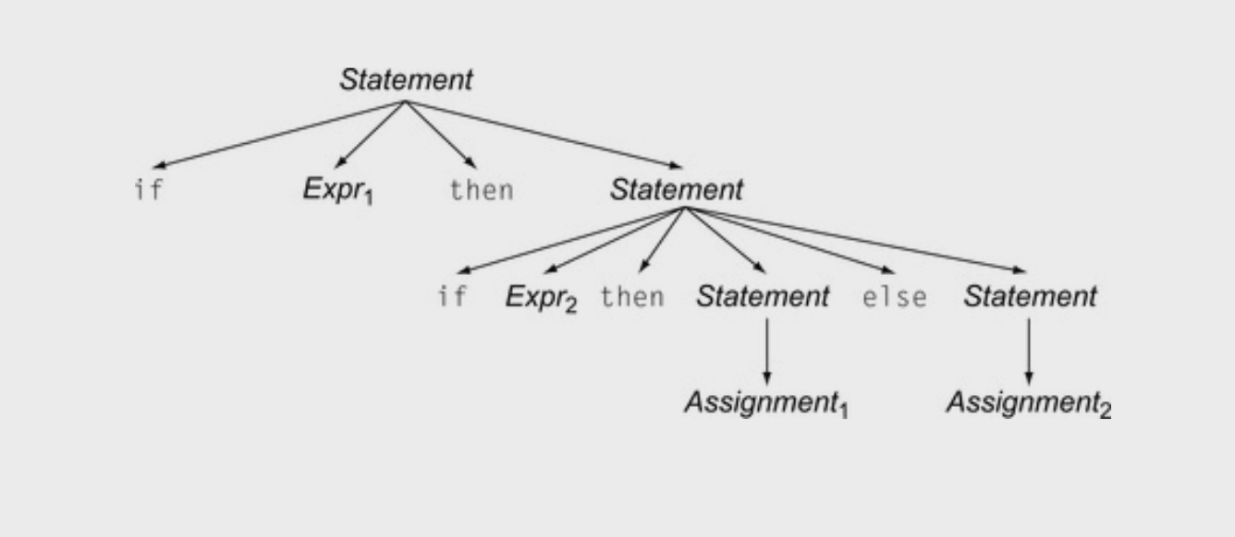
Ambiguous grammars
1: Statement ::= ”if” Expr “then” Statement “else” Statement
2: | ”if” Expr “then” Statement
3: | Assignment
4: | ....
if Expr₁ then if Expr₂ then Assignment₁ else Assignment₂

Slide 58
Ambiguous grammars
1: Statement ::= ”if” Expr “then” Statement “else” Statement
2: | ”if” Expr “then” Statement
3: | Assignment
4: | ....
if Expr₁ then if Expr₂ then Assignment₁ else Assignment₂
Valid derivation

Slide 59
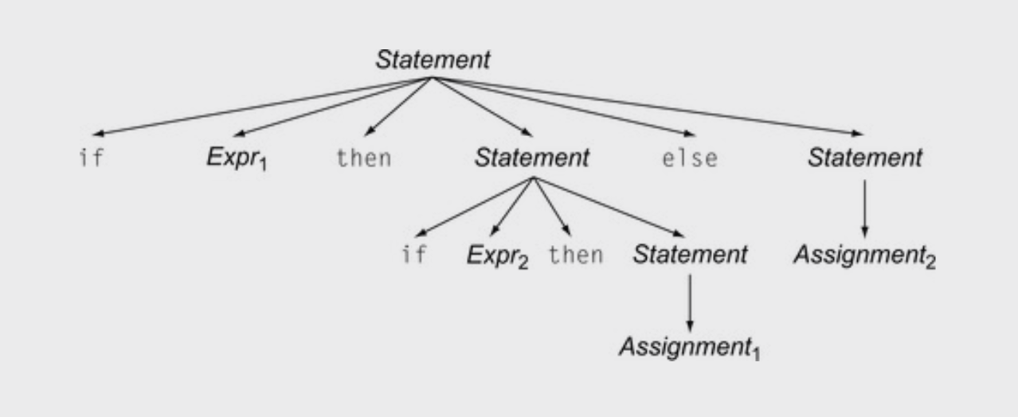
Ambiguous grammars
1: Statement ::= ”if” Expr “then” Statement “else” Statement
2: | ”if” Expr “then” Statement
3: | Assignment
4: | ....
if Expr₁ then if Expr₂ then Assignment₁ else Assignment₂
Valid derivation

Slide 60
Ambiguous grammars
1: Statement ::= ”if” Expr “then” Statement “else” Statement
2: | ”if” Expr “then” Statement
3: | Assignment
4: | ....
if Expr₁ then if Expr₂ then Assignment₁ else Assignment₂
Valid derivation
Also a valid derivation

Slide 61
Ambiguous grammars
Is this an issue? Don’t we only care if a grammar can derive a string?
Valid derivation
Also a valid derivation

Slide 62
Ambiguous grammars
When we encode meaning into structure, these are very different programs
Valid derivation
Also a valid derivation

Slide 63
We will study how to eliminate ambiguity
But I want to close out today with an interesting case study

Slide 64
Interesting Case study
Using a CFG, you can derive random strings in a language
This can be useful for testing compiler correctness.
C-Smith (from the University of Utah)
Generates random C programs
Used to test compiler correctness
clang -00
run
Random C program
Check outcome. Is it the same? if not, then there is a bug in one of the compilers
clang -03
run
gcc ...
run

Slide 65
Case study
400+ compiler bugs were found
These days Google has a couple of servers running these tests 24/7 looking for bugs.
Run a Demo (csmith)
clang -00
run
Random C program
Check outcome. Is it the same? if not, then there is a bug in one of the compilers
clang -03
run
gcc ...
run

Slide 66
Case study
int main() {
int x;
printf("%d\n", x);
return 0;
}
Big challenge: Undefined behavior
Even though the program is syntactically valid, the behavior may be undefined
Uninitialized variables can return
anything!
Use advanced compiler analysis
to catch these issues
clang -00
run
Random C program
Check outcome. Is it the same? if not, then there is a bug in one of the compilers
clang -03
run
gcc ...
run

Slide 67
Next Topic:
How to remove ambiguity from grammars
Precedence
Associativity

