Slide 1
Quiz-06-AMBIG-PREC

Slide 2
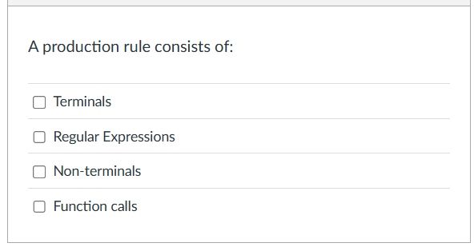
Quiz Q1:

Slide 3
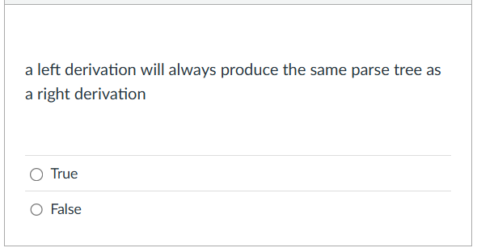
Quiz Q2:

Slide 4
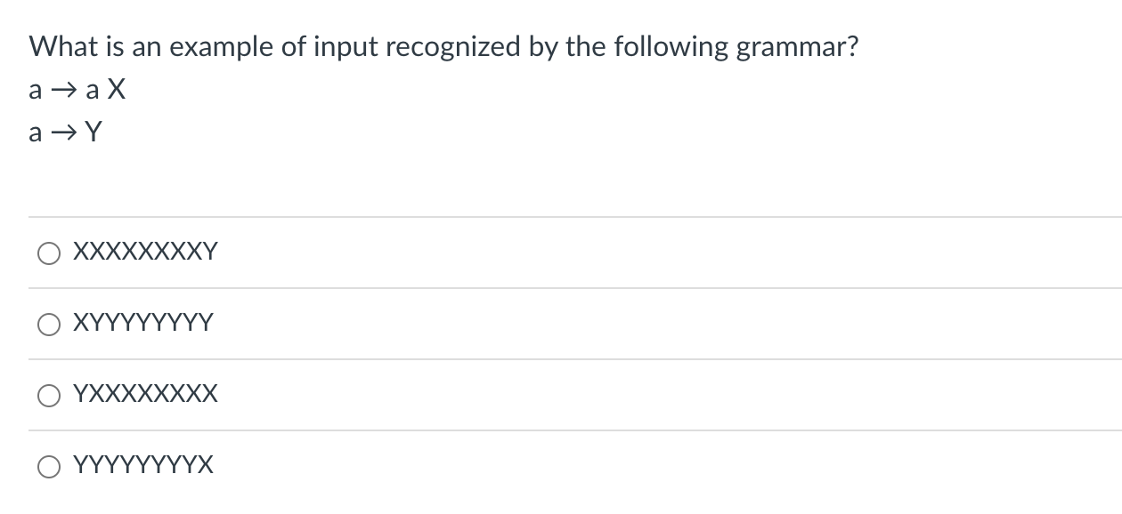
Quiz Q3:

Slide 5
Quiz
1 2
How about this one?
XXXXXXXY
RULE | Sentential Form
start | a

Slide 6
Quiz
1 2
How about this one?
XXXXXXXY
Applying either rule gives us a sentential form that won’t create the string
RULE | Sentential Form
start | a

Slide 7
Quiz
1 2
How about this one?
XYYYY
RULE | Sentential Form
start | A

Slide 8
Quiz
1 2
How about this one?
XYYYY
Similar reason: strings that are longer than 1 character cannot end in y
RULE | Sentential Form
start | A

Slide 9
Quiz
1 2
How about this one?
YXXXXXX
RULE | Sentential Form
start | A

Slide 10
Quiz
1 2
How about this one?
YXXXXXX
RULE | Sentential Form
start | A
1 | aX
1 | aXX
… | ….
2 | YXXXXX

Slide 11
Quiz
1 2
How about this one?
YYYYYYX
RULE | Sentential Form
start | A

Slide 12
Quiz
1 2
How about this one?
YYYYYYX
We can only produce
1 y, so we cannot
derive this string
RULE | Sentential Form
start | A

Slide 13
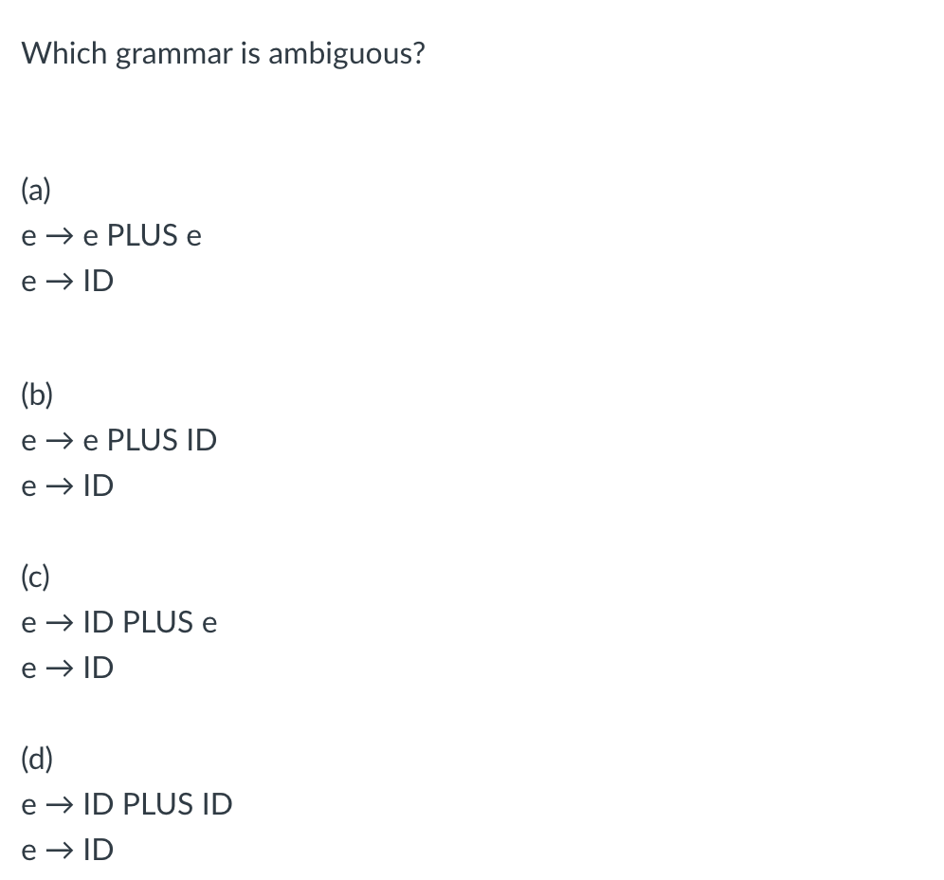
Quiz Q4:

Slide 14
Quiz
Let’s look at some examples. Let’s assume that E is an ”expr”
and x is a number

Slide 15
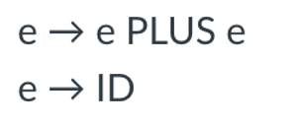
input: 2+3+4
Both parse trees are valid, this grammar is ambiguous
expr
expr
expr
<PLUS>
expr
expr
<PLUS>
expr
expr
<PLUS>
expr
term
term
expr
<PLUS>
expr
term
term
factor
term
term
factor
factor
factor
<NUM, 4>
factor
factor
<NUM, 2>
<NUM, 2>
<NUM, 3>
<NUM, 3>
<NUM, 4>

Slide 16
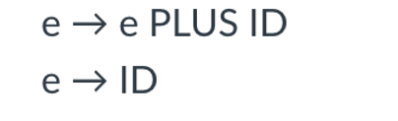
input: 2+3+4
See next slide
What about this one?
expr
expr
expr
<PLUS>
expr
expr
<PLUS>
expr
expr
<PLUS>
expr
term
term
expr
<PLUS>
expr
term
term
factor
term
term
factor
factor
factor
<NUM, 4>
factor
factor
<NUM, 2>
<NUM, 2>
<NUM, 3>
<NUM, 3>
<NUM, 4>

Slide 17
input: 2+3+4
UNAMBIGUOUS
Doesn’t allow an expression on the RHS. This parse tree is not allowed
What about this one?
expr
expr
expr
<PLUS>
expr
expr
<PLUS>
expr
expr
<PLUS>
expr
term
term
expr
<PLUS>
expr
term
term
factor
term
term
factor
factor
factor
<NUM, 4>
factor
factor
<NUM, 2>
<NUM, 2>
<NUM, 3>
<NUM, 3>
<NUM, 4>

Slide 18
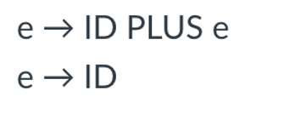
input: 2+3+4
See next slide
What about this one?
expr
expr
expr
<PLUS>
expr
expr
<PLUS>
expr
expr
<PLUS>
expr
term
term
expr
<PLUS>
expr
term
term
factor
term
term
factor
factor
factor
<NUM, 4>
factor
factor
<NUM, 2>
<NUM, 2>
<NUM, 3>
<NUM, 3>
<NUM, 4>

Slide 19
input: 2+3+4
UNAMBIGUOUS
Doesn’t allow an expression on the LHS. This parse tree is not allowed
What about this one?
expr
expr
expr
<PLUS>
expr
expr
<PLUS>
expr
expr
<PLUS>
expr
term
term
expr
<PLUS>
expr
term
term
factor
term
term
factor
factor
factor
<NUM, 4>
factor
factor
<NUM, 2>
<NUM, 2>
<NUM, 3>
<NUM, 3>
<NUM, 4>

Slide 20
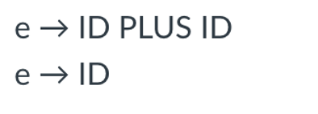
input: 2+3+4
See next slide
What about this one?
expr
expr
expr
<PLUS>
expr
expr
<PLUS>
expr
expr
<PLUS>
expr
term
term
expr
<PLUS>
expr
term
term
factor
term
term
factor
factor
factor
<NUM, 4>
factor
factor
<NUM, 2>
<NUM, 2>
<NUM, 3>
<NUM, 3>
<NUM, 4>

Slide 21
UNAMBIGUOUS
But not expressive
No recursion
input: 2+3+4
What about this one?
Cannot produce either
parse tree!
expr
expr
expr
<PLUS>
expr
expr
<PLUS>
expr
expr
<PLUS>
expr
term
term
expr
<PLUS>
expr
term
term
factor
term
term
factor
factor
factor
<NUM, 4>
factor
factor
<NUM, 2>
<NUM, 2>
<NUM, 3>
<NUM, 3>
<NUM, 4>

Slide 22
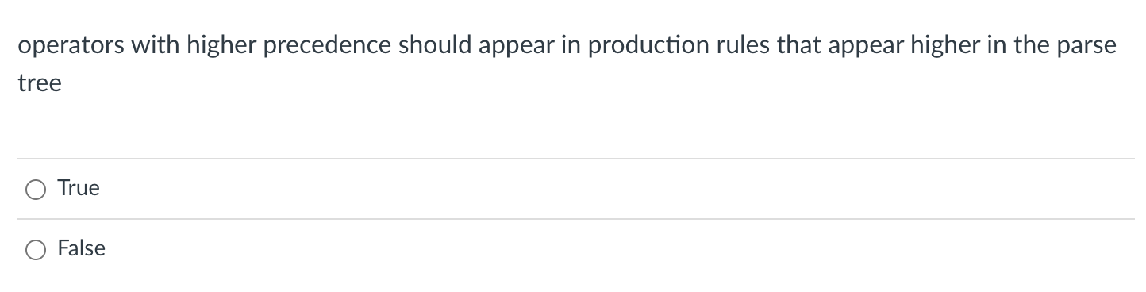
Quiz Q5:

Slide 23
Post order traversal
What is the post order traversal
of this tree?

Slide 24
Post order traversal
5
What is the post order traversal
of this tree?
3
4
1
2

Slide 25
Post order traversal
operators that are higher
in the parse tree get evaluated later
5
What is the post order traversal
of this tree?
3
4
1
2
operators that are lower
in the parse tree get evaluated earlier

Slide 26
Evaluating a parse tree
input: 1+5*6
expr
Operator | Name | Productions
+ | expr | : expr PLUS expr | term
* | term | : term TIMES term | factor
() | factor | : LPAREN expr RPAREN | NUM
expr
<PLUS>
expr
term
term
term
<TIMES>
term
factor
factor
factor
<NUM, 1>
<NUM, 5>
<NUM, 6>

Slide 27
Evaluating a parse tree
input: 1+5*6
expr: 31
Operator | Name | Productions
+ | expr | : expr PLUS expr | term
* | term | : term TIMES term | factor
() | factor | : LPAREN expr RPAREN | NUM
expr: 1
<PLUS>
expr
term: 30
term: 1
term: 5
<TIMES>
term: 6
factor: 1
factor:5
factor: 6
<NUM, 1>
<NUM, 5>
<NUM, 6>

Slide 28
Evaluating a parse tree
input: 1+5*6
expr: 31
Operator | Name | Productions
+ | expr | : expr PLUS expr | term
* | term | : term TIMES term | factor
() | factor | : LPAREN expr RPAREN | NUM
expr: 1
<PLUS>
expr
lower in the parse tree
term: 30
term: 1
term: 5
<TIMES>
term: 6
factor: 1
factor:5
factor: 6
<NUM, 1>
<NUM, 5>
<NUM, 6>

Slide 29
Avoiding Ambiguity
Precedence
increases going down
new production rules
One non-terminal for each level of precedence
lowest precedence at the top
highest precedence at the bottom
How would we add power? ^
Operator | Name | Productions
+ | expr | : expr PLUS expr | term
* | term | : term TIMES term | factor
() | factor | : LPAREN expr RPAREN | NUM
See this: See this

Slide 30

Quiz Q6:

Slide 31
Ambiguous grammars
expr ::= NUM
| expr PLUS expr
| expr TIMES expr
| LPAREN expr RPAREN
input: 1 + 5 * 6
expr
expr
expr
expr
expr
<PLUS>
expr
<TIMES>
expr
expr
<NUM, 1>
expr
<TIMES>
expr
<PLUS>
<NUM, 6>
<NUM, 1>
<NUM, 5>
<NUM, 5>
<NUM, 6>

Slide 32
Ambiguous grammars
expr ::= NUM
| expr PLUS expr
| expr TIMES expr
| LPAREN expr RPAREN
input: 1 + 5 * 6
Evaluations are different!
expr
expr
expr
expr
expr
<PLUS>
expr
<TIMES>
expr
expr
<NUM, 1>
expr
<TIMES>
expr
<PLUS>
<NUM, 6>
<NUM, 1>
<NUM, 5>
<NUM, 5>
<NUM, 6>

