Slide 1
Quiz-6-CFG-AMBIG-PREC 8 questions

Slide 2
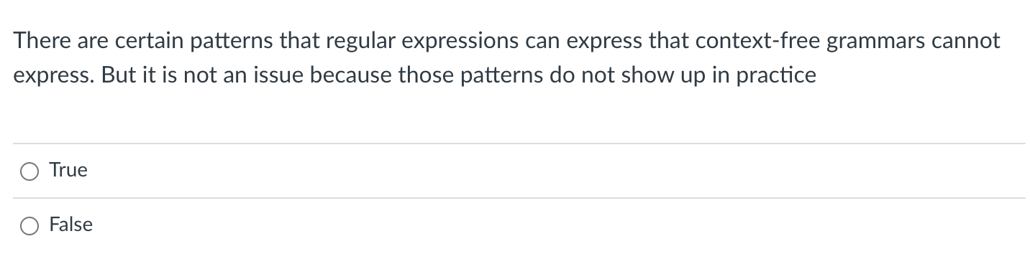
Quiz

Slide 3
Any RE can be expressed in BNF
We just need to show fundamental operators
concat, choice, star

Slide 4
Any RE can be expressed in BNF
We just need to show fundamental operators
concat, choice, star
add_expr ::= NUM ‘+’ NUM

Slide 5
Any RE can be expressed in BNF
We just need to show fundamental operators
concat, choice, star
simple_expr ::= NUM ‘+’ NUM
| NUM ‘*’ NUM

Slide 6
Any RE can be expressed in BNF
We just need to show fundamental operators
concat, choice, star
How to express “a*” in BNF?
a_star ::= “”
| “a” a_star

Slide 7
Any RE can be expressed in BNF
We just need to show fundamental operators
concat, choice, star
How to express “a*” in BNF?
a_star ::= ””
| “a”
| “a” a_star

Slide 8
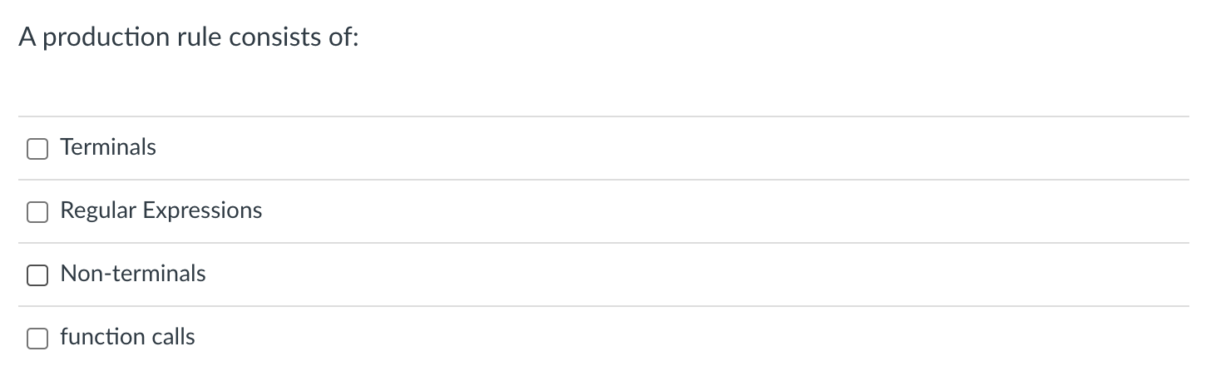
Quiz

Slide 9
Context-free grammar
We will use Backus–Naur form (BNF) form
Production rules contain a sequence of either non-terminals or terminals
In our class, terminals will either be string constants or tokens
Traditionally tokens will be all caps.
Examples:
add_expr ::= NUM ‘+’ NUM
mult_expr ::= NUM ‘*’ NUM
joint_expr ::= add_expr ‘*’ add_expr
simple_expr ::= NUM ‘+’ NUM
| NUM ‘*’ NUM

Slide 10
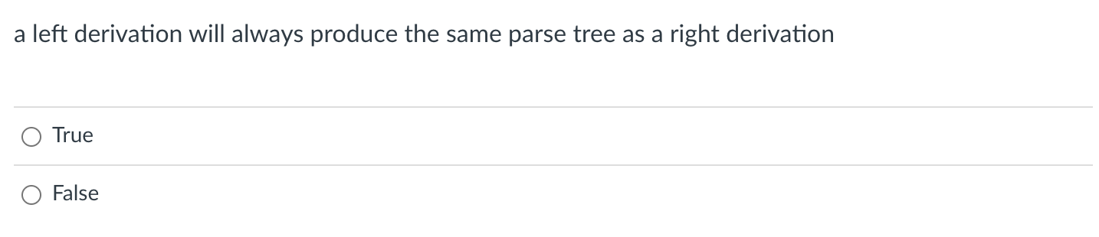
Quiz
Not discussed yet. This is TRUE if the Grammar is unambiguous. The trees will create different sentential forms at different steps, but the tree will always be unique if the grammar is unambiguous. To be discussed in class.

Slide 11
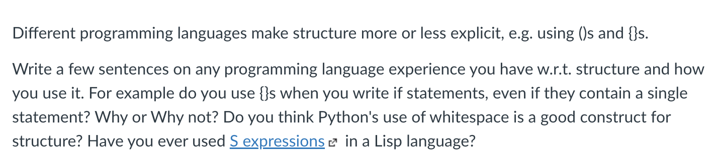
Quiz

Slide 12
Programming language structure
if (x) {
my_var++;
}
vs.
if (x)
my_var++;
Should conditionals require braces?
5 + 6 * 3
vs.
5 + (6 * 3)
should expressions require parenthesis?
(+ 5 (* 6 3))
vs.
(+ 5 (* 6 3))
S expressions (lisp) require explicit structure
What are pros and cons of each?

Slide 13
Quiz: Top Down Parsing

Slide 14
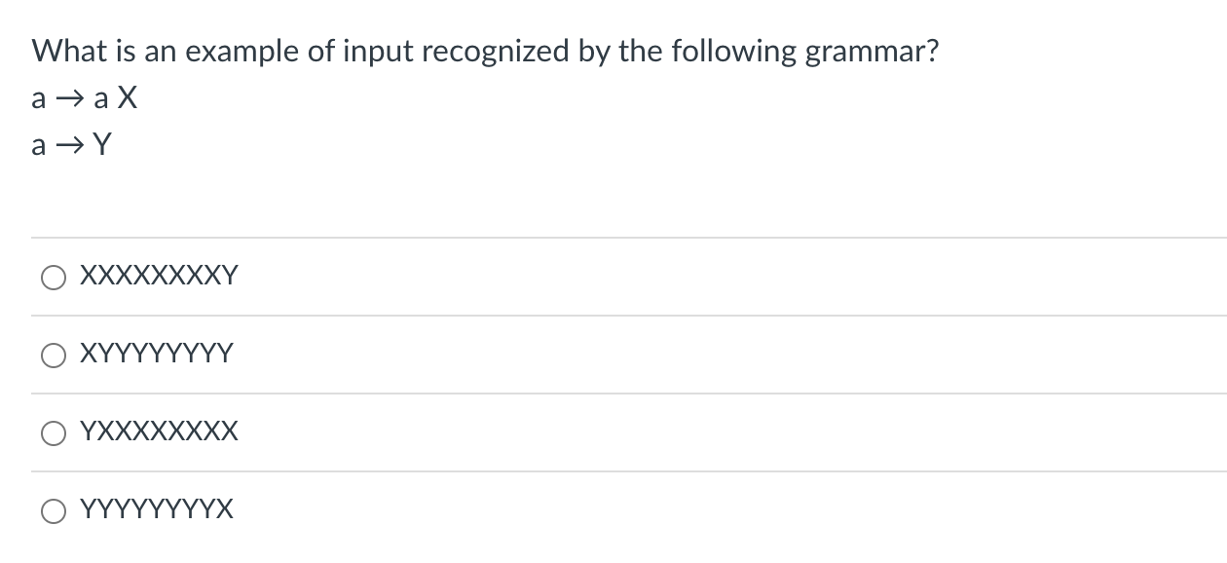
Quiz

Slide 15
Quiz
1 2
How about this one?
XXXXXXXY
RULE | Sentential Form
start | a

Slide 16
Quiz
1 2
How about this one?
XXXXXXXY
Applying either rule gives us a sentential form that won’t create the string
RULE | Sentential Form
start | a

Slide 17
Quiz
1 2
How about this one?
XYYYY
RULE | Sentential Form
start | A

Slide 18
Quiz
1 2
How about this one?
XYYYY
Similar reason: strings that are longer than 1 character cannot end in y
RULE | Sentential Form
start | A

Slide 19
Quiz
1 2
How about this one?
YXXXXXX
RULE | Sentential Form
start | A

Slide 20
Quiz
1 2
How about this one?
YXXXXXX
RULE | Sentential Form
start | A
1 | aX
1 | aXX
… | ….
2 | YXXXXX

Slide 21
Quiz
1 2
How about this one?
YYYYYYX
RULE | Sentential Form
start | A

Slide 22
Quiz
1 2
How about this one?
YYYYYYX
We can only produce
1 y, so we cannot
derive this string
RULE | Sentential Form
start | A

Slide 23
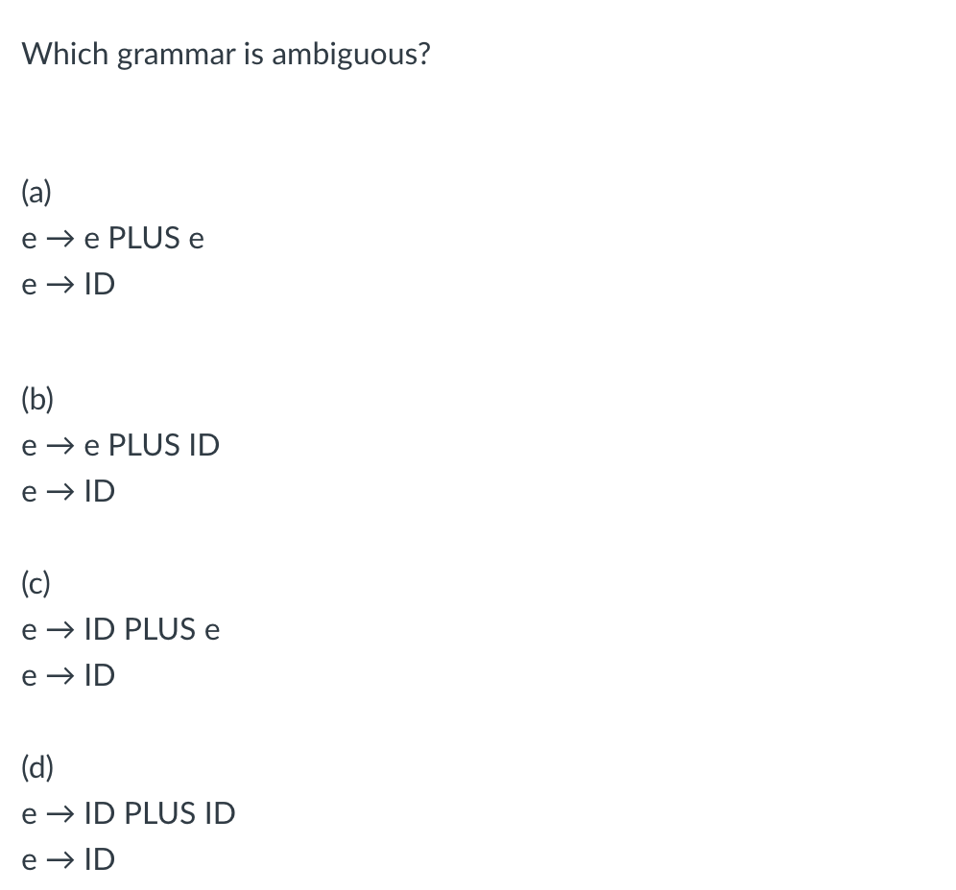
Quiz

Slide 24
Quiz
Let’s look at some examples. Let’s assume that E is an ”expr”
and x is a number

Slide 25
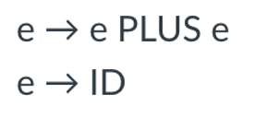
input: 2+3+4
Both parse trees are valid, this grammar is ambiguous
expr
expr
expr
<PLUS>
expr
expr
<PLUS>
expr
expr
<PLUS>
expr
term
term
expr
<PLUS>
expr
term
term
factor
term
term
factor
factor
factor
<NUM, 4>
factor
factor
<NUM, 2>
<NUM, 2>
<NUM, 3>
<NUM, 3>
<NUM, 4>

Slide 26
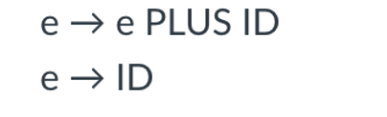
input: 2+3+4
See next slide
What about this one?
expr
expr
expr
<PLUS>
expr
expr
<PLUS>
expr
expr
<PLUS>
expr
term
term
expr
<PLUS>
expr
term
term
factor
term
term
factor
factor
factor
<NUM, 4>
factor
factor
<NUM, 2>
<NUM, 2>
<NUM, 3>
<NUM, 3>
<NUM, 4>

Slide 27
input: 2+3+4
UNAMBIGUOUS
Doesn’t allow an expression on the RHS. This parse tree is not allowed
What about this one?
expr
expr
expr
<PLUS>
expr
expr
<PLUS>
expr
expr
<PLUS>
expr
term
term
expr
<PLUS>
expr
term
term
factor
term
term
factor
factor
factor
<NUM, 4>
factor
factor
<NUM, 2>
<NUM, 2>
<NUM, 3>
<NUM, 3>
<NUM, 4>

Slide 28
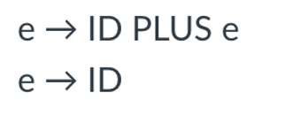
input: 2+3+4
See next slide
What about this one?
expr
expr
expr
<PLUS>
expr
expr
<PLUS>
expr
expr
<PLUS>
expr
term
term
expr
<PLUS>
expr
term
term
factor
term
term
factor
factor
factor
<NUM, 4>
factor
factor
<NUM, 2>
<NUM, 2>
<NUM, 3>
<NUM, 3>
<NUM, 4>

Slide 29
input: 2+3+4
UNAMBIGUOUS
Doesn’t allow an expression on the LHS. This parse tree is not allowed
What about this one?
expr
expr
expr
<PLUS>
expr
expr
<PLUS>
expr
expr
<PLUS>
expr
term
term
expr
<PLUS>
expr
term
term
factor
term
term
factor
factor
factor
<NUM, 4>
factor
factor
<NUM, 2>
<NUM, 2>
<NUM, 3>
<NUM, 3>
<NUM, 4>

Slide 30
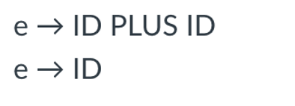
input: 2+3+4
See next slide
What about this one?
expr
expr
expr
<PLUS>
expr
expr
<PLUS>
expr
expr
<PLUS>
expr
term
term
expr
<PLUS>
expr
term
term
factor
term
term
factor
factor
factor
<NUM, 4>
factor
factor
<NUM, 2>
<NUM, 2>
<NUM, 3>
<NUM, 3>
<NUM, 4>

Slide 31
UNAMBIGUOUS
But not expressive
No recursion
input: 2+3+4
What about this one?
Cannot produce either
parse tree!
expr
expr
expr
<PLUS>
expr
expr
<PLUS>
expr
expr
<PLUS>
expr
term
term
expr
<PLUS>
expr
term
term
factor
term
term
factor
factor
factor
<NUM, 4>
factor
factor
<NUM, 2>
<NUM, 2>
<NUM, 3>
<NUM, 3>
<NUM, 4>

Slide 32
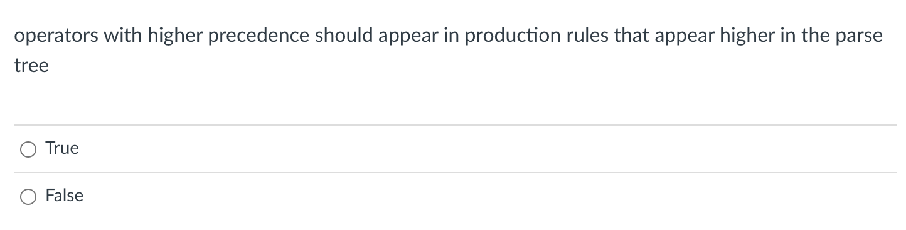
Quiz

Slide 33
Post order traversal
What is the post order traversal
of this tree?

Slide 34
Post order traversal
5
What is the post order traversal
of this tree?
3
4
1
2

Slide 35
Post order traversal
operators that are higher
in the parse tree get evaluated later
5
What is the post order traversal
of this tree?
3
4
1
2
operators that are lower
in the parse tree get evaluated earlier

Slide 36
Evaluating a parse tree
input: 1+5*6
expr
Operator | Name | Productions
+ | expr | : expr PLUS expr | term
* | term | : term TIMES term | factor
() | factor | : LPAREN expr RPAREN | NUM
expr
<PLUS>
expr
term
term
term
<TIMES>
term
factor
factor
factor
<NUM, 1>
<NUM, 5>
<NUM, 6>

Slide 37
Evaluating a parse tree
input: 1+5*6
expr: 31
Operator | Name | Productions
+ | expr | : expr PLUS expr | term
* | term | : term TIMES term | factor
() | factor | : LPAREN expr RPAREN | NUM
expr: 1
<PLUS>
expr
term: 30
term: 1
term: 5
<TIMES>
term: 6
factor: 1
factor:5
factor: 6
<NUM, 1>
<NUM, 5>
<NUM, 6>

Slide 38
Evaluating a parse tree
input: 1+5*6
expr: 31
Operator | Name | Productions
+ | expr | : expr PLUS expr | term
* | term | : term TIMES term | factor
() | factor | : LPAREN expr RPAREN | NUM
expr: 1
<PLUS>
expr
lower in the parse tree
term: 30
term: 1
term: 5
<TIMES>
term: 6
factor: 1
factor:5
factor: 6
<NUM, 1>
<NUM, 5>
<NUM, 6>

Slide 39
Avoiding Ambiguity
Precedence
increases going down
new production rules
One non-terminal for each level of precedence
lowest precedence at the top
highest precedence at the bottom
How would we add power? ^
Operator | Name | Productions
+ | expr | : expr PLUS expr | term
* | term | : term TIMES term | factor
() | factor | : LPAREN expr RPAREN | NUM
See this: See this

Slide 40

Quiz

Slide 41
Ambiguous grammars
expr ::= NUM
| expr PLUS expr
| expr TIMES expr
| LPAREN expr RPAREN
input: 1 + 5 * 6
expr
expr
expr
expr
expr
<PLUS>
expr
<TIMES>
expr
expr
<NUM, 1>
expr
<TIMES>
expr
<PLUS>
<NUM, 6>
<NUM, 1>
<NUM, 5>
<NUM, 5>
<NUM, 6>

Slide 42
Ambiguous grammars
expr ::= NUM
| expr PLUS expr
| expr TIMES expr
| LPAREN expr RPAREN
input: 1 + 5 * 6
Evaluations are different!
expr
expr
expr
expr
expr
<PLUS>
expr
<TIMES>
expr
expr
<NUM, 1>
expr
<TIMES>
expr
<PLUS>
<NUM, 6>
<NUM, 1>
<NUM, 5>
<NUM, 5>
<NUM, 6>

