Slide 1
Quiz-4: REs

Slide 2
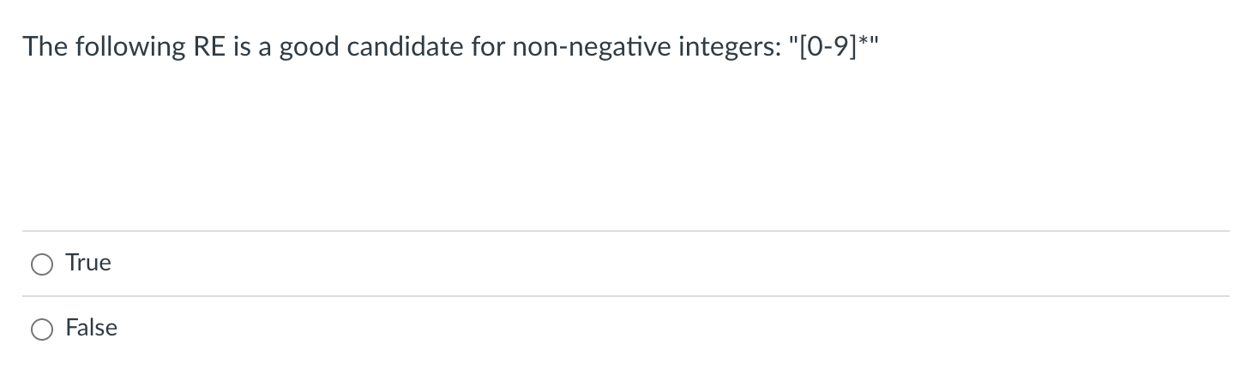
Integer RE

Slide 3
Integer RE
Does the ”” match the RE?

Slide 4
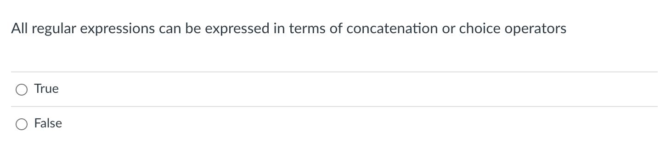
Fundamental RE operators

Slide 5
Fundamental RE operators
Fundamental RE operators are:
Concatenate: put the regexes next to each other
“|” : Choice: one or the other
“*” : Repeat: 0 or more copies
Practically:
a* roughly is the same as “” | “a” | “aa” | “aaa” ...
in theory, REs can accept strings of arbitrary length (not infinite strings though).
in practice, strings have a reasonable bound. Repeat (*) is a good abstraction though!

Slide 6
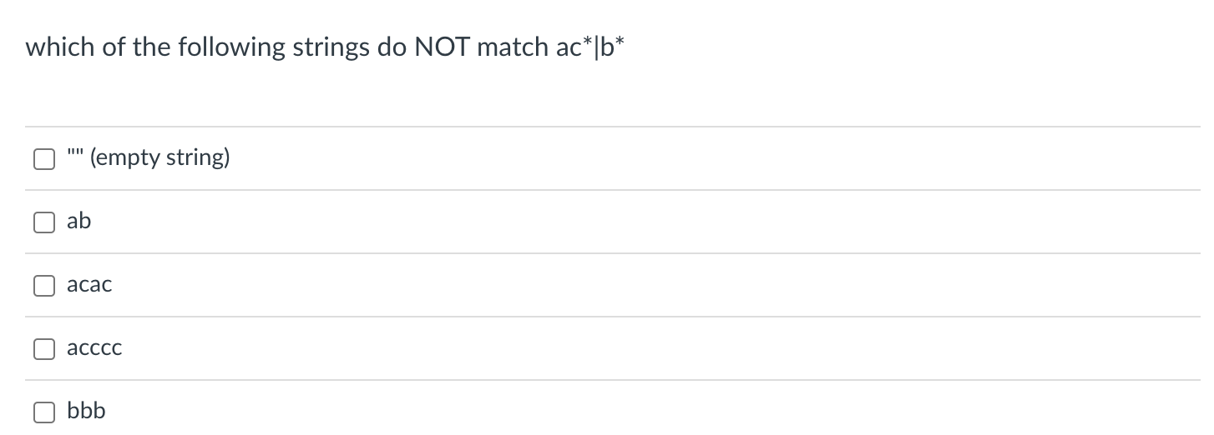
RE examples

Slide 7
RE examples
ac*|b*
“”
“ab”
“acac”
“acccc”
“bbb”
Let’s work through them

Slide 8

RE experiences

