Slide 1
Quiz from C110-AST-IR

Slide 2
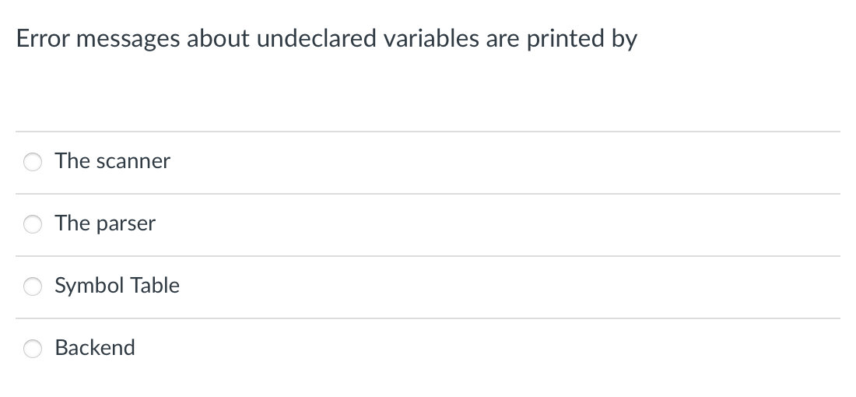
Quiz

Slide 3
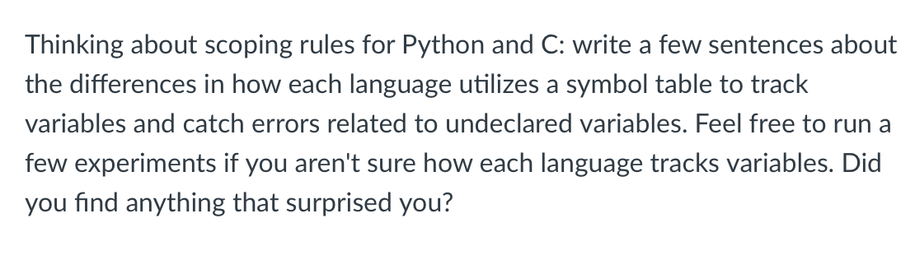
Quiz

Slide 4
Quiz from C110-16-AST-IR

Slide 5

Quiz

Slide 6
Quiz from C110-18-…

Slide 7

Quiz

Slide 8

Quiz

Slide 9
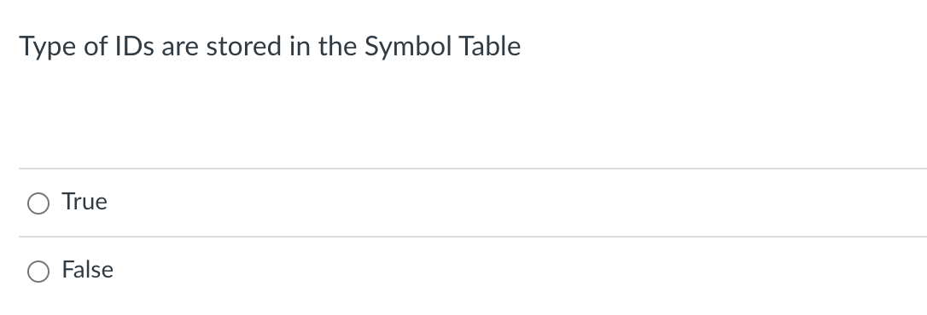
Quiz

Slide 10

Quiz

Slide 11
Quiz from C110_19-IR-SCOPE

Slide 12
Quiz

Slide 13
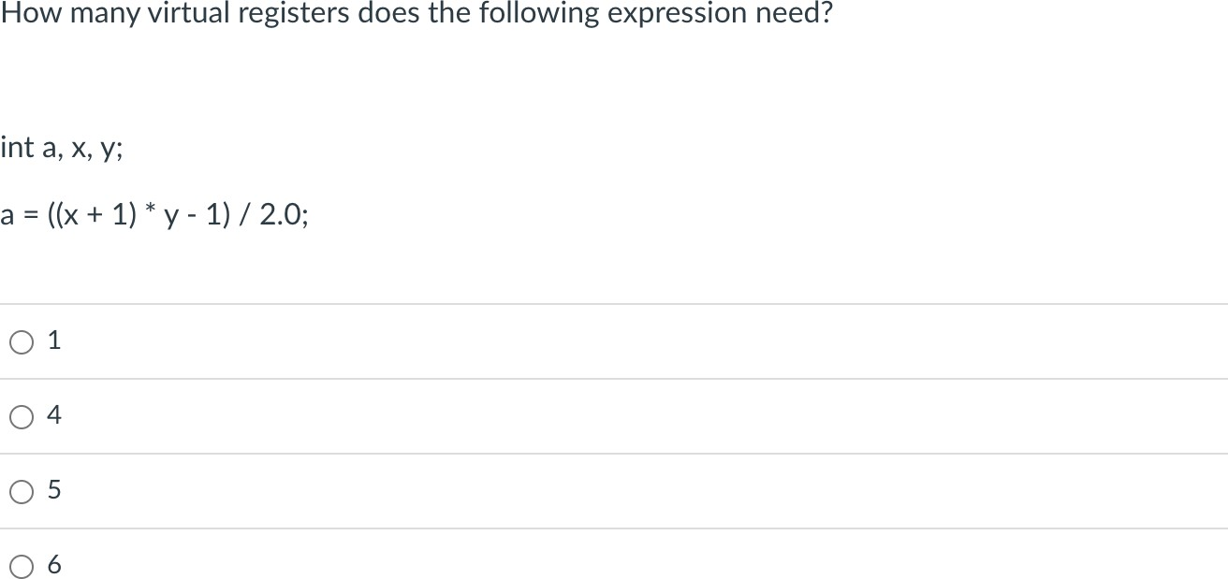
Quiz

Slide 14
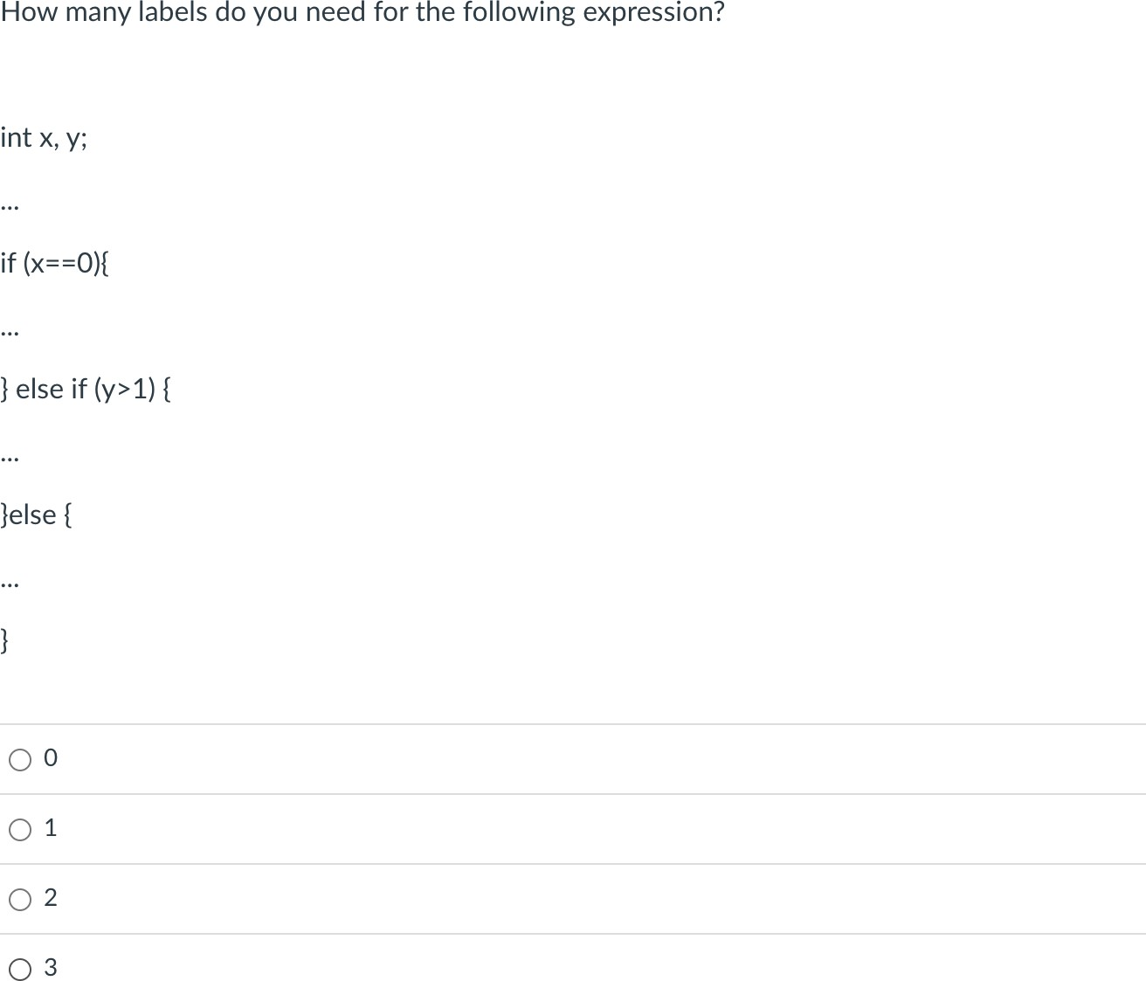
Quiz

Slide 15
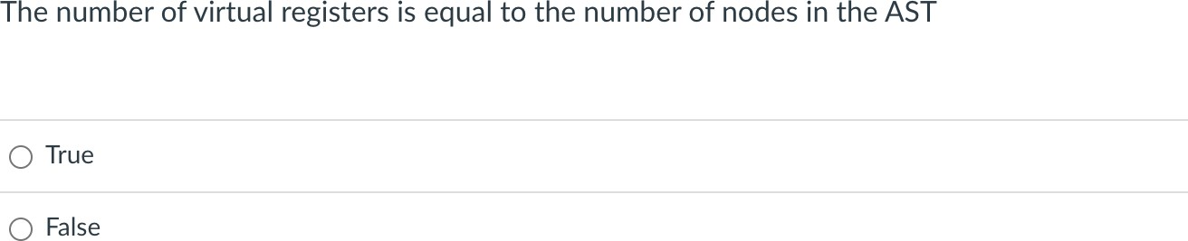
Quiz

Slide 16
Quiz

Slide 17
Quiz from C110_19-IR-SCOPE

Slide 18
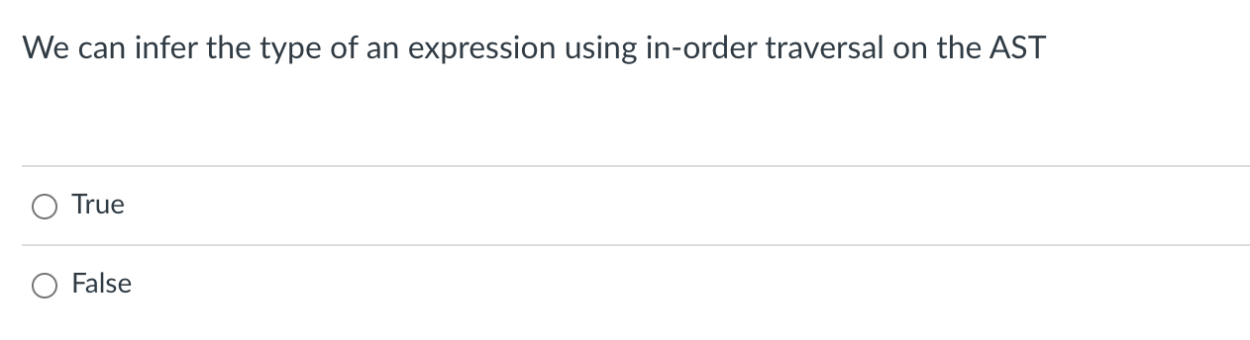
Quiz

Slide 19
Discussion
What is the in order traversal order?
2
1
4
3
5

Slide 20
Discussion
What is the in order traversal order?
if this was an AST for: “2 + (3.0 + 5.0)”
AST<+, float>
5
we cannot evaluate 2 before 4!
1
4
AST<+, float>
AST<2, int>
2
3
AST<5.0, float>
AST<3.0, float>

Slide 21
Discussion
What is the post order traversal order?
if this was an AST for: “2 + (3.0 + 5.0)”
AST<+, ?>
AST<+, ?>
AST<2, int>
AST<5.0, float>
AST<3.0, float>

Slide 22
Discussion
What is the post order traversal order?
if this was an AST for: “2 + (3.0 + 5.0)”
AST<+, ?>
5
Now we can do type inference
1
4
AST<+, ?>
AST<2, int>
2
3
AST<5.0, float>
AST<3.0, float>

Slide 23
Discussion
What is the post order traversal order?
if this was an AST for: “2 + (&c + 5.0)”
AST<+, ?>
5
How does this change things?
1
4
AST<+, ?>
AST<2, int>
2
3
AST<5.0, float>
AST<&c, ptr>

Slide 24

Quiz

Slide 25

Quiz

Slide 26
C110_20-Loop_Unrolling

Slide 27
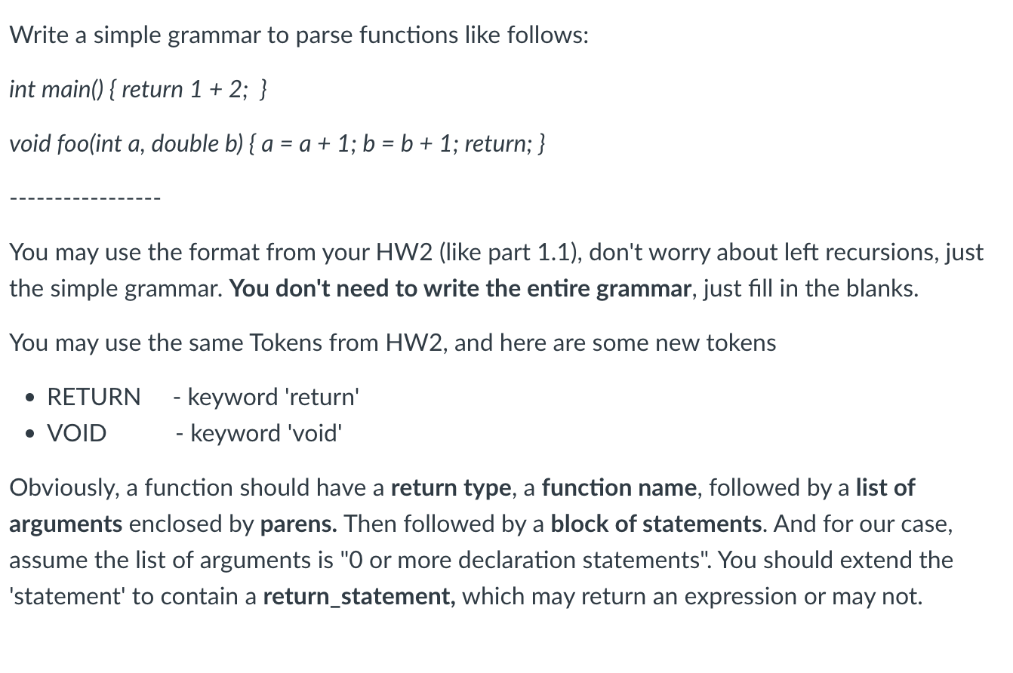

Slide 28
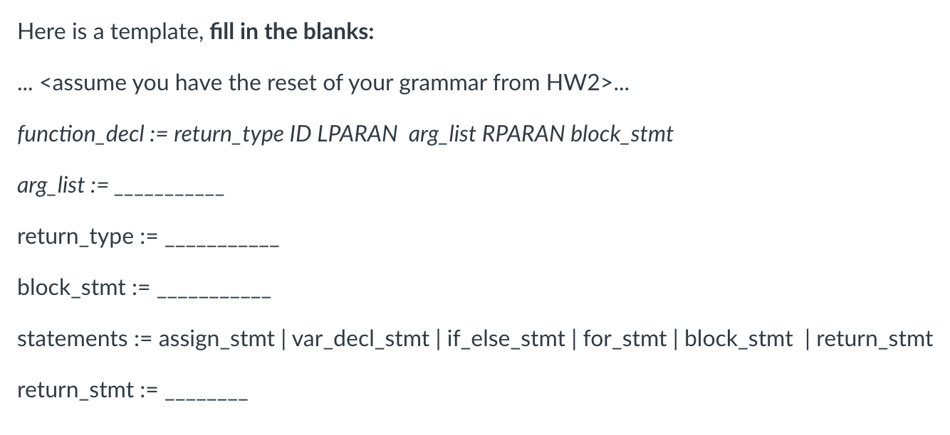
Return_type := Data_type | VOID Data_type := INT | FLOAT
Return_stmt := RETURN optional_expr SEMI optional_expr := “” | expr
Arg_list := data_type ID Arg_list_comma
| “”
Arg_list_comma := comma data_type ID arg_list_comma
| “”

Slide 29
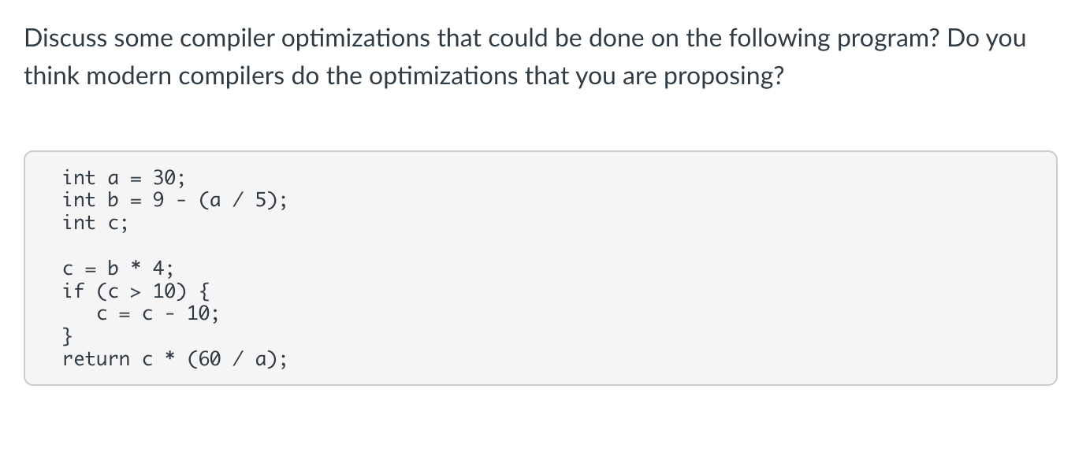
Quiz

Slide 30
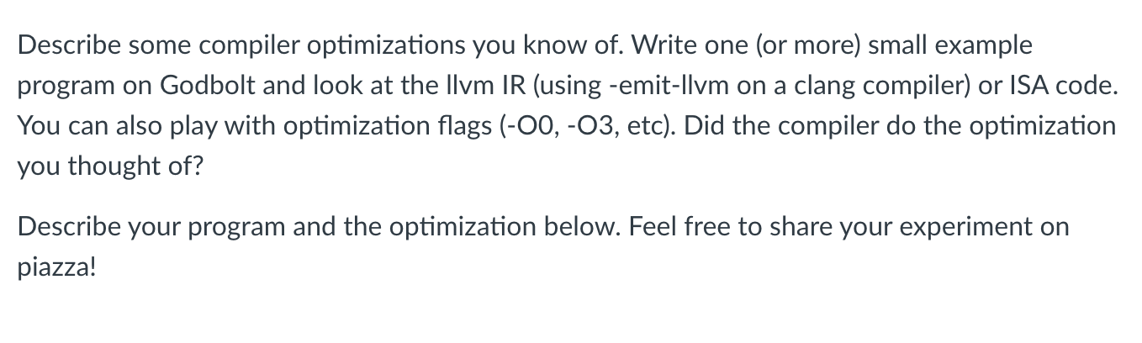
Quiz

Slide 31
C110-21-LVN-CONST-FOLD

Slide 32
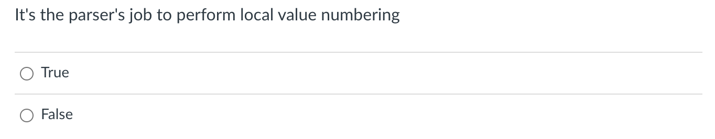
Quiz

Slide 33
Discussion
Local value numbering operates over 3 address code
The parser produces 3 address code
In some cases, the parser might use LVN, but it is independent
a2 = b0 + c1; b4 = a2 - d3; c5 = b4 + c1;
d6 = a2 - d3;
H = { “b0 + c1” : “a2”,
}

Slide 34
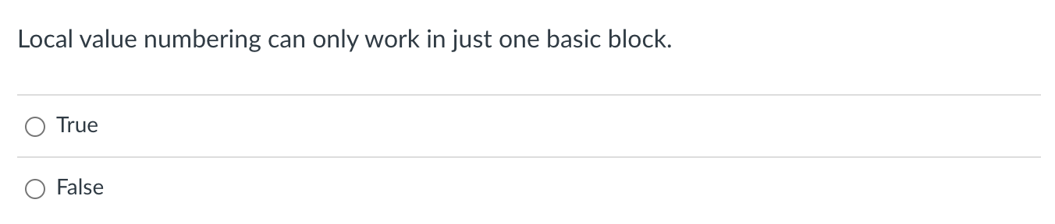
Quiz

