Slide 1
MERIDIAN AIRLINES • RESERVATIONS SERVICING
Cancellation Operations
WORKBOOK CONTENTS
01
Journey and request capture
Current-state workflow, calibration, and operator reference
02
Eligibility references
Working process workbook
03
Controls and refund handling
Prepared for workflow review
Version 0.6 • Meridian Airlines internal
04
Calibration and readiness
Meridian Airlines — internal working material
1
Notes:
[Sources]
- Airline cancellation policy: data/tau2/hyper/sops/airline_plus_sop.md
- Visual structure informed by the user-provided internal process-flow reference deck; no business content, branding, metrics, names, or system identifiers were reused.
[/Sources]

Slide 2
How to Use This Working Packet
WORKBOOK ORIENTATION
Governing references are interleaved with screens and calibration material. Context pages do not add cancellation rules.
FIND THE SOURCE
CHECK THE STATUS
BUILD THE FLOW
01
Use the current-process label.
01
Separate observed UI from policy.
01
Join the governing process pages.
02
Follow page references, not file order.
02
Check dates on working notes.
02
Retain negative and default branches.
03
Treat exercises as non-governing.
03
Keep historical options in context.
03
Review the complete workflow before use.
ORIENTATION COMPLETE
Meridian Airlines — internal working material
2
Notes:
[Sources]
- Airline cancellation policy: data/tau2/hyper/sops/airline_plus_sop.md
- Visual structure informed by the user-provided internal process-flow reference deck; no business content, branding, metrics, names, or system identifiers were reused.
[/Sources]

Slide 3
Cancellation — High-level Process
CURRENT STATE
INTAKE
ELIGIBILITY REVIEW
ACTION AND CLOSE
Customer asks to
cancel a reservation
Ask why the customer
wants to cancel
Apply segment-status
handling per reference
Get reservation identifier
Any segment
flying / landed?
Review every segment status
YES
Identifier
available?
YES
NO
Explain cancellation
cannot be processed
Allowed condition
met?
Evaluate allowed conditions
NO
NO
Open customer profile;
locate the reservation
Confirm request;
process cancellation
YES
Start refund workflow
Meridian Airlines — internal working material
3
Notes:
[Sources]
- Airline cancellation policy: data/tau2/hyper/sops/airline_plus_sop.md
- Visual structure informed by the user-provided internal process-flow reference deck; no business content, branding, metrics, names, or system identifiers were reused.
[/Sources]

Slide 4
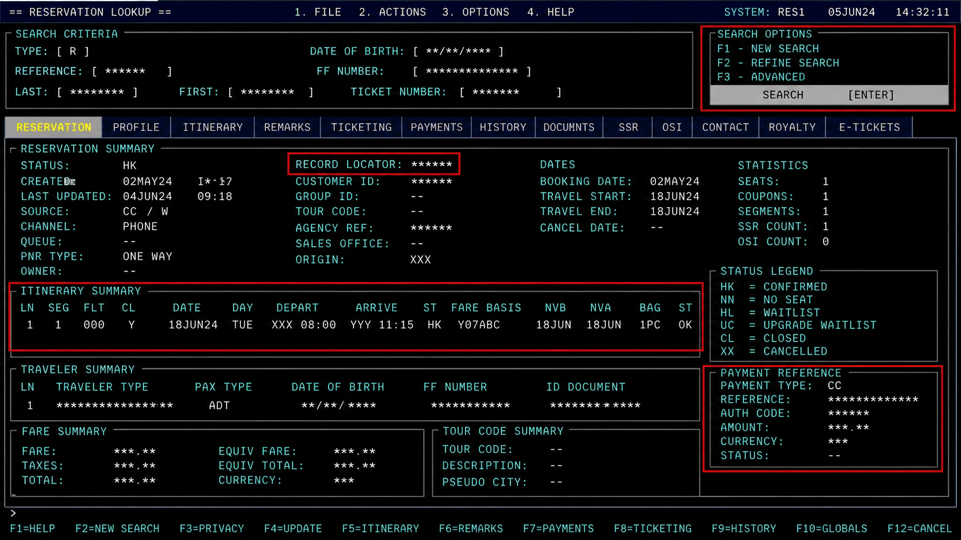
Operating Screen — Reservation Lookup
REHEARSAL SANDBOX CAPTURE
WHAT THE OPERATOR IS DOING
1
Locate the correct record
Use the reservation identifier. If the customer does not have it, use the customer profile to locate the trip.
2
Verify itinerary context
Confirm the displayed traveler and itinerary belong to the request before continuing.
3
Continue to reason capture
The lookup screen provides context; it does not determine cancellation eligibility.
Operator screen captured in the rehearsal sandbox; records shown are sandbox fixtures.
Meridian Airlines — internal working material
4
Notes:
[Sources]
- Airline cancellation policy: data/tau2/hyper/sops/airline_plus_sop.md
- Visual structure informed by the user-provided internal process-flow reference deck; no business content, branding, metrics, names, or system identifiers were reused.
- UI screen captured in the rehearsal sandbox; every identifier is a sandbox fixture.
[/Sources]

Slide 5
MERIDIAN AIRLINES • RESERVATIONS SERVICING
Reason Capture
THIS SECTION
01
Reservation lookup screen
Operator reference, screen evidence, and calibration
02
Reason-capture reference
Section divider
03
Quality calibration notes
Current workbook section
Examples remain non-governing
04
Evidence handoff
Meridian Airlines — internal working material
5
Notes:
[Sources]
- Airline cancellation policy: data/tau2/hyper/sops/airline_plus_sop.md
- Visual structure informed by the user-provided internal process-flow reference deck; no business content, branding, metrics, names, or system identifiers were reused.
[/Sources]

Slide 6
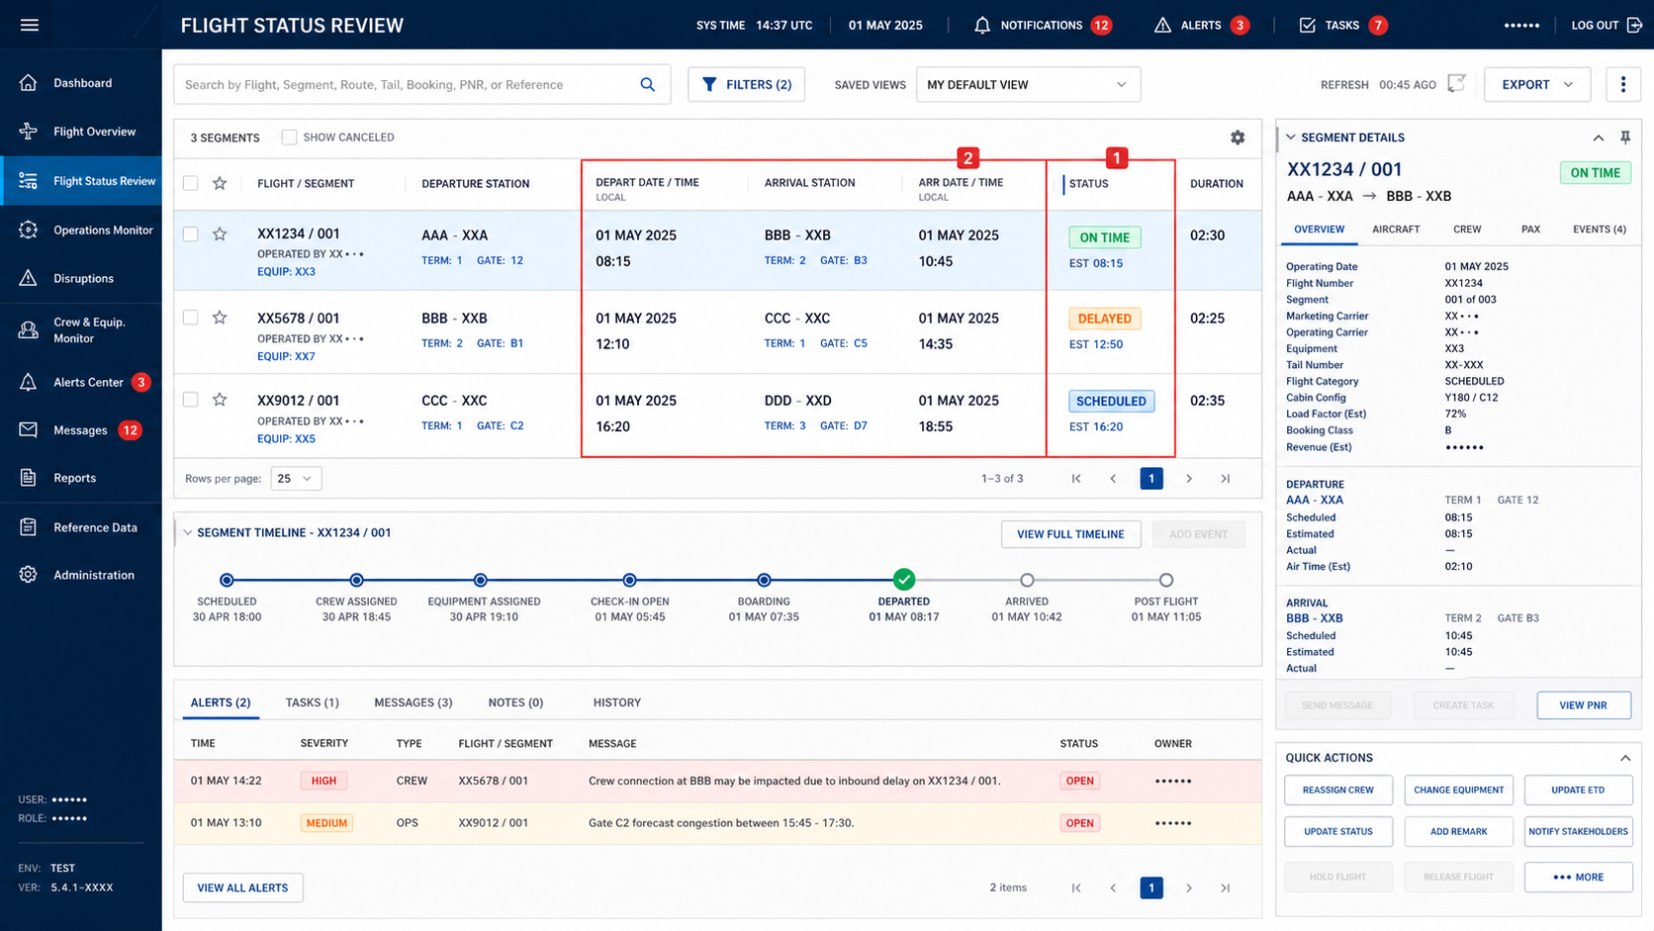
Operating Screen — Segment Status Review
REHEARSAL SANDBOX CAPTURE
REVIEW SEQUENCE
1
Check every segment
Read status across all rows in the itinerary. Do not infer the whole trip from a selected row.
2
Use current status
A flying or landed segment changes the handling path; read the status as it stands right now.
SCREEN CAVEAT
The interface may show status and timestamps, but the operator applies the policy sequence.
Meridian Airlines — internal working material
6
Notes:
[Sources]
- Airline cancellation policy: data/tau2/hyper/sops/airline_plus_sop.md
- Visual structure informed by the user-provided internal process-flow reference deck; no business content, branding, metrics, names, or system identifiers were reused.
- UI screen captured in the rehearsal sandbox; every identifier is a sandbox fixture.
[/Sources]

Slide 7
Reason-Capture Calibration Notes
CALIBRATION EXERCISE
These prompts help reviewers compare case wording. They are exercises and do not establish reason categories or outcomes.
LISTENING
RECORD QUALITY
REVIEW QUESTIONS
01
Separate the request from background.
01
Check that the note is complete.
01
Can another reviewer follow the note?
02
Retain the customer’s own wording.
02
Avoid adding an unstated motive.
02
Is the request still current?
03
Clarify ambiguous chronology.
03
Keep examples distinct from guidance.
03
Does the record identify open questions?
EXERCISE — NOT POLICY
Meridian Airlines — internal working material
7
Notes:
[Sources]
- Airline cancellation policy: data/tau2/hyper/sops/airline_plus_sop.md
- Visual structure informed by the user-provided internal process-flow reference deck; no business content, branding, metrics, names, or system identifiers were reused.
[/Sources]

Slide 8
Reason Capture — Operator Reference
STEP / PURPOSE / SYSTEM / SCREEN
Capture one reason before evaluating eligibility. The reason label is an input to the decision flow; it is not the decision by itself.
STEP
PURPOSE
SYSTEM
SCREEN / FIELD
1. Open reservation
Anchor the request to the correct trip.
Reservation workspace
Lookup / itinerary summary
2. Ask cancellation reason
Record the customer’s stated reason before checking conditions.
Customer conversation
Agent dialogue
3. Select reason
Use one of the supported reason categories.
Cancellation workspace
Reason drop-down
4. Continue to eligibility
Evaluate status and allowed conditions in the required order.
Operator procedure
Eligibility checklist
SUPPORTED CANCELLATION REASONS
OPERATOR NOTE
Change of plans
Airline cancelled the flight
Do not paraphrase a reason into a different category solely to reach a desired outcome.
Covered reason under trip protection
Other
Meridian Airlines — internal working material
8
Notes:
[Sources]
- Airline cancellation policy: data/tau2/hyper/sops/airline_plus_sop.md
- Visual structure informed by the user-provided internal process-flow reference deck; no business content, branding, metrics, names, or system identifiers were reused.
[/Sources]

Slide 9
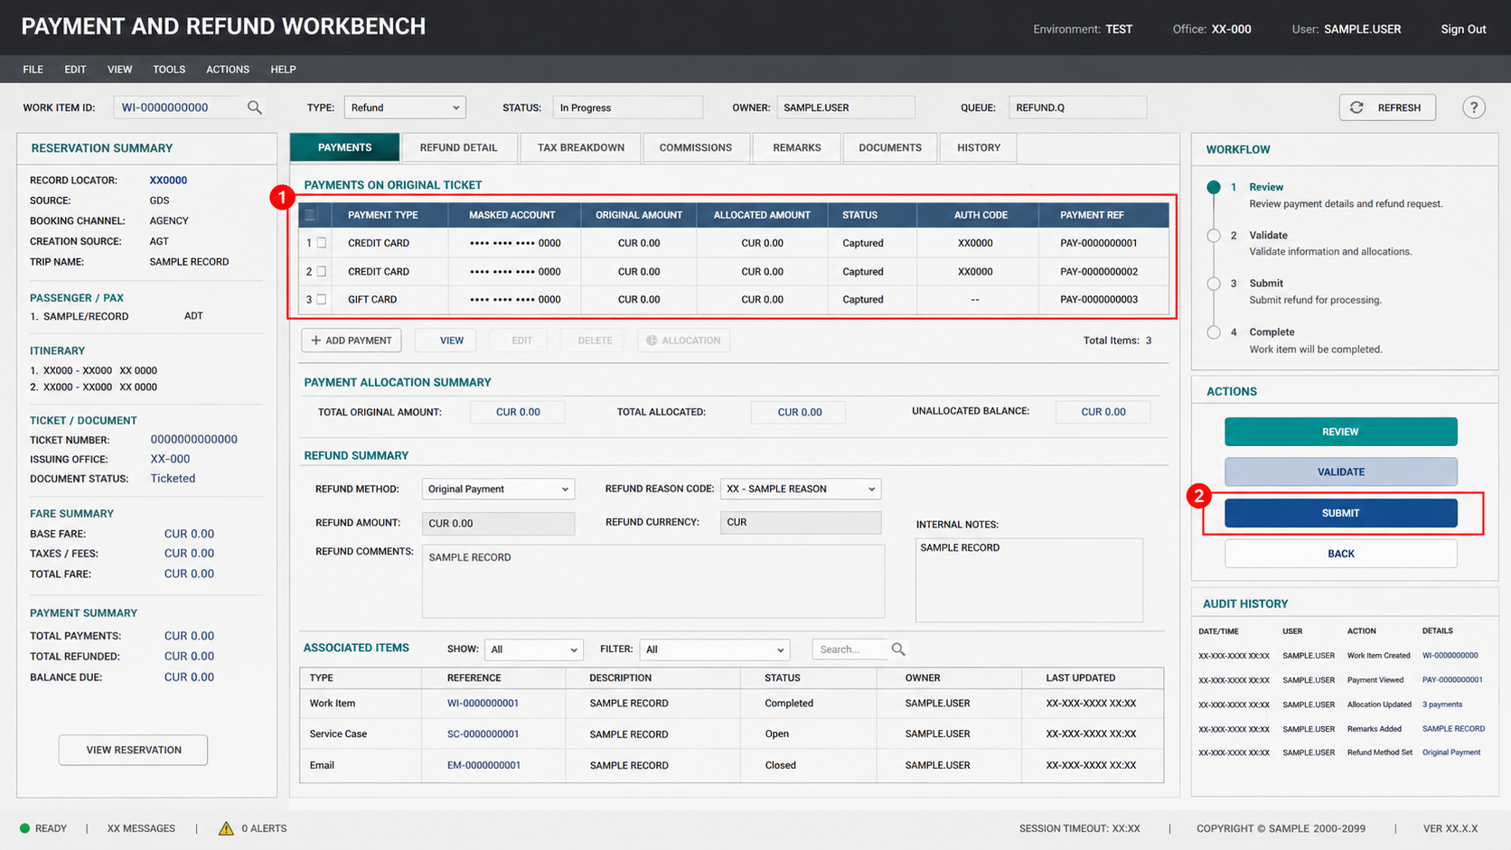
Operating Screen — Refund Workbench
REHEARSAL SANDBOX CAPTURE
OPERATOR CHECKS
1
Review original-payment rows
Refund allocation follows the payment methods used for the original purchase.
2
Validate before submit
Confirm the allocation and only submit after the cancellation eligibility review is complete.
CUSTOMER EXPECTATION
After submission, set the arrival expectation from the ratified refund window.
Meridian Airlines — internal working material
9
Notes:
[Sources]
- Airline cancellation policy: data/tau2/hyper/sops/airline_plus_sop.md
- Visual structure informed by the user-provided internal process-flow reference deck; no business content, branding, metrics, names, or system identifiers were reused.
- UI screen captured in the rehearsal sandbox; every identifier and value is a sandbox fixture.
[/Sources]

Slide 10
Eligibility Gate 1 — Segment Status
CHECK BEFORE ALL OTHER CONDITIONS
RESERVATION AND SEGMENT REVIEW
ROUTING
Open itinerary
List every flight segment
Read current status
for each segment
Record the status finding
Is any segment
FLYING or LANDED?
YES
See the desk servicing reference
NO
Continue to allowed-condition review
STATUS VIEW
Review all itinerary rows, not only the first or selected segment.
Example statuses displayed by the tool may include scheduled, delayed, flying, landed, or cancelled.
Meridian Airlines — internal working material
10
Notes:
[Sources]
- Airline cancellation policy: data/tau2/hyper/sops/airline_plus_sop.md
- Visual structure informed by the user-provided internal process-flow reference deck; no business content, branding, metrics, names, or system identifiers were reused.
[/Sources]

Slide 11
MERIDIAN AIRLINES • RESERVATIONS SERVICING
Eligibility Review
THIS SECTION
01
Evidence checklist
Current gates interleaved with calibration context
02
Alternative-condition reference
Section divider
03
Near-miss calibration
Current workbook section
Use governing pages for decisions
04
Insurance and default reference
Meridian Airlines — internal working material
11
Notes:
[Sources]
- Airline cancellation policy: data/tau2/hyper/sops/airline_plus_sop.md
- Visual structure informed by the user-provided internal process-flow reference deck; no business content, branding, metrics, names, or system identifiers were reused.
[/Sources]

Slide 12
Eligibility Review — Evidence Checklist
WORKING CHECKLIST
Use this page to locate evidence before consulting the governing eligibility references. It creates no additional eligibility condition.
ITINERARY
CUSTOMER CONTEXT
SOURCE REVIEW
01
Locate every itinerary segment.
01
Confirm the relevant customer context.
01
Grace window: read the eligibility matrix.
02
Check the current status display.
02
Separate stated facts from assumptions.
02
Compare all alternative branches.
03
Launch-era 48-hour grace is retired.
03
Avoid inferring from visual emphasis.
03
Document which evidence was used.
CHECKLIST ONLY
Meridian Airlines — internal working material
12
Notes:
[Sources]
- Airline cancellation policy: data/tau2/hyper/sops/airline_plus_sop.md
- Visual structure informed by the user-provided internal process-flow reference deck; no business content, branding, metrics, names, or system identifiers were reused.
[/Sources]

Slide 13
Alternative-Branch Calibration
FACILITATOR EXERCISE
Reviewers practice following alternative branches without turning examples into new exceptions. The governing diagram remains authoritative.
SCENARIO INPUT
BRANCH REVIEW
DEBRIEF
01
Read the full scenario first.
01
Trace one branch at a time.
01
Compare reasoning, not outcomes alone.
02
Mark facts that remain uncertain.
02
Return to the shared entry point.
02
Name any unsupported assumption.
03
Ignore decorative callouts.
03
Do not combine separate examples.
03
Recheck the governing page.
EXERCISE — NOT POLICY
Meridian Airlines — internal working material
13
Notes:
[Sources]
- Airline cancellation policy: data/tau2/hyper/sops/airline_plus_sop.md
- Visual structure informed by the user-provided internal process-flow reference deck; no business content, branding, metrics, names, or system identifiers were reused.
[/Sources]

Slide 14
Eligibility Gate 2 — Alternative Allowed Conditions
ANY ONE CONDITION IS SUFFICIENT
Run this sequence only after confirming that no segment is flying or landed.
EVALUATE IN ORDER
RESULT
YES
YES
Reservation created
in the booking-grace window?
Did the airline cancel
one of the flights?
Is the reservation
in an eligible cabin?
NO
NO
YES
Cancellation allowed
NO
Check insurance branch
No match yet:
continue to insurance / default branch
DATA READS
Creation timestamp compared with current system time
Segment disruption status
Reservation cabin value — scope per the desk servicing reference
Meridian Airlines — internal working material
14
Notes:
[Sources]
- Airline cancellation policy: data/tau2/hyper/sops/airline_plus_sop.md
- Visual structure informed by the user-provided internal process-flow reference deck; no business content, branding, metrics, names, or system identifiers were reused.
[/Sources]

Slide 15
Near-Miss Scenario Review
QUALITY CALIBRATION
Near-miss cases test evidence discipline. They are rehearsal cases from the training sandbox and do not broaden or narrow the current cancellation process.
CASE SETUP
REVIEW METHOD
QUALITY NOTES
01
Identify the missing fact.
01
Use only visible evidence.
01
Compare reviewer interpretations.
02
Flag inconsistent timestamps.
02
Do not complete the scenario mentally.
02
Resolve source disagreements first.
03
Separate intent from eligibility.
03
Record why a branch is unresolved.
03
Return to the current reference.
REHEARSAL CALIBRATION
Meridian Airlines — internal working material
15
Notes:
[Sources]
- Airline cancellation policy: data/tau2/hyper/sops/airline_plus_sop.md
- Visual structure informed by the user-provided internal process-flow reference deck; no business content, branding, metrics, names, or system identifiers were reused.
[/Sources]

Slide 16
Gate 3 — Insurance and Default Outcome
FINAL BRANCH
INSURANCE REVIEW
OUTCOME
Does the reservation
have travel insurance?
Is the reason covered
by the protection terms?
Cancellation allowed
YES
YES
NO
NO
Cancellation cannot be processed
DEFAULT
If none of the alternative allowed conditions applies, the reservation cannot be cancelled through this workflow.
Explain the outcome;
do not submit the action
Meridian Airlines — internal working material
16
Notes:
[Sources]
- Airline cancellation policy: data/tau2/hyper/sops/airline_plus_sop.md
- Visual structure informed by the user-provided internal process-flow reference deck; no business content, branding, metrics, names, or system identifiers were reused.
[/Sources]

Slide 17
MERIDIAN AIRLINES • RESERVATIONS SERVICING
Controls and Refunds
THIS SECTION
01
Control-point review
Control points, field mapping, and expectation review
02
Governing refund reference
Section divider
03
Data-mapping workshop
Current workbook section
Implementation notes are context
04
Expectation-language exercise
Meridian Airlines — internal working material
17
Notes:
[Sources]
- Airline cancellation policy: data/tau2/hyper/sops/airline_plus_sop.md
- Visual structure informed by the user-provided internal process-flow reference deck; no business content, branding, metrics, names, or system identifiers were reused.
[/Sources]

Slide 18
Control-Point Review Notes
IMPLEMENTATION CONTEXT
This page records review ownership and evidence handoffs. It does not establish process order, eligibility, or refund behavior.
OWNERSHIP
EVIDENCE
FOLLOW-UP
01
Operations owns process review.
01
Link screenshots to review dates.
01
Assign open evidence questions.
02
Quality owns calibration records.
02
Retain sandbox capture labels.
02
Record the next review forum.
03
Product owns change tracking.
03
Archive obsolete walkthroughs.
03
Keep proposals out of current guidance.
CONTEXT — NOT POLICY
Meridian Airlines — internal working material
18
Notes:
[Sources]
- Airline cancellation policy: data/tau2/hyper/sops/airline_plus_sop.md
- Visual structure informed by the user-provided internal process-flow reference deck; no business content, branding, metrics, names, or system identifiers were reused.
[/Sources]

Slide 19
Supervisor-Handoff Review
ENABLEMENT CONTEXT
The team is reviewing handoff clarity and ownership. Queue names and example wording here are not cancellation policy.
HANDOFF RECORD
OWNER REVIEW
ENABLEMENT
01
Capture why review is needed.
01
Confirm the receiving owner.
01
Use sandbox rehearsal cases.
02
Retain the customer’s stated request.
02
Check context arrives intact.
02
Compare handoff summaries.
03
Avoid promising a downstream result.
03
Record unresolved evidence gaps.
03
Log follow-up for the next session.
ENABLEMENT CONTEXT
Meridian Airlines — internal working material
19
Notes:
[Sources]
- Airline cancellation policy: data/tau2/hyper/sops/airline_plus_sop.md
- Visual structure informed by the user-provided internal process-flow reference deck; no business content, branding, metrics, names, or system identifiers were reused.
[/Sources]

Slide 20
Expectation-Language Exercise
QUALITY EXERCISE
Reviewers compare clear and unclear explanations after a simulated submission. Examples do not define timing or payment behavior.
CLEAR CONTEXT
RISKY ASSUMPTIONS
DEBRIEF
01
State what was reviewed.
01
Avoid inventing a processing state.
01
Compare the two explanations.
02
Separate action from expectation.
02
Do not generalize one fixture.
02
Identify missing context.
03
Keep account details minimized.
03
Flag unexplained certainty.
03
Return to the governing reference.
EXERCISE — NOT POLICY
Meridian Airlines — internal working material
20
Notes:
[Sources]
- Airline cancellation policy: data/tau2/hyper/sops/airline_plus_sop.md
- Visual structure informed by the user-provided internal process-flow reference deck; no business content, branding, metrics, names, or system identifiers were reused.
[/Sources]

Slide 21
Control Point and Refund Handling
OPERATOR-ENFORCED POLICY
CONTROL
CANCELLATION ACTION
REFUND
The system does not enforce
cancellation eligibility.
Eligibility review complete
Return funds to the
original payment method(s).
The operator must verify the complete eligibility sequence before using the cancellation action.
Confirm customer wants
to proceed
Tell the customer when the refund
will arrive, per the ratified window.
CONTROL EVIDENCE
Submit cancellation
Record reviewed reservation, reason, status check, and matched condition in the case notes.
MULTIPLE PAYMENT ROWS
When the original purchase used more than one method, review each original-payment row before submission.
Meridian Airlines — internal working material
21
Notes:
[Sources]
- Airline cancellation policy: data/tau2/hyper/sops/airline_plus_sop.md
- Visual structure informed by the user-provided internal process-flow reference deck; no business content, branding, metrics, names, or system identifiers were reused.
[/Sources]

Slide 22
Refund Data-Mapping Workshop
WORKING SESSION
These implementation questions concern field mapping and review evidence. The governing refund reference appears on the preceding page.
SOURCE FIELDS
DISPLAY REVIEW
OPEN QUESTIONS
01
Inventory available payment rows.
01
Arrival drafts: 10 vs 12 business days.
01
Arrival-window sign-off: change forum.
02
Note missing source labels.
02
Review long labels for clipping.
02
Schedule a fixture replay.
03
Preserve sandbox fixture markers.
03
Record screen-version dates.
03
Keep workshop ideas non-governing.
WORKSHOP NOTES
Meridian Airlines — internal working material
22
Notes:
[Sources]
- Airline cancellation policy: data/tau2/hyper/sops/airline_plus_sop.md
- Visual structure informed by the user-provided internal process-flow reference deck; no business content, branding, metrics, names, or system identifiers were reused.
[/Sources]

Slide 23
MERIDIAN AIRLINES • RESERVATIONS SERVICING
Calibration and Readiness
THIS SECTION
01
Quality calibration
Quality, implementation, measurement, and source hygiene
02
Implementation readiness
Section divider
03
Measurement context
Working appendix section
No additional policy is established
04
Closing source review
Meridian Airlines — internal working material
23
Notes:
[Sources]
- Airline cancellation policy: data/tau2/hyper/sops/airline_plus_sop.md
- Visual structure informed by the user-provided internal process-flow reference deck; no business content, branding, metrics, names, or system identifiers were reused.
[/Sources]

Slide 24
Quality Calibration Round
CALIBRATION PACK
Quality reviewers use these prompts to compare evidence handling. The prompts are process-neutral and introduce no cancellation requirement.
EVIDENCE USE
REASONING TRACE
CONSISTENCY
01
Cite the governing page used.
01
Explain the selected branch.
01
Compare reviewers on one fixture.
02
Name any unresolved input.
02
Retain the default path.
02
Resolve source disagreements.
03
Keep examples subordinate.
03
Separate UI behavior from policy.
03
Document the calibration result.
CALIBRATION COMPLETE
Meridian Airlines — internal working material
24
Notes:
[Sources]
- Airline cancellation policy: data/tau2/hyper/sops/airline_plus_sop.md
- Visual structure informed by the user-provided internal process-flow reference deck; no business content, branding, metrics, names, or system identifiers were reused.
[/Sources]

Slide 25
Implementation Readiness Review
READINESS CONTEXT
Readiness items track ownership, test data, rendering, and review logistics. They do not alter the current operating process.
ARTIFACTS
TEST SETUP
OWNERS
01
Verify every source file opens.
01
Use sandbox reservation fixtures.
01
Assign each open question.
02
Check page references after export.
02
Check timestamps and statuses.
02
Name the approval forum.
03
Retain editable deck sources.
03
Record the tested screen version.
03
Archive superseded materials.
READINESS CONTEXT
Meridian Airlines — internal working material
25
Notes:
[Sources]
- Airline cancellation policy: data/tau2/hyper/sops/airline_plus_sop.md
- Visual structure informed by the user-provided internal process-flow reference deck; no business content, branding, metrics, names, or system identifiers were reused.
[/Sources]

Slide 26
Measurement Working Notes
ANALYTICS CONTEXT
Candidate measurements remain under definition. No metric, threshold, or sample shown here establishes customer-service behavior.
DEFINITIONS
DATA QUALITY
READOUT
01
Define the review population.
01
Check missing source fields.
01
Name the baseline window.
02
Separate attempts from completions.
02
Compare channel definitions.
02
Document unresolved caveats.
03
Record exclusion criteria.
03
Avoid combining unlike counts.
03
Present results with definitions.
METRICS NOT YET APPROVED
Meridian Airlines — internal working material
26
Notes:
[Sources]
- Airline cancellation policy: data/tau2/hyper/sops/airline_plus_sop.md
- Visual structure informed by the user-provided internal process-flow reference deck; no business content, branding, metrics, names, or system identifiers were reused.
[/Sources]

Slide 27
Future-State Ideas Register
NOT CURRENT PROCESS
The entries on this page are workshop ideas only. None is approved, effective, or part of the current cancellation workflow.
IDEAS
DEPENDENCIES
DECISION PATH
01
Explore a unified review screen.
01
Requires architecture review.
01
Write a scoped proposal.
02
Consider clearer source labels.
02
Requires quality evidence.
02
Review in the change forum.
03
Test alternate training formats.
03
Requires operations ownership.
03
Publish only after approval.
PROPOSALS — NOT CURRENT
Meridian Airlines — internal working material
27
Notes:
[Sources]
- Airline cancellation policy: data/tau2/hyper/sops/airline_plus_sop.md
- Visual structure informed by the user-provided internal process-flow reference deck; no business content, branding, metrics, names, or system identifiers were reused.
[/Sources]

Slide 28
Workbook Readiness Checklist
CLOSING REVIEW
Complete this document-quality review before using the packet. The checklist does not replace the governing process pages.
CONTENT
RENDERING
HANDOFF
01
All governing pages are present.
01
No text is clipped or hidden.
01
Current and future states are separate.
02
Context pages carry status labels.
02
Page references match the export.
02
Open questions have owners.
03
Examples remain subordinate.
03
Sandbox screen captures remain legible.
03
Editable sources are retained.
END OF WORKBOOK
Meridian Airlines — internal working material
28
Notes:
[Sources]
- Airline cancellation policy: data/tau2/hyper/sops/airline_plus_sop.md
- Visual structure informed by the user-provided internal process-flow reference deck; no business content, branding, metrics, names, or system identifiers were reused.
[/Sources]

