Slide 1
MERIDIAN AIRLINES • RESERVATIONS SERVICING
Cancellation Operations
WORKBOOK CONTENTS
01
High-level cancellation flow
Current-state workflow and operator reference
02
Reason and eligibility references
Working process workbook
03
Operator screen walkthrough
Prepared for workflow review
Version 0.4 • Meridian Airlines internal
04
Controls and readiness notes
Meridian Airlines — internal working material
1
Notes:
[Sources]
- Airline cancellation policy: data/tau2/hyper/sops/airline_plus_sop.md
- Visual structure informed by the user-provided internal process-flow reference deck; no business content, branding, metrics, names, or system identifiers were reused.
[/Sources]

Slide 2
Cancellation — High-level Process
CURRENT STATE
INTAKE
ELIGIBILITY REVIEW
ACTION AND CLOSE
Customer asks to
cancel a reservation
Ask why the customer
wants to cancel
Stop processing;
transfer to supervisor
Get reservation identifier
Any segment
flying / landed?
Review every segment status
YES
Identifier
available?
YES
NO
Explain cancellation
cannot be processed
Allowed condition
met?
Evaluate allowed conditions
NO
NO
Open customer profile;
locate the reservation
Confirm request;
process cancellation
YES
Start refund workflow
Meridian Airlines — internal working material
2
Notes:
[Sources]
- Airline cancellation policy: data/tau2/hyper/sops/airline_plus_sop.md
- Visual structure informed by the user-provided internal process-flow reference deck; no business content, branding, metrics, names, or system identifiers were reused.
[/Sources]

Slide 3
Reason Capture — Operator Reference
STEP / PURPOSE / SYSTEM / SCREEN
Capture one reason before evaluating eligibility. The reason label is an input to the decision flow; it is not the decision by itself.
STEP
PURPOSE
SYSTEM
SCREEN / FIELD
1. Open reservation
Anchor the request to the correct trip.
Reservation workspace
Lookup / itinerary summary
2. Ask cancellation reason
Record the customer’s stated reason before checking conditions.
Customer conversation
Agent dialogue
3. Select reason
Use one of the supported reason categories.
Cancellation workspace
Reason drop-down
4. Continue to eligibility
Evaluate status and allowed conditions in the required order.
Operator procedure
Eligibility checklist
SUPPORTED CANCELLATION REASONS
OPERATOR NOTE
Change of plans
Airline cancelled the flight
Do not paraphrase a reason into a different category solely to reach a desired outcome.
Health or weather covered by insurance
Other
Meridian Airlines — internal working material
3
Notes:
[Sources]
- Airline cancellation policy: data/tau2/hyper/sops/airline_plus_sop.md
- Visual structure informed by the user-provided internal process-flow reference deck; no business content, branding, metrics, names, or system identifiers were reused.
[/Sources]

Slide 4
Eligibility Gate 1 — Segment Status
CHECK BEFORE ALL OTHER CONDITIONS
RESERVATION AND SEGMENT REVIEW
OUTCOME
Open itinerary
List every flight segment
Read current status
for each segment
Do not process cancellation
Is any segment
FLYING or LANDED?
YES
Transfer to a human supervisor
NO
Continue to allowed-condition review
STATUS VIEW
Review all itinerary rows, not only the first or selected segment.
Example statuses displayed by the tool may include scheduled, delayed, flying, landed, or cancelled.
Meridian Airlines — internal working material
4
Notes:
[Sources]
- Airline cancellation policy: data/tau2/hyper/sops/airline_plus_sop.md
- Visual structure informed by the user-provided internal process-flow reference deck; no business content, branding, metrics, names, or system identifiers were reused.
[/Sources]

Slide 5
Eligibility Gate 2 — Alternative Allowed Conditions
ANY ONE CONDITION IS SUFFICIENT
Run this sequence only after confirming that no segment is flying or landed.
EVALUATE IN ORDER
RESULT
YES
YES
Reservation created
within the last 24 hours?
Did the airline cancel
one of the flights?
Is the reservation
in business cabin?
NO
NO
YES
Cancellation allowed
NO
Check insurance branch
No match yet:
continue to insurance / default branch
DATA READS
Creation timestamp compared with current system time
Segment disruption status
Reservation cabin value
Meridian Airlines — internal working material
5
Notes:
[Sources]
- Airline cancellation policy: data/tau2/hyper/sops/airline_plus_sop.md
- Visual structure informed by the user-provided internal process-flow reference deck; no business content, branding, metrics, names, or system identifiers were reused.
[/Sources]

Slide 6
Gate 3 — Insurance and Default Outcome
FINAL BRANCH
INSURANCE REVIEW
OUTCOME
Does the reservation
have travel insurance?
Is the reason
health or weather?
Cancellation allowed
YES
YES
NO
NO
Cancellation cannot be processed
DEFAULT
If none of the alternative allowed conditions applies, the reservation cannot be cancelled through this workflow.
Explain the outcome;
do not submit the action
Meridian Airlines — internal working material
6
Notes:
[Sources]
- Airline cancellation policy: data/tau2/hyper/sops/airline_plus_sop.md
- Visual structure informed by the user-provided internal process-flow reference deck; no business content, branding, metrics, names, or system identifiers were reused.
[/Sources]

Slide 7
Control Point and Refund Handling
OPERATOR-ENFORCED POLICY
CONTROL
CANCELLATION ACTION
REFUND
The system does not enforce
cancellation eligibility.
Eligibility review complete
Return funds to the
original payment method(s).
The operator must verify the complete eligibility sequence before using the cancellation action.
Confirm customer wants
to proceed
Tell the customer the refund
will arrive within 12 business days.
CONTROL EVIDENCE
Submit cancellation
Record reviewed reservation, reason, status check, and matched condition in the case notes.
MULTIPLE PAYMENT ROWS
When the original purchase used more than one method, review each original-payment row before submission.
Meridian Airlines — internal working material
7
Notes:
[Sources]
- Airline cancellation policy: data/tau2/hyper/sops/airline_plus_sop.md
- Visual structure informed by the user-provided internal process-flow reference deck; no business content, branding, metrics, names, or system identifiers were reused.
[/Sources]

Slide 8
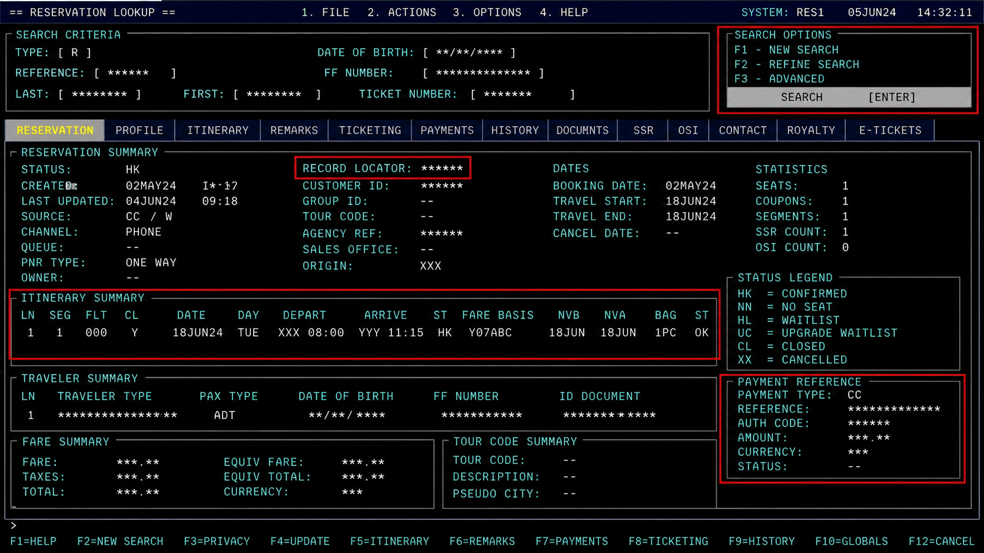
Operating Screen — Reservation Lookup
REHEARSAL SANDBOX CAPTURE
WHAT THE OPERATOR IS DOING
1
Locate the correct record
Use the reservation identifier. If the customer does not have it, use the customer profile to locate the trip.
2
Verify itinerary context
Confirm the displayed traveler and itinerary belong to the request before continuing.
3
Continue to reason capture
The lookup screen provides context; it does not determine cancellation eligibility.
Operator screen captured in the rehearsal sandbox; records shown are sandbox fixtures.
Meridian Airlines — internal working material
8
Notes:
[Sources]
- Airline cancellation policy: data/tau2/hyper/sops/airline_plus_sop.md
- Visual structure informed by the user-provided internal process-flow reference deck; no business content, branding, metrics, names, or system identifiers were reused.
- UI screen captured in the rehearsal sandbox; every identifier is a sandbox fixture.
[/Sources]

Slide 9
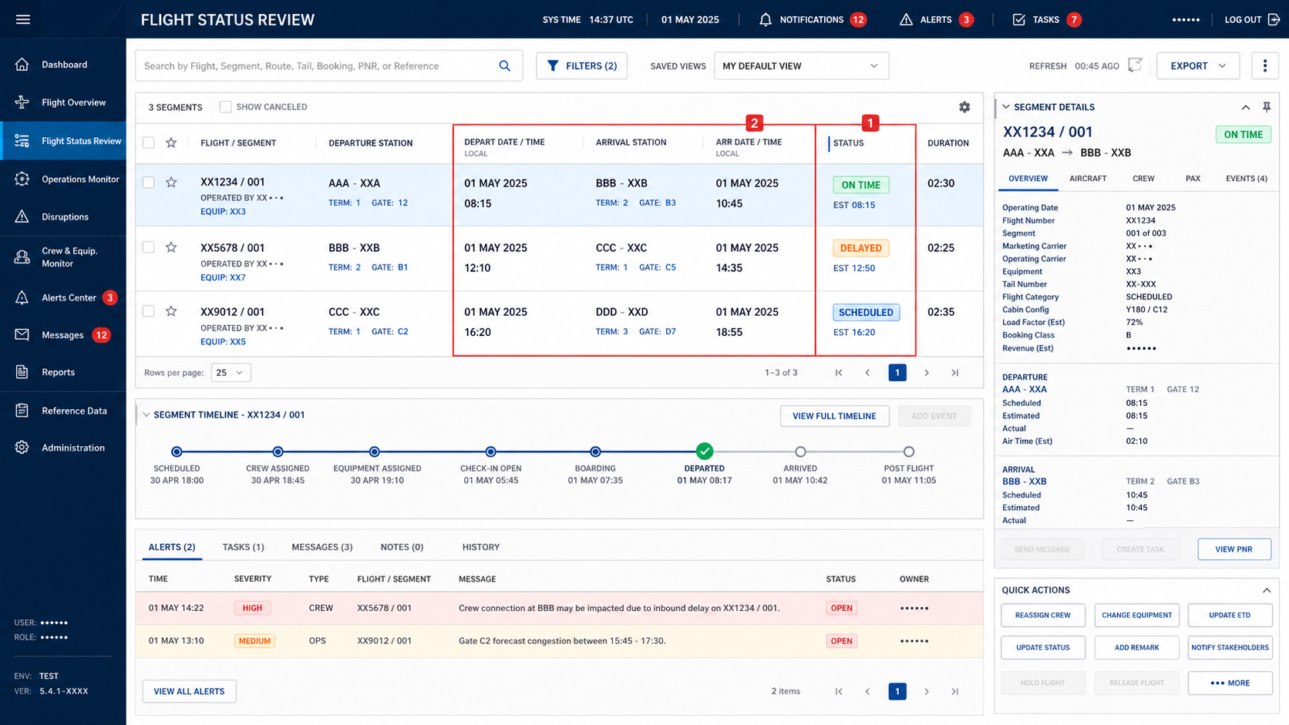
Operating Screen — Segment Status Review
REHEARSAL SANDBOX CAPTURE
REVIEW SEQUENCE
1
Check every segment
Read status across all rows in the itinerary. Do not infer the whole trip from a selected row.
2
Use current status
A flying or landed segment stops the automated cancellation path and requires supervisor transfer.
SCREEN CAVEAT
The interface may show status and timestamps, but the operator applies the policy sequence.
Meridian Airlines — internal working material
9
Notes:
[Sources]
- Airline cancellation policy: data/tau2/hyper/sops/airline_plus_sop.md
- Visual structure informed by the user-provided internal process-flow reference deck; no business content, branding, metrics, names, or system identifiers were reused.
- UI screen captured in the rehearsal sandbox; every identifier is a sandbox fixture.
[/Sources]

Slide 10
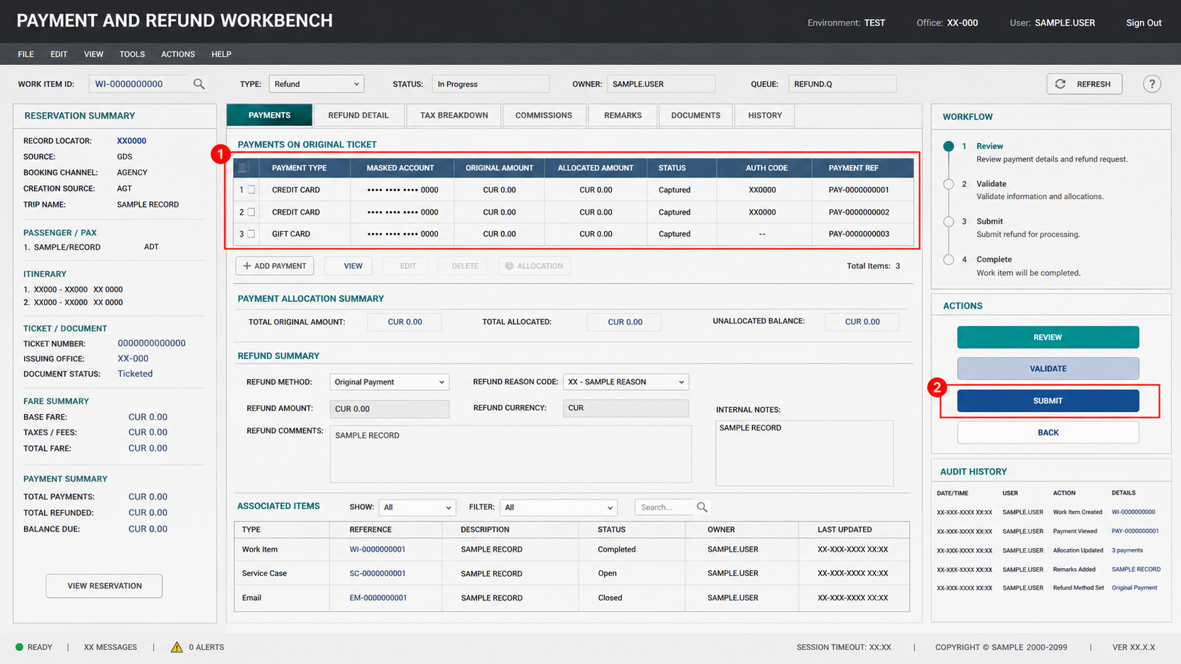
Operating Screen — Refund Workbench
REHEARSAL SANDBOX CAPTURE
OPERATOR CHECKS
1
Review original-payment rows
Refund allocation follows the payment methods used for the original purchase.
2
Validate before submit
Confirm the allocation and only submit after the cancellation eligibility review is complete.
CUSTOMER EXPECTATION
After submission, explain that the refund will arrive within 12 business days.
Meridian Airlines — internal working material
10
Notes:
[Sources]
- Airline cancellation policy: data/tau2/hyper/sops/airline_plus_sop.md
- Visual structure informed by the user-provided internal process-flow reference deck; no business content, branding, metrics, names, or system identifiers were reused.
- UI screen captured in the rehearsal sandbox; every identifier and value is a sandbox fixture.
[/Sources]

Slide 11
Implementation Notes and Open Items
WORKING APPENDIX
Collected during the rollout working sessions. The items below are implementation context, not additional cancellation rules.
WORKFLOW CONTROLS
DATA AND SCREEN MAPPING
REVIEW CHECKLIST
01
Keep the departed-flight gate first.
01
Reservation lookup and segment-status screens may be separate.
01
Confirm reason labels match the customer’s statement.
02
Treat allowed conditions as alternatives.
02
Current system time is required for the 24-hour comparison.
02
Validate handoff wording for supervisor transfers.
03
Do not rely on the tool to block ineligible actions.
03
Payment rows may contain more than one original method.
03
Verify refund expectation is included after submission.
END OF WORKBOOK
Meridian Airlines — internal working material
11
Notes:
[Sources]
- Airline cancellation policy: data/tau2/hyper/sops/airline_plus_sop.md
- Visual structure informed by the user-provided internal process-flow reference deck; no business content, branding, metrics, names, or system identifiers were reused.
[/Sources]

