Slide 2
Southern Ocean
Responsible for much

Slide 3
West Antarctica
More rapidly melting

Slide 4
Amundsen Sea
Dotson/Getz ice shelves
Thwaites * important later

Slide 5
Polynya
What is polynya
Blooms area
Iron and light limited
Important to understand how iron moves in this system

Slide 6
Major iron sources
CDW (two other water masses)
Glacial melt
Sea-ice
Percentages for them

Slide 7
Video of CDW

Slide 8
Video of glacial melt

Slide 9
Three main water masses

Slide 10
ARTMEIS aims

Slide 11
Unique bacterial community
Associated with bloom, but deep-water and Dotson inflow + outflow has not been explored

Slide 12
The main questions of this study were:
How do bacterial communities (both free-living and particle-associated) vary by location within the ASP? By depth?
How does the bacteria community change between the CDW flowing into and the mCDW flowing out of the ice shelf cavity?
How do communities differ under high- and low-iron conditions? Are there any specific indicator taxa that may indicate biogeochemical processing?
How do communities change as the CDW flows onto and across the continental shelf?
How does the community in the coastal current change as it flows along the DIS? Is there any contribution from the basal melt of upstream ice shelves?

Slide 13
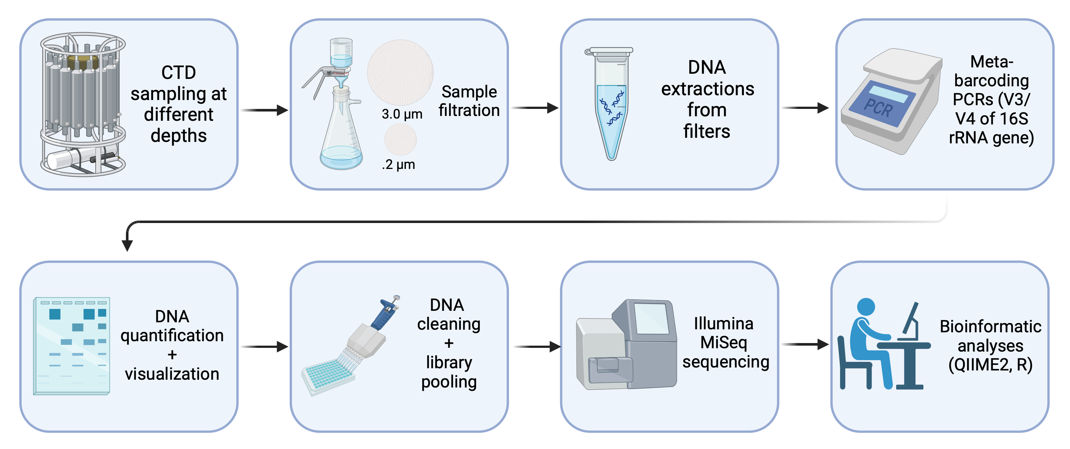
METHODS

Slide 14
Methods
For beta-diversity analysis on amplicon and miTag data, Bray Curtis distance matrices were calculated in Vegan and visualized using a principal coordinate analysis (PcoA). Independent permutational analysis of variance (PERMANOVA) based on the Bray-Curtis dissimilarities values were calculated with the adonis function in Vegan (999 random permutations), to test for significant differences in community structure between depth profiles. Finally, a beta-dispersion test (PERMDISP) was applied to confirm that observed differences were not influenced due to dispersion. As a post-hoc evaluation of taxa responsible for differences in microbial community structure, we performed an indicator species analysis. We used the indicator value method⁹² to calculate indicator values using the R package indicspecies. An individual ASV was considered a valid indicator species if the p value was < 0.05 and the Test statistic (the indicator value) was 0.5 or greater, based on 1000 random permutations⁹³. IndVals were compared between two groups, basal layer (30 m) and mid-column samples (180 m and 330 m), with the multipatt function in the R Indicspecies package (with the option control = how(nperm = 999)). This function uses an extension of the original Indicator Value method: it looks for indicator species of both individual site groups and combinations of site groups

Slide 16
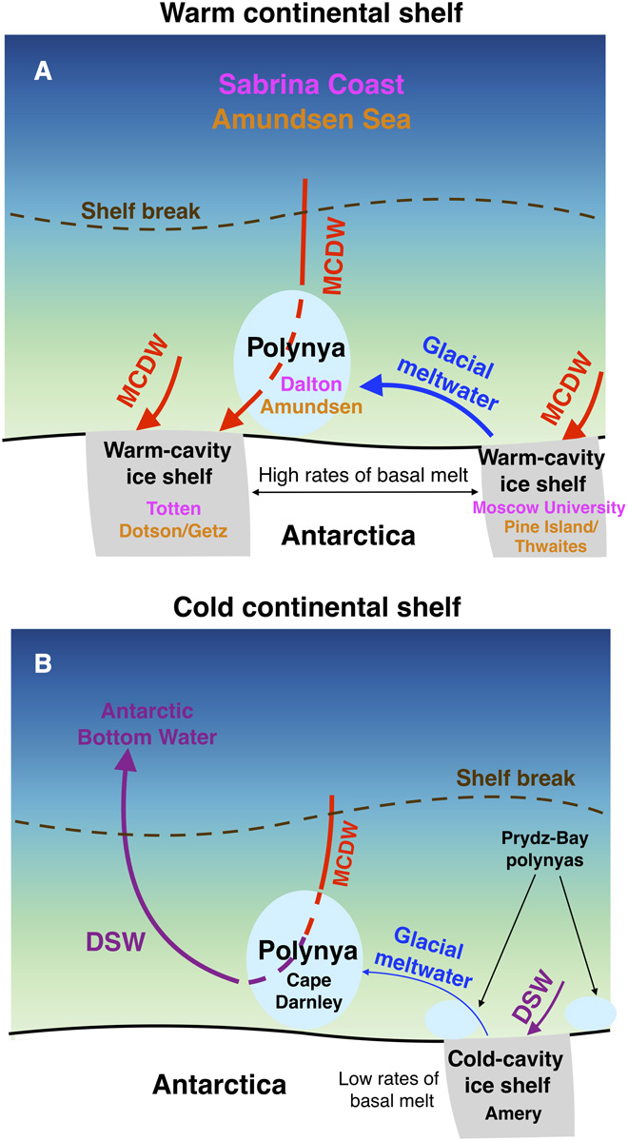
Most of the glacial meltwater released by these ice shelves is transported westward in the coastal current to the Amundsen Polynya in the top 300 to 400 m of the water column (11). [Meltwater exits the cavity beneath the Dotson Ice Shelf south of the polynya (fig. S2A), but the core of this outflow is located on the western edge of the polynya (12) and therefore likely has less impact on convection in the Amundsen Polynya.) https://www.science.org/doi/10.1126/sciadv.aap9467

Slide 17
DISCUSSION
The colder and less salty the water is, the more carbon dioxide is dissolved.

Slide 19
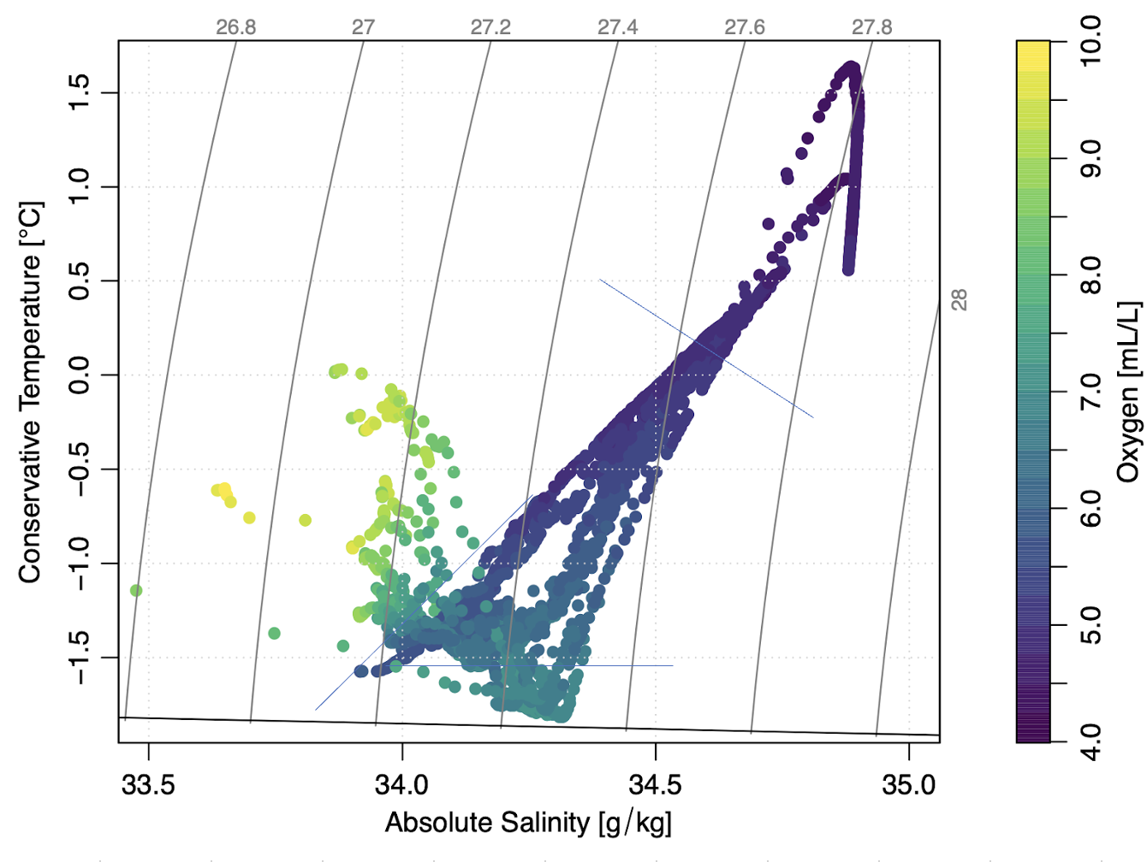

Slide 20
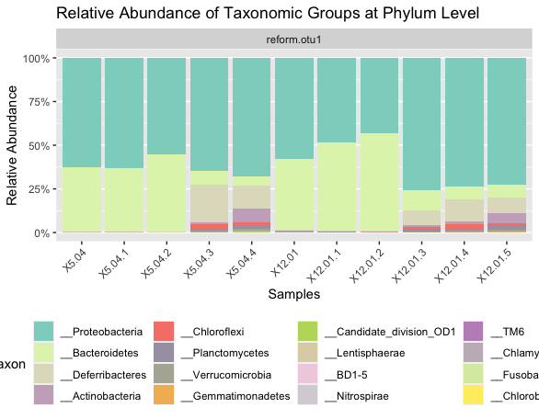
Baby’s first graph :,)

Slide 21
SUPPLEMENTARY

Slide 22
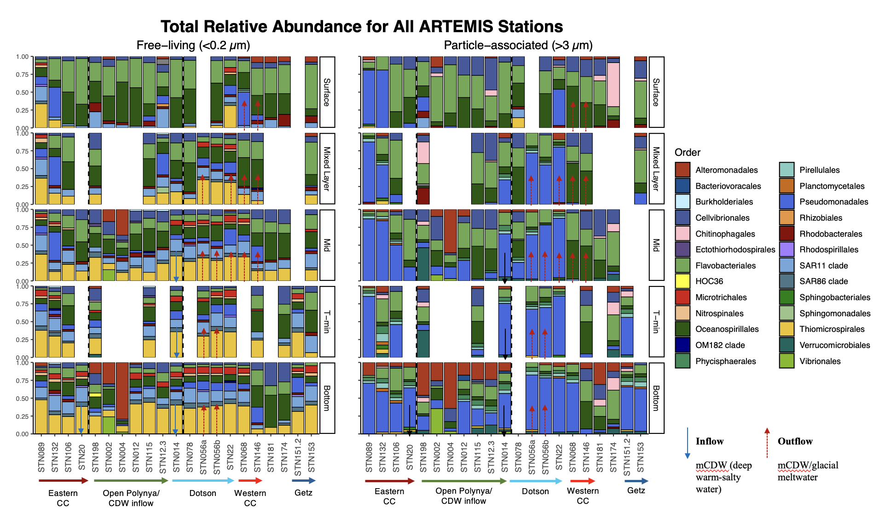
Notes:
** outflow arrows based on velocity profiles.
Relative abundance of Order (free vs particle associated) free-living >Higher pseudomonas in some of the outflow.
> Microtrichales
> Alteromonadales at depth,
Particle-associated Planctomycetales found in almost all eastern CC + Getz in particle-associated stations
> Vibrio + Aleromonadales are found in different

Slide 23
>40
Notes:
Dissolved iron in surface (left) and mixed layer depth (MLD) (right)
Observing the coastal current – 89 to 68, east to west
The easterlies push water to create coastal current, along the iceshelf upper ~200m, MLD ranges from 90-300m.
Surface
Highest in surface waters toward pine island (eastern notch)
Higher at outflow (56)

Slide 24
Notes:
Dissolved iron concentration in bottom water.
To observe the how the CDW bottom water travels to the Dotson.
- High in open polynya stations (198 is cont. shelf)
High at inflow (SNT 14)
Iron isn’t higher at outflow @ bottom water bc outflow is around 90-400m

