Slide 1
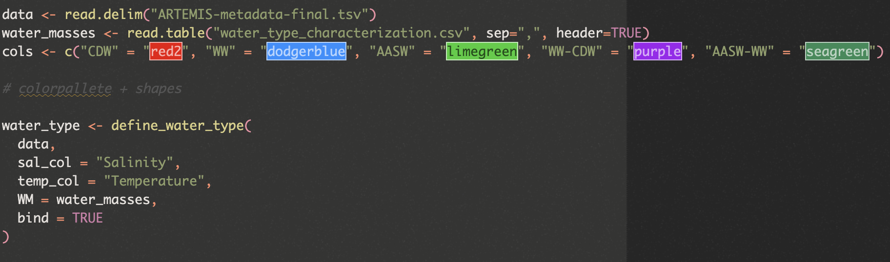
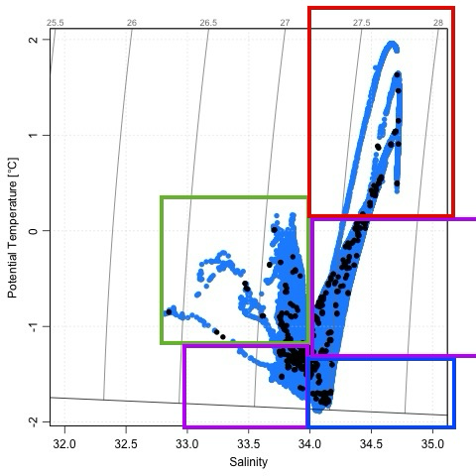
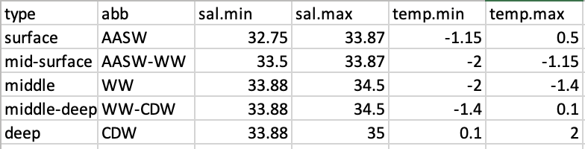
Notes:
Watertype characterization clarification, creates a categorical column with these ranges, looked at temp salinity plot

Slide 2
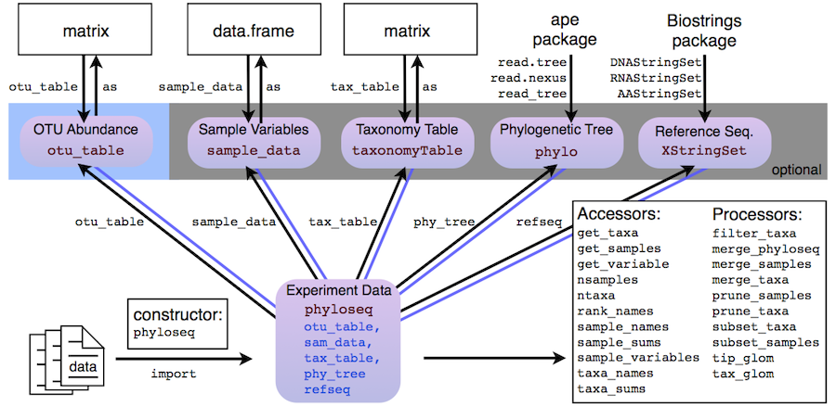
phyloseq

Slide 3
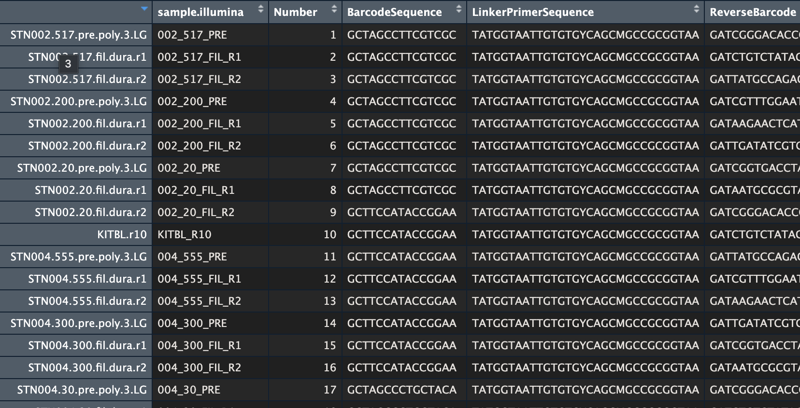
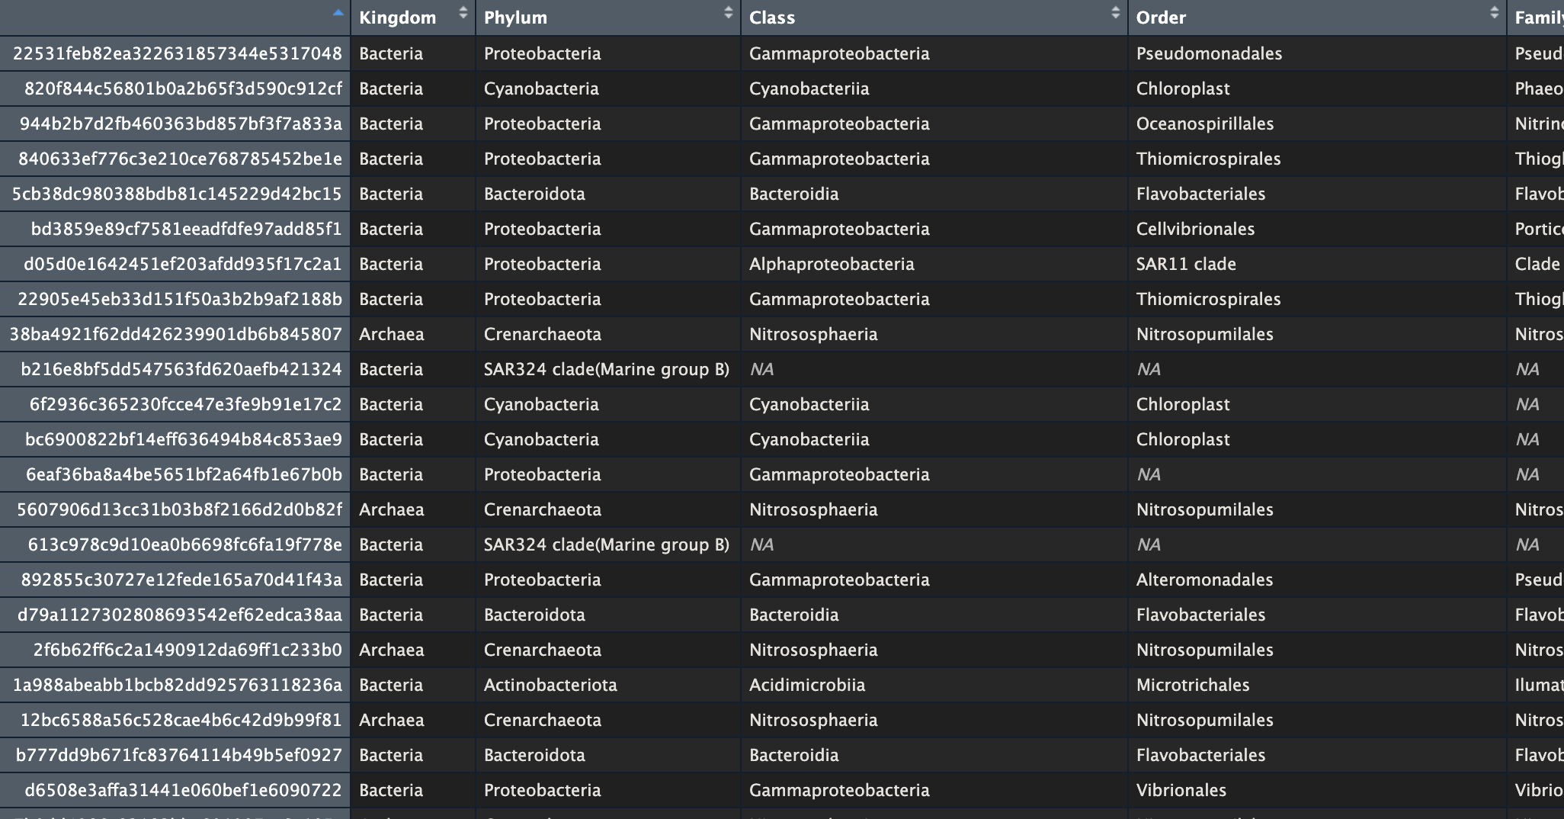
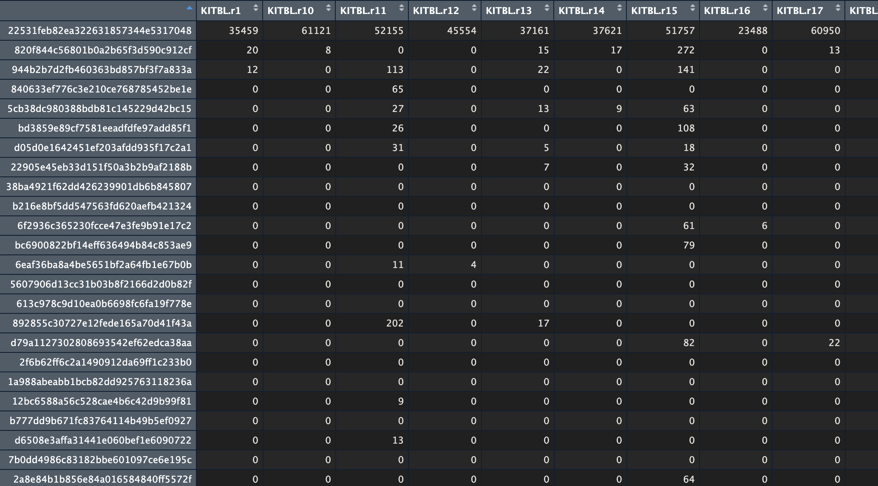
Taxonomy table - where the unique taxa ID are row names, along with the taxonomic classification for each unique ID
Metadata – has environmental variables, anything you need to know about the sample, sample as rows
ASV/ feature table – unique TAXA ID as rows, samples as columns, with abundance counts for each taxa within each sample
Notes:
ASV - Amplicon Sequence Variant

