Slide 1
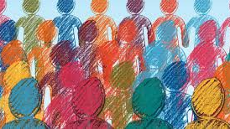
Mental Shifts in communities
By: Sierra Gomez

Slide 2

Recent mental health trends
According to the WHO, In the first year of the COVID-19 pandemic, global prevalence of anxiety and depression increased by 25%,
- Led to “Gaps in care”
- Rise in Telehealth, subscription based therapy models such as BetterHelp

Slide 3

ABOUT THE DATA
Mental health dataset was collected from a bi-monthly national survey regarding mental health over the course of two years.
It recorded percentage of surveyed population that exhibited symptoms of depression, anxiety, or both.
There are 50 different time points throughout the dataset. (new data every 2 weeks)

Slide 4
Classifying the data
Percentage of Population Exhibiting Mental Health Symptoms
Low Presence (<30%)
High Presence (>=30%)

Slide 5
Transforming the data
Prepping for the Algorithms
Dropped rows with null values
Transformed the symptoms percentage into a value of 1 or 2 (high/ low presence)
One-Hot encoded the rest of the columns with categorical data types
Split data into features and target arrays
Split data into training and testing dataset
Created, fit, and scaled the data with a standard scaler instance
*Chose accuracy as success metric

Slide 6
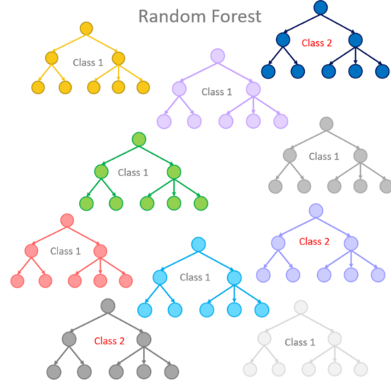
Algorithm trial One – Random forests
Random Forest algorithm sampled the dataset and built several, smaller decision trees.
Chose the optimal split point for each decision
Accuracy: 85.67%

Slide 7
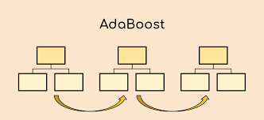
Algorithm trial TWo – adaptive boosting
Chosen to “boost” previous random trees model
“Boosted” weak learners in the previous algorithm if they were contributing to the accuracy and reduced if not.
Accuracy: 86.51%

Slide 8
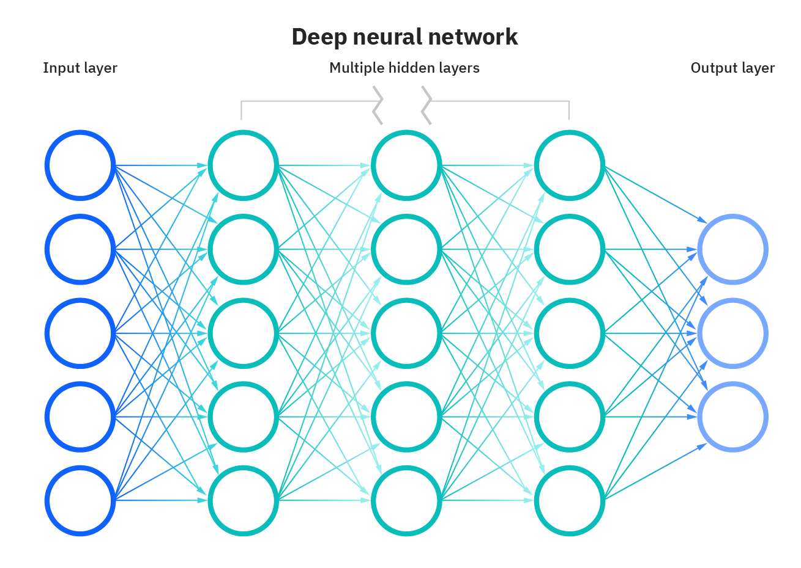
Algorithm trial three – neural network model
Keras Neural Network Model optimized components:
Input Layer: Relu activation function
2 Hidden Layers: Relu activation function- 8 and 10 nodes
Output Layer: Sigmoid activation layer
100 Epochs
Accuracy: 83.51%

Slide 9
Comparing the algorithms
Accuracy Percentage

Slide 10

Why does this matter?
Community Health Applications
Using the created algorithm predicting the higher affected populations enables more strategic…
Building/funding choices for mental health clinic locations
Advertising mental health services to targeted subpopulation
More specific primary care mental health screenings

