Slide 1
Microsoft Movie Analysis
By: Sierra Mecalo-Schwigen

Slide 2
Outline:
Data & Methods
Business Problems
Recommendations
Further suggestions

Slide 3
Data & Methods:
Databases used:
IMDB
Runtime Minutes
Genres
The Numbers
Release Date
Movie
Production Budget
Worldwide Gross
Methods used:
Merged dataframes for complete picture of all included movies
Added columns for production budget, worldwide gross, and profit adjusted for inflation
Evaluated correlations between profit, return on investment, and movie runtime
Created visualizations of correlations

Slide 4
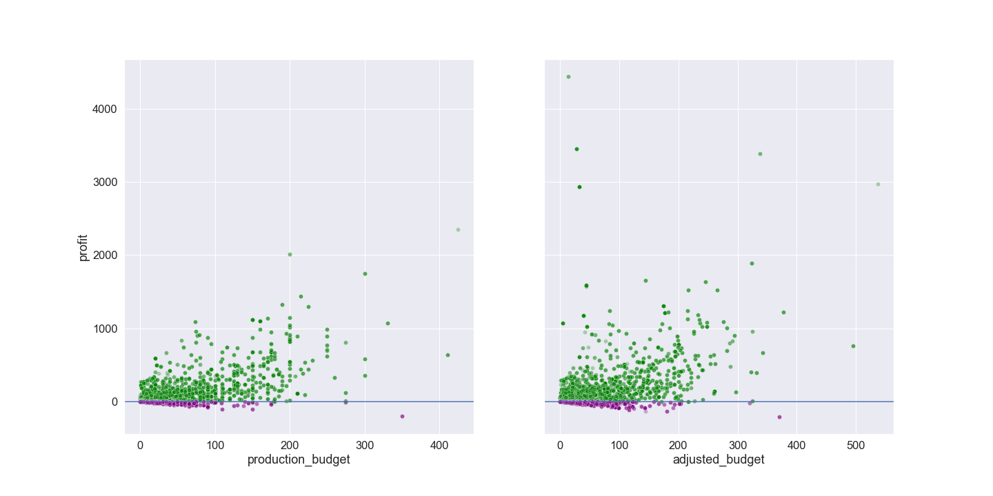
Business Problem 1: Profit
A weak relation between production budget and profit earned was shown before and after adjusting for inflation.

Slide 5
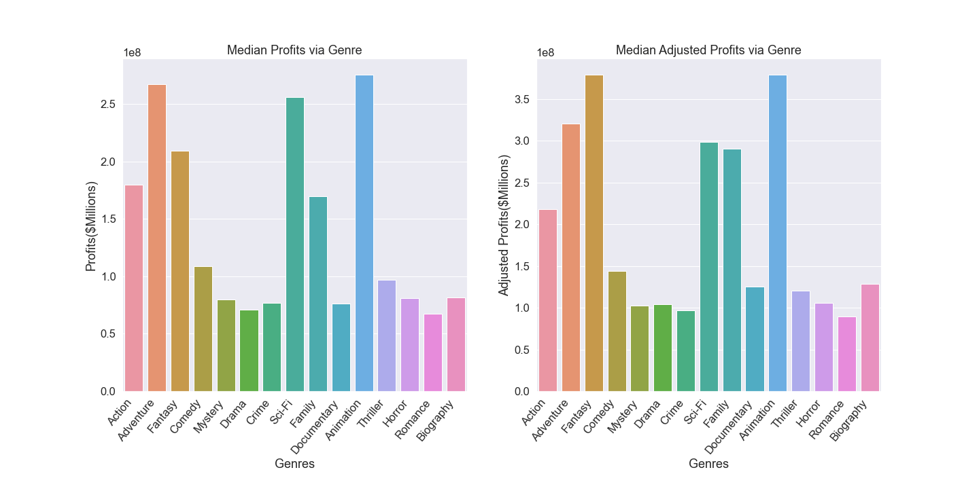
Business Problem 1: Profit Continued
Taking inflation into consideration, Animation and Fantasy came in first and second place for highest profits earned.

Slide 6
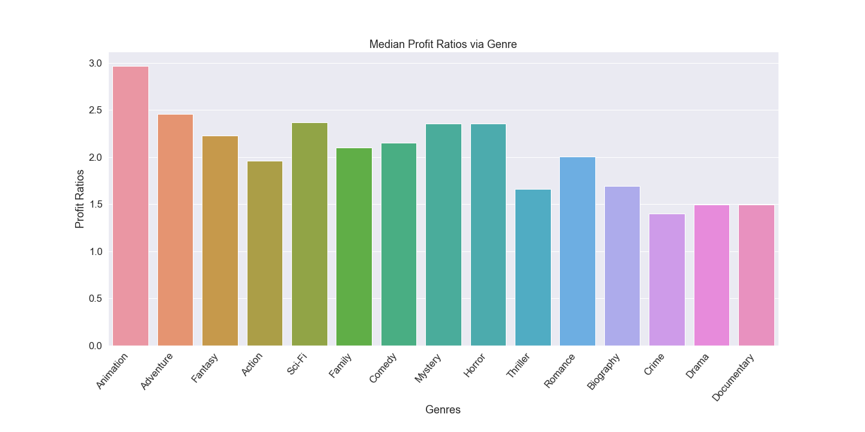
Business Problem 2: Return on Investment
After seeing that Animation and Fantasy came very close in profit, return on investment was investigated.
Animation came in first place when looking at return on investment.

Slide 7
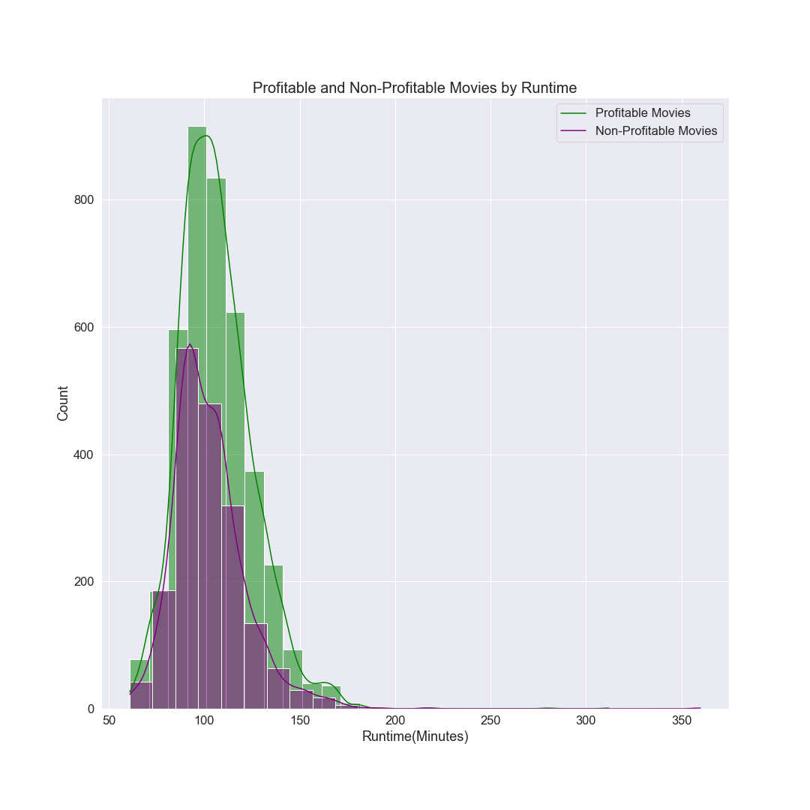
Business Problem 3: Runtime
Looking at all move genres, a right-skewed distribution was found.
Movies with runtimes of 90-120 minutes appear to be the most successful.
Animation came in first place for profit and return on investment, so analysis will now look strictly at that genre.

Slide 8
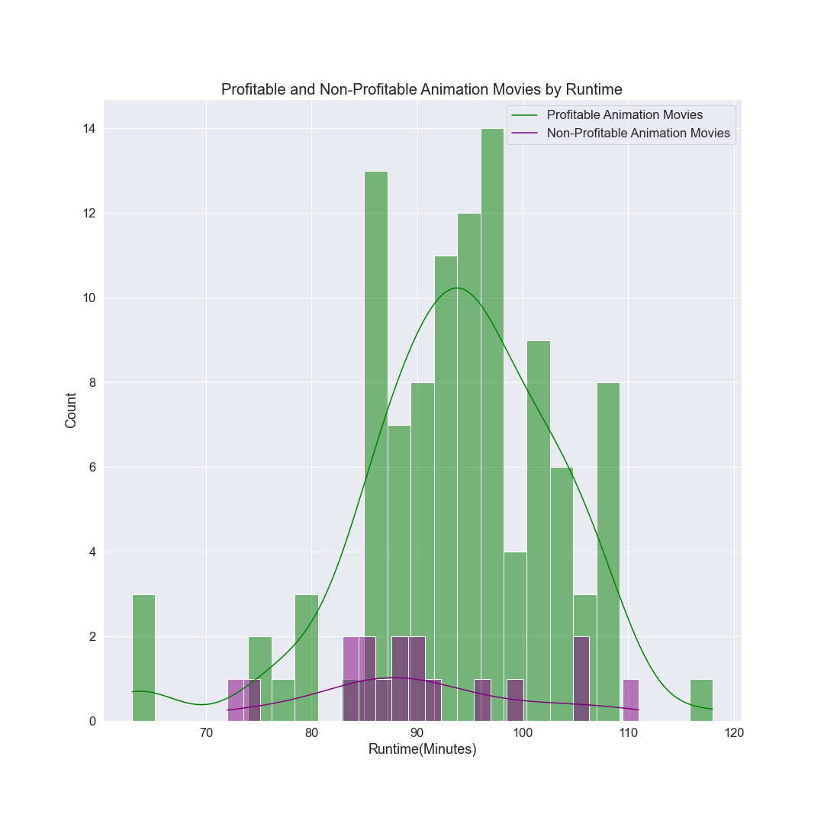
Business Problem 3: Runtime Continued
Similar to the visualization of all genres, Animation movies tend to run between 85-110 minutes.
90-98 minutes appears to be the ideal runtime length with the majority of past Animation movies falling within these parameters.

Slide 9
Final recommendations:
Maximum potential profit: Animation or Fantasy genres
Maximum potential return on investment: Animation
Ideal movie runtime in minutes: 90-98

Slide 10
Suggestions for Further Research:
Optimal release month
Success rates of various directors and actors
Impact on movie success by critic reviews

Slide 11
Thank you
Email: sierra.m.schwigen@icloud.com
GitHub: @sierrajul
LinkedIn: linkedin.com/in/sierramecaloschwigen/

