Slide 1
Microsoft Movie Analysis
By: Sierra Mecalo-Schwigen
Notes:
Hello! My name is Sierra and I will be presenting my Phase 1 project. The goal of this project is to analyze movie data that I scraped from IMDB and The Numbers databases. This data analysis will be used to provide Microsoft with recommendations for their first Movie Studio production.

Slide 2
Outline:
Data & Methods
Business Problems
Recommendations
Further suggestions
Notes:
This presentation will outline the data and methods used for analysis, three business problems addressed by the findings of that analysis, and the corresponding recommendations to Microsoft. Further suggestions are made at the end of the presentation on additional data Microsoft could use to further encourage a strong start for their new Movie Studio.

Slide 3
Data & Methods:
Databases used:
IMDB
Runtime Minutes
Genres
The Numbers
Release Date
Movie
Production Budget
Worldwide Gross
Initial dataframe contained 6740 entries
Dataframe excluding non-profitable movies contained 4549 entries
Dataframe of profitable movies after removing missing runtime data contained 4261 entries
Dataframe only including profitable Animation genre movies contained 106 entires
Methods used:
Merged dataframes for complete picture of all included movies, removed unnecessary columns
Initial dataframe contained 6740 rows
Dataframe of only Animation movies contained 106 rows
Added columns for production budget, worldwide gross, and profit adjusted for inflation
Evaluated correlations between profit, return on investment, and movie runtime
Created visualizations of correlations
Notes:
Data was scarped from two databases, IMDB and The Numbers, that were merged for analysis. From IMDB Title Basics, I chose to use the runtime minutes and genres columns. From The Numbers Movie Budgets, I chose to use the movie title, release date, production budget, and worldwide gross columns. The other columns present were removed, as they were unnecessary.
Because I planned to investigate profitability, I added a column to subtract the production budget from the worldwide gross for each movie entry. I then chose to add three additional columns to hold the production budget, worldwide gross, and profit figures adjusted to account for inflation. I did this by utilizing the CPI library to calculate to 2021 inflation.

Slide 4
Business Problem Overview
Which movies are doing the best in the box office?
To answer this question the following will be explored:
Highest grossing genre
Genre providing highest return on investment
Ideal movie runtime
Notes:
I first wanted to look at the highest grossing movie genres. I began by creating a scatterplot of the correlation between production budget and profit earned.
In the above graphs, movies that made a profit are shown in green and those that didn’t in purple. I included graphs representing the data before and after accounting for inflation.
These graphs show that while there does appear to be a positive correlation between production budget and profit, it’s a weak one. I decided to move forward with my investigation by looking at movie genres.

Slide 5
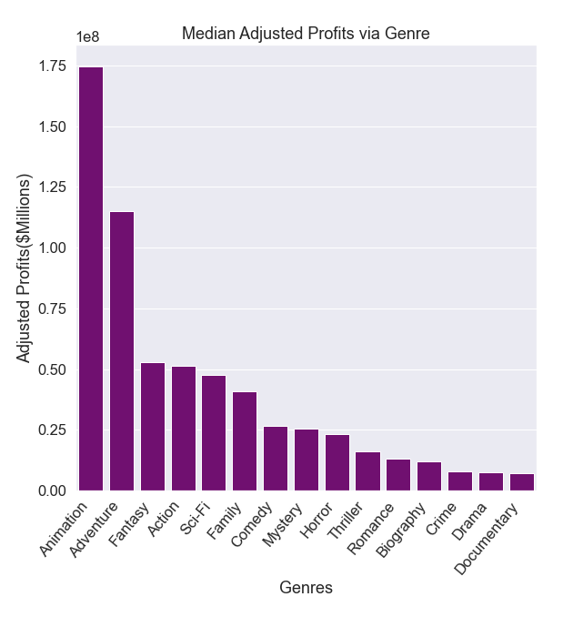
Business Problem 1: Highest Grossing Genre
Taking inflation into consideration, Animation and Adventure came in first and second place for highest profits earned.
Notes:
I wanted to look at the profit information by genre rather than individual movies. So the above bar graphs represent each movie genre’s median profit in millions of dollars.
Again, I wanted to look at the data both before and after accounting for inflation.
Looking at the graphs side-by-side, it was clear that Animation came in first place for profit. After accounting for inflation, the Fantasy genre came in second place. Seeing as Microsoft Movie Studio is just beginning, I would recommend either Animation or Fantasy as the genre of their first movie via the provided profit data.

Slide 6
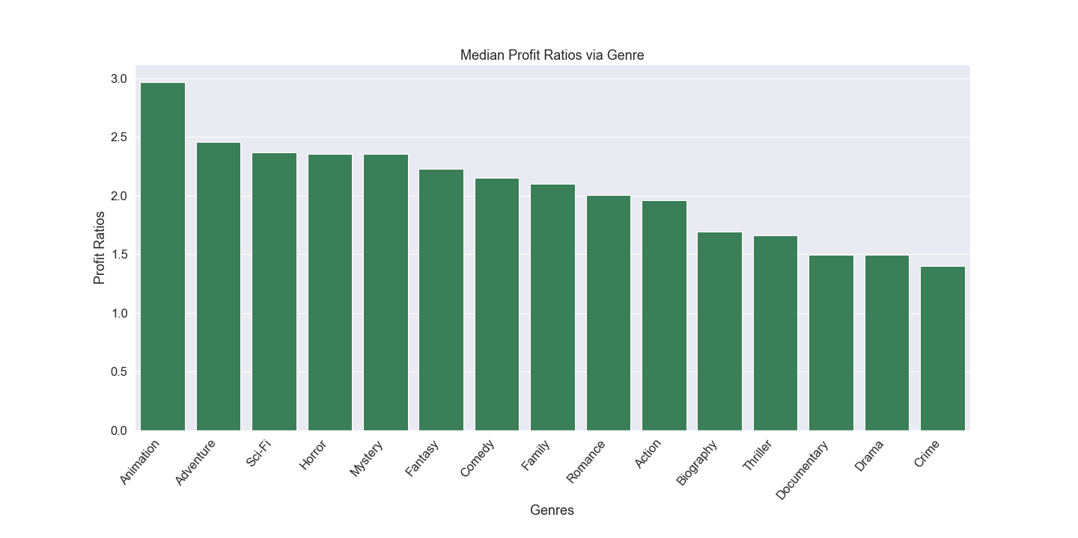
Business Problem 2: Return on Investment
After seeing that Animation came in first place for profit, return on investment was investigated.
Animation came in first place with a 3:1 ratio when looking at return on investment.
Notes:
Because Animation and Fantasy were so close in adjusted profits, I thought I’d investigate return on investment to see if this helped determine a clear winner.
This graph shows the profit ratios for each genre. Once again, Animation comes in first place with an almost 3:1 ratio of money earned to money spent. Fantasy came in at approximately a 2.25:1 ratio. Not bad, but it’s a noticeable difference.
Based on this return on investment information, the Animation genre would be my recommendation.

Slide 7
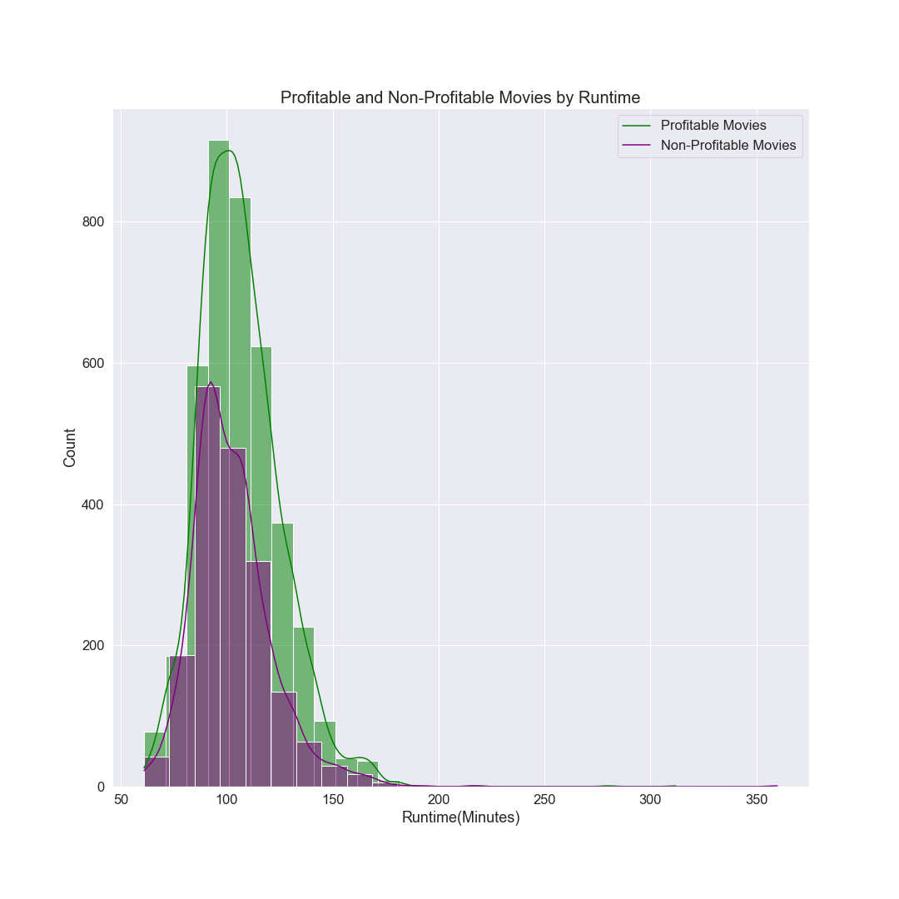
Business Problem 3: Runtime
Looking at all move genres, a right-skewed distribution was found.
Movies with runtimes of 90-120 minutes appear to be the most successful.
Animation came in first place for profit and return on investment, so analysis will now look strictly at that genre.
Notes:
Finally, I wanted to look at movie runtimes to see what the ideal movie length should be. I first created a graph to show all movie genres and found that movies that turned a profit and were 90-120 minutes seemed to be the most successful.
I wanted to narrow this down to strictly the Animation genre to see if the results were the same.

Slide 8
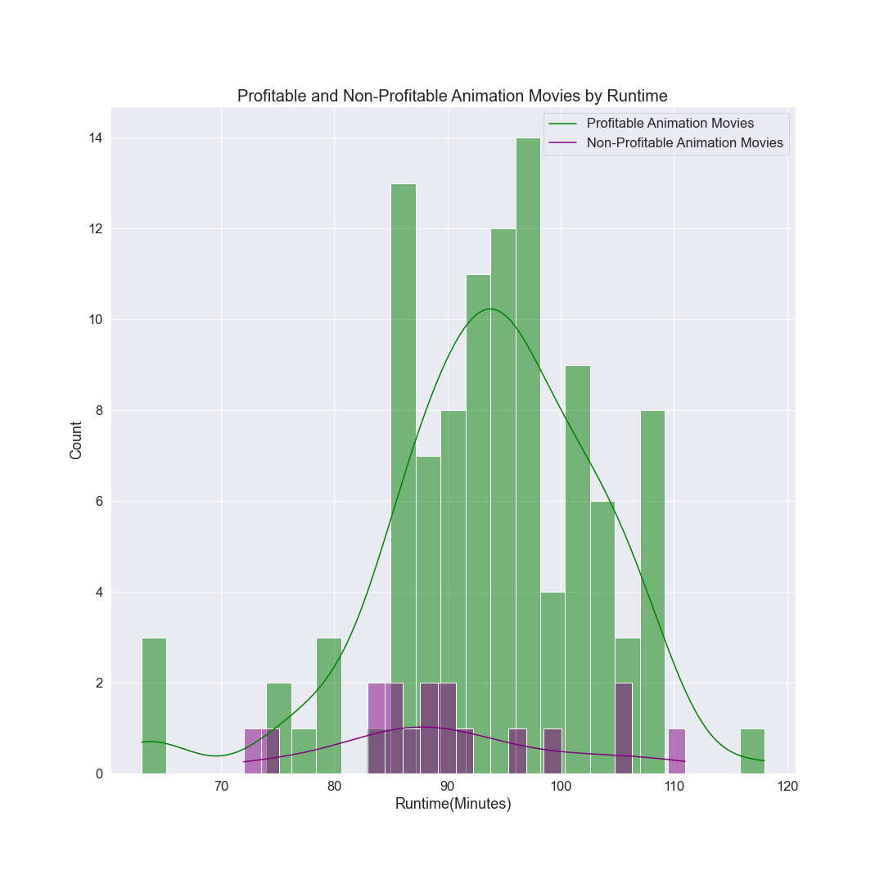
Business Problem 3: Runtime Continued
Similar to the visualization of all genres, Animation movies tend to run between 85-110 minutes.
90-98 minutes appears to be the ideal runtime length with the majority of past Animation movies falling within these parameters.
Notes:
Visualizing Animation movies, I saw that while the distribution was a bit more spread out, the ideal runtime appears to be between 90-98 minutes. It seems that past Animation movies tend to fall within these parameters.

Slide 9
Final recommendations:
Maximum potential profit: Animation or Adventure genres
Maximum potential return on investment: Animation
Ideal movie runtime in minutes: 90-98
Notes:
After completing my data analysis I wanted to present Microsoft with three recommendations for their first Movie Studio production.
For maximum potential profit, I’d recommend they choose either an Animation or Fantasy film. As they are a new studio, I wanted to provide them with both options since the profit data was so similar between the two.
For maximum potential return on investment, I’d recommend the choose an Animation film as the Animation genre was the clear roi winner.
For the ideal movie runtime, I’d recommend 90-98 minutes for optimal success.

Slide 10
Suggestions for Further Research:
Optimal release month
Success rates of various directors and actors
Impact on movie success by critic reviews
Notes:
Microsoft Movie Studio is just beginning, so further research may be desired. This presentation aims to provide recommendations for their first production based on profit, roi, and runtime, but there are other areas of interest they may want to explore.
I would suggest they look into an optimal release month, success rates of various actors and directors, and the potential impact on movie success by critic reviews to gain more insight.

Slide 11
Thank you
Email: sierra.m.schwigen@icloud.com
GitHub: @sierrajul
LinkedIn: linkedin.com/in/sierramecaloschwigen/

