Slide 1






Topology, Data Science, Machine Leaning, Deep Learning, Image Processing….. an more
D. Sierra-Porta, UTB, June 2024
ENO-CANCOA 24
Cartagena de Indias, COL

Slide 2
https://www.youtube.com/watch?v=vzC7Gt6z_I4

Slide 3
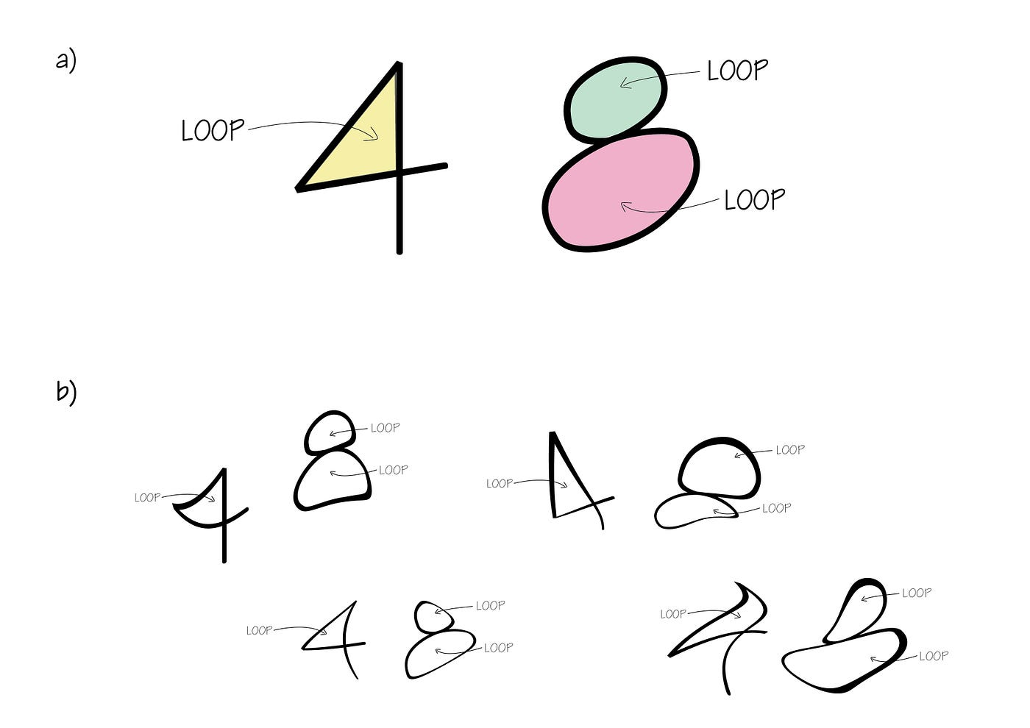
In applied mathematics, topological data analysis (TDA) is an approach to the analysis of datasets using techniques from topology. Extraction of information from datasets that are high-dimensional, incomplete and noisy is generally challenging.
Significance Statement
Information such as the geometric structure and texture of image data can greatly support the inference of the physical state of an observed Earth system, for example, in remote sensing to determine whether wildfires are active or to identify local climate zones. Persistent homology is a branch of topological data analysis that allows one to extract such information in an interpretable way—unlike black-box methods like deep neural networks.

Slide 4
Time Series Data
Comparing trends over time across different regions/products
    Comparing how multiple stock- markets perform across similar time periods
    Comparing product sentiment over time across different types of bread
Forecasting future sales or population
    Forecasting population growth
    Forecasting how much impact an epidemic might have in region
Detecting future changes in system behavior
    Price spikes in grain
    Stock market crashes
    Public health crisis leveling out

Slide 5
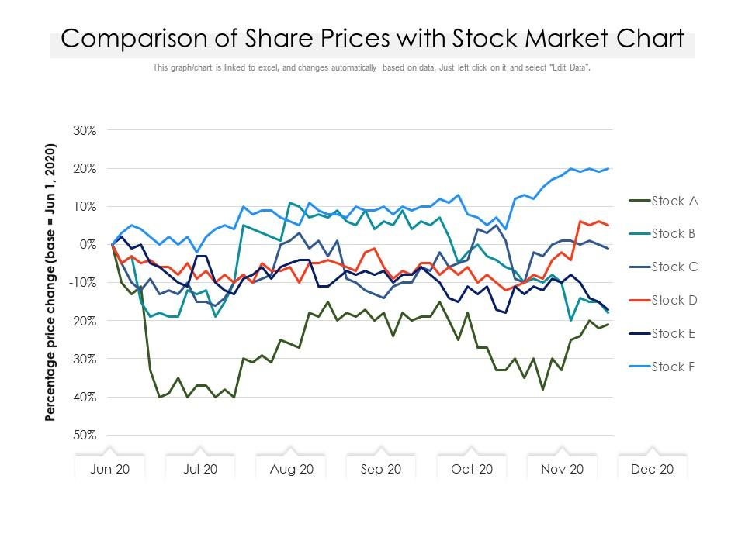
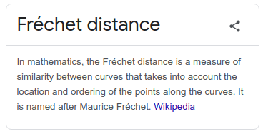
Comparing Time Series
Stationary assumption
Measurement at same time points
Autocorrelation assumpitions
No outliers
Fréchet distance

Slide 6
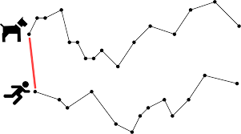
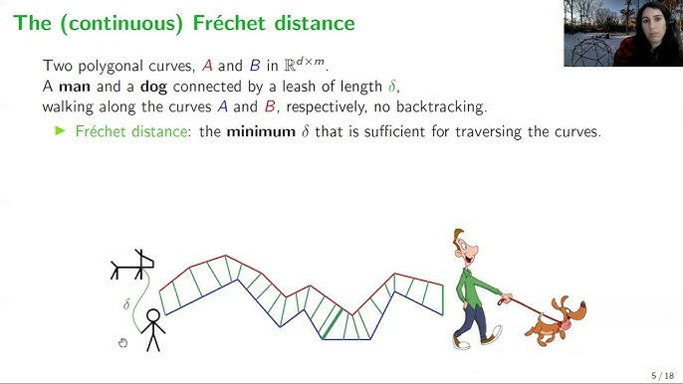
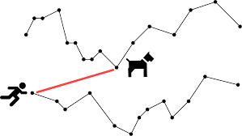

Slide 7
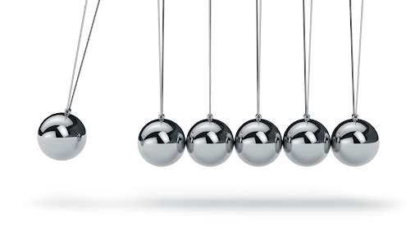
Time Series as Dynamic System
Sampling of dynamic system at different or similar intervals of time
Comparison of the systems themselves useful in comparison tasks
Allows for the use of a field called topology to model the components of the system underlying the time series data

Slide 8

What is the difference between a doughnut and a cup of coffee?
How are a balloon and a cup of soup similar?

Slide 9
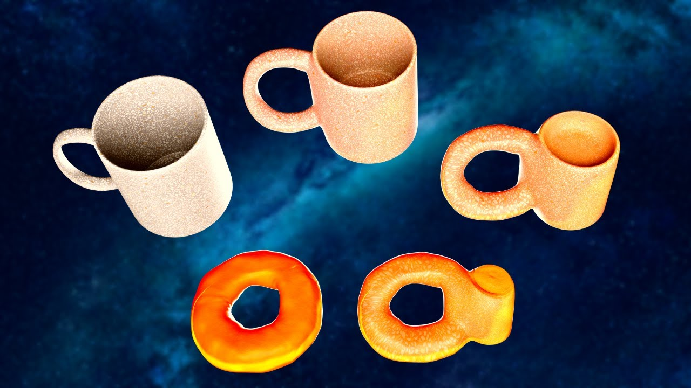
Topology…..?
Global properties of a space
  Many invariants (hole-counting)
  Not concerned with distances or curvature
Donuts and coffee mug example
  Solid ring with a hole in the middle

Slide 10
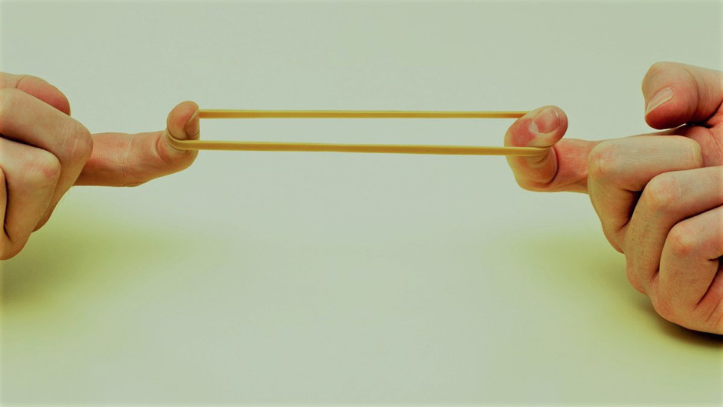
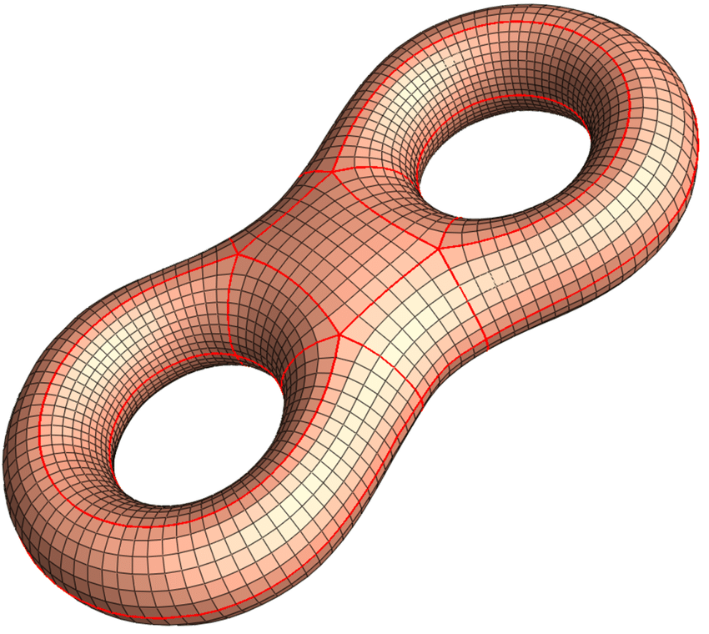
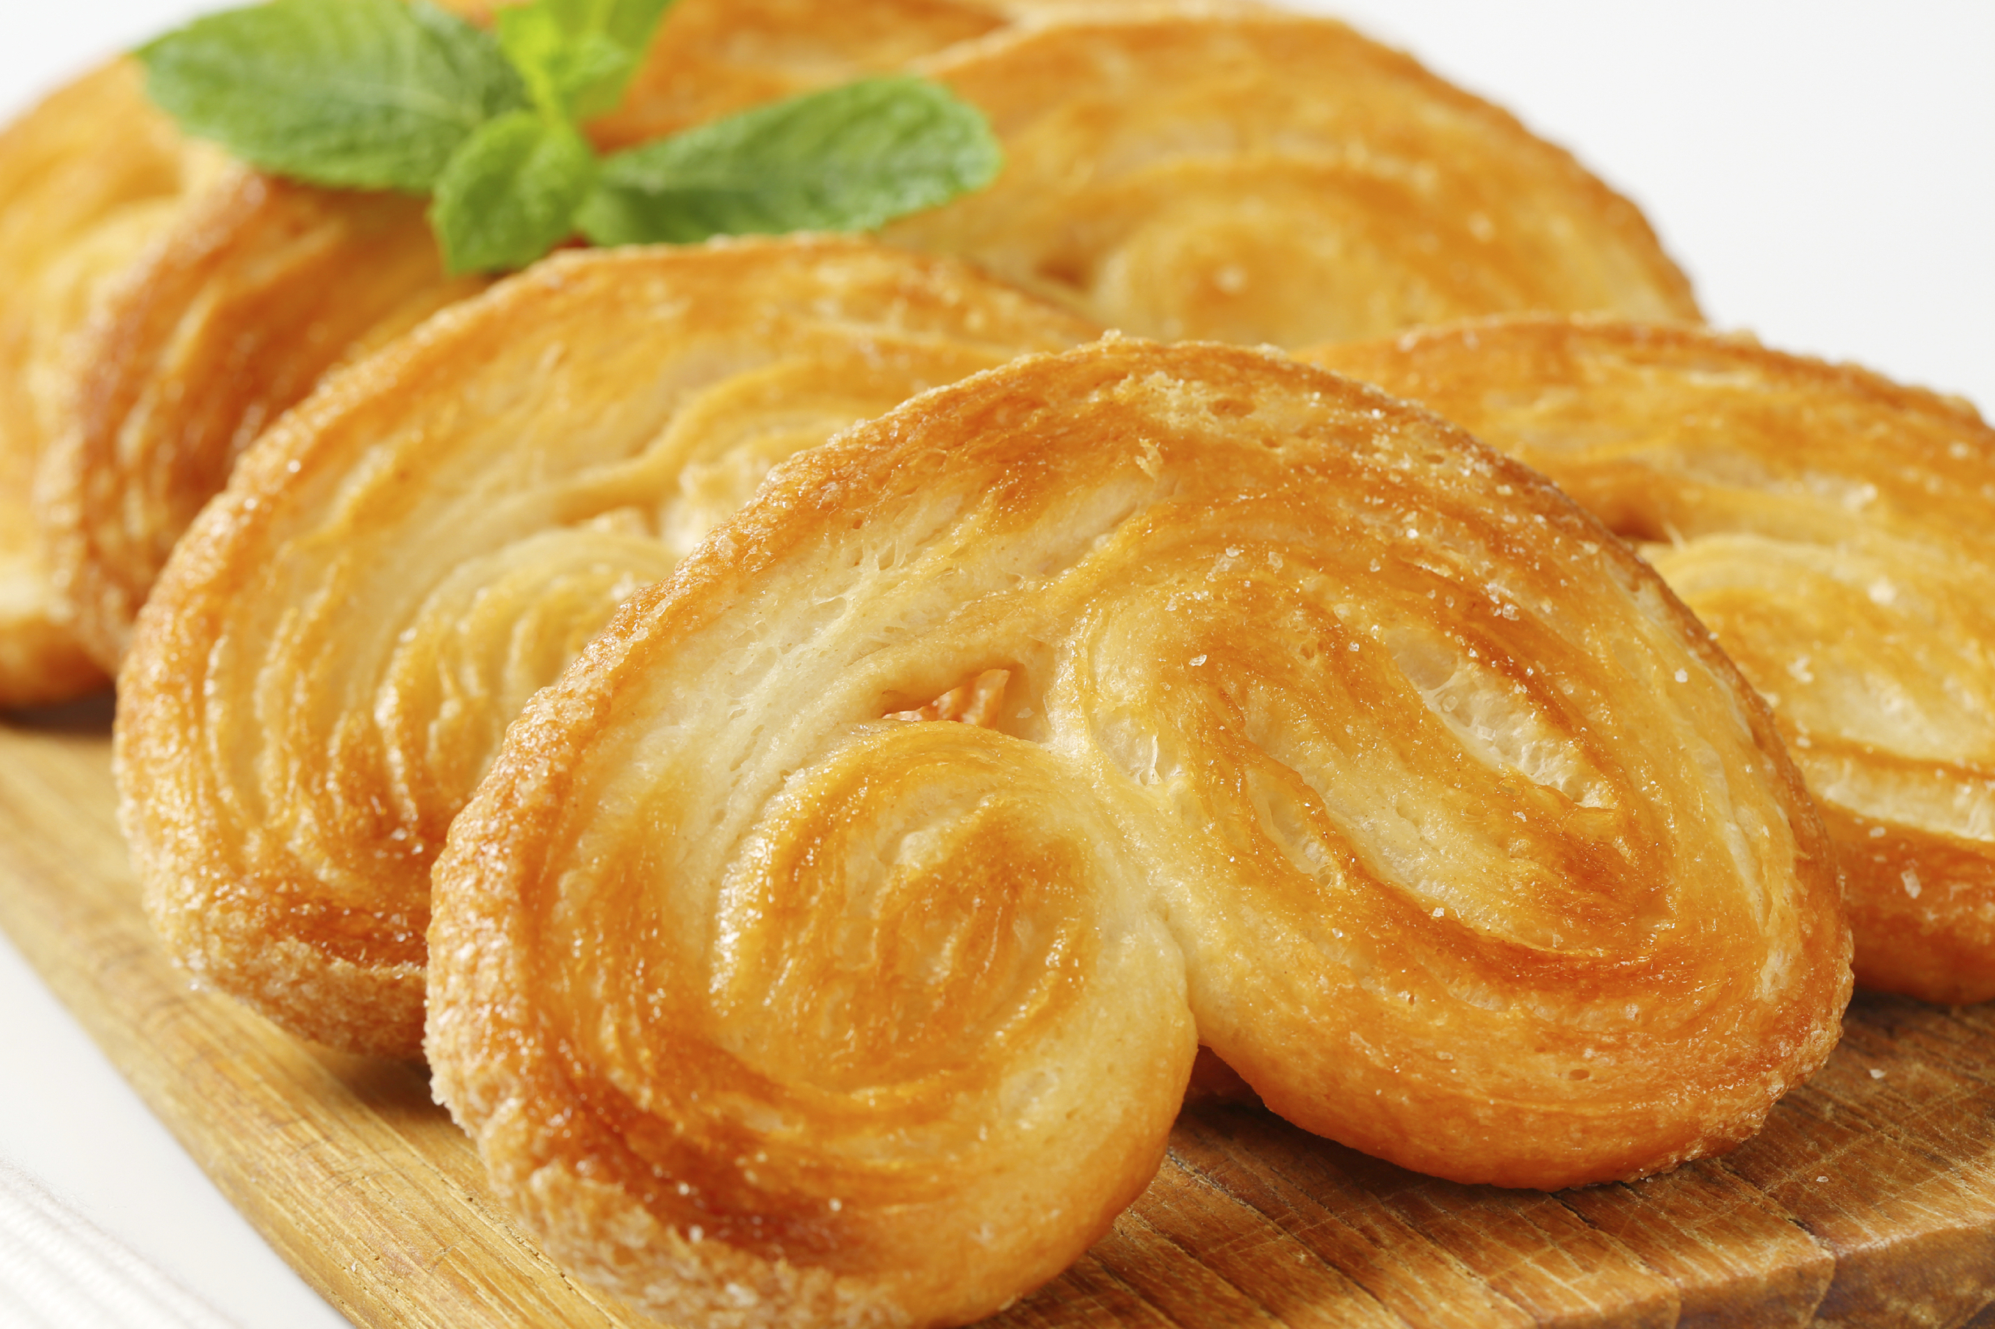
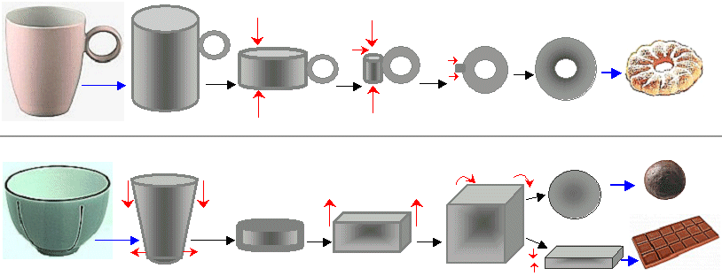

Slide 11
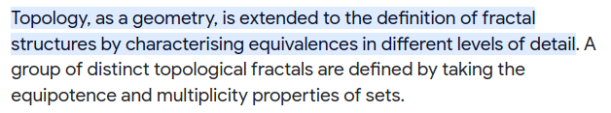
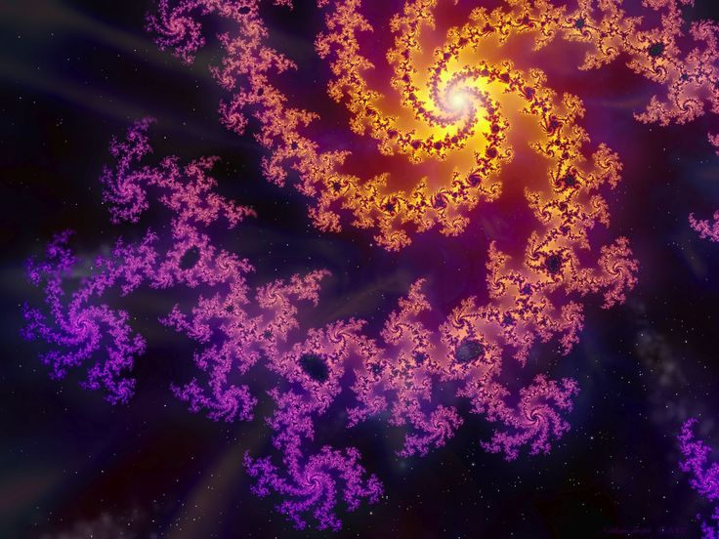
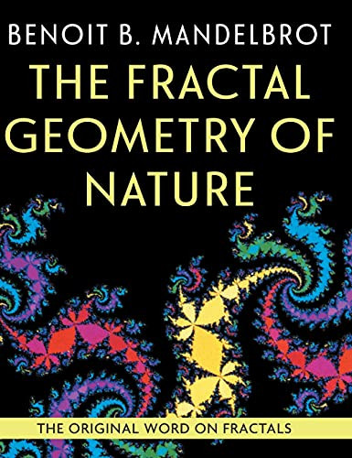

Slide 12
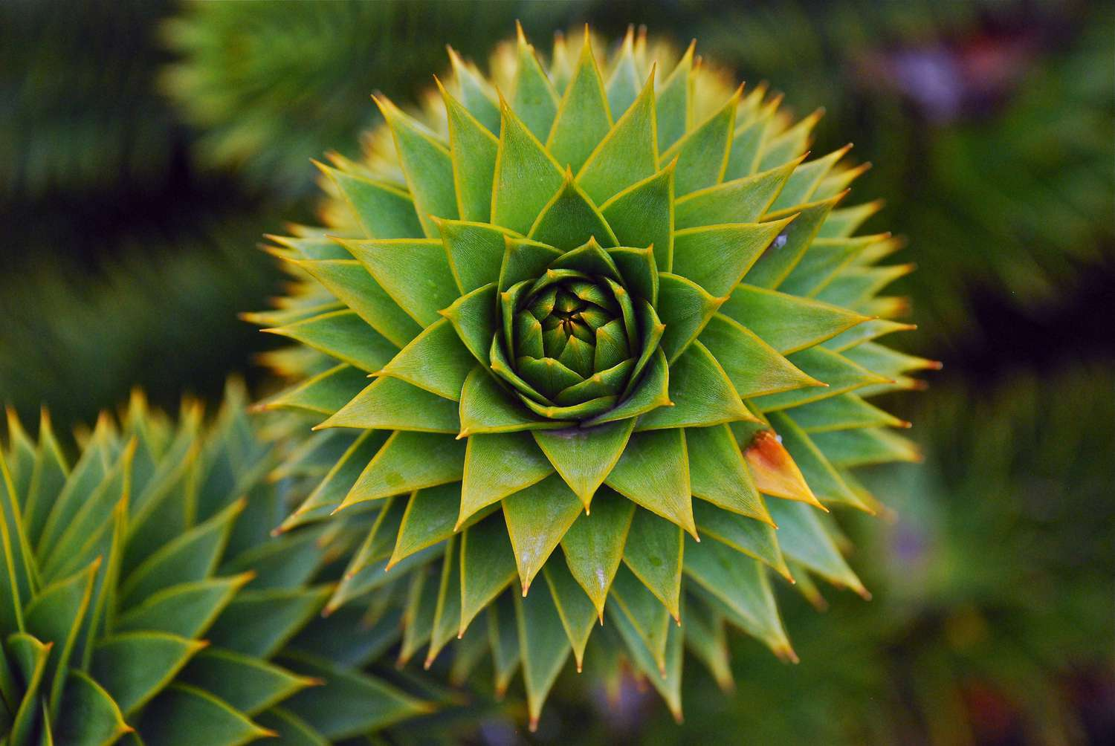
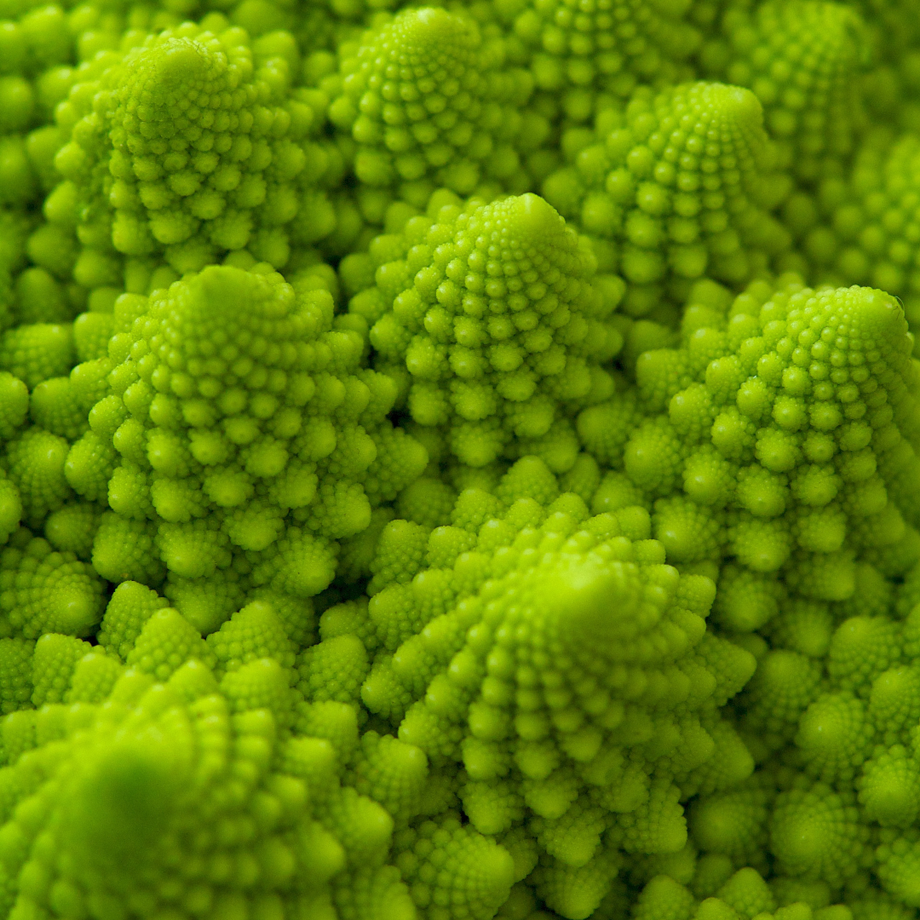
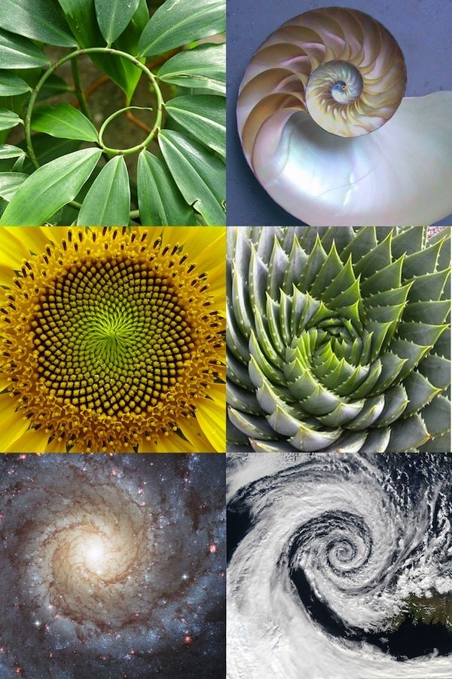
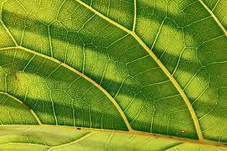
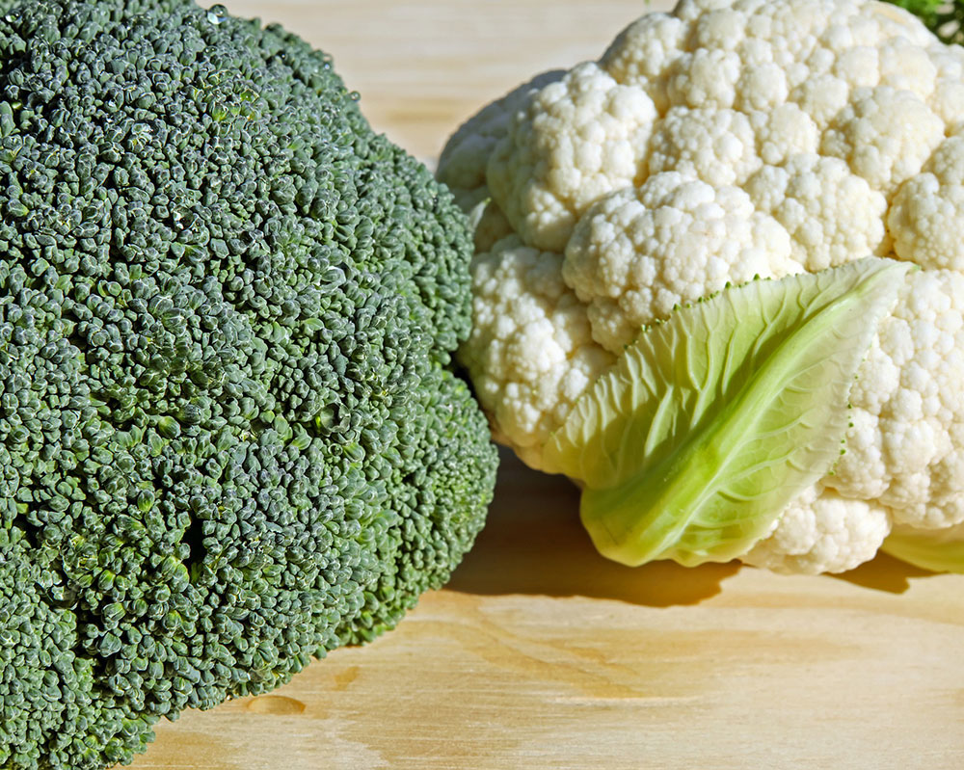
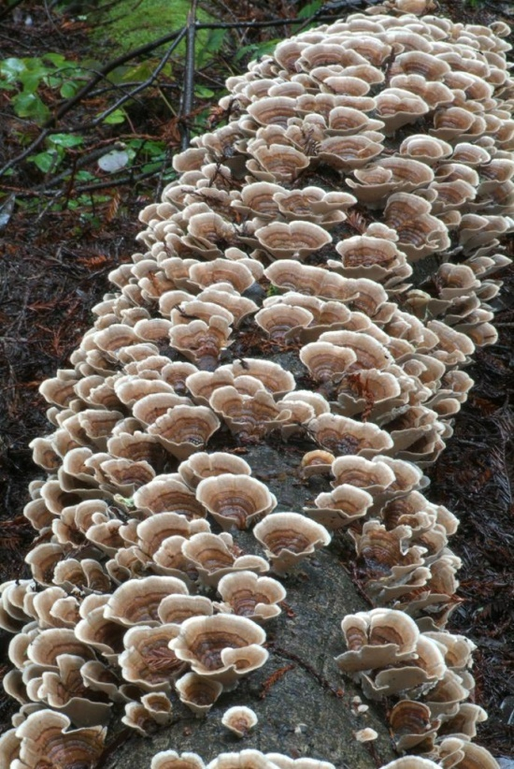
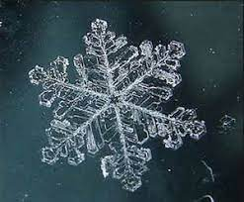
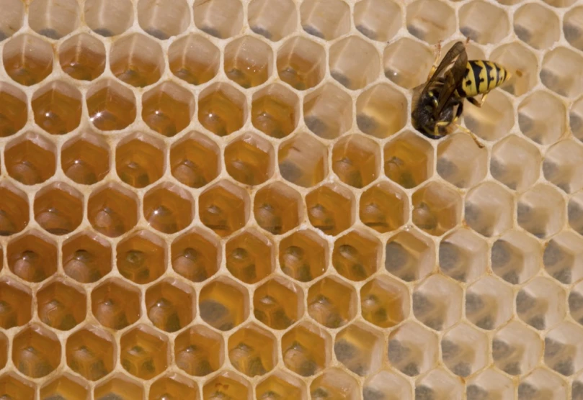

Slide 13
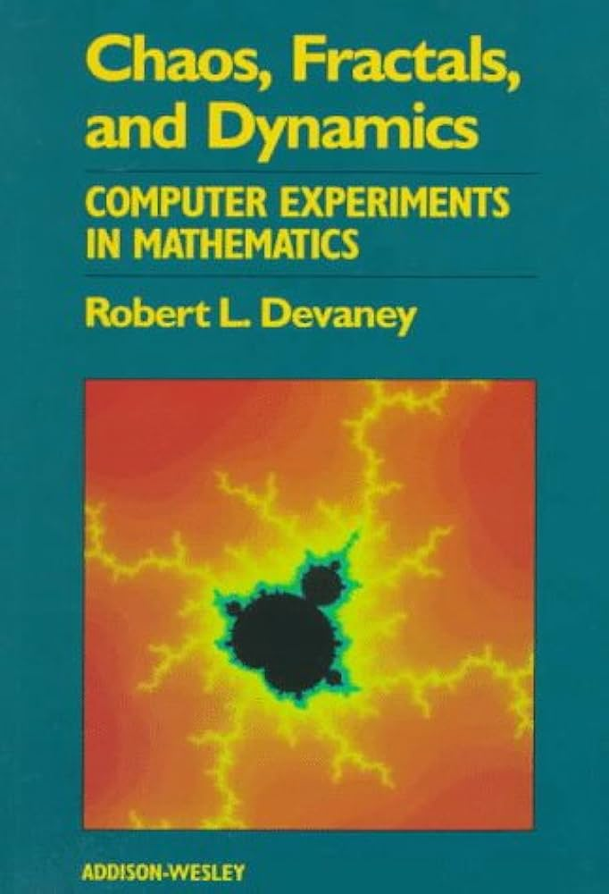
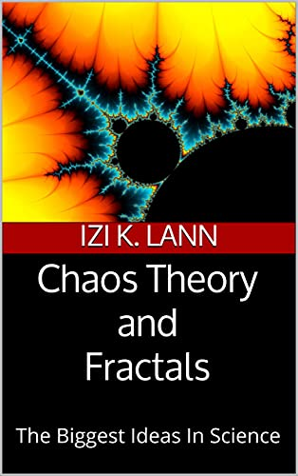
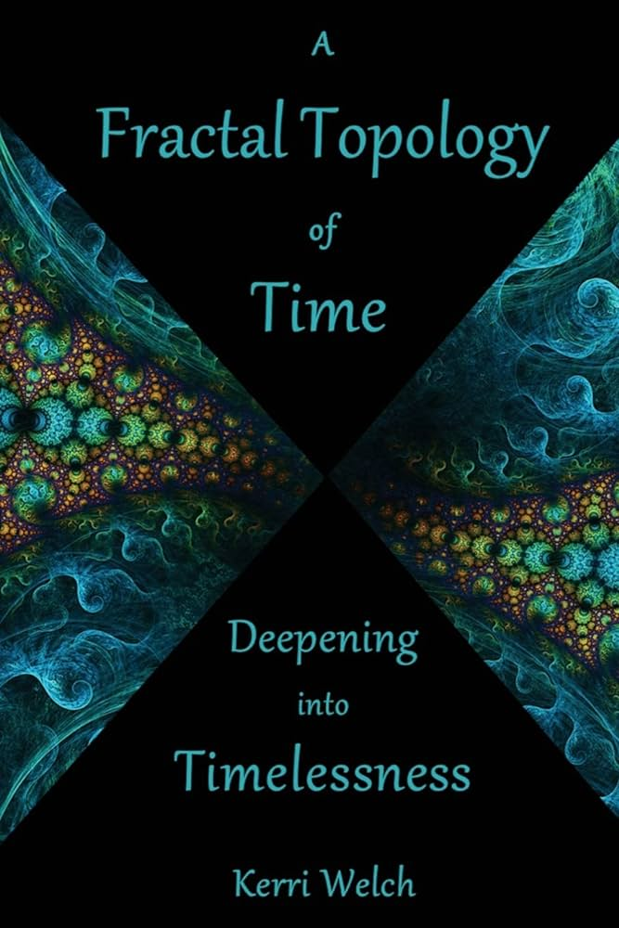

Slide 14
Some applications on time series….

Slide 15
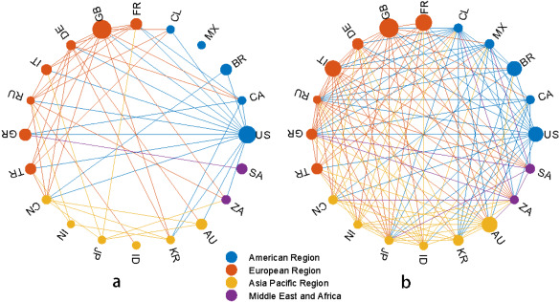

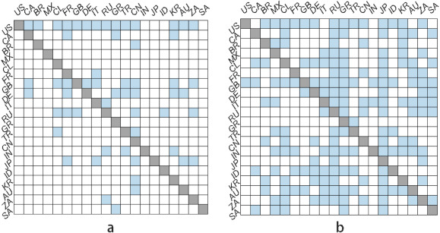
Stock markets...

Slide 16
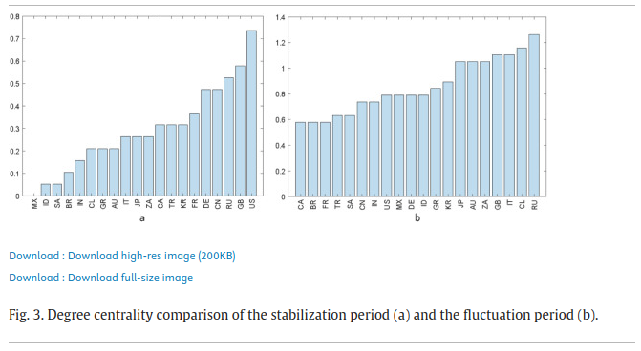
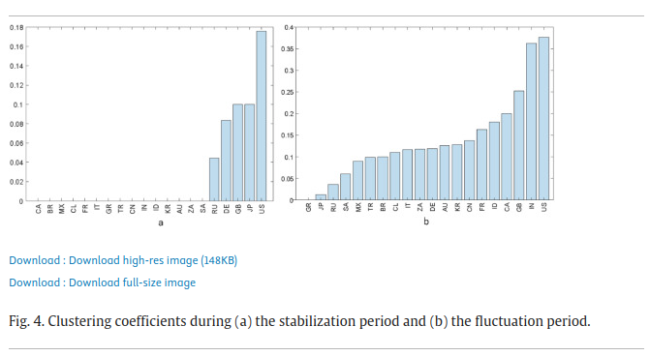
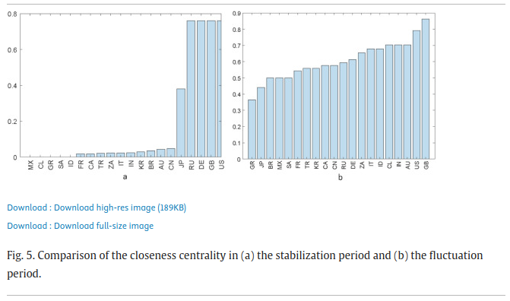

Slide 17
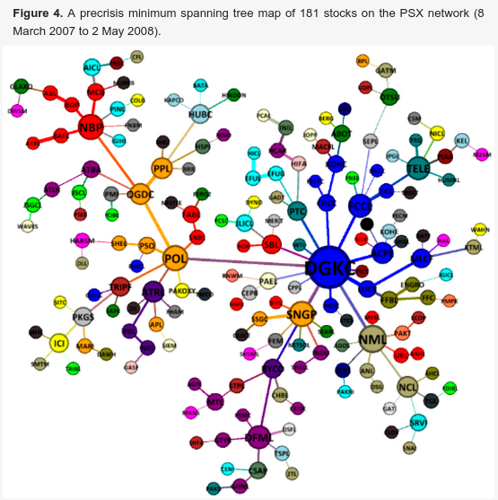
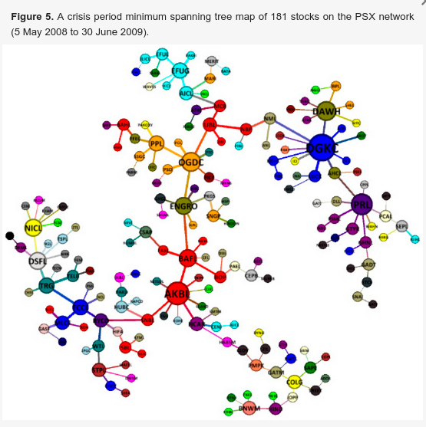

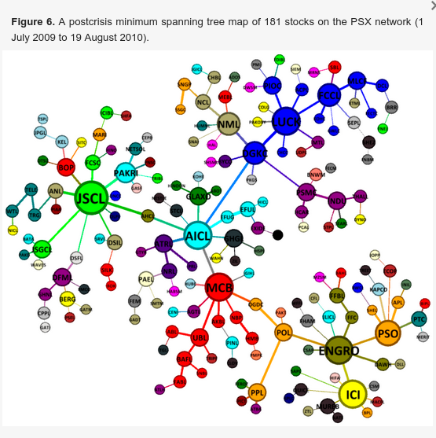
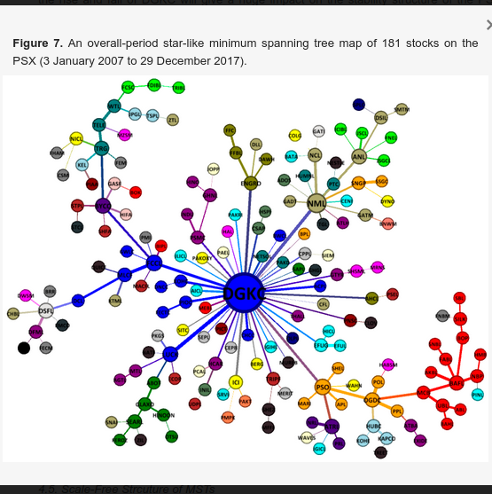
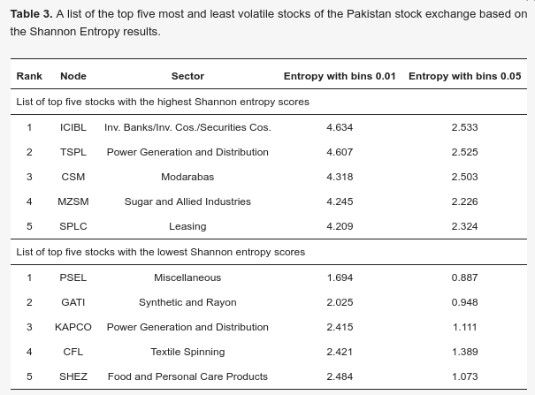

Slide 18
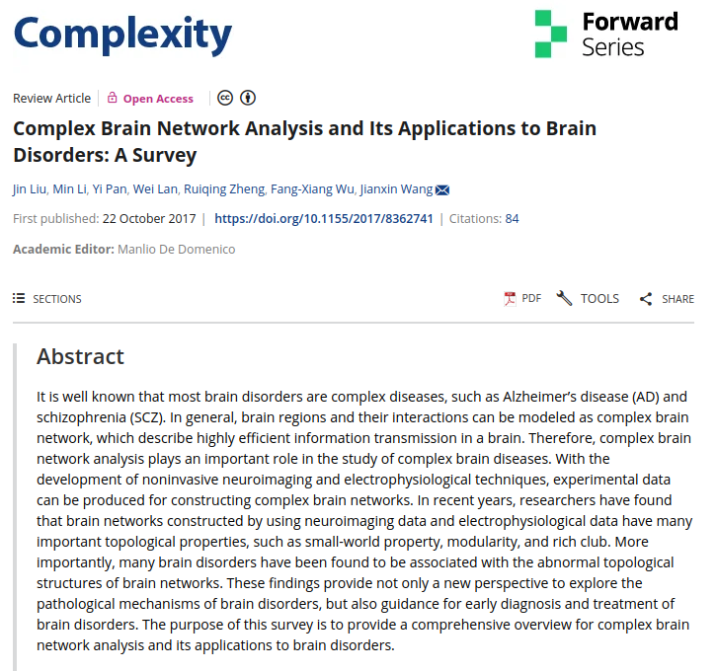
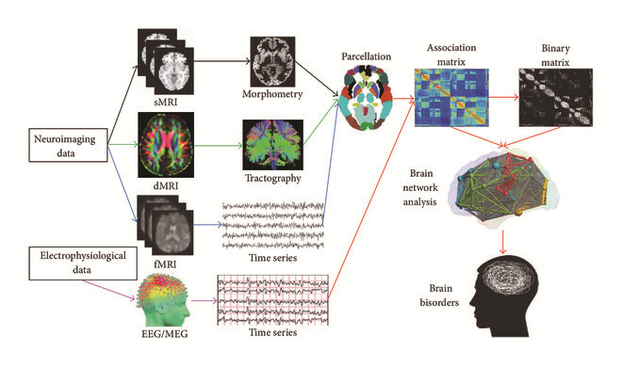
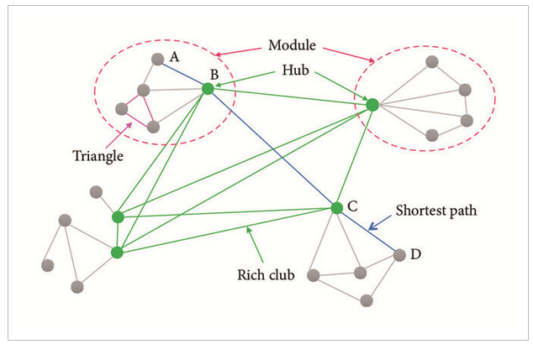
NeuroScience… Parkinson / brain disorders

Slide 19
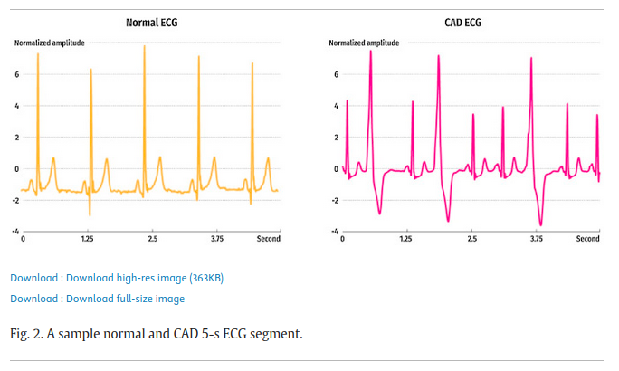

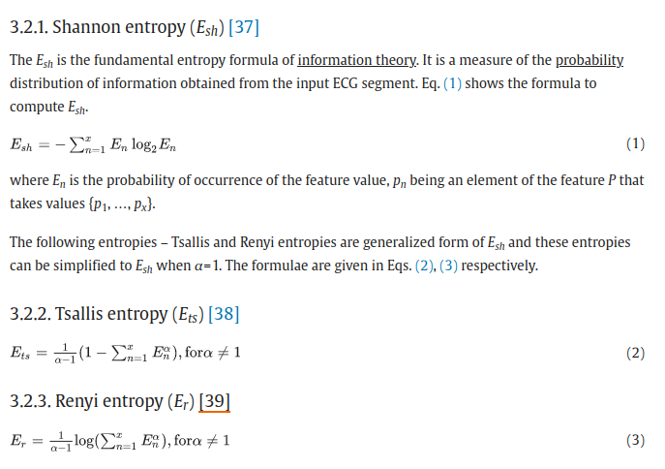
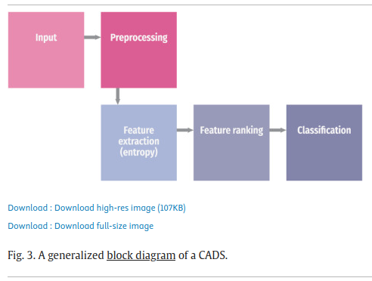
Electro-Cardiograms disease….

Slide 20
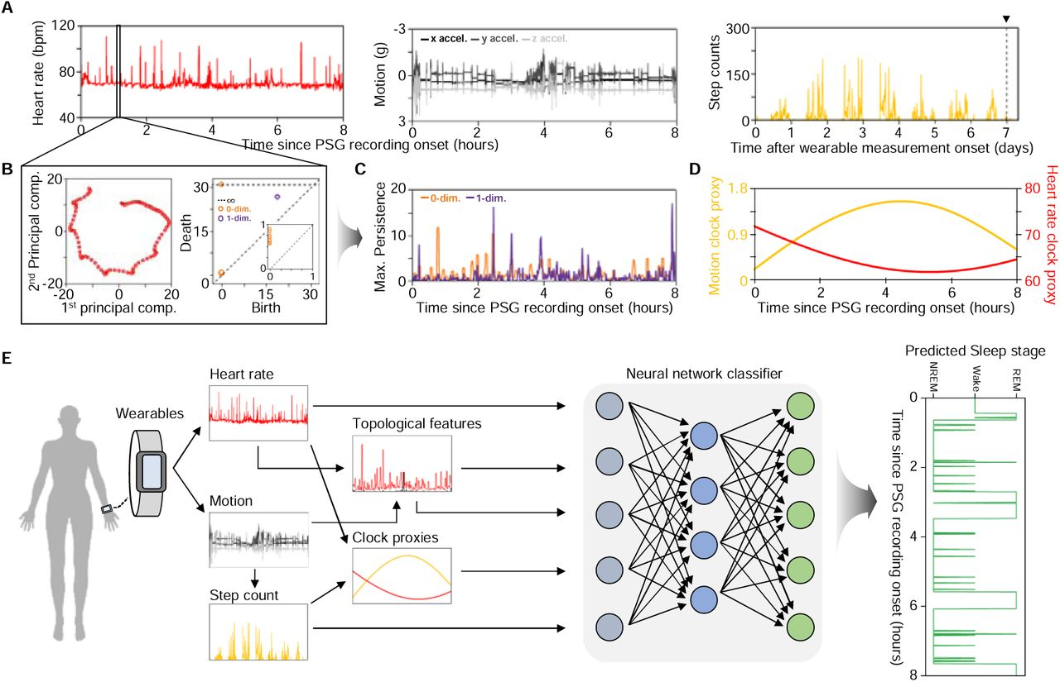

Slide 21
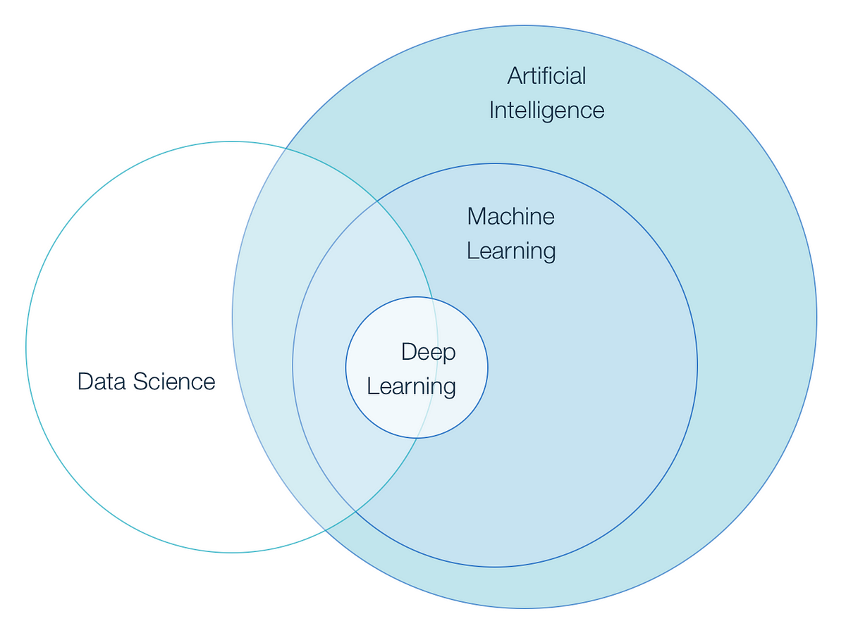
Some applications on image processing and classification….

Slide 22
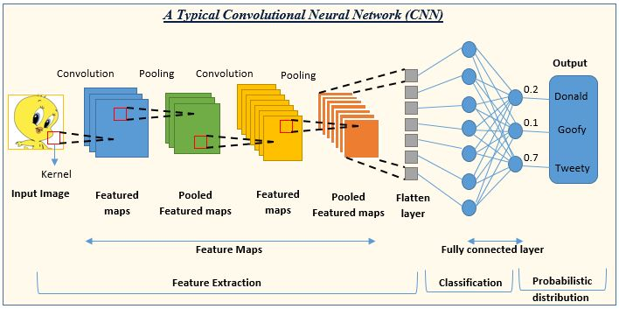
Machine learning (ML) methods such as convolutional neural networks (CNNs) are now the dominant technique for many such tasks, where they operate as black boxes

Slide 23
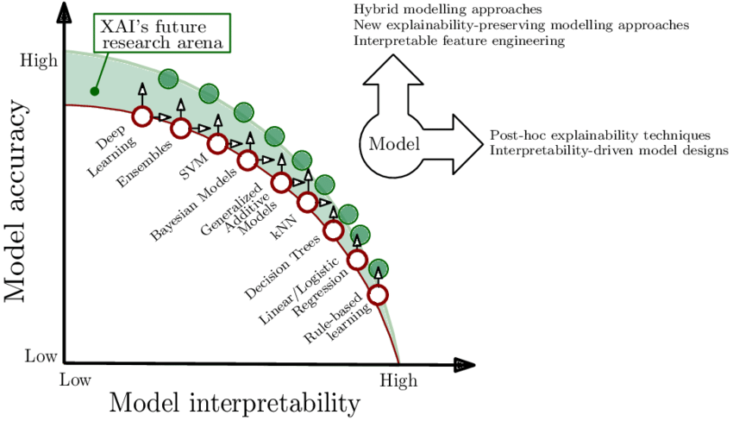
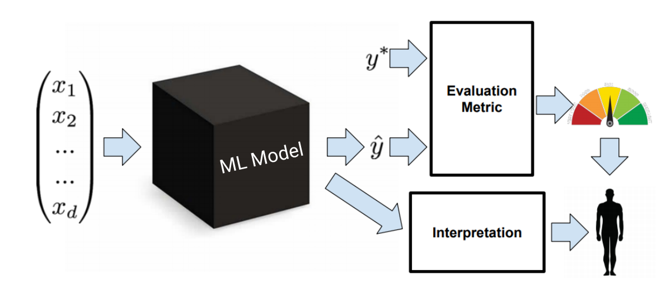

Slide 24
Advantages of TDA for image analysis tasks
Transparency: All the internal steps of the algorithm are known and well-understood, and the method has a high degree of theoretical interpretation, giving it far more transparency than most ML methods.
Known failure modes: No technique is perfect, and there will always be situations that cause errors and incorrect results. To use a method in practice, it is important to understand in what situations it struggles and what sorts of errors can result. Because persistent homology is a deterministic method, we can both theoretically predict these failure modes and interpret experimental results in terms of the original feature space.
No need for large, labeled datasets: As a deterministic algorithm, persistent homology does not require large, reliably labeled datasets. Instead, a small set of representative examples can be used to explore the different patterns that emerge in the transformed data. TDA is often used in combination with a simple ML model, and the number of labeled samples to obtain good performance is smaller than would be required to train a CNN or similar tool without TDA. This is a huge advantage for environmental science datasets, which are frequently large and detailed but almost entirely unlabeled.
Environmentally friendly: Many CNNs for image analysis tasks are known to have a surprisingly high carbon footprint due to the extensive computational resources required for model training. TDA is more in line with the Green AI movement, as it enables context-driven numerical results without the environmental impact inherent in training a deep neural network.

Slide 25
Next, we discuss the key abilities that persistent homology brings to image analysis tasks. These fall into three general categories: the incorporation of spatial context into a deterministic algorithm, the detection of texture and contrast, and invariance under certain transformations. The categories are discussed further below:
Incorporating spatial context: Many deterministic algorithms, as well as fully connected neural networks, struggle to incorporate the spatial context inherent in satellite data. Integrating this spatial context is precisely what motivated the development of CNNs, but CNNs are costly to train and challenging to make explainable. Persistent homology naturally incorporates spatial context, so patterns that are evident in this spatial context can be incorporated without resorting to CNNs or other spatially informed neural network architectures.
Detection of texture and contrast: Persistent homology excels at detecting contrast differences—regions (small or large) that differ from the surrounding average, which gives a representation of the texture present in an image. This focus on texture is useful in analyzing satellite weather imagery, as texture is frequently a key distinguishing factor, even more than a cloud being a particular shape or size.
Invariance to homeomorphisms: The notion of not wanting to be constrained by a particular geometry brings us to the final advantage: invariance under a common class of transformations called homeomorphisms.

Slide 26
Combining TDA with simple ML algorithms
For some image analysis tasks, TDA methods can be used as a stand-alone tool, but for the majority of tasks, one would first use TDA to extract topological features and then afterward add a simple machine learning algorithm. TDA can thus be viewed as a transparent means to construct new, physically meaningful, and interpretable features that may reduce the need for black-box machine learning algorithms. Using TDA in this way can support the goals of creating ethical, responsible, and trustworthy artificial intelligence approaches for environmental science outlined in, since transparency is a key requirement for ML approaches to be used in tasks that affect life-and-death decision-making, such as severe weather forecasting.
Two different ways to extract desired information from imagery: (a) the pure ML approach, in which image information is extracted by using a complex ML model, typically a deep neural network, and (b) the TDA approach, in which image information is extracted by using TDA followed by a simpler ML model/method. The latter can lead to more transparent and computationally efficient approaches.

Slide 27
Feature extraction...

Slide 28
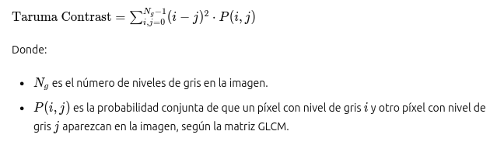
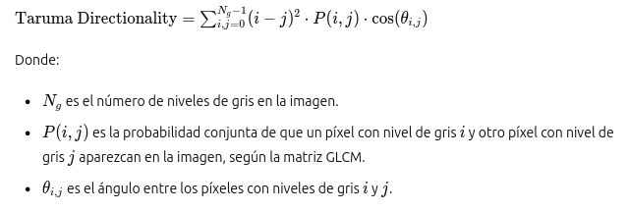
Taruma’s Features
Contraste de Taruma:
Mide la diferencia de intensidad entre píxeles vecinos en una imagen. Cuanto mayor es el contraste, más marcadas son las transiciones entre las regiones claras y oscuras en la imagen.Se calcula como la media de los cuadrados de los gradientes de la imagen.
Directionality de Taruma:
Indica la dirección predominante de las transiciones de intensidad en una imagen. Se calcula como la desviación estándar de los ángulos de los gradientes de la imagen. Una dirección más alta sugiere que las transiciones son más uniformes en una dirección específica.

Slide 29
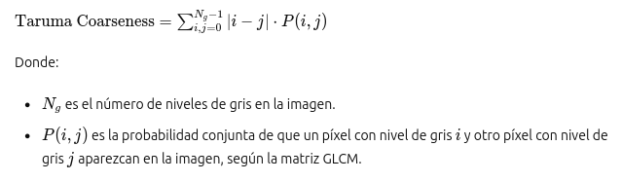

Taruma’s Features
Coarseness de Taruma:
Representa la textura gruesa o fina de una imagen. Una coarseness alta indica una textura más gruesa, con cambios abruptos en la intensidad. Se calcula como la varianza de la imagen suavizada con un filtro de desenfoque.
Linelikeness de Taruma:
Mide la presencia y la prominencia de líneas o bordes en una imagen. Cuanto mayor es el valor, más líneas distintas se encuentran en la imagen. Se calcula como la media de la imagen después de aplicar el detector de bordes de Canny.

Slide 30


Taruma’s Features
Regularity de Taruma:
Describe la uniformidad de la textura en una imagen. Una regularidad alta indica una textura más uniforme sin cambios bruscos. Se calcula como la desviación estándar de la imagen suavizada con un filtro de desenfoque.
Roughness de Taruma:
Representa la irregularidad o rugosidad de una imagen. Una roughness alta indica una superficie más desigual o textura más rugosa. Se calcula como la desviación estándar de la intensidad de los píxeles en la imagen.

Slide 31


Haralick’s Features
Homogeneidad de Haralick:
Mide la proximidad de la distribución de intensidad de los píxeles al máximo valor posible. Cuanto mayor es el valor, más uniforme es la textura de la imagen.
Entropía de Haralick:
Describe la desorden en la distribución de intensidad de los píxeles. Un valor alto indica una textura más compleja y aleatoria.

Slide 32


Haralick’s Features
Correlación de Haralick:
Describe la correlación lineal de la distribución de intensidad de los píxeles. Un valor alto sugiere una imagen más homogénea, donde los píxeles tienen intensidades similares.
Energía de Haralick:
Representa la uniformidad de la distribución de intensidad de los píxeles. Un valor alto indica una imagen más uniforme, donde la mayoría de los píxeles tienen la misma intensidad.

Slide 33

Another important Features
Dimensión de Correlación:
La dimensión de correlación es una medida de la autocorrelación espacial de una imagen.
Se calcula utilizando métodos como la función de correlación de pares o la función de estructura espacial.
Esta dimensión indica cuánto se correlacionan los píxeles a diferentes distancias dentro de la imagen.
Una imagen con una mayor dimensión de correlación tiene más autocorrelación espacial y estructuras repetitivas.

Slide 34


Another important Features
Dimensión Fractal con Box Counting:
La dimensión fractal es una medida de la complejidad geométrica y la irregularidad de una estructura.
El método de Box Counting es una técnica común para estimar la dimensión fractal de una imagen.
Consiste en dividir la imagen en cuadrados de diferentes tamaños y contar cuántos cuadrados son necesarios para cubrir la imagen.
La dimensión fractal se calcula como el límite de la relación entre el logaritmo del número de cuadrados necesarios y el logaritmo del tamaño del cuadrado cuando el tamaño del cuadrado tiende a cero.
Una imagen con una dimensión fractal mayor indica una mayor irregularidad y detalle en su estructura, mientras que una dimensión fractal menor sugiere una estructura más suave y regular.

Slide 35
Vamos al asunto con Notebook...

Slide 36
Muchas gracias por las atenciones….
D. Sierra-Porta, UTB

