Slide 1
Some Viz ideas and data analytics

Slide 2
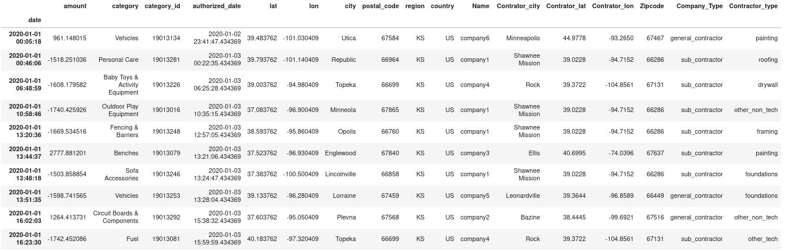
How does the data look like?

Slide 3
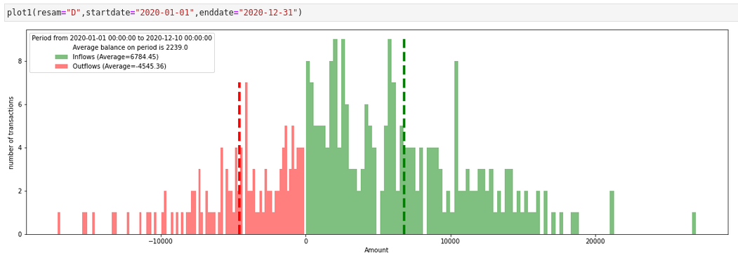
How do income and expense flows behave for all companies and transactions, in a specific period of time?

Slide 4
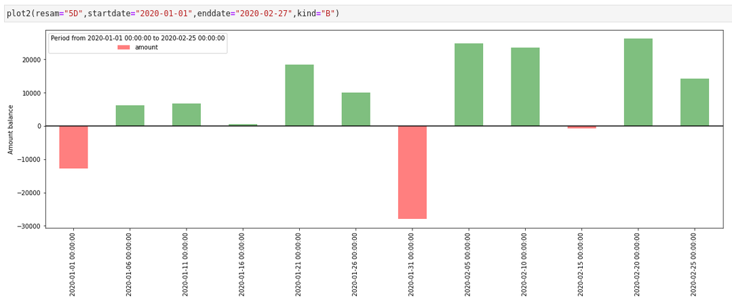
Cash flow balance sheet behavior for all companies and transactions, in a specific time period by days?

Slide 5
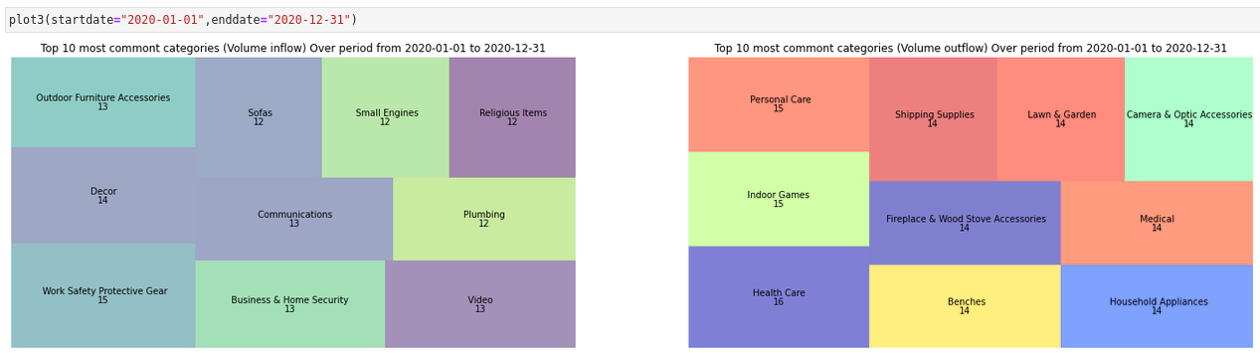
Transaction volume related to income and expense categories

Slide 6
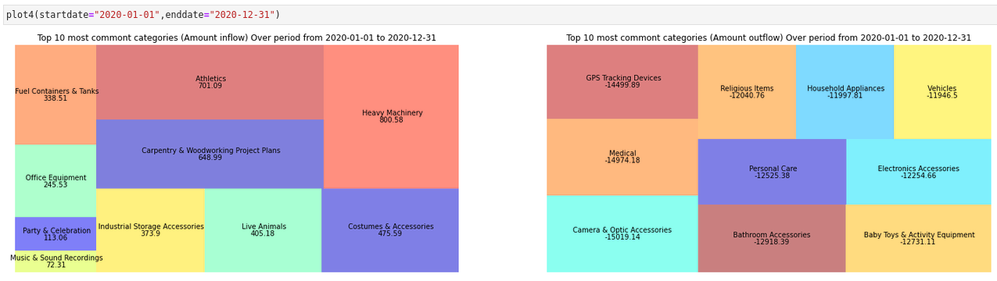
Balance of transactions related to income and expense categories

Slide 7
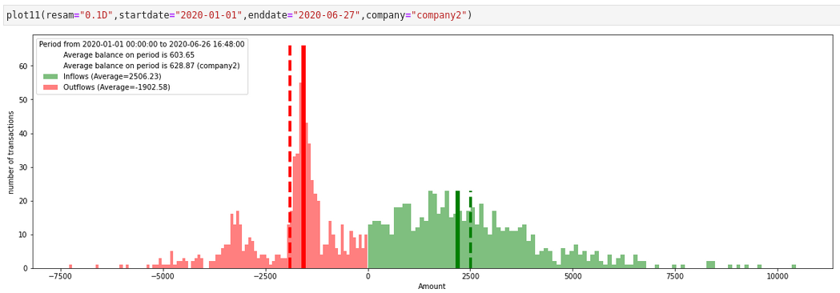
Company2 balance
outflow and inflow
Company2 balance
outflow and inflow
All companies balance
outflow and inflow
How does a particular company compare in its transactions with the rest of the companies in the pool?

Slide 8
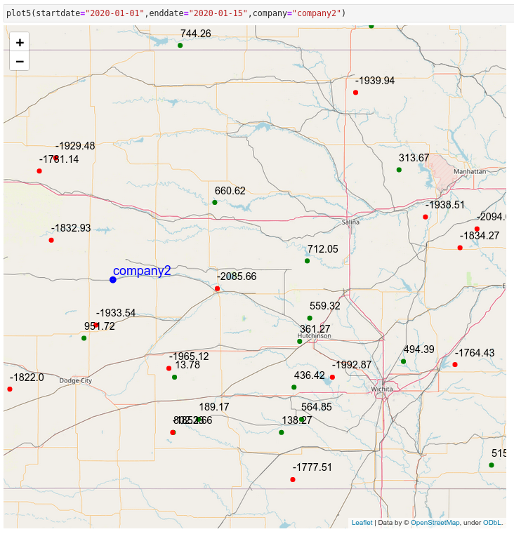
Where does a particular company transact business? How far from its center of operations?

Slide 9
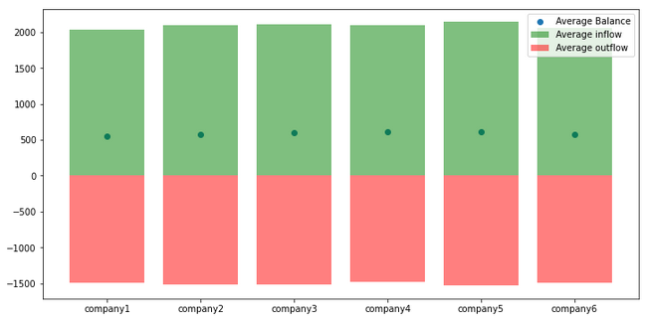
How do all companies compare with respect to their revenues and expenses over a specific time period?

Slide 10
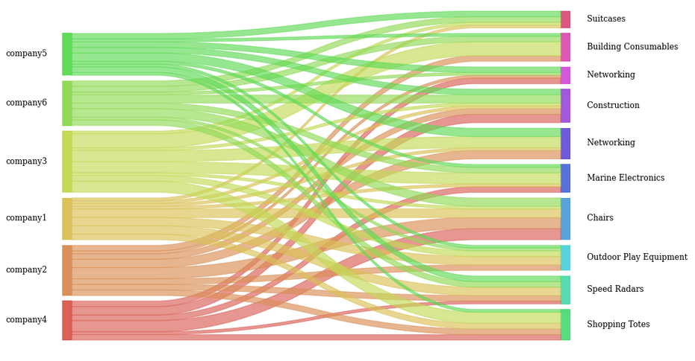
To which category do the cash flows (income and expenses) of each company go relative to their comparison with the rest of the pool of companies?

