Slide 1

A (very short) introductory journey through data science
2022 International Workshop in Applied Statistics and Data Science (Cartagena – Colombia)
June 29 – July 1, 2022
D. Sierra Porta
Faculty of Basic Sciences
Universidad Tecnológica de Bolivar
dporta@utb.edu.co

Slide 2
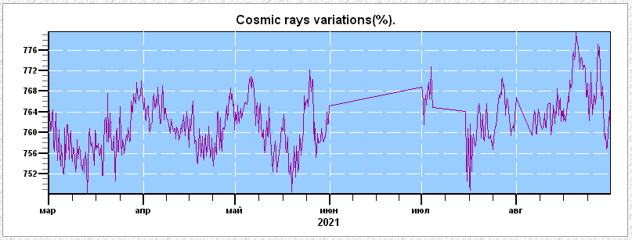
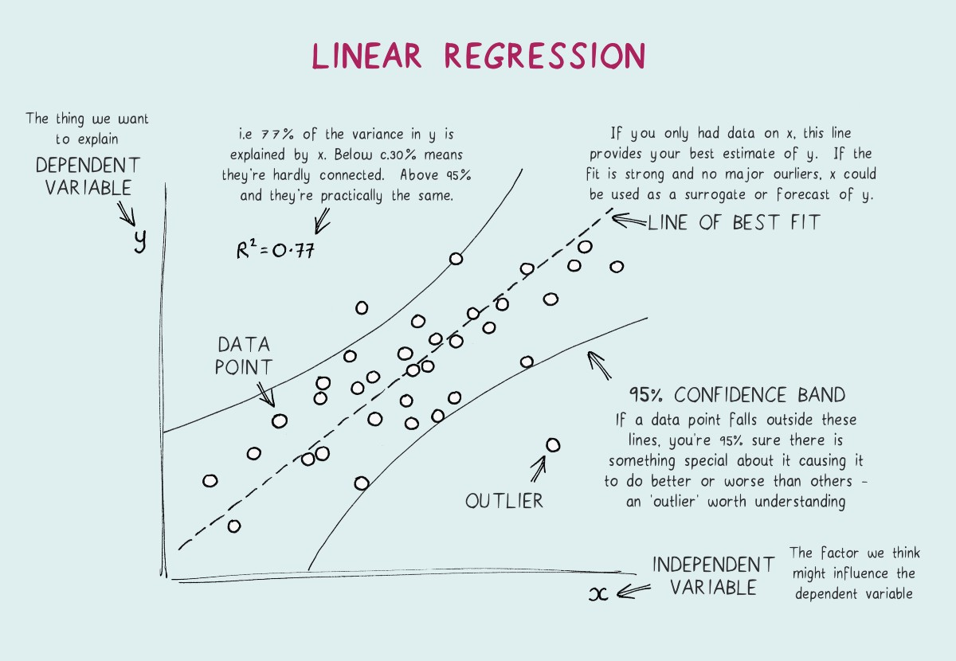
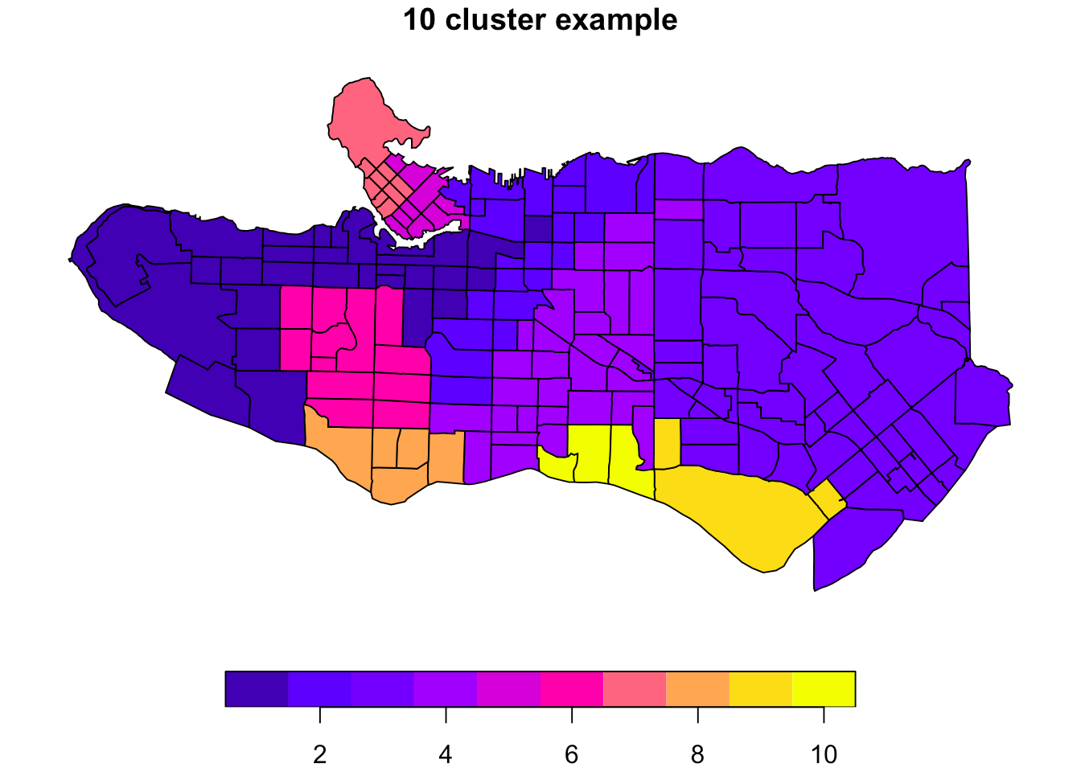
Contents
We are talking about three important topics (or common task) in Data Sciene:
Imputation methods
Regression methods
Clustering methods

Slide 3
Tutorial: Introduction to Missing Data Imputation
D. Sierra Porta
Faculty of Basic Sciences
Universidad Tecnológica de Bolivar
dporta@utb.edu.co

Slide 4
131 → 12
241 → 24
162 → 36
343 → 48
146 → ??
Think fast 1...
111 → 12
231 → 24
324 → 36
453 → 48
542 → ??
Think fast 2...

Slide 5
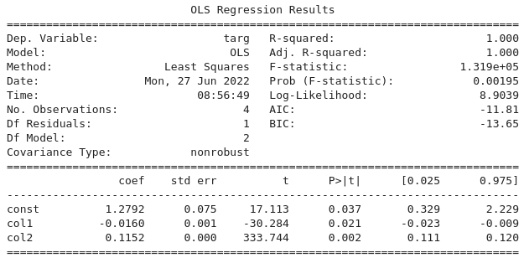
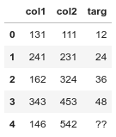
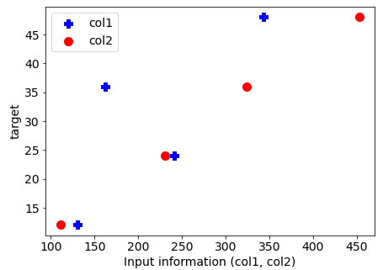
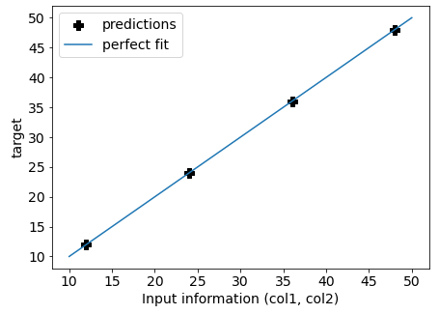
131 → 12
241 → 24
162 → 36
343 → 48
146 → ??
Think fast 1...
111 → 12
231 → 24
324 → 36
453 → 48
542 → ??
Think fast 2...
Model: targ ~ col1 + col2, target(predcition)=61

Slide 6
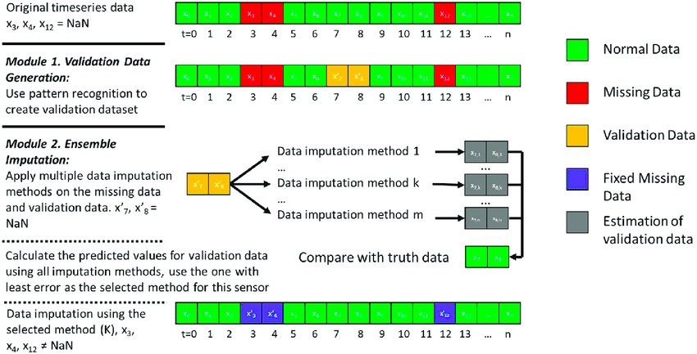
Missing data mechanisms
The study of missing data was formalized by Donald Rubin (see [6], [5]) with the concept of missing mechanism in which missing-data indicators are random variables and assigned a distribution. Missing data mechanism describes the underlying mechanism that generates missing data and can be categorized into three types — missing completely at random (MCAR), missing at random (MAR), and missing not at random (MNAR). Informally speaking, MCAR means that the occurrence of missing values is completely at random, not related to any variable. MAR implies that the missingness only relate to the observed data and NMAR refers to the case that the missing values are related to both observed and unobserved variable and the missing mechanism cannot be ignored.
Missing data is a common problem in practical data analysis. They are simply observations that we intend to make but did not. In datasets, missing values could be represented as ‘?’, ‘nan’, ’N/A’, blank cell, or sometimes ‘-999’, ’inf’, ‘-inf’. The aim of this tutorial is to provide an introduction of missing data and describe some basic methods on how to handle them.

Slide 7
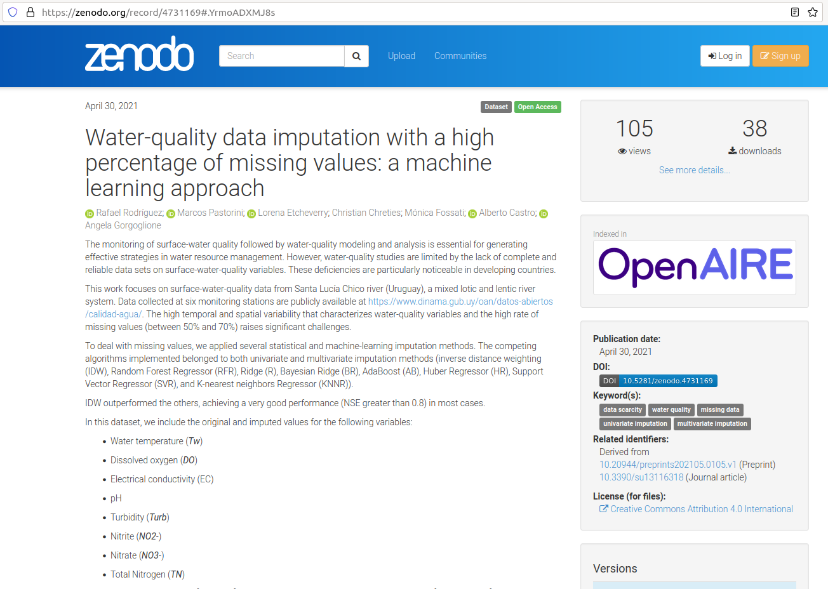
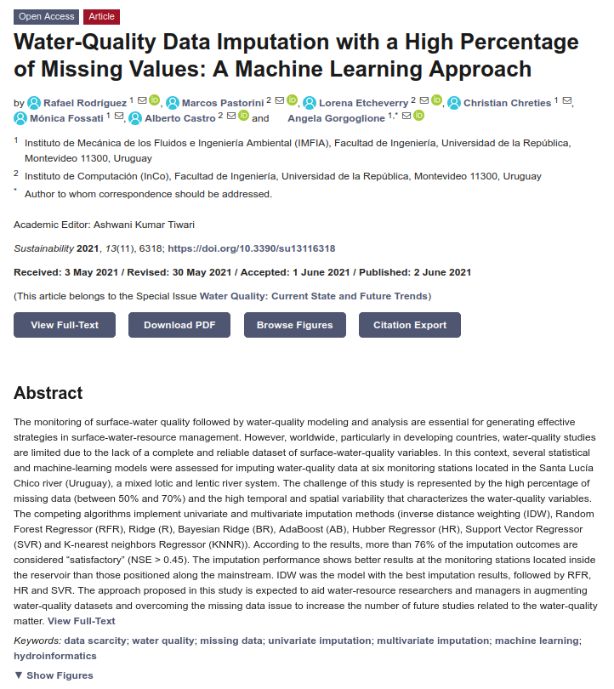
https://www.mdpi.com/2071-1050/13/11/6318
https://zenodo.org/record/4731169#.YrmoADXMJ8s

Slide 8
...let's get to the data and get to work…
https://github.com/sierraporta/introductory-journey-data-science/blob/main/Notebooks/Inputation.ipynb

Slide 9
Clustering methods
D. Sierra Porta
Faculty of Basic Sciences
Universidad Tecnológica de Bolivar
dporta@utb.edu.co

Slide 10
Regression methods
D. Sierra Porta
Faculty of Basic Sciences
Universidad Tecnológica de Bolivar
dporta@utb.edu.co

